Slide 1

Energy:
Conventional and Sustainable Sources
EESC 1201: Introduction to Environmental Science
Slides adapted from:
Karr, Scientific American: Environmental Science for a Changing World, 4e
© 2021 W. H. Freeman and Company
Dr. S. Perl Egendorf
April 17, 2023

Slide 2
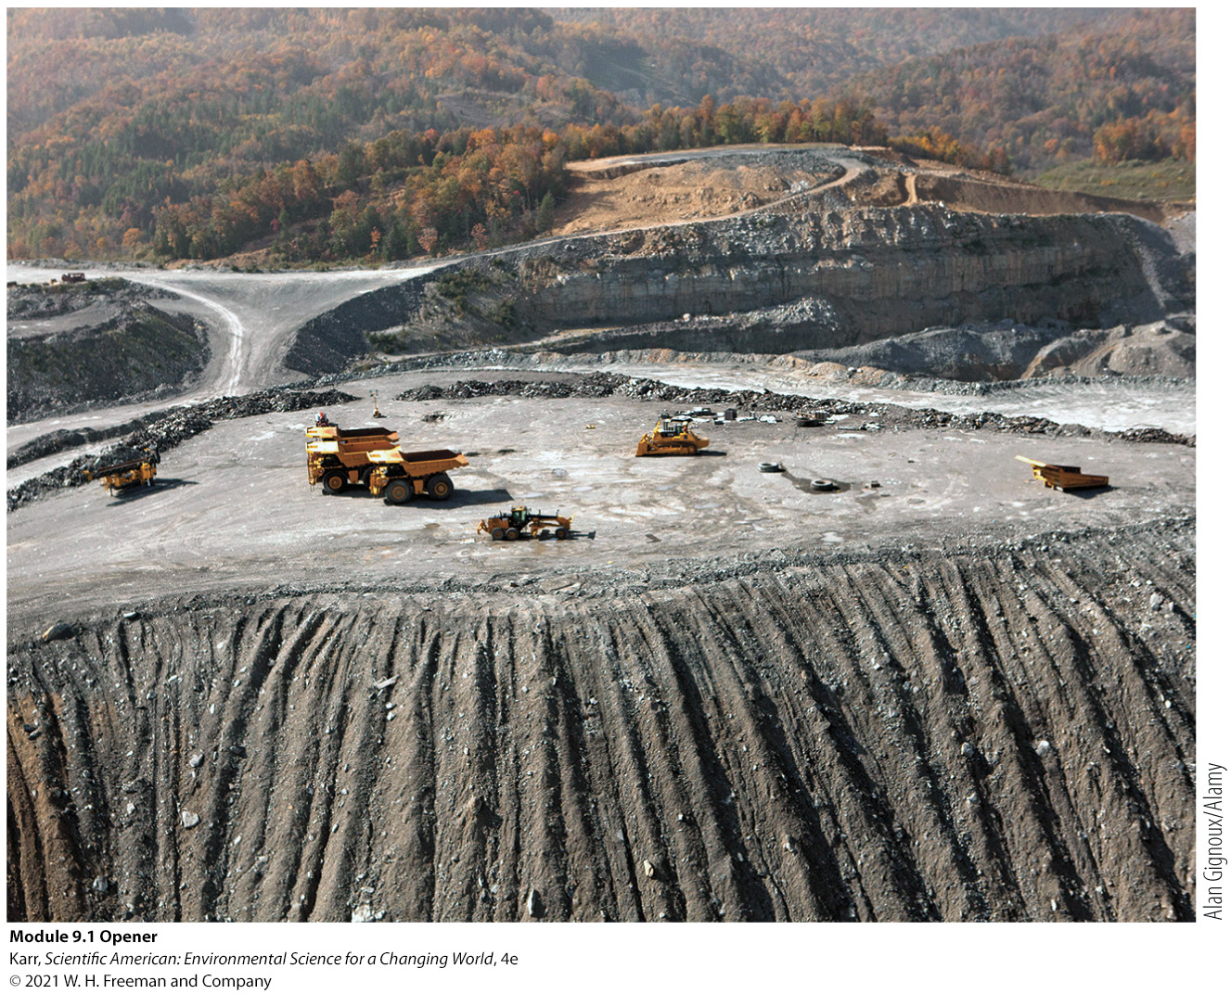
Module 9.1
Coal: Bringing Down the Mountain

Slide 3
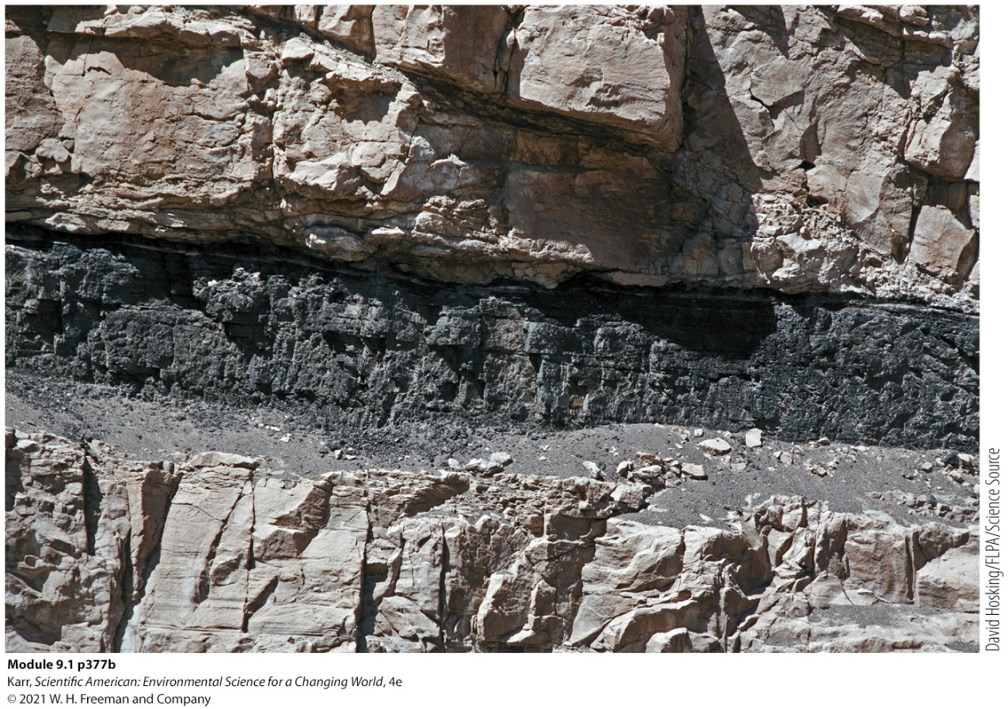
Core Message
Coal is a major energy source.
Coal mining brings irreversible environmental damage, pollution, loss of biodiversity.
We can lessen its impact, but not eliminate it as long as we use it.
An exposed coal seam between two layers of rock

Slide 4
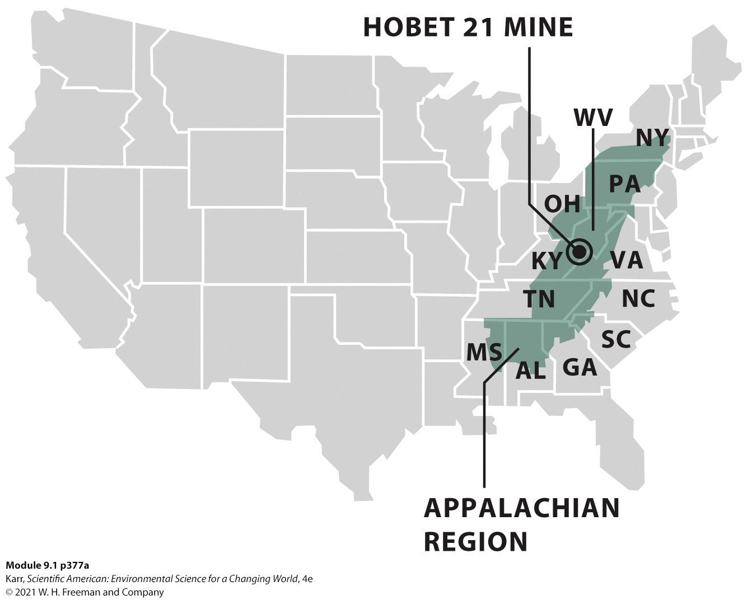
Case Study: Hobet 21 and Mountaintop Removal
Mountaintop removal: a type of mining that involves blasting off several hundred feet of mountaintop, dumping the rubble into adjacent valleys, and harvesting the thin ribbons of coal beneath.
Hobet 21, at more than 52 square kilometers (20 square miles), is the region’s largest mining operation.
Notes:
https://www.youtube.com/watch?v=hyjCcxkML4Q Hobet (Corridor G) Mine Complex, Lincoln County, WV by Kanawha Forest Coalitiion
So far, MTR has claimed roughly 400,000 hectares (1 million acres) of forested mountain, across just four states: Kentucky, West Virginia, Virginia, and Tennessee.
There is still more coal to mine. It could mean the obliteration of hundreds of thousands more acres in the coming years.

Slide 5
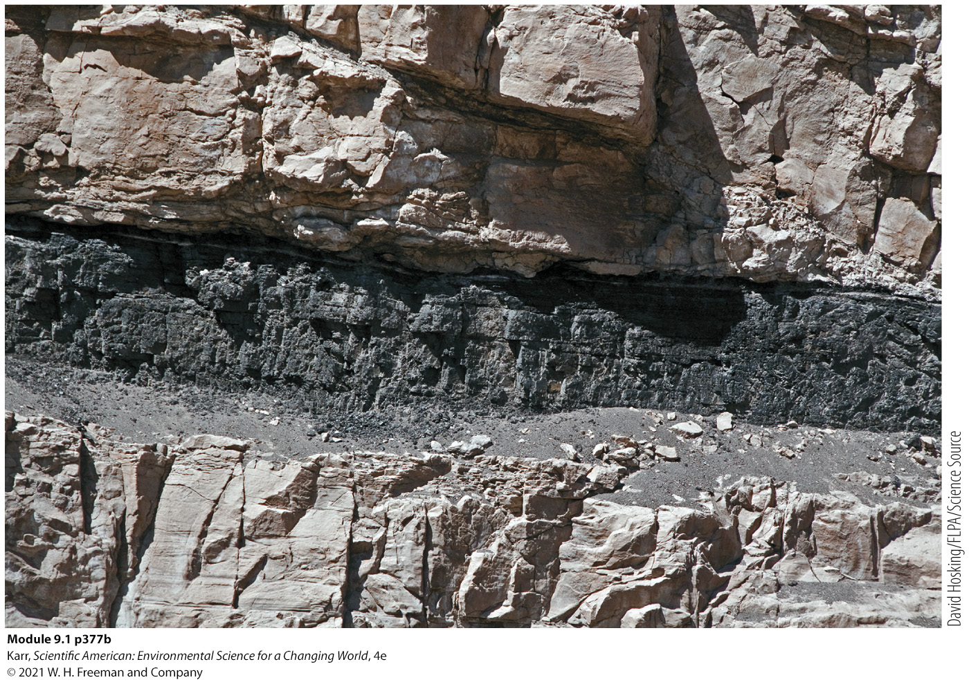
Coal
Key Terms
Coal: A fossil fuel that is formed when plant material is buried in oxygen-poor conditions and subjected to high heat and pressure over a long time.

Slide 6
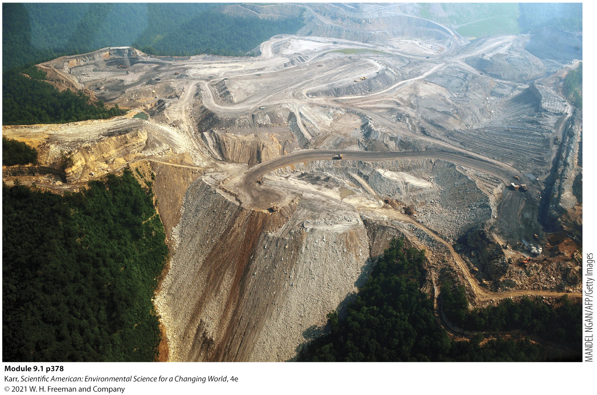
Arguments Against Mountaintop Removal
The Environmental Activists
Destroys biodiversity
Pollutes the water
Threatens the health and safety of area residents
Obliterates the culture of Appalachia

Slide 7
Arguments for Mountaintop Removal
Coal Industry Representatives
Provides jobs, tax revenue, and business to an impoverished region.
Culture of Appalachia is as bound to coal mining as it is to the mountains.

Slide 8
I. What Energy Sources Are Used in Modern Society and for What Purposes?
Key Concept 1: Modern society depends on stationary sources of energy to produce heat and electricity (e.g., coal, natural gas, nuclear energy) and mobile sources for transportation purposes (e.g., petroleum products).

Slide 9
Energy and Energy Sources
Key Terms
Energy: the capacity to do work
Fossil fuels: nonrenewable resources like coal, oil, and natural gas that were formed over millions of years from the remains of dead organisms
  Provide the majority of energy for modern society

Slide 10
IG 1: Energy Sources Used By Modern Society
TYPE | PREDOMINANT USE
 | NONRENEWABLE SOURCES
Coal | Stationary source: electricity/heat
Oil/Petroleum | Mobile source: vehicles; also used for electricity or heat
Natural Gas | Stationary source: electricity/heat; also used in vehicles (compressed natural gas)
Nuclear | Stationary source: electricity; also used in nuclear submarines and ships
 | RENEWABLE SOURCES
Solar | Stationary source: electricity/heat/light
Wind | Stationary source: electricity
Geothermal | Stationary source: electricity/heat
Hydroelectric | Stationary source: electricity
Biomass | Stationary or mobile source: electricity, heat, or vehicle fuel
Infographic 9.1.1
Karr, Scientific American: Environmental Science for a Changing World, 4e
© 2021 W. H. Freeman and Company
Notes:
Ask your students which of the nonrenewable and renewable energy sources listed above appear to be the most versatile (have the most uses). Explain.

Slide 11
II. How Important Is Coal as an Energy Source, and How Is It Used to Generate Electricity?
Key Concept 2: Coal is mainly used for electricity production. It is burned to heat water to produce steam; the steam turns a turbine connected to a generator, producing electricity.

Slide 12
Electricity and Coal
Key Terms
Electricity: The flow of electrons (negatively charged subatomic particles) through a conductive material (such as wire).
  In 2018, 8.5 billion U.S. tons of coal were used primarily to generate electricity.
  In 2018, burning coal generated approximately 40% of electricity worldwide and 27% in the United States.
  It takes roughly 1 pound of coal to generate 1 kilowatt-hour (kWh) of electricity.
  An average U.S. family of four would require 3,000 pounds of coal per person per year if all of their electricity is produced using coal.
Notes:
The use of coal in the United States has decreased in recent years due largely to an abundance of cheaper natural gas.
More stringent air pollution standards for coal-fired power plants have also had a role in the downturn; natural gas releases less air pollution and greenhouse gas emissions than coal when burned.
Coal produces more air pollution than any other fossil fuel. On the other, it is safer to ship, cheaper to extract, and in the United States at least, abundant. In fact, the United States has 10 times more coal than it does conventional sources of oil and natural gas combined.

Slide 13
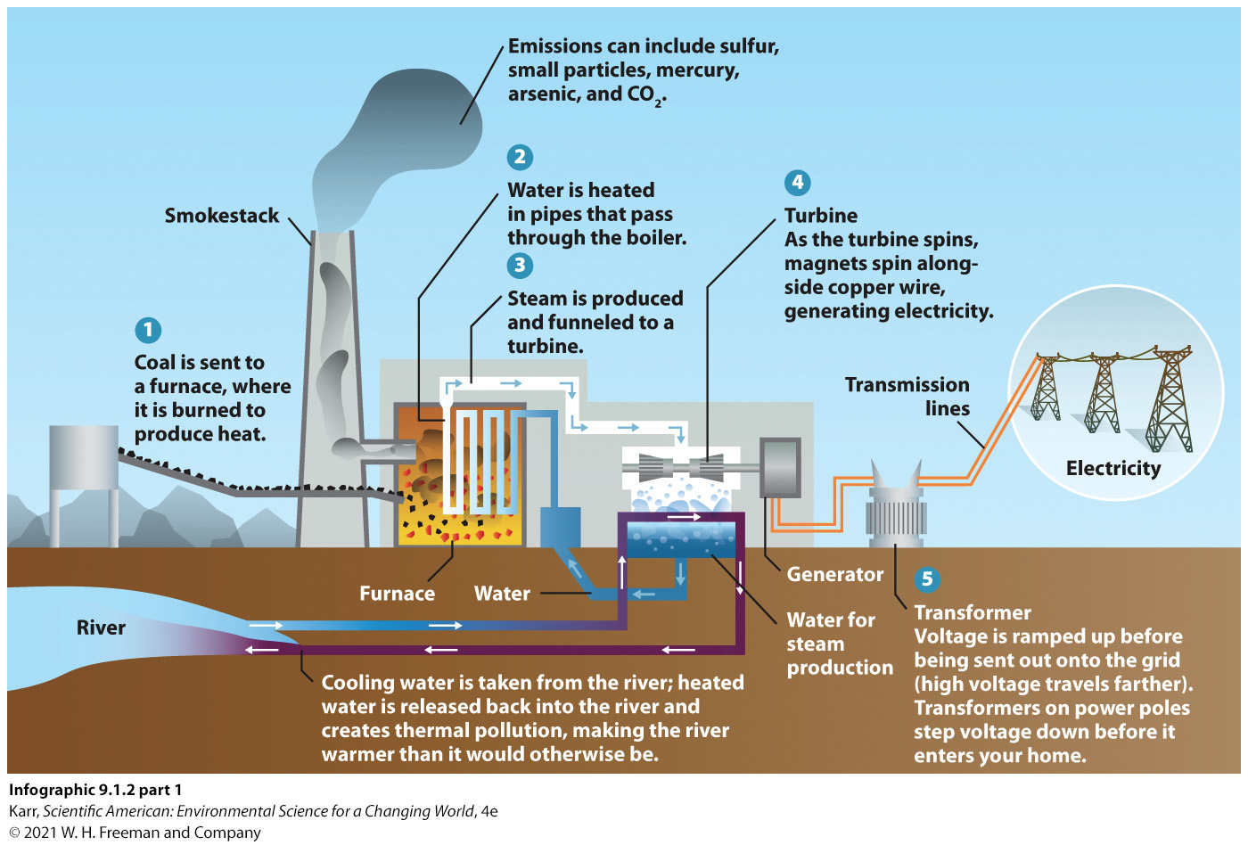
IG 2a: How It Works: Electricity Production from Coal
Notes:
Ask your students what other methods could be used to spin a turbine and generate electricity.

Slide 14
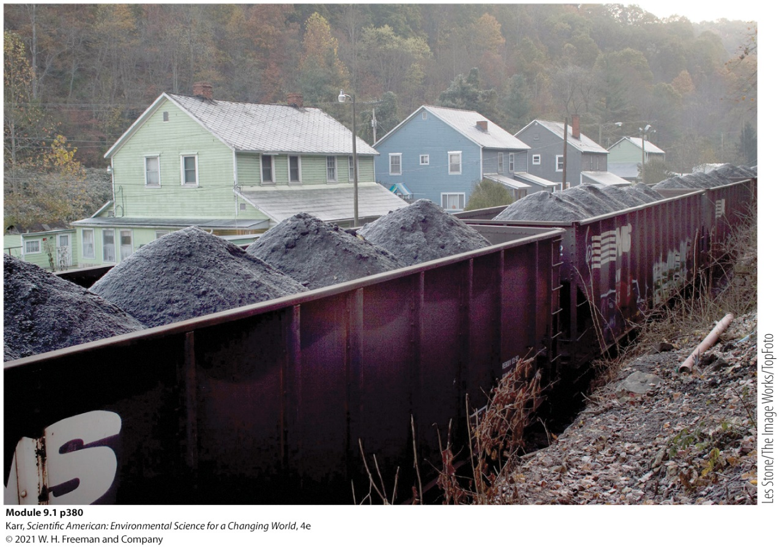
The EROEI of Coal
Key Terms
Energy return on energy investment (EROEI): A measure of the net energy from an energy source (the energy in the source minus the energy required to get it, process it, ship it, and then use it.)
The average EROEI of coal is about 17:1.
Coal is transported via train
Notes:
Compared to other forms of energy the EROEI of coal is somewhere in the middle.
There can be considerable variability in the EROEI estimate for a given energy source because many factors influence its net yield. This is especially true for wind or solar electricity production—“windy” or “sunny” areas will have a higher EROEI than areas with less dependable wind or less abundant solar radiation. As fossil fuel supplies have declined, the EROEI has also declined—more energy is required to extract the remaining supplies. On the other hand, improvements in technology, especially for renewable energy sources, are raising the EROEI of these methods.

Slide 15
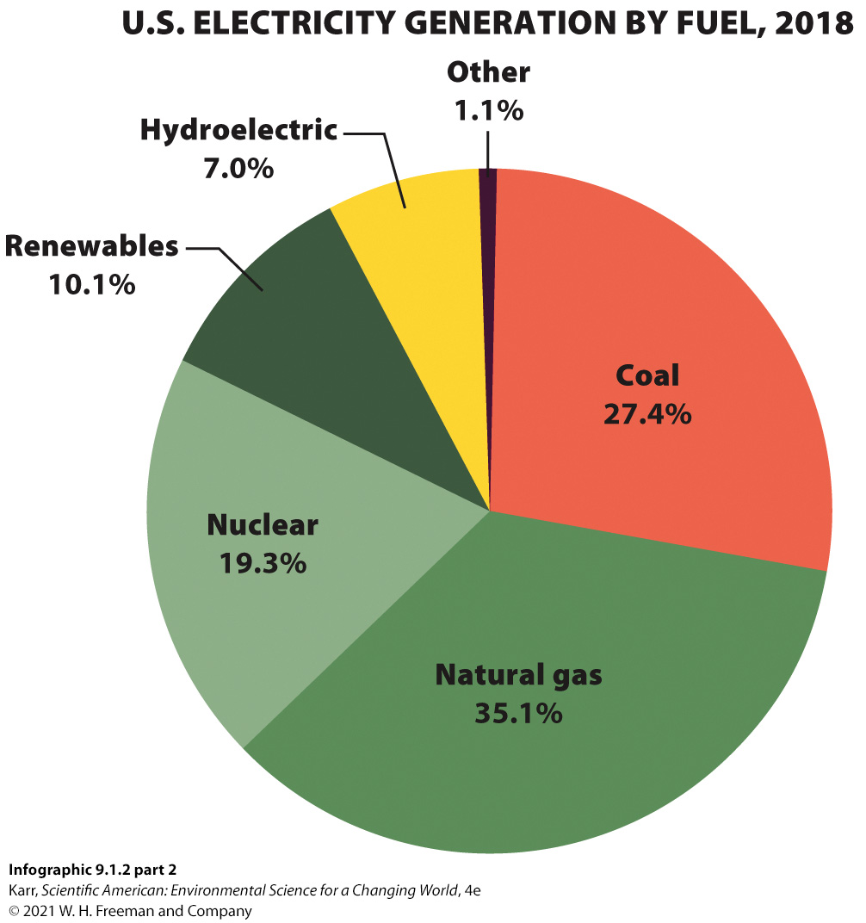
IG 2b: How It Works: Electricity Production from Coal
Notes:
Ask your students what other methods could be used to spin a turbine and generate electricity.

Slide 16
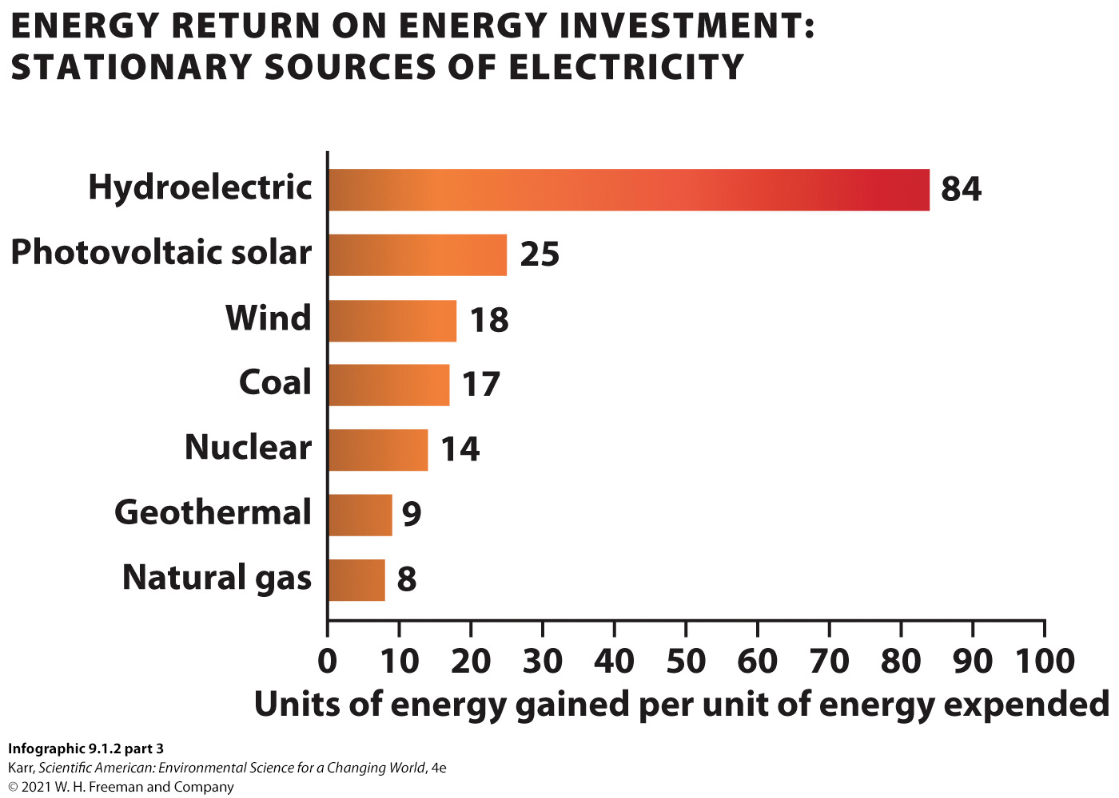
IG 2c: How It Works: Electricity Production from Coal
Notes:
Ask your students what other methods could be used to spin a turbine and generate electricity.

Slide 17
III. What Is Coal, How Is It Formed, and What Regions of the World Have Coal Deposits that Are Accessible?
Key Concept 3: Coal formation occurred over long periods of time when dead plant material was buried and subjected to high heat and pressure. Coal deposits are located throughout the world, though some areas have a larger supply than others.

Slide 18
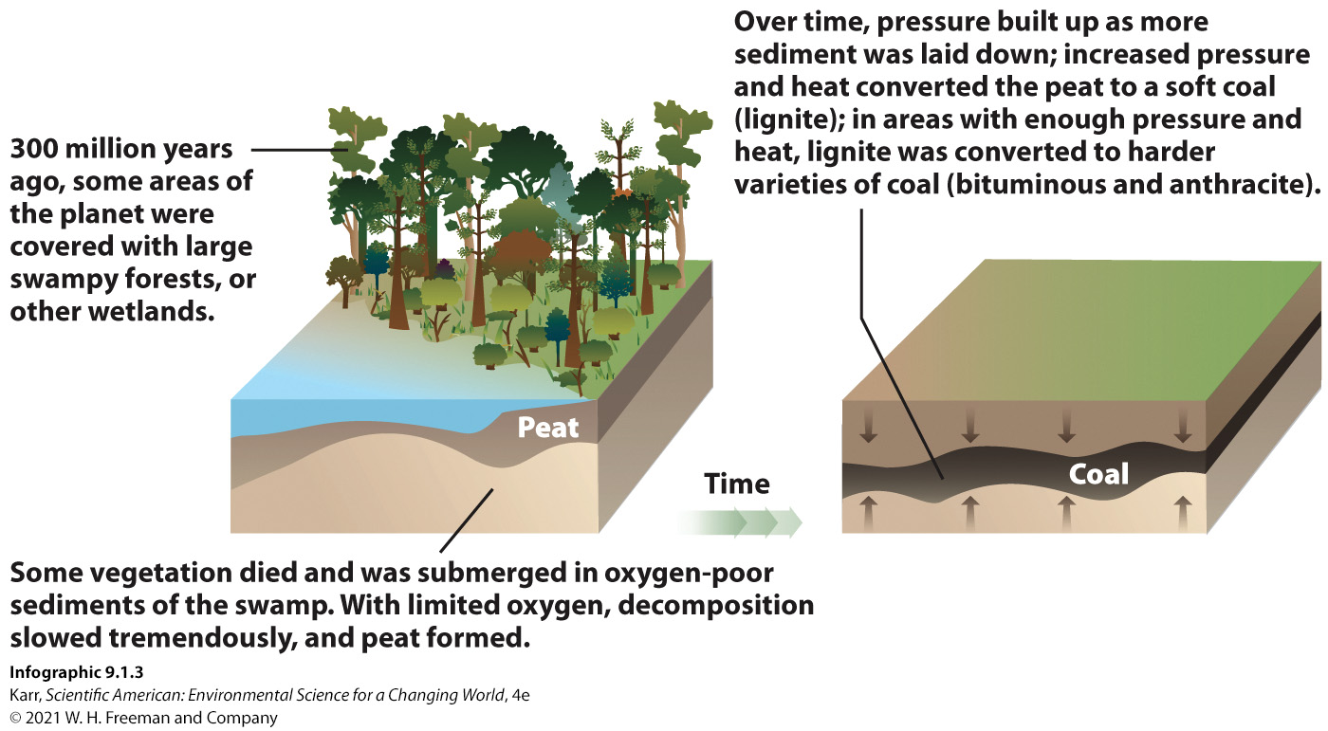
IG 3: Coal Formation
Notes:
Ask your students why deposits of coal aren’t found everywhere.

Slide 19
Proven Reserves of Coal
Key Terms
Proven reserves: a measure of the amount of a fossil fuel that is economically feasible to extract from a known deposit using current technology.
  As of 2018:
    42% of the world’s proven reserves are in Asia.
    13% in Europe.
    24.5% in North America.
  The North Antelope Rochelle coal mine in Wyoming is the largest proven coal reserve in the world.
Notes:
The United States has more coal than any other country with an estimated 24% of the world’s total proven reserves.
In Appalachia, after about after 150 or so years of mining, coal reserves have dwindled noticeably. At current rates of usage, proven coal reserves should last about 100 years—longer if deeper reserves can be accessed. As the layers of minable coal have grown thinner and harder to reach, the coal industry has become both more sophisticated and more destructive.

Slide 20
IV. What Surface Methods Are Used to Mine Coal, and What Are Their Advantages and Disadvantages?
Key Concept 4: Coal close to the surface is accessed in flat areas via strip mining and in mountainous areas with mountaintop removal (MTR). Both are cost-effective mining techniques, but MTR creates significantly more environmental damage than traditional strip mining.

Slide 21
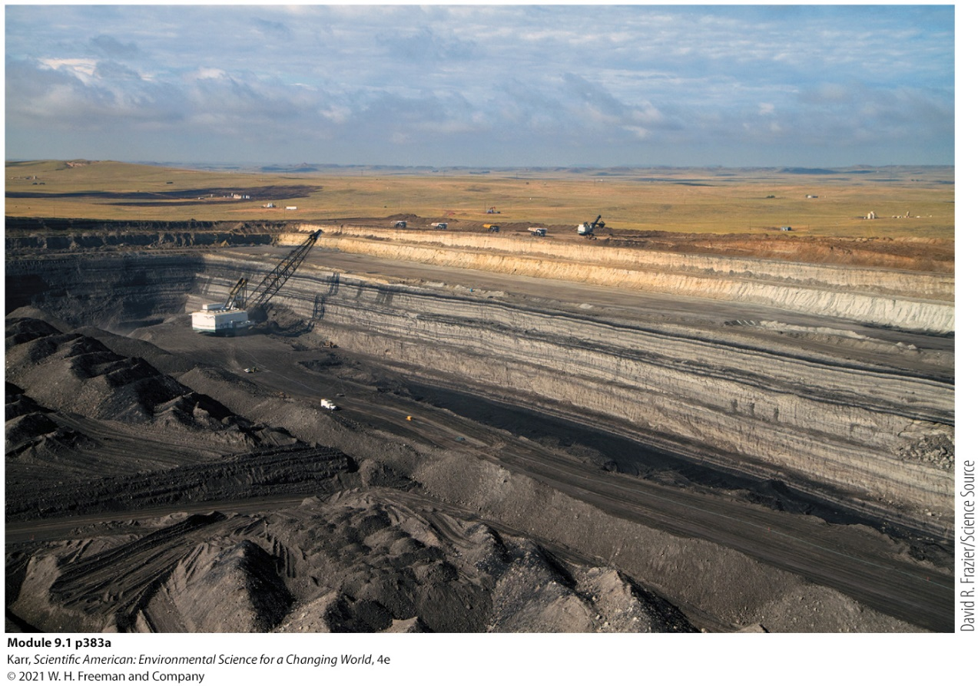
Surface Mining
Key Terms
Surface mining: a form of mining that involves removing soil and rock that overlays a mineral deposit close to the surface in order to access that deposit
Strip mining: a surface mining method that accesses coal from deposits close to the surface on level ground, one section at a time
A Wyoming strip mine
Notes:
The method used to retrieve coal depends on the depth of the deposit and the thickness of the coal seam.
Strip mining is used to access coal reserves in Wyoming.

Slide 22
Mountain Top Removal (MTR) (1 of 2)
Key Terms
Overburden: the rock and soil removed to uncover a mineral deposit during surface mining
After the coal has been removed, the rock is returned to the pit and topped with the reserved soil.
  The area can be replanted with native grasses (or allowed to reseed) while the next strip is excavated and mining continues.
Notes:
Hobet 21 is mined via MTR.

Slide 23
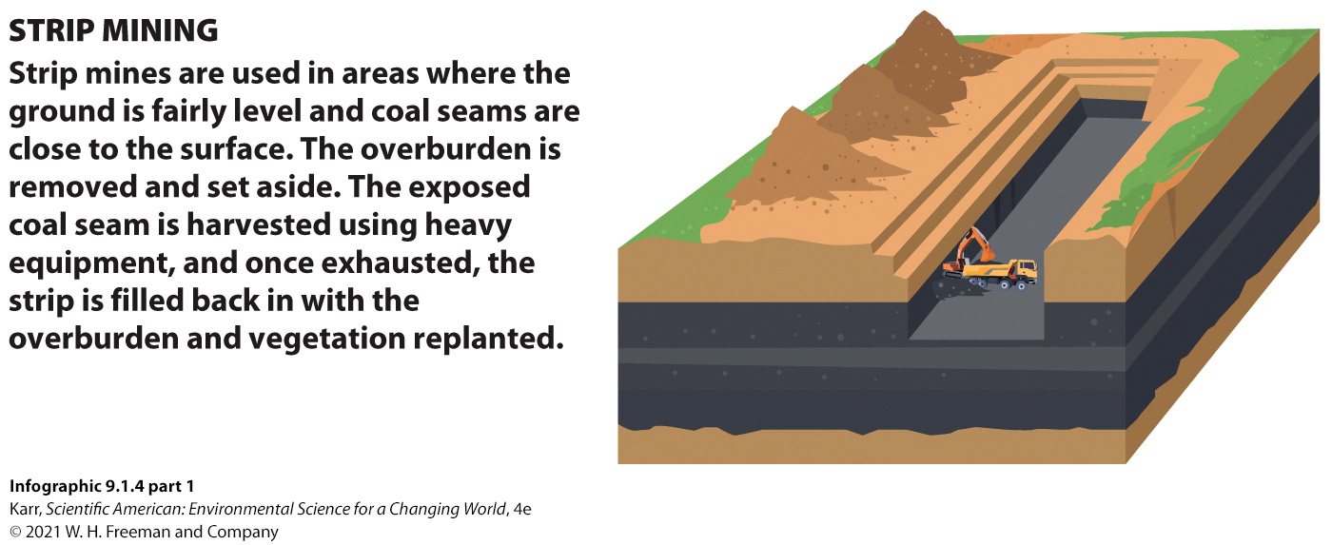
IG 4a: Surface Mining Techniques
Notes:
Ask your students why the overburden dumped is into the valley below when it is known that it damages streams and valley habitat.

Slide 24
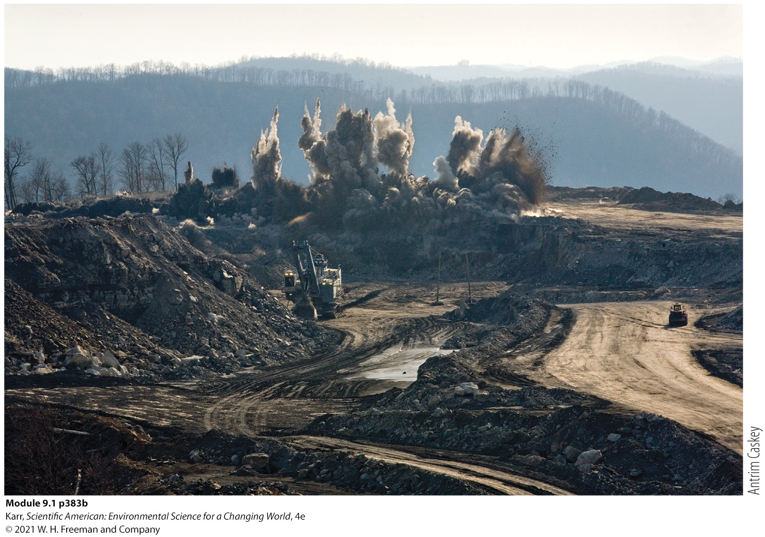
Mountain Top Removal (MTR) (2 of 2)
Key Terms
Mountaintop removal (MTR): a surface mining technique that involves using explosives to blast away the top of a mountain to expose the coal seam underneath; the waste rock and rubble is deposited in a nearby valley
  The process obliterates the forest habitat.
  Buries countless streams.
  Permanently reorders the land’s natural contours.
Mountain top removal at a coal mine
Notes:
Hobet 21 is mined via MTR.

Slide 25
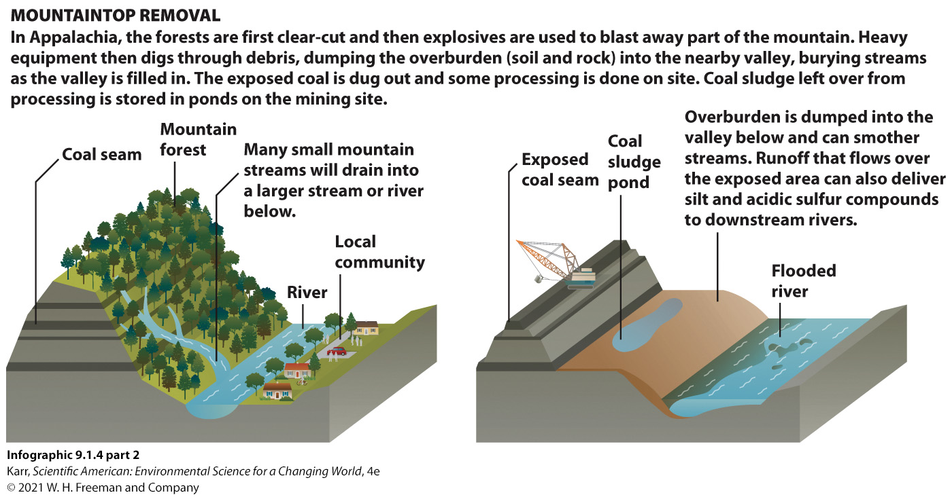
IG 4b: Surface Mining Techniques
Notes:
Ask your students why the overburden is dumped into the valley below when it is known that it damages streams and valley habitat.

Slide 26
Acid Mine Drainage
Key Terms
Acid mine drainage: Water that flows past exposed rock in mines and leaches out sulfates. These sulfates react with the water and oxygen to form acids (low pH solutions).
  Acidic water is toxic to living organisms.
  Acidic water alters the nutrient cycle of streams in ways that affect the entire food chain.

Slide 27
V. How Are Deep Deposits of Coal Mined, and What Are the Advantages and Disadvantages of This Method?
Key Concept 5: Subsurface mining is used to access deep, thick coal seams. It is less environmentally damaging and employs more workers than surface mining but is a hazardous job.

Slide 28
Subsurface Mining (1 of 2)
Key Terms
Subsurface mines: sites where tunnels are dug underground to access mineral resources
Acid mine drainage is an issue with subsurface mines.
Mining is dangerous.
  Explosions and toxic fumes can be fatal.
  Breathing in coal dust causes pneumoconiosis (black lung disease).
  If a fire starts, it is hard to extinguish.
Notes:
Subsurface mines make up about 50% of all U.S. coal mines.
More miners die from lung disease than from mining accidents.

Slide 29
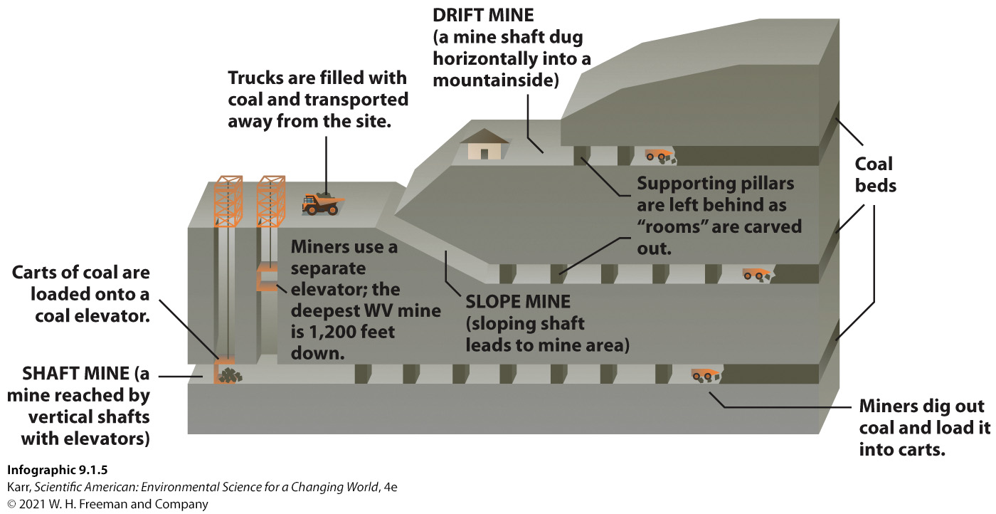
Subsurface Mining (2 of 2)
Notes:
Ask your students why a might mining operation might use mountaintop removal instead of subsurface mining.

Slide 30
Advantages of Subsurface Mines
Subsurface mines have some advantages over surface mines.
  They don’t disrupt or permanently alter large surface areas.
  They employ more people.
    In Appalachia, 100,000 mining jobs were lost between 1980 and 1993 as underground mining gave way to mountaintop removal.
    Slight increases were seen in 2017 and 2018.

Slide 31
VI. What Are the Advantages and Disadvantages of Using Coal?
Key Concept 6: Coal is an abundant and high-energy fuel, but mining and burning it create significant environmental and health problems for human populations and ecosystems through habitat destruction and the pollution of air and water.

Slide 32
Advantages of Coal
Widely distributed around the world
Proven reserves are estimated to last another 100 years
Easier and safer to store and transport compared to other fossil fuels
Affordable
Notes:
In 2005, a 3-year old child was killed when a boulder crashed through his house and landed on the bed where he was sleeping.
Studies show a higher-than-typical incidence of respiratory illnesses in mining communities.
A 2011 study showed that children in MTR communities are more likely to suffer a range of serious birth defects, including heart, lung, and central nervous system disorders.
A 2012 study found increased rates of leukemia and lung, colon, kidney, and bladder cancer in Appalachian counties with mountaintop removal sites compared to nonmining counties.

Slide 33

The Many Disadvantages of MTR
The loss of forest and the compaction of soil increases both the frequency and severity of flooding.
Explosions send rock and debris flying, which can damage homes and, in rare cases, trigger rockslides.
The toxic debris released during blasting causes respiratory illnesses and other serious health problems.
Maria Gunnoe became an environmentalist; her family are coal miners.
Notes:
In West Virginia, overburden has completely buried more than 3,200 kilometers (2,000 miles) of streams and destroyed an untold range of natural habitats in the process, threatening local species diversity.
To separate the coal from the rock, miners use a mix of water and magnetite powder known as slurry in which coal can float. Once the sulfur and other impurities have been washed out, the coal is sent for further processing, and the slurry by-product is pumped into artificial holding ponds.
In October 2000, the containment at a sludge pond holding coal slurry failed, pouring more than 1.1 billion liters (300 million gallons—30 times the Exxon Valdez spill) of toxic sludge into the Big Sandy River of Martin County, Kentucky. The contamination killed all wildlife in streams and streamside areas in the immediate area and impacted waterways for more than 100 km (about 60 miles). The sludge was 1.5 meters (5 feet) deep in some places. The EPA would register it as one of the worst environmental disasters in U.S. history. Sludge can still be found a few inches under the river sediments.
Coal burning accounts for 24% of the total anthropogenic mercury released.
In 2008, following a heavy rain event, a 15-meter-tall (50-foot-tall) dike from a pond holding coal fly ash from the Kingston Fossil Plant in Tennessee failed, releasing 4.2 billion liters (1.1 billion gallons) of fly ash into nearby rivers and coating vast expanses of riverside land. The EPA spent 6 years and $1.1 billion in clean-up efforts, and in 2017, reported that the ecosystem was back to “prespill conditions.”

Slide 34
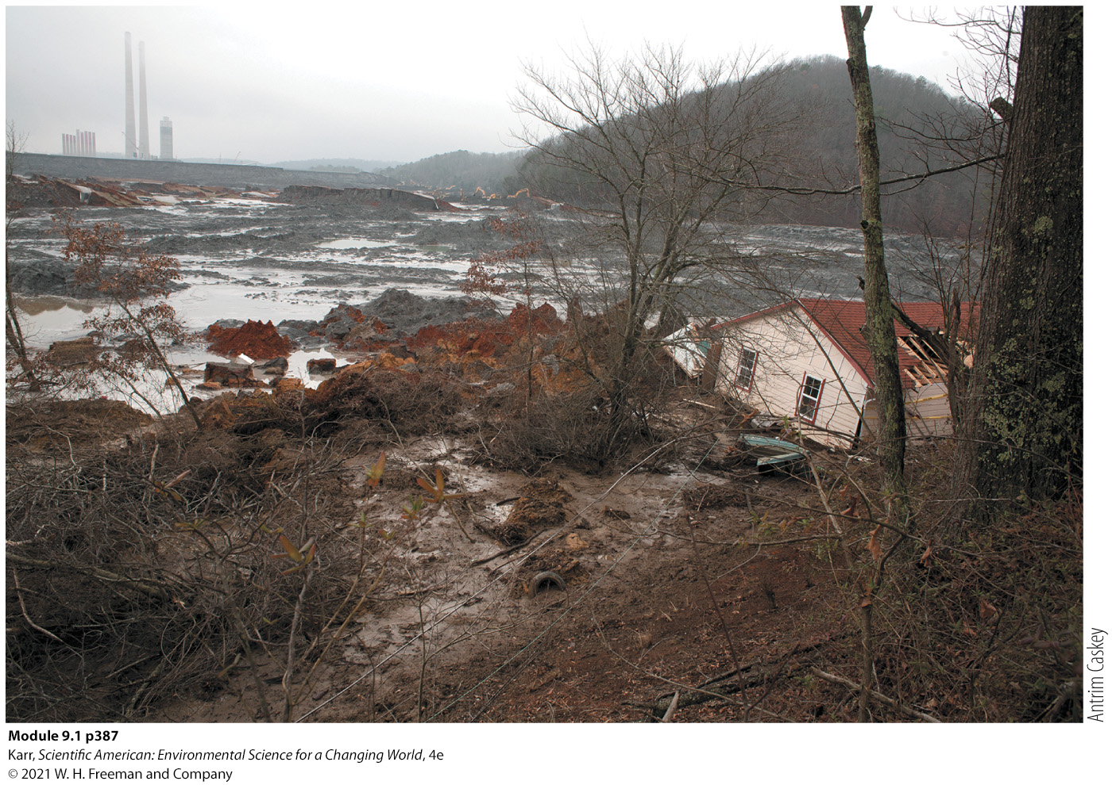
2008 Flood Released Toxic Fly-Ash Slurry
Toxic substances also permeate the region’s rivers, streams, and groundwater.
The coal extraction process creates toxic slurry impoundments.
Burning coal for energy releases toxic compounds like mercury that are damaging to the environment and human health.
Coal-fired power plants also generate tons of toxic fly ash.

Slide 35
IG 6: The Trade-offs of Coal
Though coal has many advantages as a fuel, mining, processing, and burning coal contribute to a variety of environmental problems, many of which lead to serious health issues for human populations.
ADVANTAGES | DISADVANTAGES
Widely distributed and fairly abundant supply Low geopolitical conflict over supplies Energy-rich fuel Safe to transport and store Affordable | Nonrenewable, finite resource Hazardous air pollution from mining and burning coal Most carbon-intensive fossil fuel to burn (high CO₂ emissions) Water pollution (surface and groundwater) from mining and burning coal Habitat/property destruction from surface mining, and ash and sludge pond failures Biodiversity loss from mining (especially MTR mining) Blasting hazards to nearby communities from MTR mining Flooding risk increased due to loss of vegetation from surface mining Health issues such as respiratory problems, cancers, birth defects, and cardiovascular diseases in miners and community members living near surface mines or coal power plants
Infographic 9.1.6
Karr, Scientific American: Environmental Science for a Changing World, 4e
© 2021 W. H. Freeman and Company
Notes:
If we choose to continue to use coal, ask your students what could be done to address the disadvantages of mining, processing, or burning it.

Slide 36
VII. What New Technologies Allow Us to Burn Coal with Fewer Environmental and Health Problems?
Key Concept 7: The negative impact of burning coal can be addressed by capturing pollutants before they are released or converting coal to a liquid or gaseous fuel that burns more cleanly.

Slide 37
Clean Coal Technology and Clean Coal
Key Terms
Carbon capture and sequestration (CCS): The process of removing carbon from fuel combustion emissions or other sources and storing it to prevent its release into the atmosphere.
Clean coal: A liquid or gaseous product produced by removing some contaminant contained in coal so that the resulting fuel releases less pollution when burned.
  The process requires significant inputs of energy.
  Lowers the EROEI despite its greater energy efficiency in electricity generation.

Slide 38
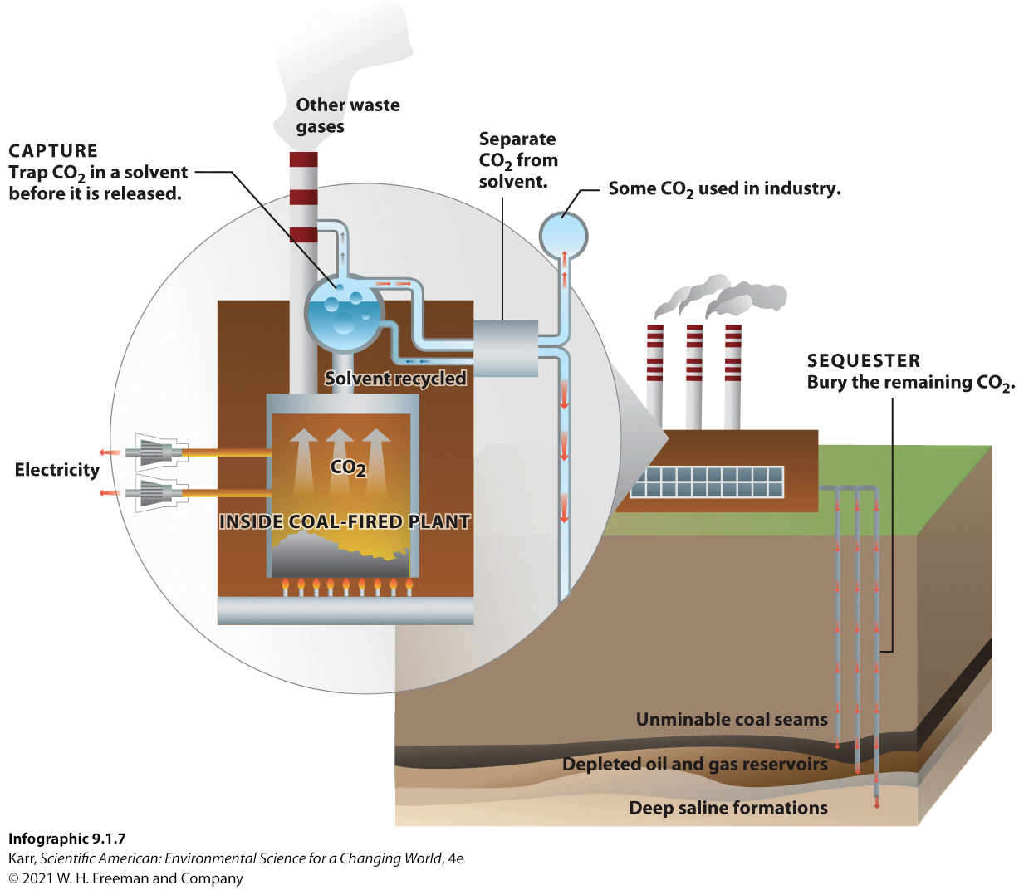
IG 7: How It Works: Carbon Capture and Sequestration (CCS)
Notes:
If successful, CCS will reduce coal’s contribution to climate change—a significant outcome. Ask your students what impact it would have on the negative consequences of extracting coal.

Slide 39
VIII. How Can Mining Damage Be Repaired, and How Effective Is This Restoration?
Key Concept 8: Surface coal mines must undergo reclamation once they are closed; this reduces the environmental damage of mining but does not eliminate it.

Slide 40
Reclamation (1 of 2)
Key Terms
U.S. Surface Mining Control and Reclamation Act (1977): mandates that areas that have been surface mined for coal be reclaimed once the mine closes.
Reclamation: requires that the area be returned to a state close to its premining condition.
    Reclamation of MTR sites is difficult due to the total destruction of the forest habitat and the loss of soil and native species.

Slide 41
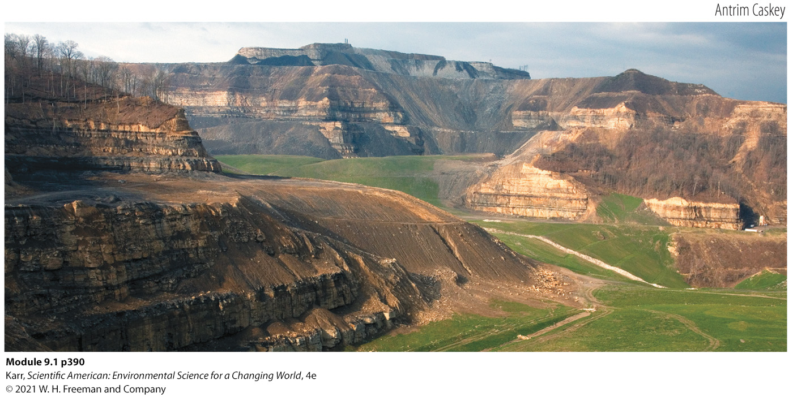
Reclamation (2 of 2)
A reclamation site. Note that the original mountain contouring and forest cannot be replaced.
Notes:
Reclamation of MTR sites is difficult due to the total destruction of the forest habitat and the loss of soil and native species.

Slide 42
Stream Reclamation
The Clean Water Act (1973) requires that damaged streams be returned close enough to their original state such that the overall impact on the stream ecosystem is “nonsignificant.”
  The method of choice is to dig drainage ditches and line them with stones in a way that resembles a stream or river.
  These do not perform the ecological functions of a stream.

Slide 43
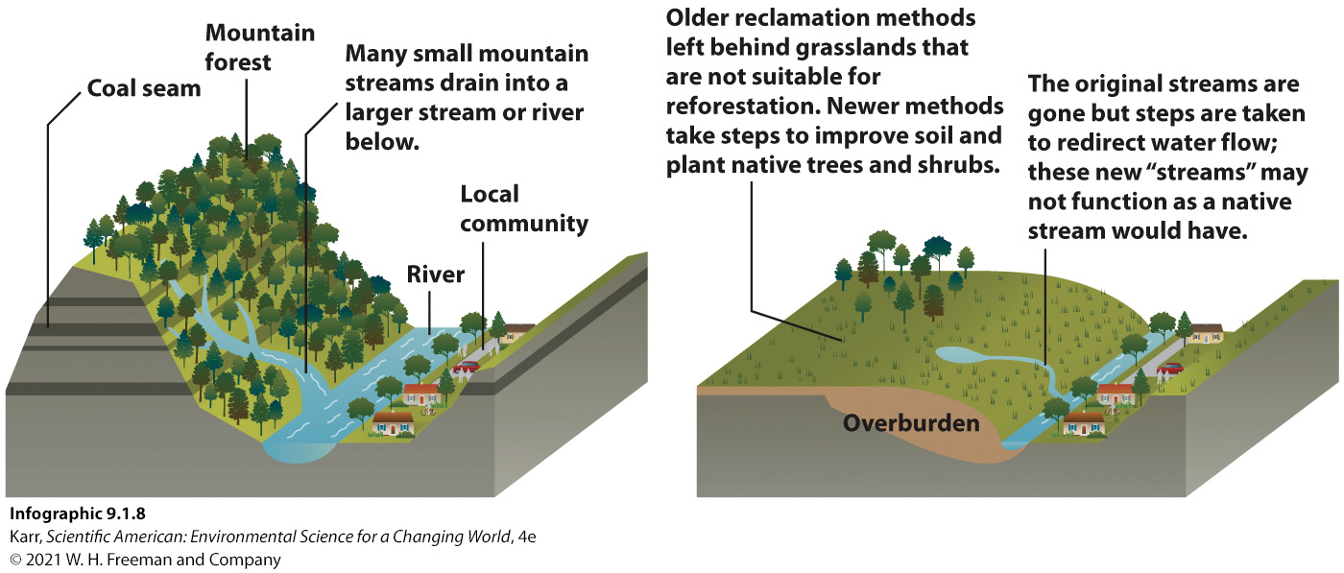
IG 8: Mine Site Reclamation
Notes:
Ask your students if they lived near an area where mountaintop removal mining was being done, would they be satisfied with the reclamation process and final product? What are the advantages and disadvantages of this type of reclamation?

Slide 44
Summary
In West Virginia, coal reserves are expected to last another 50 years, at best.
Once the coal is gone, the clean-up will be significant.
As the Spruce No. 1 and the Hobet mines in West Virginia have shown us, coal mining, especially MTR, causes irreversible environmental degradation and significant environmental and health risks.
Although researchers are developing ways to lessen the impact of burning coal, the best way to reduce the environmental impact is to use less of it.
Perhaps it is time to accept that our coal reserves are coming to an end and instead focus our attention on renewable forms of energy.

Slide 45
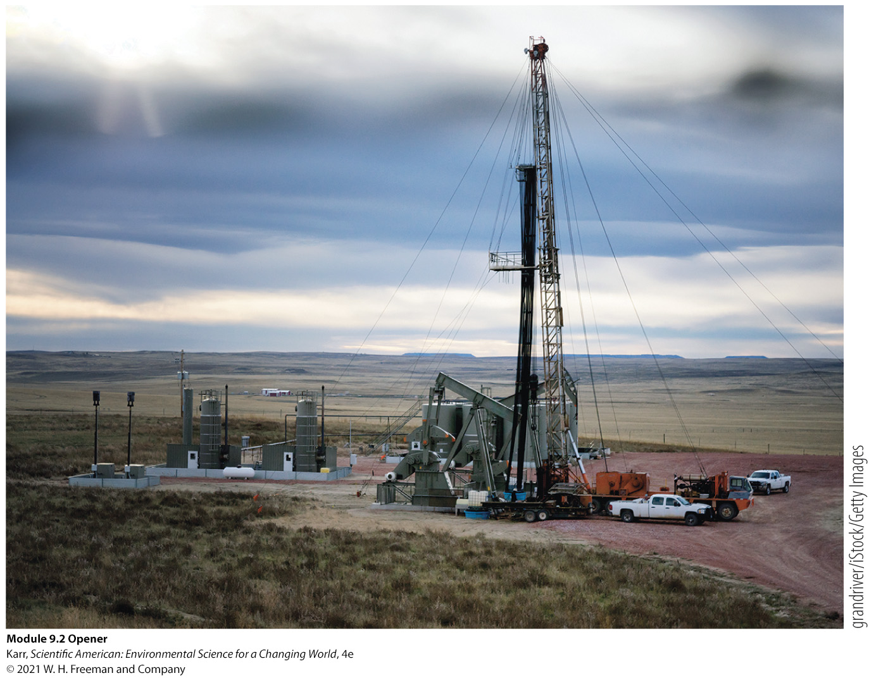
Module 9.2
Oil and Natural Gas: The Bakken Oil Boom

Slide 46
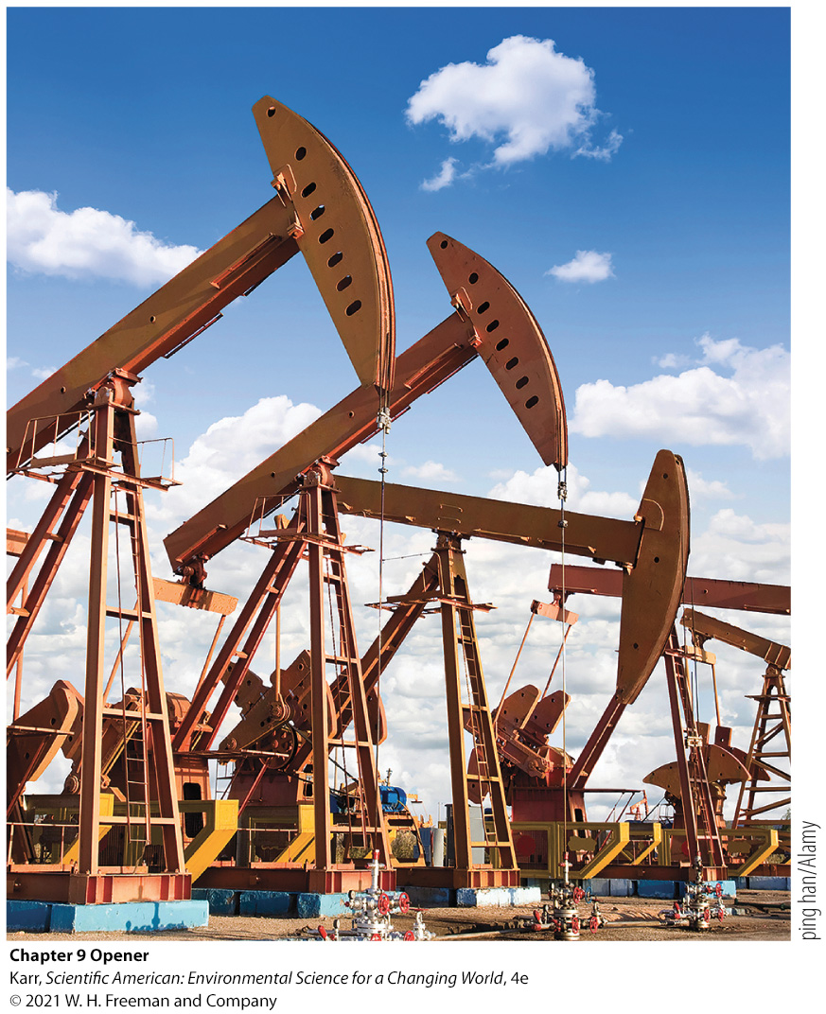
Core Message
Oil and natural gas:
  Vital resources
  A lot of environmental damage
  Conventional supplies dwindling
Unconventional sources
  More difficult and expensive to extract
Notes:
Oil and natural gas are vital resources for modern society, but damage is caused at every stage of their acquisition, and conventional supplies are becoming depleted.
Unconventional sources are available but are more difficult and costly (economically and environmentally) to extract, so we should weigh the pros and cons of pursuing these fossil fuels.

Slide 47
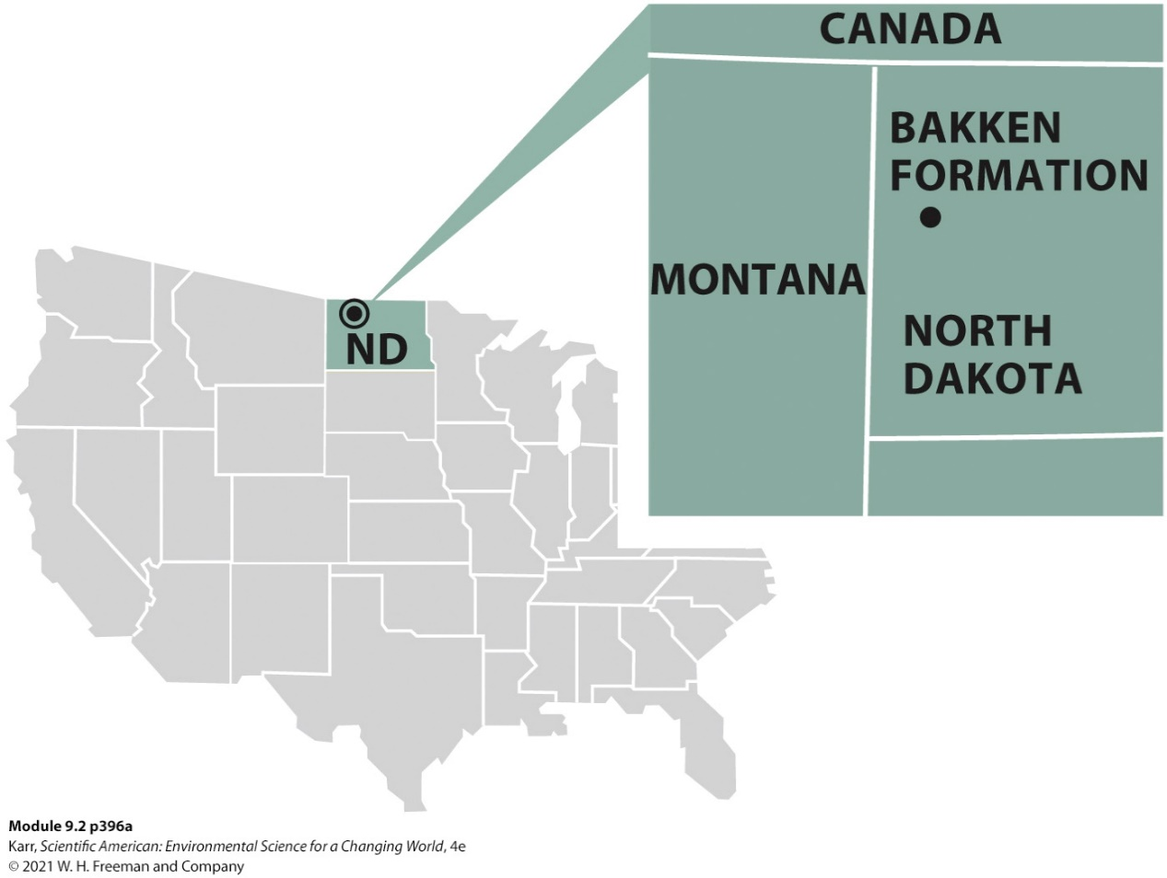
Case Study: Can Fracking Lead to Energy Independence?
Prior to 2006, North Dakota and the other prairie states were suffering a mass exodus of their human population.
In six years, an oil boom in Bakken, North Dakota, reversed the exodus, and Bakken became one of the most expensive cities in the U.S. to live in.
Bakken oil reserves are collected via fracking.
By 2014, the price of oil was dropping.

Slide 48
I. How Are Fossil Fuels Formed, and Why Are They Considered Nonrenewable Resources?
Key Concept 1: Fossil fuels form when organic matter is buried and subjected to high temperature and pressure. Because we use them much faster than they form, they are considered nonrenewable resources.

Slide 49

Fossil Fuels
Key Terms
Fossil fuel: a variety of hydrocarbons formed from the remains of dead organisms that are buried in sediment under low oxygen conditions that slow down decomposition tremendously
  In time, as pressure and heat increase, the buried material goes through a chemical transformation to form oil (a liquid), natural gas, or coal (a solid).
A mobile home park in Williston, N.D., once the most expensive city in which to rent

Slide 50
Oil and Natural Gas
Key Terms
Oil: a liquid fossil fuel useful as a fuel or as a raw material for industrial products
Natural gas: a gaseous fossil fuel composed mainly of simpler hydrocarbons, mostly methane
Fossil fuels are nonrenewable: a resource that is formed more slowly than it is used or that is present in a finite supply
Notes:
Since 2014 Bakken has produced about 14% of all the oil produced in the United States.

Slide 51
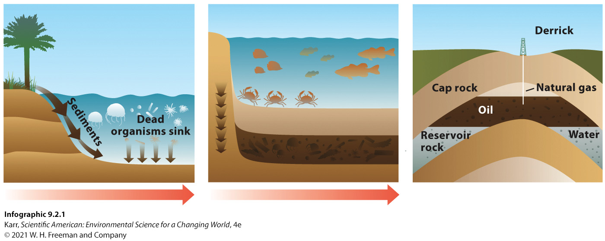
IG 1: Oil and Natural Gas Fossil Fuel Formation
Notes:
Ask your students how the formation of oil and natural gas is similar to and different from the formation of coal.

Slide 52
The Bakken Oil Formation
The heart of the U.S. oil boom is the Bakken formation.
  Resides mostly in North Dakota but extends into Montana and Canada
  The largest continuous oil accumulation the U.S. Geological Survey (USGS) has ever assessed
  Currently extracts more than 1 million barrels/day
  Requires newer technology to extract oil
Notes:
1.2 million barrels was almost 14% of all oil produced in the United States (around 6% of the oil consumed per day).

Slide 53
II. How Are Oil and Natural Gas Reserves Classified, and Where Are They Found?
Key Concept 2: The largest conventional oil and natural gas reserves are in the Middle East; however, North America has large deposits of unconventional oil and natural gas.

Slide 54
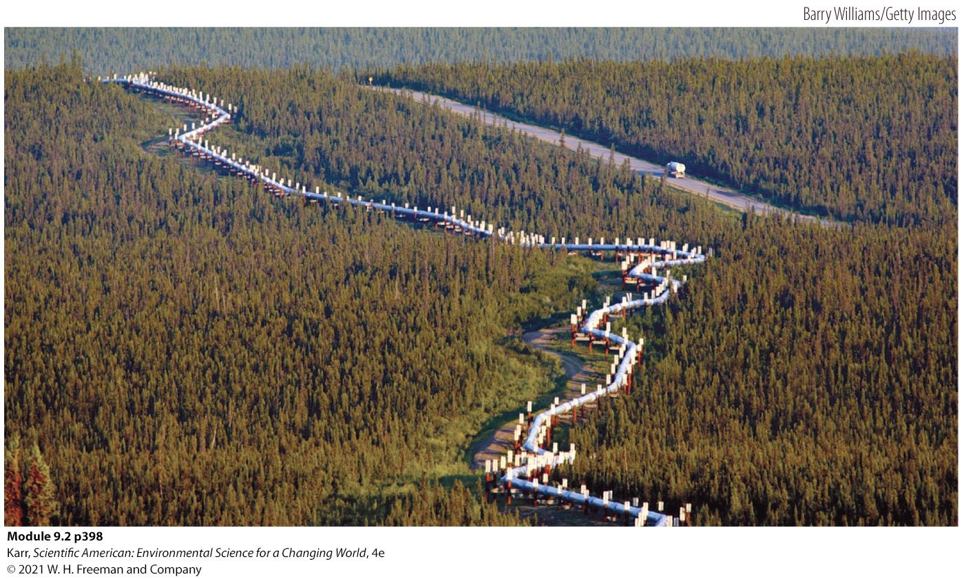
Crude Oil
Key Terms
Crude oil: a mix of hydrocarbons that exists as a liquid underground; can be refined to produce fuels or other products
  Generally found as tiny droplets wedged within the microscopic open spaces, or pores, inside rocks
The 800 mile Trans-Alaska pipeline
Notes:
Oil and natural gas often occur together in formations—the lighter natural gas is found at the top of the deposit.
After formation, the oil and natural gas slowly migrate up from the source rock in which they were formed into porous, sedimentary rock formations closer to the surface until they are stopped by a dense “cap rock” layer, such as granite, that prevents further migration and allows the oil and natural gas to collect in one area.
In these deposits, oil does not exist in thick black pools. Instead, the oil is contained in tiny droplets wedged within the microscopic open spaces, or pores, inside rocks.

Slide 55
Proven Reserves
Key Terms
Proven reserves: a measure of the amount of a fossil fuel that is economically feasible to extract from a known deposit using current technology
  Conventional oil reserves are not evenly distributed around the planet, leading to political problems among countries.
  The Middle East has the largest proven reserves of oil and natural gas, with about 49% and 39% of the world’s oil and natural gas reserves, respectively.
Notes:
At current rates of extraction and use, known conventional reserves are expected to last another 50 years or so, though this number is uncertain because reports of oil reserves tend to be questionable.
The United States has about 6% of the world’s natural gas reserves.
Total world conventional reserves of natural gas are expected to last 60 to 100 years at current rates of use.

Slide 56
Conventional versus Unconventional Reserves
Key Terms
Conventional reserves: deposits of crude oil or natural gas that can be extracted by vertical drilling and pumping
  Many researchers estimate that we have used about half of the available conventional oil on the planet.
Unconventional reserves: deposits of oil or natural gas that cannot be recovered with traditional oil/gas wells but may be recoverable using alternative techniques
Tight oil: light (low-density) oil in shale rock deposits of very low permeability; extracted by fracking
  Most oil found in Bakken is tight oil.
Notes:
Extraction of oil and natural gas from conventional reserves is peaking. This means less can be extracted each year as time goes on. Exploiting unconventional reserves such as Bakken tight oil or Marcellus shale natural gas will extend supplies, but not for long.

Slide 57
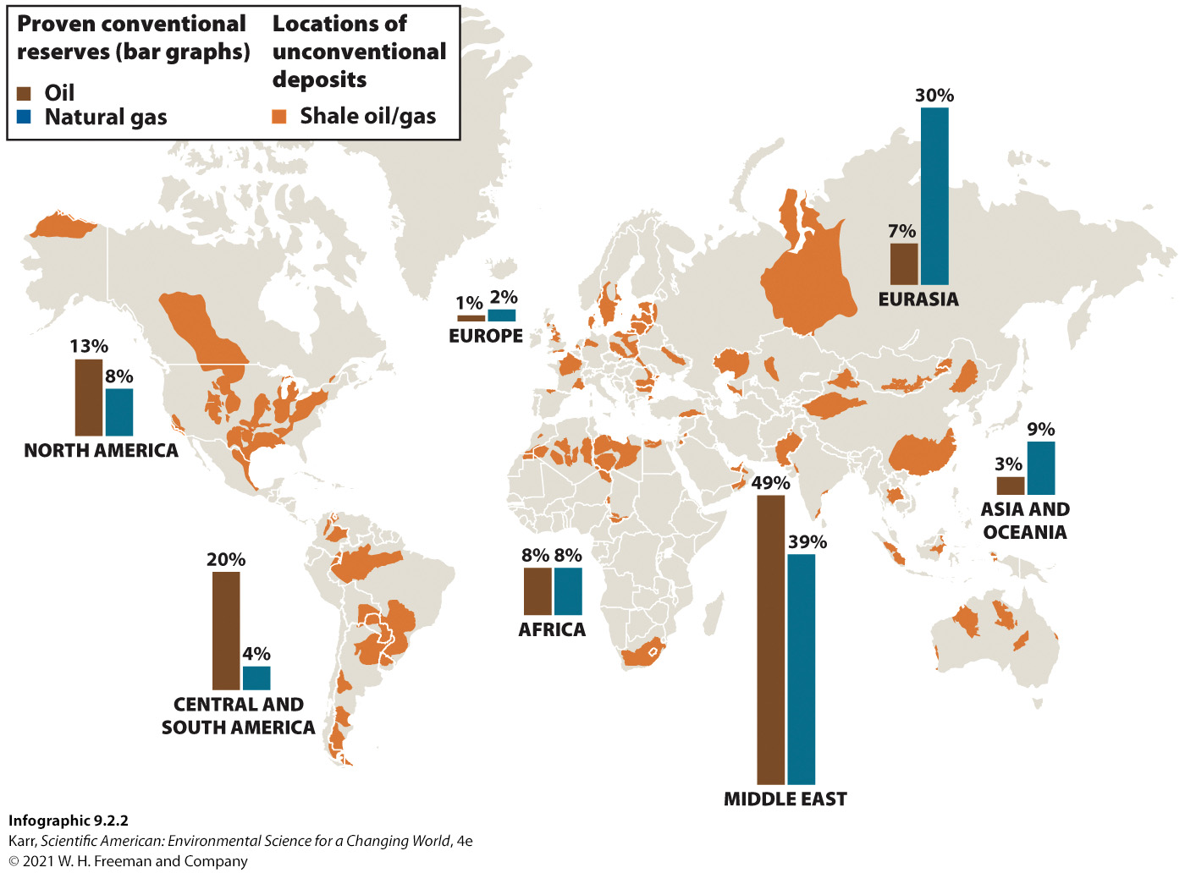
IG 2: Oil and Natural Gas Reserves
Notes:
In 2018, there were 1,662 billion barrels (bbl) of oil in proven conventional oil reserves. Ask your students how many bbl were in North America.

Slide 58
III. How Are Conventional Oil and Natural Gas Extracted?
Key Concept 3: Oil and natural gas often occur together in rock formations and are extracted from conventional reserves using oil and gas wells.

Slide 59
Primary, Secondary, and Tertiary Production
Primary production: occurs when a well is first drilled
  Pumpjacks used to pump out additional oil once oil stops flowing freely
  Recovers up to 15% of the oil
Secondary production: injection wells are drilled near the oil well, and water is pumped in
Tertiary production: injects steam, natural gas, or carbon dioxide gas into the reservoir
Notes:
Secondary production: injection wells are drilled near the oil well, and water is pumped in
Increases the pressure on the remaining oil, forcing it upward to where it can be pumped out
Recovers 20% to 40% of oil
Tertiary production: injects steam, natural gas, or carbon dioxide gas into the reservoir
Recovers up to 20% of oil
Conventional natural gas can be found in deposits that contain no oil (nonassociated gas reserves) or in deposits that contain both oil and natural gas (associated gas reserves). The extraction of natural gas is very similar to that of oil. Wells are drilled into the gas-containing formation, and natural gas flows freely up the well due to underground pressure, or it is pumped out (primary production). Secondary and tertiary methods that extract oil also extract any natural gas that is trapped in the oil, but these techniques are not used in nonassociated gas wells.

Slide 60
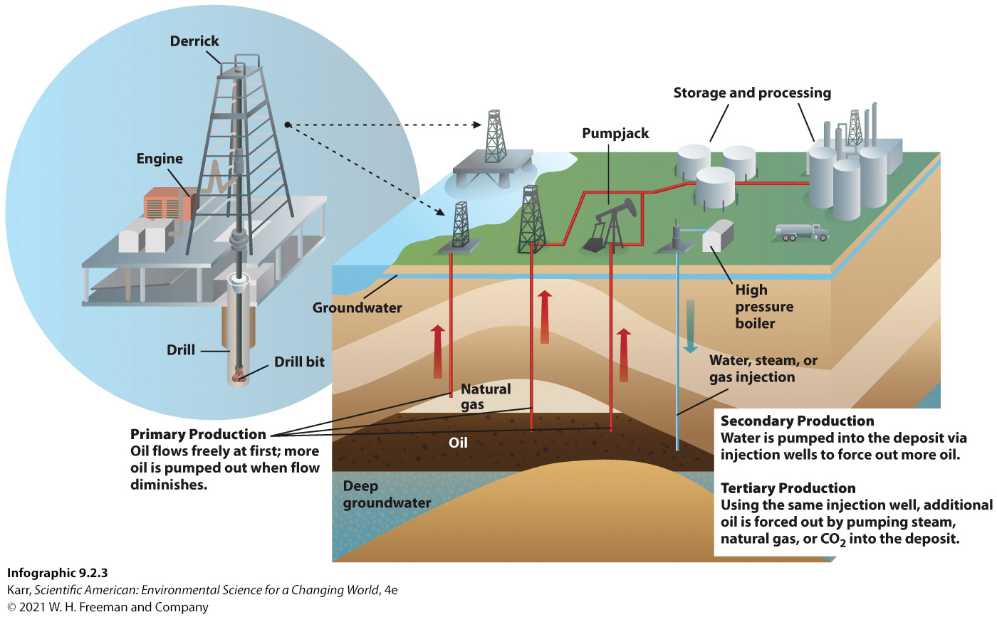
IG 3: How It Works: Conventional and Natural Gas Wells
Notes:
Ask your students why pumpjacks aren’t needed during the initial retrieval of oil from a newly drilled well.

Slide 61
EROEI
Energy return on energy investment (EROEI): a measure of the net energy from an energy source (the energy in the source minus the energy required to get it, process it, ship it, and then use it)
  In the 1950s when oil wells were first being tapped using primary production, the EROEI was close to 30:1.
  As the production transitioned to secondary and tertiary methods, the EROEI declined to the current average of around 10:1.
Notes:
A comparison of the EROEI for the extraction of different energy sources helps producers and investors determine which energy sources are worth pursuing.
An energy source that requires almost as much energy to tap into as it ultimately produces will be left untapped in favor of sources with higher EROEI values.

Slide 62
IV. What Are the Trade-offs of Acquiring and Using Conventional Oil and Natural Gas Resources?
Key Concept 4: Oil and natural gas are used to create a variety of fuel and industrial products. Natural gas is considered the cleanest burning fossil fuel, but like oil, every step of acquisition and use damages the environment and impacts human health.

Slide 63
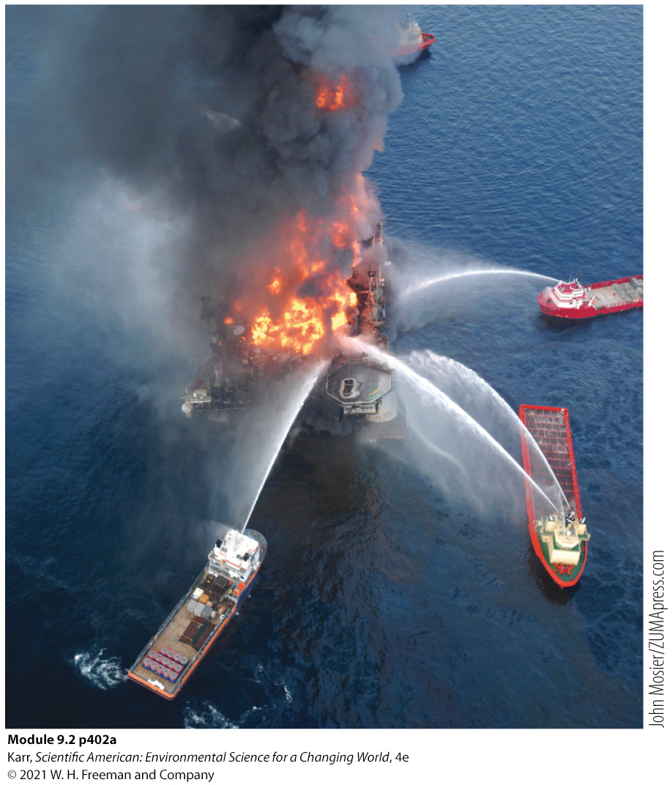
The Trade-offs of Oil
Key Terms
Petrochemicals: distillation products from the processing of crude oil such as fuels or industrial raw materials
Hazards of oil include:
  Disruption and danger to wildlife
  Oil spills
  Air pollution
  Health problems
Putting out the flames of the Deepwater Horizon
Notes:
To locate deposits of oil and natural gas, companies send seismic waves into the ground that bounce back to reveal the location of possible reserves. Doing this in ocean areas disorients marine wildlife; in 2009, ExxonMobile had to abandon its oil exploration in Madagascar because more than 100 whales had beached themselves, presumably because of these sonic exploratory methods.
Millions of gallons of oil are spilled from tankers, trains, pipelines, and ships annually. And while large-scale accidents like the 2010 Deepwater Horizon oil platform explosion and oil spill in the Gulf of Mexico are rare, they are devastating. The Deepwater Horizon spill released close to 5 million barrels of oil; eventually covered 930 square kilometers (360 square miles) of ocean; impacted roughly 1,800 kilometers (1,100 miles) of coastline; and infiltrated and damaged coastal wetlands.
Workers in the petroleum chemical industry have much higher rates of cancer, rashes, heart disease, and various other health problems than the general population. This hazard extends to people living near oil refineries and petrochemical plants; rates of cancer, birth defects, headaches, and asthma in such areas exceed national averages.

Slide 64
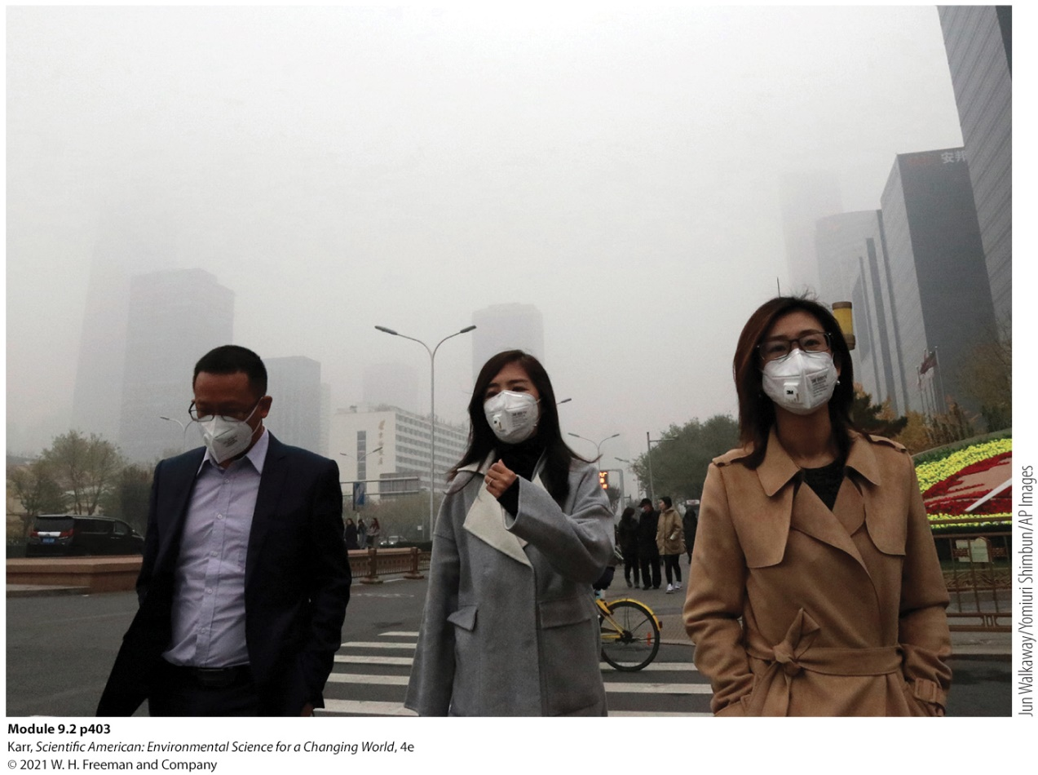
The Trade-offs of Natural Gas
Key Terms
Carbon footprint: the amount of carbon released to the atmosphere by a person, company, nation, or activity
However, there are trade-offs related to natural gas:
  Exploration and extraction are environmentally damaging.
  Shipping and handling are dangerous due to high flammability.
  Shipping requires pipelines which can leak methane, a greenhouse gas.
  It is nonrenewable.
Citizens of Beijing wearing face masks to protect themselves from air pollution.
Notes:
Natural gas has fewer impurities, burns more efficiently, and has a lower carbon footprint than oil.
Natural gas is made up of shorter-chain hydrocarbons (predominately methane, CH₄) and tends to have fewer impurities than oil, so when burned, fewer toxic pollutants are released.
Natural gas releases roughly 44% and 29% less CO₂ than coal and oil, respectively, per unit of heat energy.
Natural gas is seen as the best fossil fuel to serve as a “bridge fuel”—one that we can use while we transition to more sustainable options. In addition, natural gas, like oil, is also the starting material for a wide variety of industrial products such as fertilizers, paints, plastics, and pharmaceuticals.

Slide 65
IG 4: The Trade-Offs of Oil and Natural Gas
OIL
ADVANTAGES | DISADVANTAGES
• Energy-rich fuel • Provides variety of liquid fuels that meet needs for vehicles • No ash produced when burned (no disposal issues as with coal) • Can transport via pipeline or vehicle (rail, truck, or ship) • Raw materials for a wide variety of industrial products | • Nonrenewable, finite resource • Geopolitical tensions from unequal distribution of reserves • Air pollution, including greenhouse gas emissions (extraction, processing, and burning) • Water pollution (extraction, processing, and burning) • Habitat destruction (extraction and spills) • Biodiversity loss (exploration, extraction, and spills) • Dangerous to ship • Occupational and community health hazard
NATURAL GAS
ADVANTAGES | DISADVANTAGES
• Energy-rich fuel • Versatile fuel: generates electricity, heating and cooking, vehicle fuel • Lowest air pollution and greenhouse gas emissions of the fossil fuels • No ash produced when burned (no disposal issues as with coal) • Raw material for a wide variety of industrial products | • Nonrenewable, finite resource • Methane is a potent greenhouse gas; produces CO₂ emissions when burned • Water pollution (extraction and burning) • Habitat destruction (extraction and spills) • Biodiversity loss (exploration, extraction, and spills) • Hazardous chemical • Difficult to ship
Infographic 9.2.4
Karr, Scientific American: Environmental Science for a Changing World, 4e
© 2021 W. H. Freeman and Company
Notes:
Ask your students what could be done to decrease the occupational and community hazards associated with working in the oil industry or living near a refinery or oil extraction operation.

Slide 66
V. What Unconventional Sources of Oil and Natural Gas Exist, and How Are They Extracted?
Key Concept 5: Shale oil and natural gas deposits that can’t be accessed with conventional wells can be retrieved by fracking; strip mining is used to extract tar sands.

Slide 67
Fracking
Key Terms
Fracking (hydraulic fracturing): the extraction of oil or natural gas from dense rock formations by creating factures in the rock and then flushing out the oil/gas with pressurized fluid
  The United States leads the world in fracking, significantly reducing the amount of coal used in this country.

Slide 68
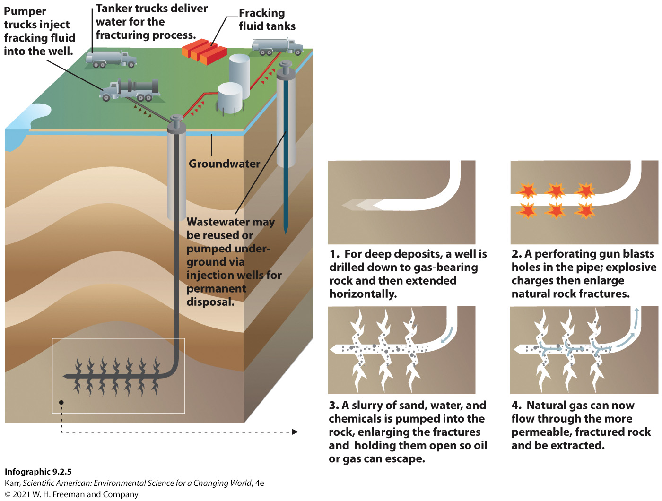
IG 5: How It Works: Fracking (Hydraulic Fracturing)
Notes:
Ask your students to suppose they are homeowners. An oil company approaches them, offering to lease their land to install a fracking well. What questions would they have for the company as they consider what to do?

Slide 69
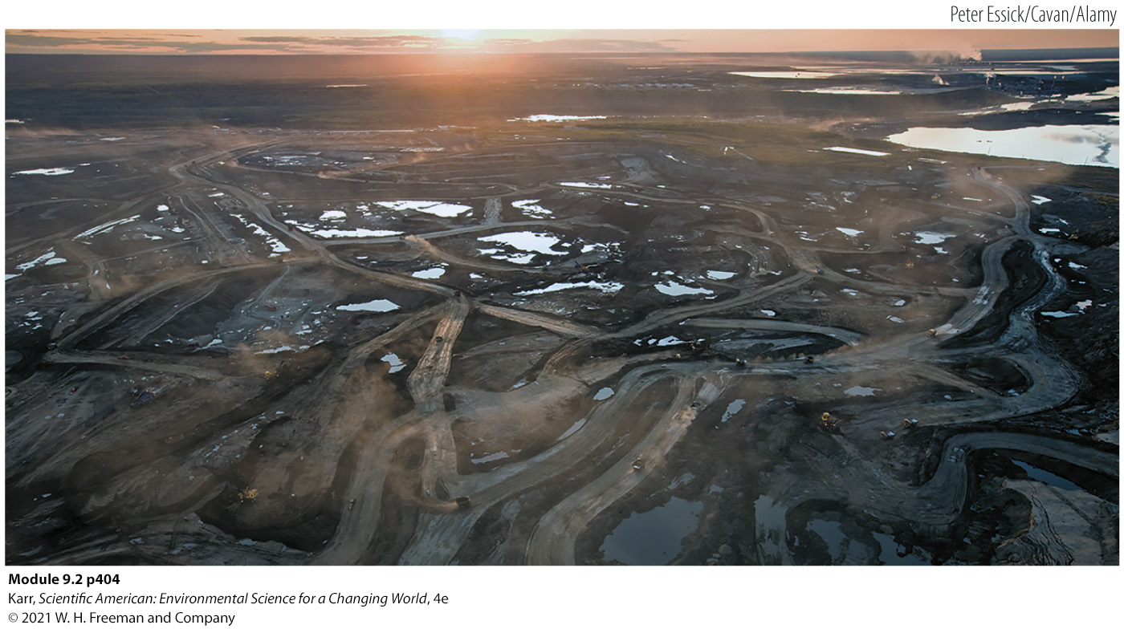
Tar Sands
Key Terms
Tar sands (oil sands): sand or clay formations that contain a heavy-density crude oil (crude bitumen) that is often trapped in sticky, dense conglomerations of sand or clay; extracted by surface mining
  Another type of unconventional oil reserve
  Most destructive and energy-intensive way to acquire oil
A tar sand operation in Alberta
Notes:
Alberta, Canada, is home to the second largest tar sand reserve; with 170 billion barrels of economically retrievable oil, it is the third-largest proven oil reserve in the world. In 2014, Alberta produced 2.3 million barrels of synthetic crude oil per day from the tar sands—much of it shipped to the United States.
Venezuela was recently recognized as having the largest tar sands deposits in the world. With 300 billion barrels of recoverable oil, its oil reserves surpass that of Saudi Arabia.
Huge swaths of boreal forest have been destroyed in tar sands operations.

Slide 70
VI. What Are the Trade-offs of Pursuing Unconventional Oil and Natural Gas Sources?
Key Concept 6: Extracting unconventional oil and natural gas supplies produces positive economic benefits, but fracking and tar sands mining have serious negative environmental and societal impacts.

Slide 71

The Trade-offs of Unconventional Oil and Gas Mining
More expensive than conventional methods
Contaminates drinking water with methane
Huge water footprint
Produces toxic wastewater
Earthquakes triggered by injection wells
Water burns in areas where natural gas is fracked.
Notes:
It pays to pursue unconventional fossil fuels only when prices are high.
New technologies deployed in 2016 have increased productivity per well, making fracking more cost competitive, but this comes at the expense of jobs—automated systems are improving efficiency, decreasing the cost of fracking, and replacing workers.
A 2013 study by Duke University researchers found that methane contamination of drinking water was highest in areas closest to fracking wells.
The volume of water required to frack a well is huge—around 11 million liters (3 million gallons) for a Bakken well.
The Oklahoma City area experienced 31 earthquakes (2.0 magnitude or greater) in a 1-week period in July 2014. To put this into perspective, whereas the state experienced only 6 earthquakes between 2000 and 2008, it experienced 6,345 earthquakes between 2010 and 2013.
Another problem is that the amount of oil being fracked has outpaced the existing capacity to transport it. Without a pipeline to rely on, oil companies have resorted to using railways. But the sheer volume of oil to be transported is bogging down the rail system nationwide, and shipping tight oil this way is a hazardous undertaking. Tight oil contains methane (natural gas) dispersed throughout, making it more volatile and explosive than crude oil; it is similar to jet fuel in its combustibility. In the summer of 2013, the brakes failed on a parked, unmanned train carrying Bakken oil. The runaway train sped downhill, derailing in Lac-Mégantic, a tiny lakeside village in Quebec; the resulting crash caused an explosion when the highly combustible fuel ignited, leveling 30 some buildings and claiming 47 lives.

Slide 72
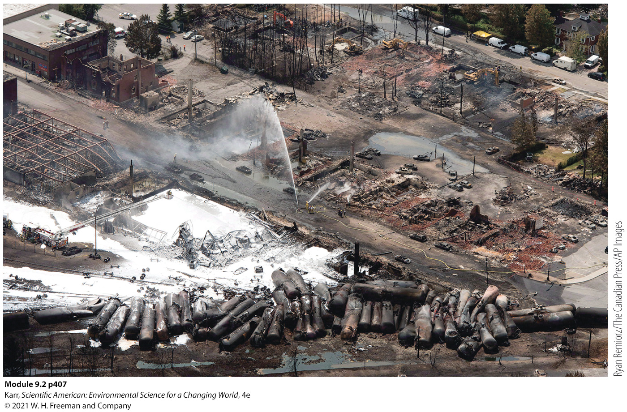
More Trade-offs of Unconventional Fossil Fuels
Transporting tight oil via pipeline or railway: dangerous
Violates private property rights
Most energy- and water-intensive way to extract and process oil
Produces the most hazardous waste
Results of a runaway train explosion in 2013 in Quebec; 47 people died

Slide 73
IG 6: The Trade-offs of Unconventional Fossil Fuels
ADVANTAGES | DISADVANTAGES
• Energy-rich fuels • Can be used in the same way that conventional oil or natural gas is used • Extends worldwide supply of oil and natural gas • Abundant U.S. supply: reduces dependence on imports and stimulates local economies | • Nonrenewable, finite resource • Same air pollution when burned as with conventional oil and natural gas
 | FRACKING FOR SHALE GAS/OIL | MINING FOR TAR SANDS OIL
 | • High water inputs • Potential for pollution of well water • Can occur without permission of property owner • Wastewater issues: hazardous and its disposal is linked to earthquakes • Dangerous to transport (tight oil) • More expensive to extract than conventional sources | • High water and energy inputs • Extensive surface water pollution • Extreme habitat destruction • Difficult to transport; pipelines must be heated • Highest carbon footprint of any fossil fuel extraction method • More expensive to extract than conventional sources
Infographic 9.2.6
Karr, Scientific American: Environmental Science for a Changing World, 4e
© 2021 W. H. Freeman and Company
Notes:
Ask your students if the advantages of fracking or tar sands mining outweigh their disadvantages. Encourage them to explain their answers.

Slide 74
VII. What Obstacles Stand in the Way of the United States (or Any Nation) Achieving Energy Independence or Security?
Key Concept 7: Achieving energy independence or security will require an eventual transition away from fossil fuels; conservation efforts and diversification of energy sources can help in the pursuit of these goals.

Slide 75
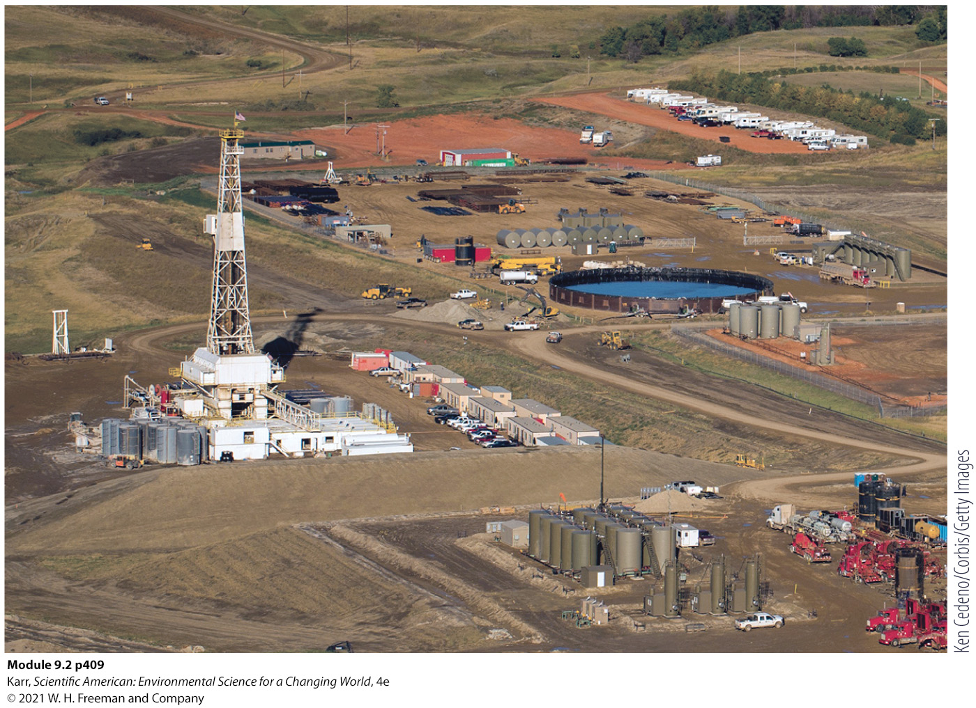
Energy Independence
Key Terms
Energy independence: meeting all of one’s energy needs without importing any energy
A fracking operation in North Dakota
Notes:
Conventional and unconventional oil reserves will not ultimately give us energy independence or energy security.
“At the high end of the estimates, predicted production from Bakken and Eagle Ford together amounts to perhaps a 2-year oil supply for the United States at 2011 consumption rates,” says Raymond Pierrehumbert, a professor and geophysicist at the University of Chicago. “That’s significant, but not a game changer.”

Slide 76

Energy Security
Key Terms
Energy security: having access to enough reliable and affordable energy sources to meet one’s needs
In 2016, after the bust, new apartments offered free rent for several months.
Notes:
Conventional and unconventional oil reserves will not ultimately give us energy independence or energy security.
“At the high end of the estimates, predicted production from Bakken and Eagle Ford together amounts to perhaps a 2-year oil supply for the United States at 2011 consumption rates,” says Raymond Pierrehumbert, a professor and geophysicist at the University of Chicago. “That’s significant, but not a game changer.”

Slide 77
A Wicked Problem
How to best meet our future energy needs is a wicked problem.
  We need an abundant, reliable source of energy to power our societies, but many of our energy choices come with significant problems.
  No single sustainable energy source can replace fossil fuels, but together, the wide variety of energy sources at our disposal can.
  Efforts should focus on acquiring a variety of domestic sources of energy and reducing energy needs through increased conservation and energy efficiency.
Notes:
Iceland is increasing its energy security by focusing on conservation and energy independence, such that it will meet all of its energy needs without imports by the year 2050.
In 2016, renewables met 85% of Sweden’s energy needs; the country vows to be among the first fossil-free nations in the world.

Slide 78
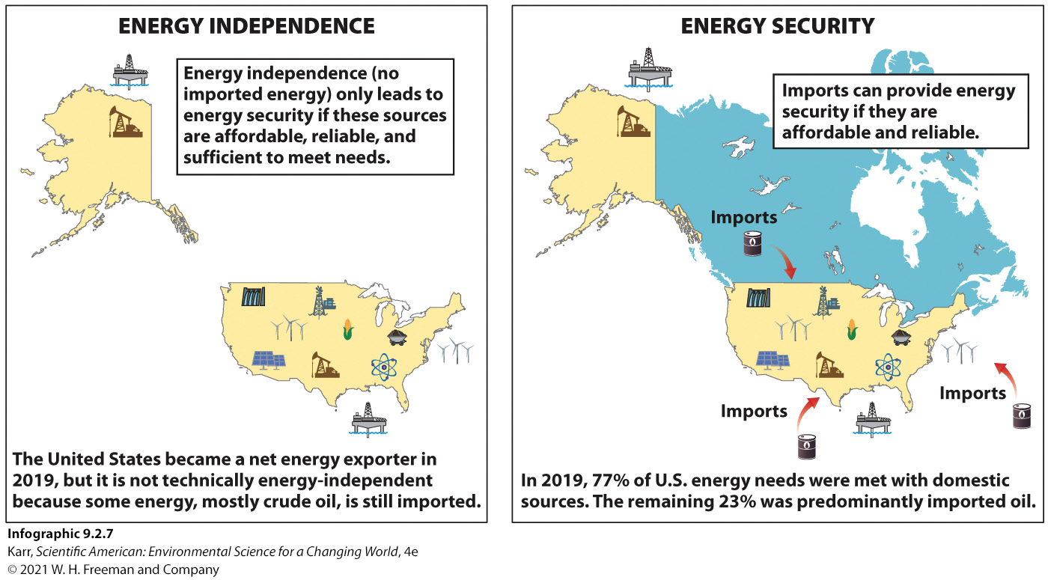
IG 7: Energy Independence and Security
Notes:
Ask your students how the United States could increase its chance of becoming energy independent if it cannot produce enough oil to meet its needs.

Slide 79
Summary
Conventional and unconventional oil reserves are finite and therefore cannot provide us with energy independence or energy security indefinitely.
Bakken and the other known reserves can provide us with approximately 2 years worth of oil.
The greatest gift of Bakken may be the time it buys us to develop other domestic energy sources.
“It will only do us good if we use this transitional period wisely,” says Pierrehumbert. “We’re in for a hard landing if we don’t use our current prosperity to pave the way for a secure energy and climate future.”
Notes:
Raymond Pierrehumbert is a professor and geophysicist at the University of Chicago.

Slide 80
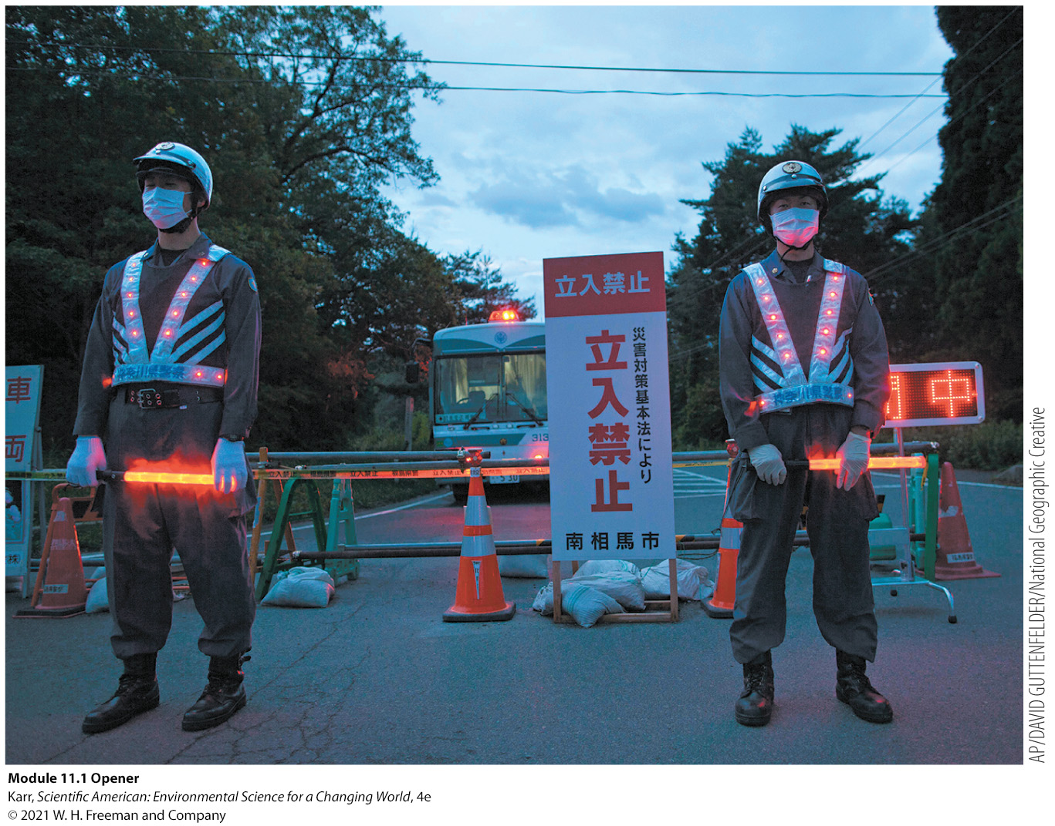
Module 11.1
Nuclear Power: The Future of Fukushima

Slide 81
Core Message
Harnessing nuclear energy to create electricity would help address concerns over fossil fuel supplies, air pollution, and climate change.
However, there are serious safety concerns with nuclear power, including vulnerability to natural disasters, radioactive waste disposal, and potential for weapons production.

Slide 82
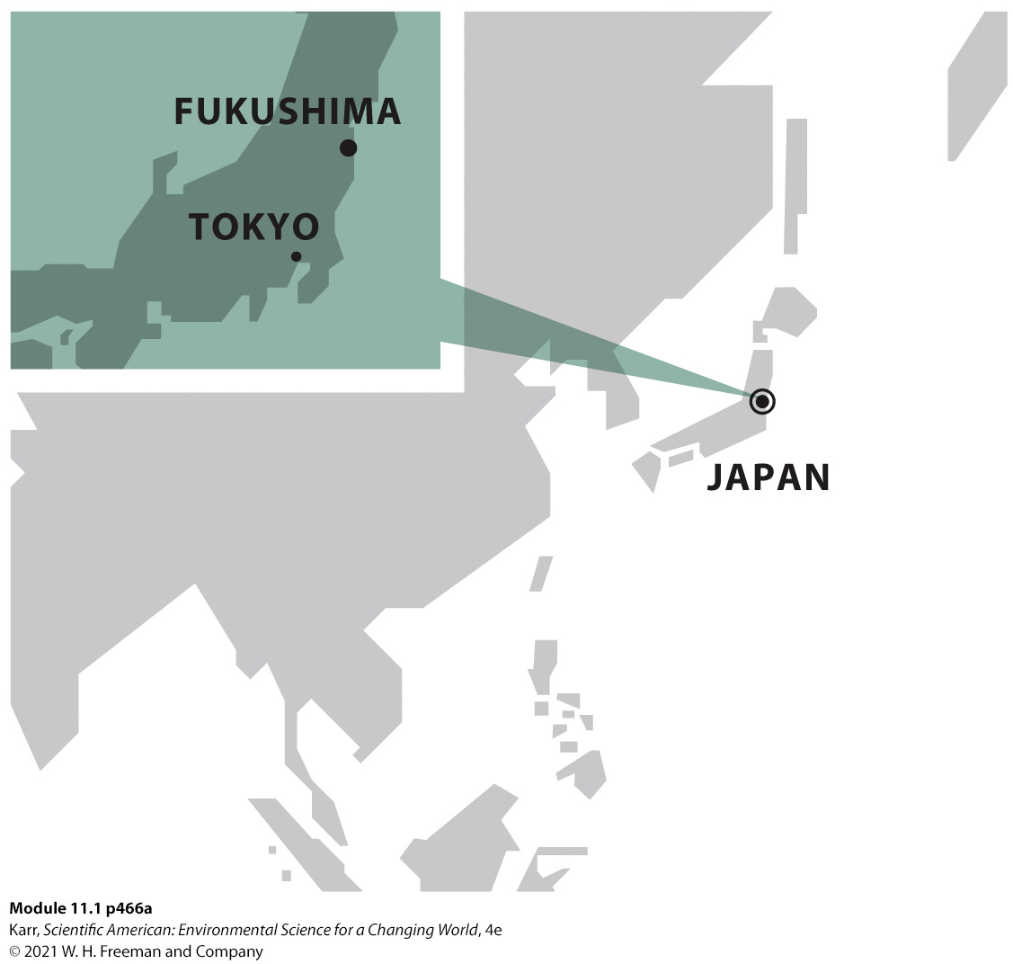
Case Study: Disaster at Fukushima
The Fukushima Daiichi Nuclear Power Station supplied some 4.7 GW (1 gigawatt = 1 billion watts) of electric power to the country, making it one of the largest nuclear power plants in the world.
On March 11, 2011, a magnitude 9.0 earthquake struck 130 kilometers (80 miles) north of the plant.
The quake triggered a tsunami that breached the protective wall around the facility and created the potential for a nuclear meltdown at Daiichi.
Notes:
These were the strongest earthquake and largest tsunami in the country’s long memory. Together, they would claim more than 16,500 lives along a 400-kilometer (250-mile) stretch of coast (roughly equal to the distance between Maine and Manhattan).
Go to https://www.youtube.com/watch?v=BdbitRlbLDc to view “Fukushima Nuclear Reactor Problem Explained (CNN).”

Slide 83
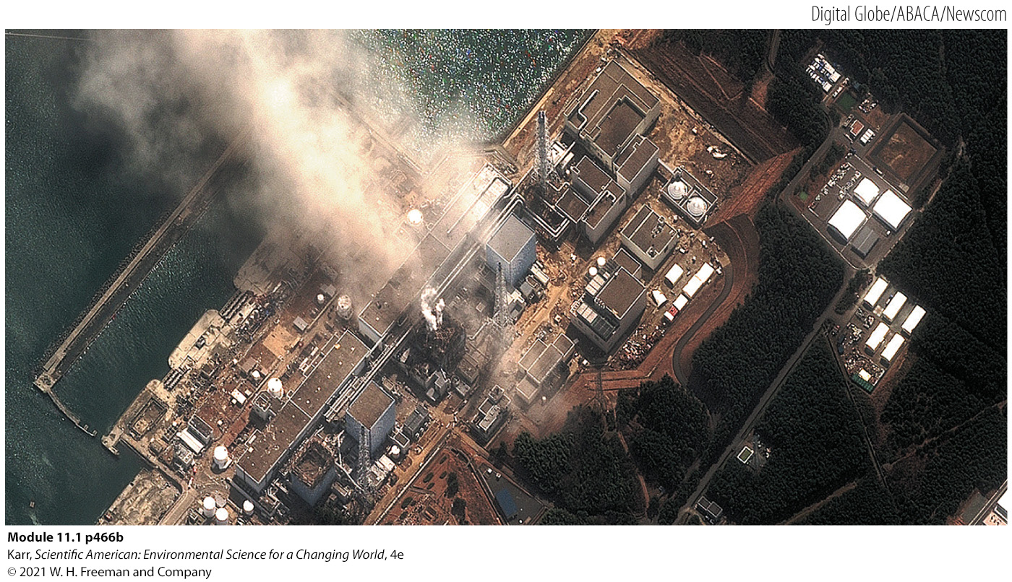
Satellite Image of the Damaged Fukushima Daiichi Nuclear Power Station

Slide 84
I. What Are Radioactive Isotopes, and Why Are They Important for Nuclear Power?
Key Concept 1: The energy contained in an atom (nuclear energy) can be harnessed to generate electricity. A radioactive isotope of uranium typically provides the fuel for nuclear power.

Slide 85
Nuclear-Powered Fuel: Radioactive Isotopes
Key Terms
Nuclear energy: energy released when an atom is split (fission) or combines with another to form a new atom (fusion)
  Uses heat generated from a controlled nuclear reaction to boil water and produce steam, which is then used to generate electricity

Slide 86
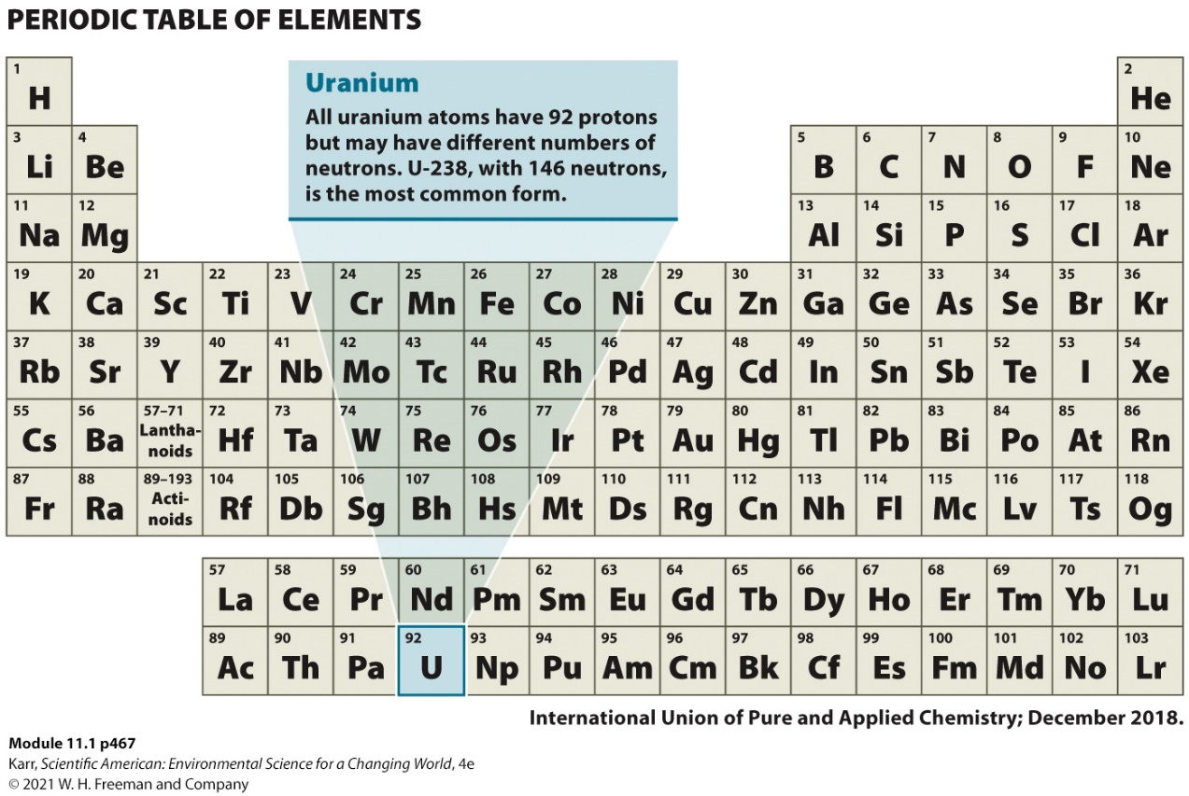
The Chemistry of Nuclear Power
Key Terms
Atom: the simplest form of matter that cannot be broken down by chemical means
  Contains a nucleus where protons and neutrons are found
  Electrons orbit around this nucleus
Element: a substance composed of all the same type of atoms
  Example: uranium
Notes:
The atom of any element is defined by the number of protons it possesses (known as its atomic number). For example, any atom that contains two protons is a helium atom; those that contain six are carbon atoms. Because electrons are so small compared to the subatomic particles in the nucleus, the atomic mass of an atom is simply the number of protons plus the number of neutrons (its mass number). While the number of protons in the atom of an element is unique (if the number of protons changes, the element changes), the number of neutrons can vary.

Slide 87
Isotopes
Key Terms
Isotopes: atoms that have different numbers of neutrons in their nucleus but the same number of protons
  Named based on mass
  Example: uranium-238 and uranium-235
  Most isotopes are stable.
Radioactive: atoms that spontaneously emit subatomic particles and/or energy
  Radiation is also emitted when atom is struck by subatomic particle, splitting the atom into one or more smaller atoms.
  These processes release heat.
Notes:
Nuclear power depends on the ability of the atoms to be split
Large amount of released heat is captured and used to generate electricity

Slide 88
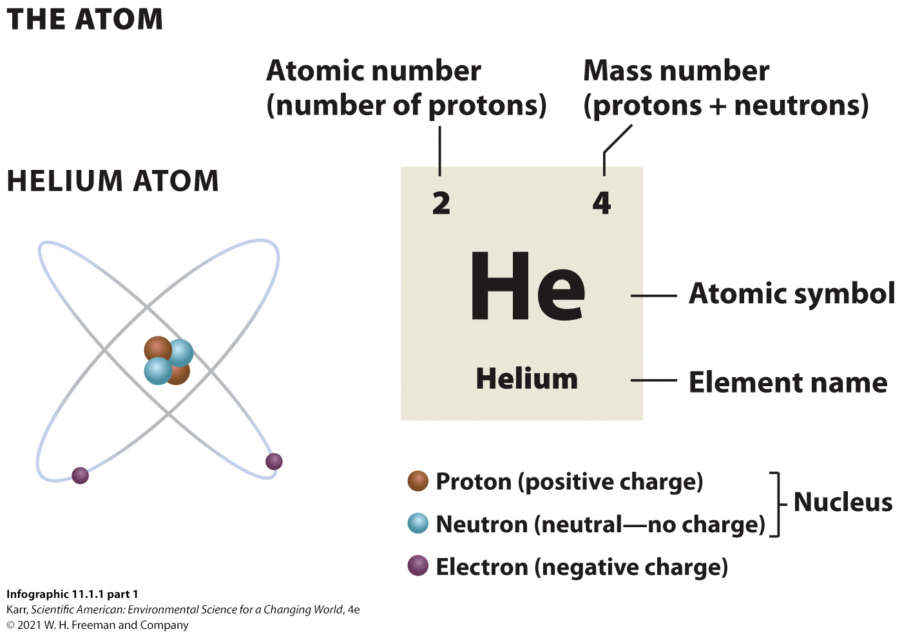
IG 1a: Atoms and Isotopes
Notes:
Uranium also exists as uranium-233. Ask your students how many protons and neutrons it has. Do they think it is more or less stable than U-235? Encourage them to explain their responses.

Slide 89
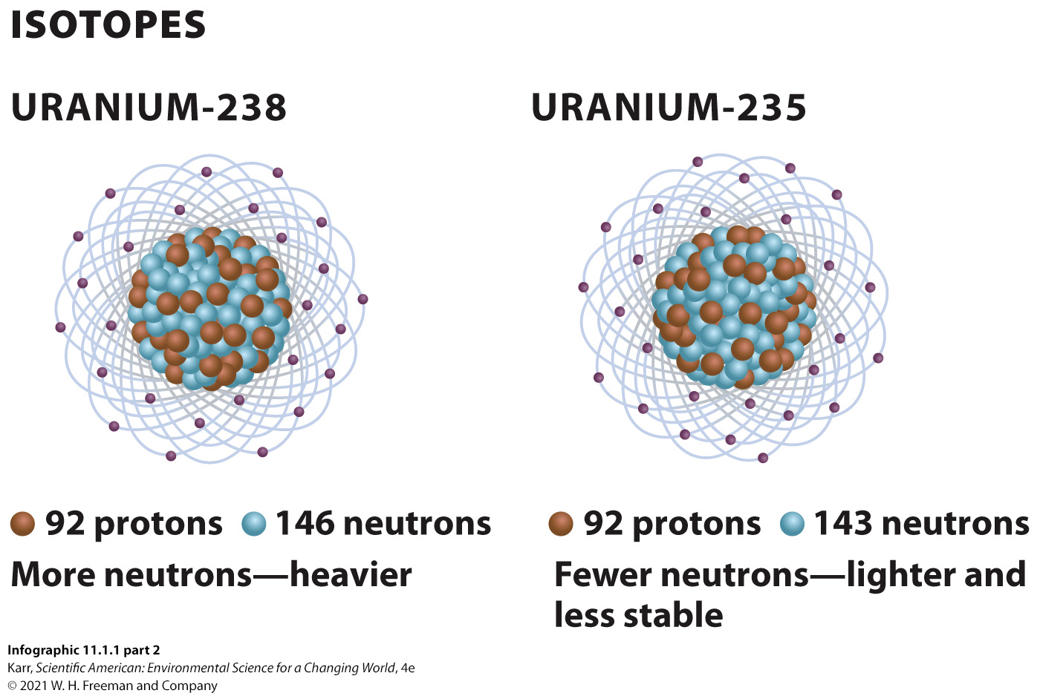
IG 1b: Atoms and Isotopes
Notes:
Uranium also exists as uranium-233. Ask your students how many protons and neutrons it has. Do they think it is more or less stable than U-235? Encourage them to explain their responses.

Slide 90
II. How Is Uranium Fuel for Nuclear Power Produced?
Key Concept 2: The production of nuclear fuel involves mining and several processing steps, all of which generate hazardous waste.

Slide 91
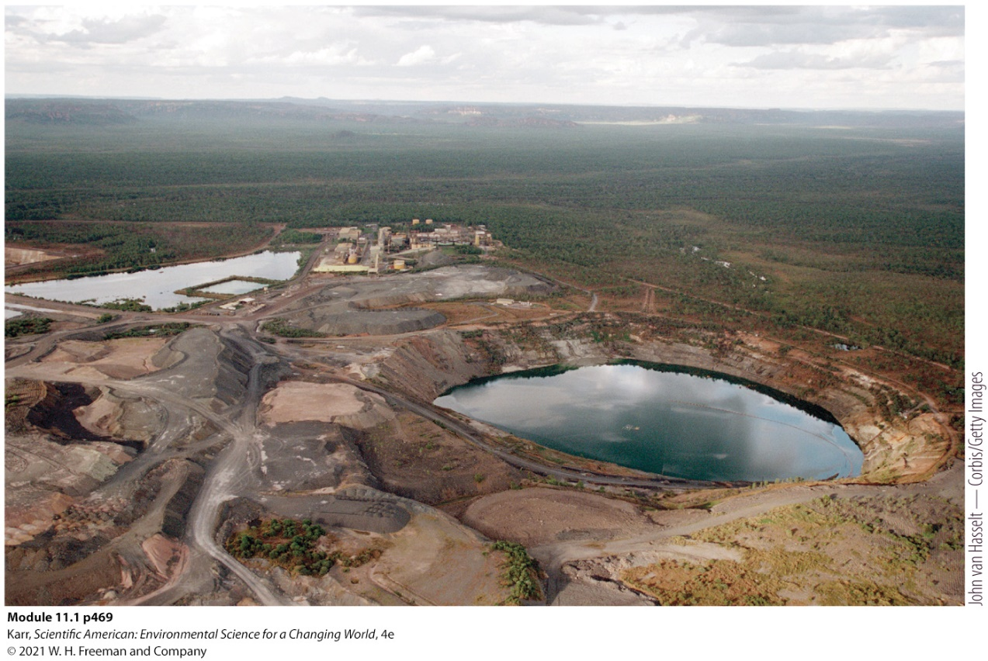
Mining Uranium for Nuclear Fuel
U-235 provides the “fuel” used in a typical fission reactor.
  The least common form of uranium
  Requires an extensive amount of mining to produce a useful fuel for the nuclear reactor
Uranium mine in Australia. This is an open-pit mill tailings site.
Notes:
The mining and processing of uranium raises concerns about health and environmental safety. The processing of uranium from the mining to the enrichment and production of fuel pellets creates hazardous waste that must be dealt with. Uranium mining itself is inherently dangerous due to the radioactive material; workers and residents who live near the mines suffer from higher than normal cancer rates.

Slide 92
Production of Nuclear Fuel
Key Terms
Fuel rods: hollow metal cylinders filled with uranium fuel pellets for use in fission reactors
    More than 100 of these fuel rods are loaded into a framework to form a fuel assembly.
    Several fuel assemblies are placed into a thick-walled vessel called the reactor core, where they remain in place for a year or two before being replaced.
Notes:
The uranium goes through several processing steps and then is made into pellets.
The mining and processing of uranium raises concerns about health and environmental safety. The processing of uranium from the mining to the enrichment and production of fuel pellets creates hazardous waste that must be dealt with. Uranium mining itself is inherently dangerous due to the radioactive material; workers and residents who live near the mines suffer from higher than normal cancer rates.

Slide 93
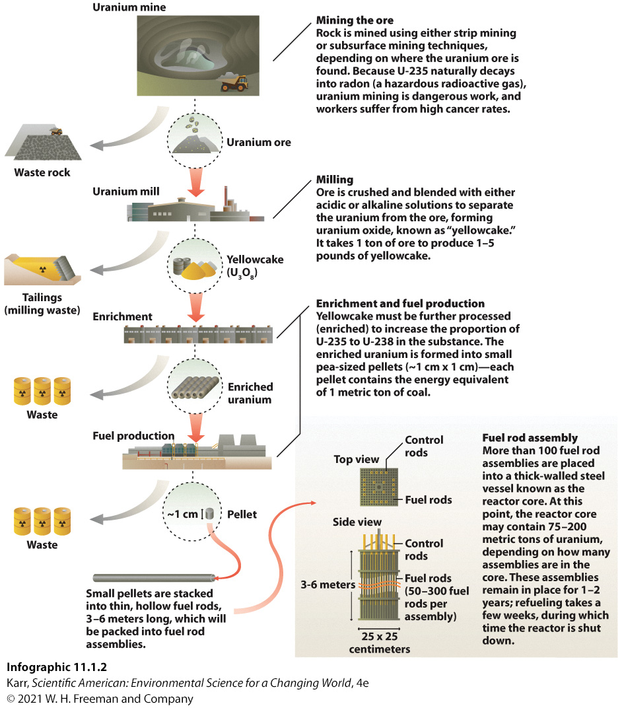
IG 2: Nuclear Fuel Production
Notes:
Ask your students which stages of nuclear fuel production have radioactive material present.

Slide 94
III. How Is Nuclear Energy Harnessed to Generate Electricity in a Fission Reactor?
Key Concept 3: In a nuclear fission reactor, U-235 is bombarded with neutrons to split the atoms; this releases more neutrons, which leads to a self-perpetuating chain reaction. Heat from this reaction is used to produce steam, which turns a turbine attached to a generator to generate electricity.

Slide 95
Generating Electricity with Nuclear Energy
Key Terms
Nuclear fission: a nuclear reaction that occurs when a neutron strikes the nucleus of an atom and breaks it into two or more parts
  Begins when fuel rods are bombarded with neutrons
  Split uranium atoms release more neutrons.
Control rod: cylinder that can be added to a fuel assembly to absorb neutrons and slow the fission chain reaction
  Chain reaction releases heat, which is used to boil water, which produces steam, which turns turbines attached to a generator that creates electricity.
Notes:
Nuclear fusion reactions, the combining of two atoms to form a new one, also generate heat. The Sun is a giant fusion reactor, forming helium through the joining of two hydrogen atoms. (Research and development is underway to try to make fusion reactors a viable option.)
A nuclear bomb contains a much higher percentage of “fissile material” that sets off a massive chain reaction that is almost instantaneous.
Control rods can be added (to slow down or stop the reaction) or removed (to make it go faster).

Slide 96
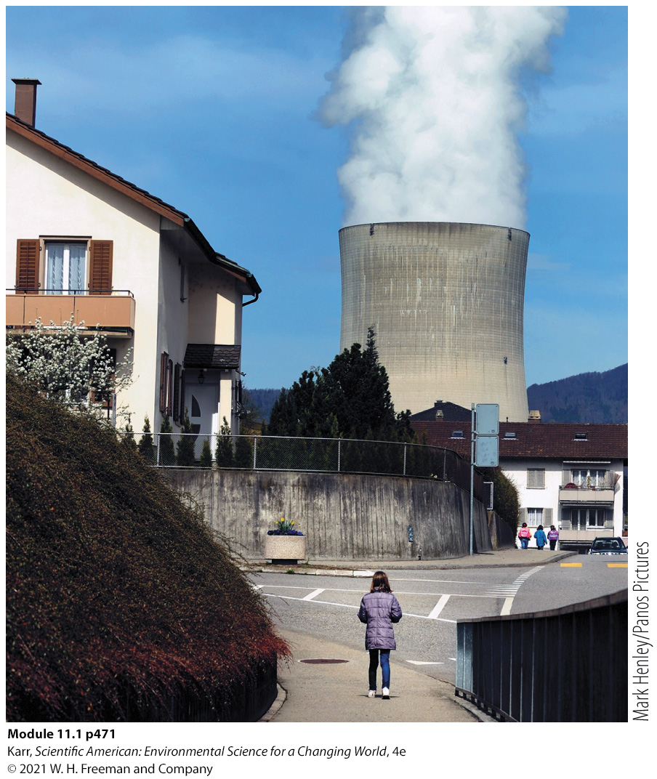
Types of Fission Reactors
Pressurized water reactor (PWR)
  Produces steam that is not exposed to radiation
  Most common type of reactor
Boiling water reactor (BWR)
  Produces steam in the reactor core itself
  Both steam and turbine become radioactive in the process.
  Fukushima was BWR.
Cooling tower of a nuclear plant in Switzerland
Notes:
Nuclear power requires more water than other types of power plants, roughly 25% more than a coal-fired power plant and 75% more than a natural gas plant.
Though most of the water (more than 95%) is returned to the source (river or ocean), releasing this warmer-than-normal water back into the environment (called thermal pollution) causes problems for species not adapted to the higher temperature.
The reason for all that water is simple: With nuclear energy, water is needed to produce steam and also to prevent the reactor from overheating. And even after the spent fuel rods are removed from the reactor, they still produce tremendous amounts of heat and need constant cooling.

Slide 97
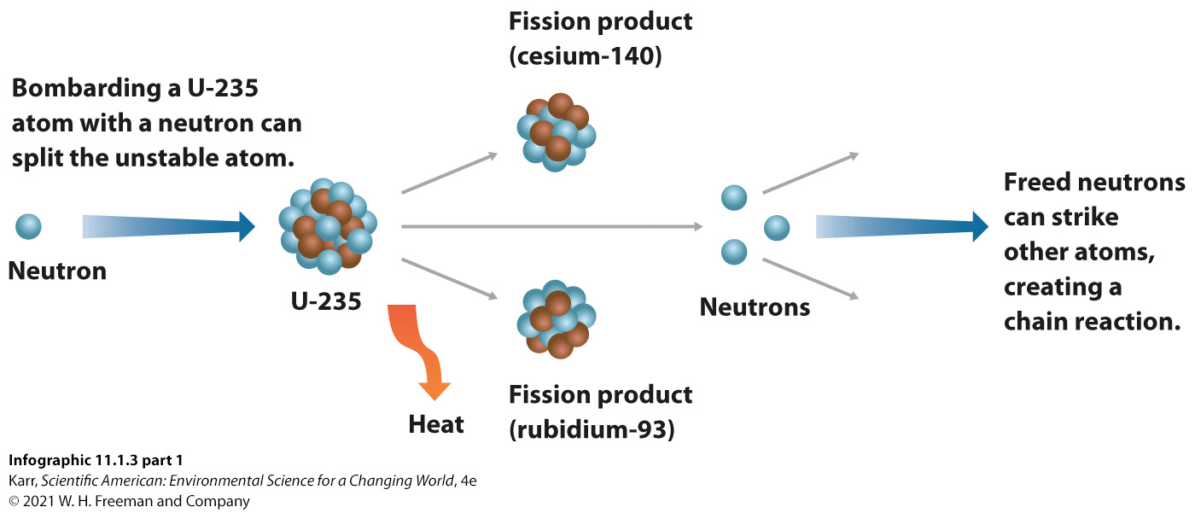
IG 3a: How It Works: Nuclear Reactors
Notes:
Ask your students how a nuclear reactor is similar to a coal-fired power plant. How are they different?

Slide 98
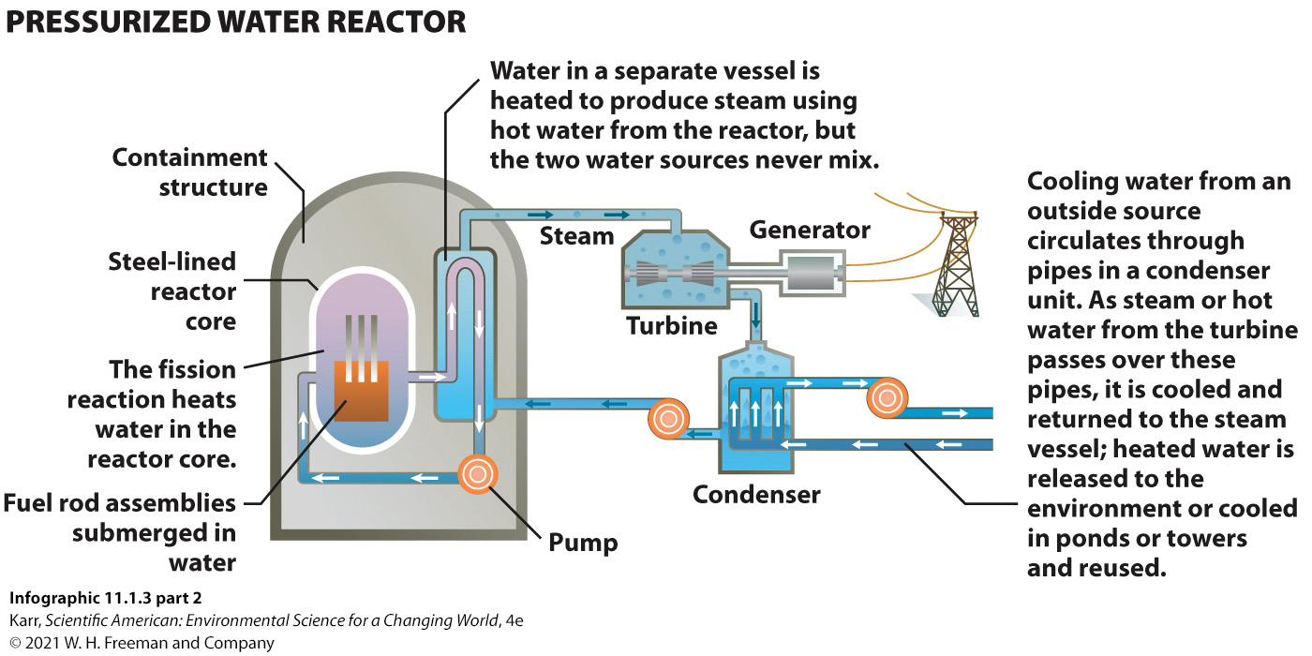
IG 3b: How It Works: Nuclear Reactors
Notes:
Ask your students how a nuclear reactor is similar to a coal-fired power plant. How are they different?

Slide 99
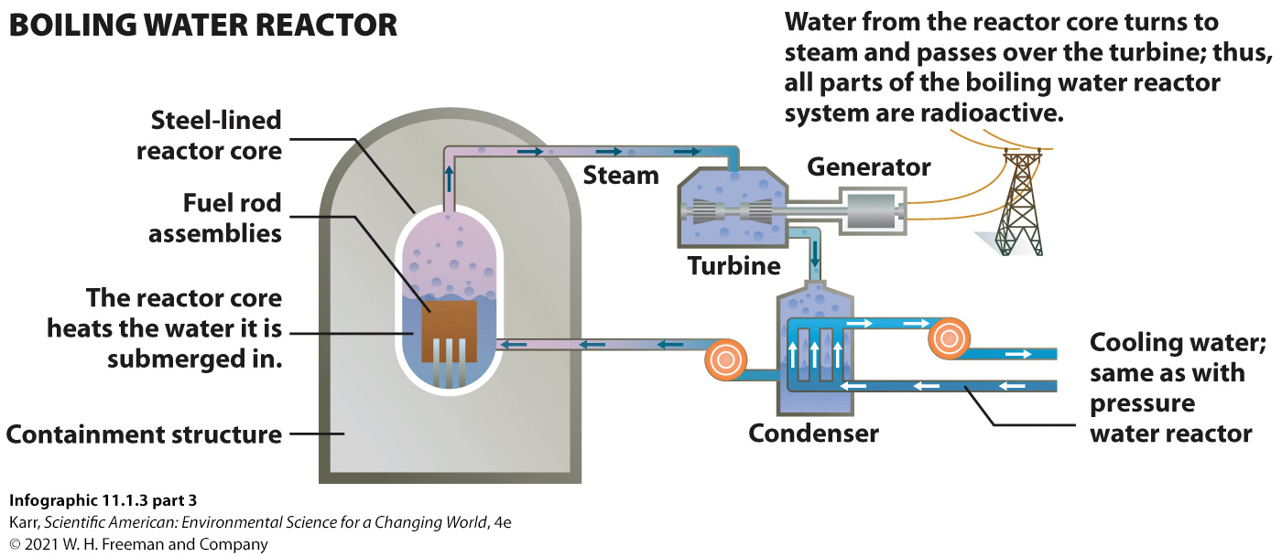
IG 3c: How It Works: Nuclear Reactors
Notes:
Ask your students how a nuclear reactor is similar to a coal-fired power plant. How are they different?

Slide 100
IV. What Types of Radiation Are Produced When Isotopes Decay?
Key Concept 4: Alpha, beta, and gamma radiation vary in their ability to penetrate substances; while all are dangerous, gamma radiation is the most hazardous to health.

Slide 101
Types of Radiation
Key Terms
Alpha radiation: ionizing particle radiation that consists of two protons and two neutrons
  Can’t penetrate skin
  If inhaled or ingested, can cause organ damage and cancer
Beta radiation: ionizing particle radiation that consists of electrons
  Can penetrate upper layers of skin but easily blocked by protective clothes
  If inhaled or ingested, can cause organ damage and cancer
Gamma radiation: ionizing high-energy electromagnetic waves (photons)
  Easily penetrates skin and difficult to block
  Greatest potential harm to human health
Notes:
On the day of the tsunami, each of the three operating reactors at the Fukushima plant held about 25,000 fuel rods. The reactors had gone through a successful emergency shutdown after the earthquake hit, but heat was still being generated by the radioactive decay of the fission products in the fuel rods.
Keeping the fuel cool was still vitally important. Unfortunately, the power outage had not only plunged the plant into darkness but also stopped the normal delivery of water to those reactors. (Backup generators were unfortunately located in the basement, which was flooded by the tsunami and rendered inoperable.)
As Fukushima’s reactor cores lost water (the heat of the fuel assemblies boiled off the water, and disabled pumps could add no new cooling water), there was a risk of a hydrogen explosion—temperatures would climb so high that the metal cladding of the fuel rods would melt, react with water, and release explosive hydrogen gas. A steam explosion was also a risk—the build-up of tremendous pressure from the rapid production of steam could blow the top off the building.
Eventually, fire trucks made their way through and, using hoses designed for jet-fuel fires, emergency responders were able to get some water to the places where it was most needed. However, it was not enough. As the heat climbed due to lack of cooling, a steam or hydrogen explosion seemed inevitable. Radiation from damaged reactor number 2 reached the control room.
The building housing reactor number 1 exploded, sending concrete and steel debris flying. Radiation levels around the plant climbed exponentially, deterring efforts to vent the other two reactors. In the days that followed, both exploded.
Ionizing radiation: radiation that causes an atom to lose electrons and become ionized or charged

Slide 102
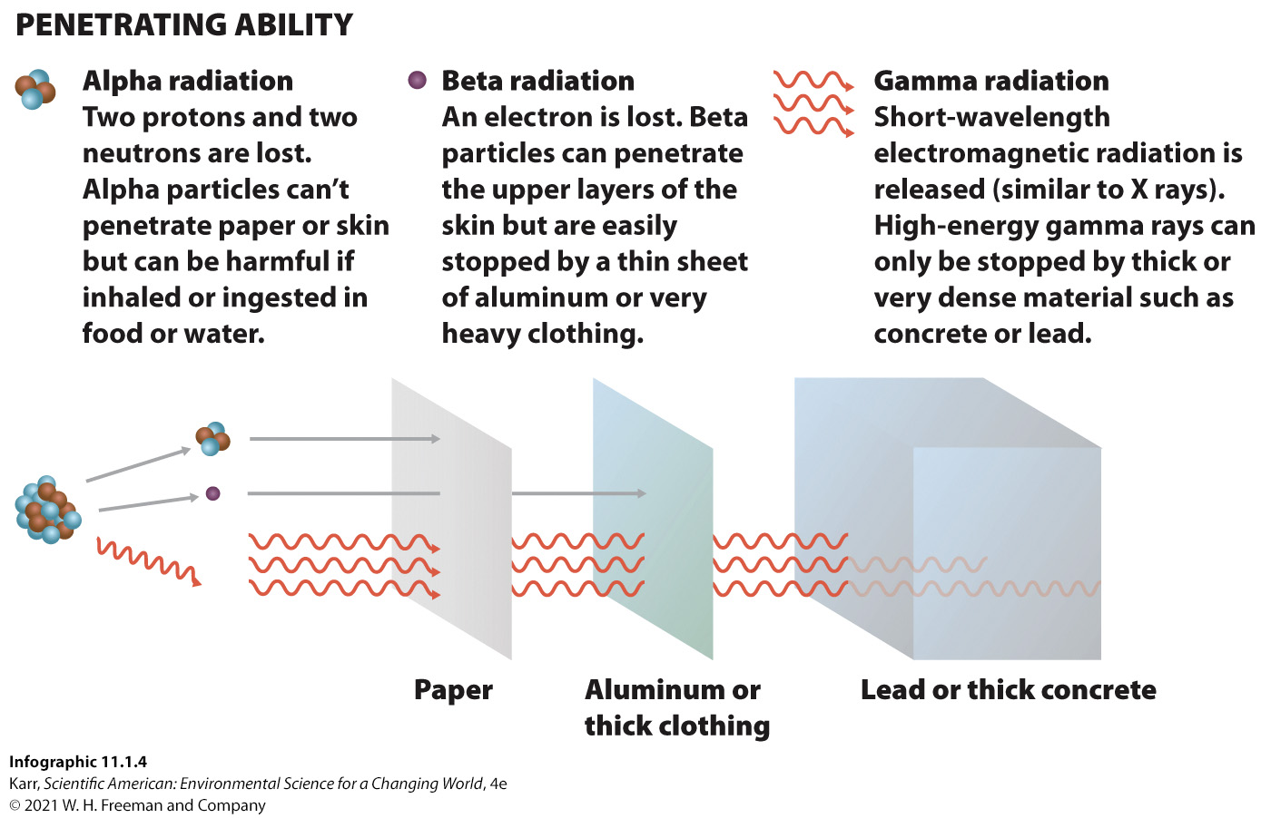
IG 4: Ionizing Radiation
Notes:
Ask your students why the people of Fukushima Prefecture were concerned about the alpha radiation released with the reactor meltdown (after all, it cannot even penetrate paper!).

Slide 103
V. How Is the Rate of Decay of a Radioactive Atom Measured?
Key Concept 5: Radioactive decay is measured in terms of a half-life and can vary in duration from milliseconds to billions of years for different isotopes.

Slide 104
Radioactive Decay
Key Terms
Radioactive decay: the spontaneous loss of particle or gamma radiation from an unstable nucleus
  The hazard presented by radioactive isotopes depends on the type of radiation released.
  Gamma radiation is most concerning.
Radioactive half-life: the time it takes for half of the radioactive isotopes in a sample to decay to a new form
  Some isotopes generated in the nuclear fission reaction have a very short half-life; others are more stable with half-lives in the hundreds or thousands of years.
Notes:
The half-life of radioactive iodine (I-131) is 8 days; cesium and strontium (Cs-137 and Sr-90) have half-lives of about 30 years.
A general rule of thumb is that after 10 half-lives, enough radioactive material will have decayed to render the material safe. For I-131, that is 80 days; for Cs-137 and Sr-90, that is 300 years. But for isotopes with half-lives in the hundreds or thousands of years, we are looking at thousands or tens of thousands of years before the material could be considered safe.

Slide 105
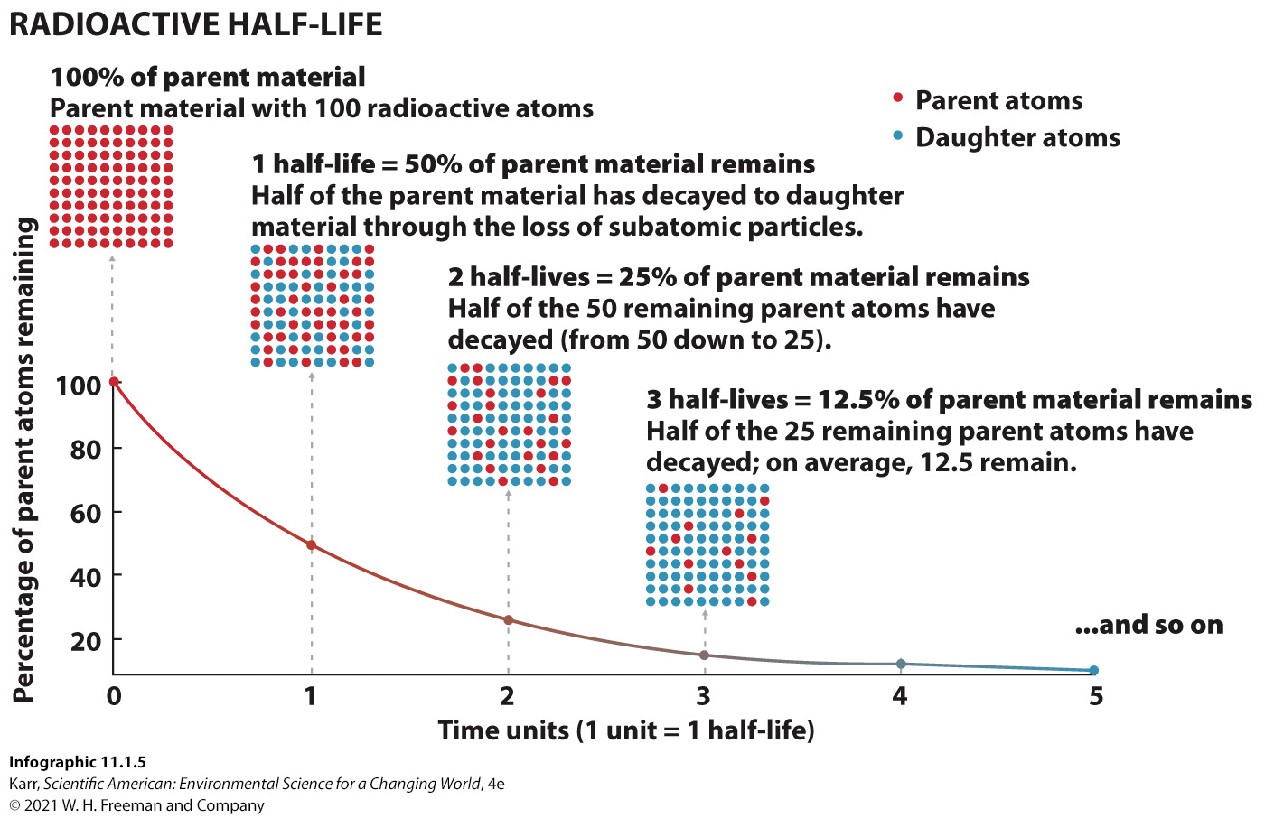
IG 5: Radioactive Decay
Notes:
Ask your students what percentage of the parent material will be left after 5 half-lives.

Slide 106
VI. What Problems Are Associated with Nuclear Waste?
Key Concept 6: Radioactive waste is considerably more radioactive than the original fuel. We currently have no long-term storage plan for high-level radioactive waste.

Slide 107
Nuclear Waste
Key Terms
Low-level radioactive waste (LLRW): material that has a low level of radiation for its volume
  Can usually be safely buried
  Most LLRW isotopes decay to background levels in 100 years.
Notes:
At Fukushima, the reactors weren’t the only problem. Experts around the world were also concerned about all the radioactive waste stored onsite at Fukushima.
The United States produces about 60,000 cubic meters (2 million cubic feet, a volume equivalent to 15 million gallons) of LLRW per year, all of which is stored at just four sites—in South Carolina, Texas, Utah, and Washington.
The United States produces about 2,000 metric tons of HLRW per year and has some 65,000 metric tons of the stuff in interim storage right now; this estimate includes both spent fuel rods and waste from the nuclear weapon production.

Slide 108
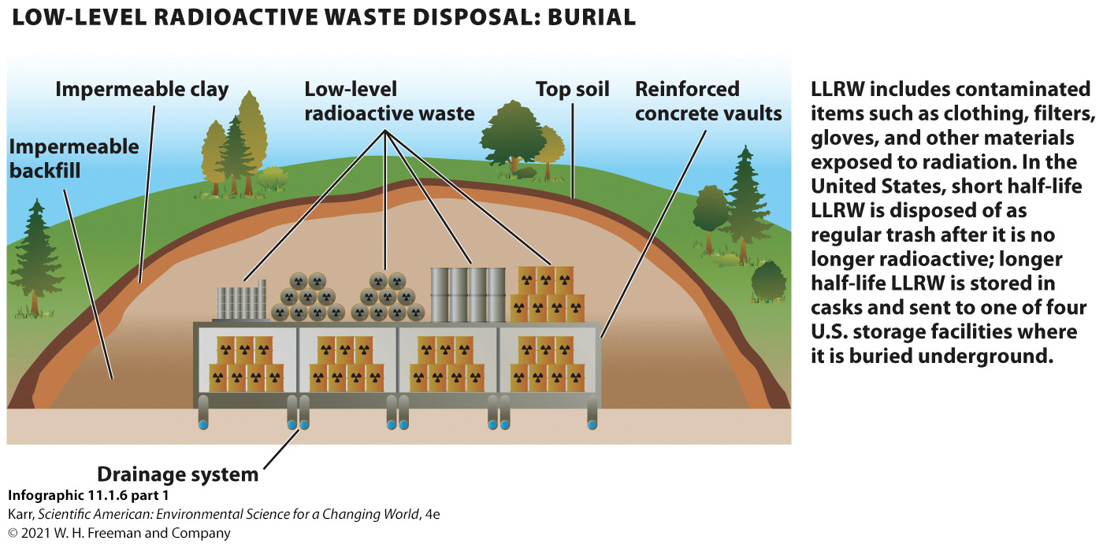
IG 6a: Radioactive Waste
Notes:
Ask your students if they think we should continue to use nuclear power, or increase its usage, if we do not have a plan for long-term storage of HRLW.

Slide 109
Nuclear Waste: HLRW
Key Terms
High-level radioactive waste (HLRW): spent nuclear reactor fuel or waste from the production of nuclear weapons that is still highly radioactive
  An estimated 1 million times more radioactive than the original fuel rods
  Generates tremendous heat, making storage in containers inherently dangerous
Notes:
At Fukushima, the reactors weren’t the only problem. Experts around the world were also concerned about all the radioactive waste stored onsite at Fukushima.
The United States produces about 60,000 cubic meters (2 million cubic feet, a volume equivalent to 15 million gallons) of LLRW per year, all of which is stored at just four sites—in South Carolina, Texas, Utah, and Washington.
The United States produces about 2,000 metric tons of HLRW per year and has some 65,000 metric tons of the stuff in interim storage right now; this estimate includes both spent fuel rods and waste from nuclear weapon production.

Slide 110
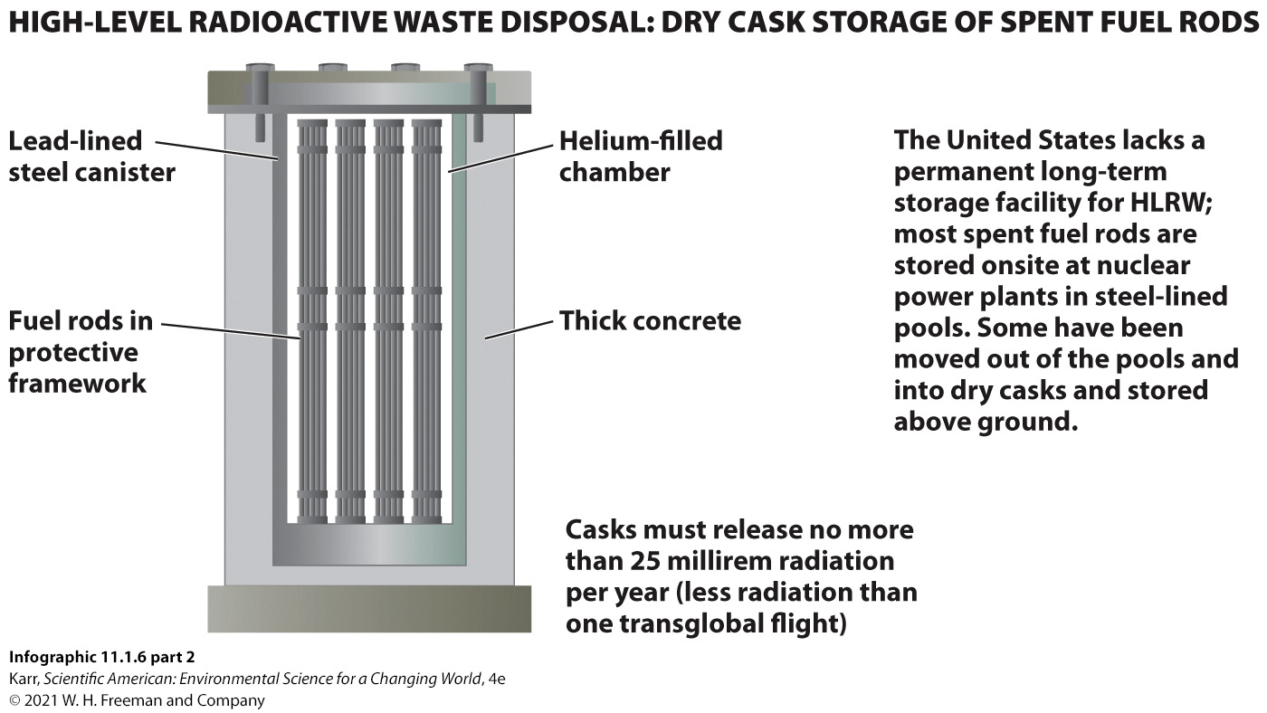
IG 6b: Radioactive Waste
Notes:
Ask your students if they think we should continue to use nuclear power, or increase its usage, if we do not have a plan for long-term storage of HRLW.

Slide 111
U.S. Nuclear Waste Policy Act
Key Terms
U.S. Nuclear Waste Policy Act (1982): the federal law that mandated that the federal government build and operate a long-term repository for the disposal of high-level radioactive waste
  Enacted 25 years after the first U.S. nuclear power plant started operation
  Assigns responsibly for nuclear waste disposal to the federal Department of Energy
  Identified deep underground storage as the best way to dispose of HLRW
  Established guidelines for research and development into permanent repositories
Notes:
The radioactive waste produced by nuclear power plants is extremely dangerous. There is a lot of it, and we do not yet have a plan for disposing of it safely.
The United States selected Yucca Mountain in Nevada as a site for a long-term repository and began construction in 1994, but the project has been repeatedly stymied by opponents. After 15 years and billions of dollars, President Barack Obama halted construction in 2010, a move that fueled even more bickering.
In Fukushima, another problem centers around disposing of the water that has been constantly added to the steel-lined pool where the assemblies were kept or that has been sprayed on the melted reactor cores.
This radioactive water is collected, and radioactive isotopes are removed with the exception of tritium (radioactive hydrogen). There is no way to remove tritium, so the tritiated water is stored. So far, more than 1 quadrillion liters (264 trillion gallons) of contaminated water is currently stored in huge aboveground containers, with more containers added every day or so. Unfortunately, some of the water escapes collection and flows into the ocean—one estimate puts it at 9,000 liters (2,400 gallons) per day. And with this water go radioactive cesium and strontium, levels of which are still detectable off the coast of Japan, indicating continued release, according to research by Woods Hole Oceanographic Institute scientist Ken Buesseler. No one knows what the impact of that constant release will be—we are in uncharted waters. To compound matters, in July 2017, Tokyo Electric announced it would dump the stored tritiated water into the ocean, generating outcries from local fishermen and residents.

Slide 112
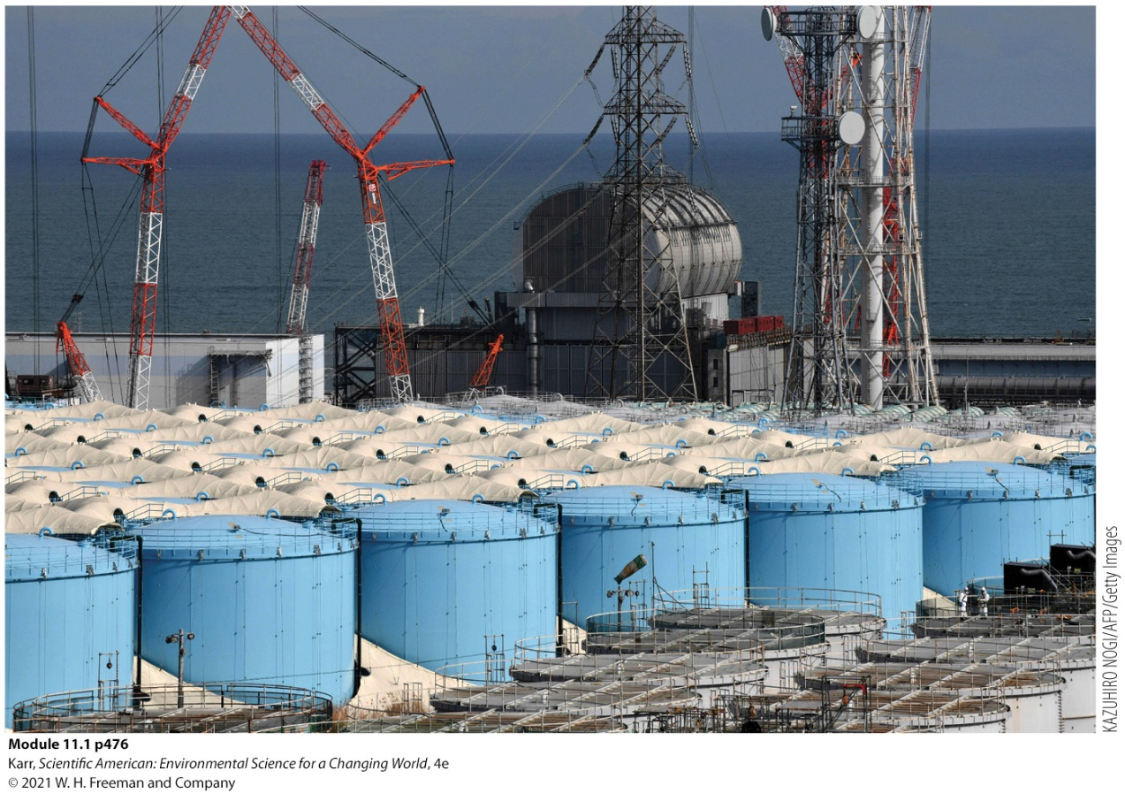
At Fukushima
To keep assemblies cool, have used lots of water. It is now radioactive.
Some radiation is removed, but they cannot remove tritium.
They are running out of storage space. Should they release water back into the ocean?
Storage tanks for radioactive water at Fukushima

Slide 113
VII. What Is the History of Nuclear Accidents Worldwide?
Key Concept 7: There have been around 100 nuclear accidents in the history of the industry; most were minor but several caused deaths, and two were severe: Chernobyl and Fukushima.

Slide 114
Nuclear Industry Accidents
Worldwide, there are more than 450 nuclear power plants, accounting for about 10% of global electricity production.
Two infamous nuclear accidents (before Fukushima):
  Three Mile Island (1979)
    Electrical failure was followed by a flurry of operator errors
    Resulted in only minor release of radiation
    Did not cause any public health problems but destroyed the reactor
  Chernobyl (1986):
    Caused by human error during an experiment
    Chain reaction escalated out of control, resulting in a full nuclear meltdown, which caused a steam explosion
    WHO estimates that the radiation will ultimately be responsible for some 4,000 deaths
Notes:
The Three Mile Island plant is near Middletown, Pennsylvania.
Chernobyl is in the Ukraine.

Slide 115

IG 7a: Nuclear Accidents
Notes:
International Nuclear and Radiological Event Scale:
Created after Three Mile Island and Chernobyl
Ranks the seriousness of an event so that officials can accurately inform the public and regulatory bodies
Ranks events from 1 to 7; each higher level of the scale represents a 10-fold increase in severity
For “accidents” (levels 4–7), severity determined by the amount of radiation released
For “incidents” (levels 1–3), severity determined by the degree of failure of safety protocols
Ask your students to identify which of the accidents described above had a component of human error. What does this suggest about the safety of nuclear power?

Slide 116
IG 7b: Nuclear Accidents
 |  |  | NOTABLE NUCLEAR EVENTS
YEAR | PLACE | EVENT LEVEL | DESCRIPTION
1952 | Chalk River (Canada) | 5 | First reactor accident; malfunction and human error led to partial meltdown and steam explosion that released radiation.
1961 | Idaho National Laboratory (U.S.) | Not determined | Failed attempt to safely restart an experimental reactor (possibly due to incorrectly inserted control rods) resulted in an uncontrolled chain reaction and explosion that killed three workers.
1979 | Three Mile Island (U.S.) | 5 | Cooling malfunction and subsequent human error led to partial meltdown; release of radioactive water and gas occurred but was contained to the immediate area.
1986 | Chernobyl (Ukraine) | 7 | Human error during an experiment led to a steam explosion and massive release of radiation; caused 30 deaths within a week and was, or ultimately will be, responsible for thousands of illnesses and deaths.
1987 | Goiania (Brazil) | 5 | A radiotherapy device, stolen from an abandoned clinic where it was mistakenly left behind, was sold as scrap metal; many curious people came in contact with the colorful material inside (radioactive cesium). More than 200 were exposed to radiation, which resulted in four deaths and 20 hospitalizations.
1999 | Tokaimura (Japan) | 4 | Worker error in the handling of radioactive material caused two deaths and resulted in local evacuations.
2011 | Fukushima (Japan) | 7 | Earthquake and tsunami caused total meltdown and steam explosions that released large amounts of radiation.
2014 | New Mexico (U.S.) | Not determined | Waste container exploded in underground bunker, releasing radiation into the atmosphere; the accident was attributed to using the wrong type of kitty litter (an absorbent material used to clean and contain chemical spills). Clean-up estimates run around $2 billion.
Infographic 11.1.7 part 2
Karr, Scientific American: Environmental Science for a Changing World, 4e
© 2021 W. H. Freeman and Company

Slide 117
VIII. What Are the Advantages and Disadvantages of Nuclear Power?
Key Concept 8: The advantages (low air pollution, ample supplies) and disadvantages (radioactive hazards) of nuclear power must be weighed to determine its future role in electricity production.

Slide 118

The Pros of Nuclear Power
Uranium ore is more abundant and produces a more energy-rich fuel than fossil fuels are and do.
No CO₂ and very little by-product is released during the production of electricity.
Checking a child for radiation before entering an evacuee shelter
Notes:
A 2011 study by Annette Queisser-Luft found that the risk of birth defects did not increase the closer one lived to a nuclear facility. Meanwhile, Javier García-Pérez found that in Spain, the number of cancer-related deaths increases as proximity to coal-fired power plants increases. “You still have some environmental hazards, from mining uranium and from radioactive waste and water,” says Powers. “But on balance, nuclear is far cleaner than any fossil fuel.”
Decommissioning a nuclear power plant could cost close to $1 trillion.

Slide 119
The Cons of Nuclear Power
The cost of building, maintaining, and then decommissioning nuclear plants is very expensive.
  Decommissioning could cost $1 trillion.
Debates over safety remain unresolved:
  Nuclear power plants are vulnerable to natural disasters.
  There is potential for nuclear fuel to be stolen and weaponized.
  Radioactive waste must be dealt with.
Notes:
A 2011 study by Annette Queisser-Luft found that the risk of birth defects did not increase the closer one lived to a nuclear facility. Meanwhile, Javier García-Pérez found that in Spain, the number of cancer-related deaths increases as proximity to coal-fired power plants increases. “You still have some environmental hazards, from mining uranium and from radioactive waste and water,” says Powers. “But on balance, nuclear is far cleaner than any fossil fuel.”
Decommissioning a nuclear power plant could cost close to $1 trillion.

Slide 120
IG 8: Nuclear Power: Trade-offs
ADVANTAGES | DISADVANTAGES
 | COSTS
• Operating costs are comparable to those of a fossil fuel power plant. • The technology is available now. | • Nuclear power plants are much more expensive to build ($20 billion to build a fission reactor) and maintain than fossil fuel power plants, and even more expensive to decommission ($200 million to $1 trillion).
 | ELECTRICITY PRODUCTION
• Power production can be increased or decreased to meet demand. | • Though power production can be altered to meet demand, it cannot be done as quickly as it can be done with a fossil fuel facility. • Large amounts of water are needed in the process for cooling.
 | SUPPLIES
• Uranium supplies are good, and other isotopes can also be used. • Nuclear fuels are energy rich: One small uranium pellet contains the same amount of energy as 1 metric ton of coal. | • Mining and processing ore for nuclear fuel produce hazardous waste and can pollute air and water. • Some methods of nuclear power production produce radioisotopes that could be used in nuclear weapons production.
 | POLLUTION AND SAFETY
• Much less pollution is released during operation at a nuclear power plant compared to a fossil fuel facility. During operation, no particulates, no sulfur or nitrogen pollution, and no CO₂ are released. | • Radioactive waste is very hazardous, and we still have no long-term plan for dealing with HLRW. • Shipping fuel or waste (by truck or rail) is also a safety concern and vehemently opposed by those who live on the transport route. • Though serious accidents are rare, they can have devastating consequences and long-term impacts when they occur.
Infographic 11.1.8
Karr, Scientific American: Environmental Science for a Changing World, 4e
© 2021 W. H. Freeman and Company
Notes:
Ask your students which advantage of nuclear power they consider to be its strongest. Which of its disadvantages is its biggest
detractor? Encourage them to explain their responses.

Slide 121
Summary
The March 2011 tsunami would become the most expensive natural disaster in human history, with loss estimates far exceeding $1 trillion.
In its wake, countries around the world began rethinking their plans to expand their own nuclear energy programs.
Since global electricity use is projected to double by 2030, nuclear power will continue to be an alternative energy source.
But in making choices about how to pursue our energy future, we must consider the costs and benefits of all our energy options.
A cost analysis must consider not just the monetary cost of getting kilowatts delivered to our homes but also the environmental and social costs associated with every step of the energy source’s life.
A risk assessment is also necessary and must address two very crucial questions: How risky is the venture? How much risk are we willing to take?
Notes:
Germany resolved to move up the date for its planned phase-out of all nuclear power plants by 10 years, to 2022. In the United States and other countries safety procedures and infrastructure were examined and new protocols put in place based on lessons learned at Fukushima.

Slide 122
Module 11.2
Sustainable Energy: Stationary Sources

Slide 123

Core Message
Sustainable societies = reliable, renewable energy sources with acceptable environmental and social impacts
No single source can replace fossil fuels.
A variety of methods are required.
  Meet the needs of the population
  Are available
Solar panels on the roof of Shedd Aquarium in Chicago
Notes:
Since no single energy source can replace fossil fuels, a variety of methods, selected to meet the needs of the population and availability of local energy sources, will help communities shift to sustainable energy use.

Slide 124

Case Study: Chicago Commits to a 100% Clean Energy Future
Chicago became the largest city to commit to powering public buildings with renewable energy by 2025.
Power all buildings with renewables by 2035.
Power buses with electricity by 2040.
Many cities and communities around the world are making similar commitments.
Notes:
Go to https://www.youtube.com/watch?v=4UE5Pl4p2nY to view “The Danish Island of Samsø: A Model of Energy Self-Sufficiency” by Journal Reporter.

Slide 125
I. What Are the Characteristics of a Sustainable Energy Source, and What Types Are Commonly Used?
Key Concept 1: Sustainable energy sources are those that meet our needs and are readily replenished while producing impacts we, and ecosystems, can live with long term.

Slide 126
Characteristics of Sustainable Energy Sources
Key Terms
Renewable energy: energy that comes from an infinitely available or easily replenished source
Sustainable energy: energy from renewable sources that are used no more quickly than replenished and whose use has an acceptable environmental impact.
  Many forms, including biomass, solar, water
Biomass energy: energy from biological material such as plants (wood, charcoal, crops) and animal waste
Notes:
Because energy cannot be recycled or reused, living organisms need to depend on an energy source that is readily replenished.
To be sustainable, an energy source must be used at a rate equal to or less than its replacement rate.

Slide 127

IG 1: Sustainable Energy Sources
Notes:
Ask your students which of these renewable energy options are direct and which are indirect forms of solar energy.

Slide 128
II. What Are the Current and Projected Roles of Renewables in Global Energy Production?
Key Concept 2: Fossil fuels are the leading fuel for electricity production. The use of renewables is rising, but so is the use of fossil fuels, due to a rise in energy demand.

Slide 129
Current and Projected Use of Sustainable Energy Sources
As of 2019, fossil fuels accounted for 63% of utility-scale electricity production.
The use of renewables is slowly climbing, but so is the demand for energy.
Renewables in 2019 accounted for 17.5%, an increase since 1990.
Predict that renewable energy will double by 2050.
However, the need for electricity is expected to increase over the same time frame, resulting in very little change in fossil fuel usage.
Notes:
Nuclear energy provides the remainder of electricity demands.

Slide 130

IG 2a: Renewable Energy Use (1 of 2)
Notes:
Ask your students which renewable energy sources are expected to increase the most in the next few decades and which will see little change. What might account for these trends?

Slide 131

IG 2b: Renewable Energy Use (2 of 2)
Notes:
Ask your students which renewable energy sources are expected to increase the most in the next few decades and which will see little change. What might account for these trends?

Slide 132
III. How Can Wind Energy Be Captured to Generate Electricity, and What Are the Pros and Cons of These Methods?
Key Concept 3: Wind power is a cost-effective way to generate electricity. It has a low environmental impact but is an intermittent energy source. In addition, turbines are dangerous to wildlife, and some consider them eyesores.

Slide 133

Wind Power
Key Terms
Wind power: energy contained in the motion of air across Earth’s surface
  Wind farms: areas containing dozens of turbines
Wind turbine technicians are one of the fastest growing energy jobs in the U.S.
Wind farm in southern California
Notes:
Chicago is called “the Windy City” but doesn’t generate any wind power, although Illinois does.
Wind power is an indirect form of solar energy; it results from the difference in temperature between different regions of Earth, such as the poles and the equator, causing air to move from cooler regions to warmer regions.
Wind power in Texas produces 20,000 megawatts (MW) per year, enough to power 5 million homes.
The threat to wildlife can be reduced by carefully locating wind turbines (out of migratory paths).

Slide 134

IG 3a: How It Works: Wind Turbines
Notes:
Some people feel that windmills and wind farms are eyesores, but one must also consider the alternatives. Ask your students if they would rather live near a wind farm or a mountaintop removal coal mine. Encourage them to explain their responses.

Slide 135
IG 3b: Advantages and Disadvantages of Wind Power
Advantages | Disadvantages
• Abundant in some areas. • Pollution-free. • Low environmental impact and carbon footprint. • Effective at large and small scales. • Lowest-cost renewable energy source. • Creates jobs. | • Wind is unpredictable and intermittent. • Not all areas are windy enough to support it. • Wildlife (birds and bats) are killed by windmills.* • Considered an eyesore by some. • Usually must be paired with other energy sources to meet needs.
Infographic 11.2.3 part 2
Karr, Scientific American: Environmental Science for a Changing World, 4e
© 2021 W. H. Freeman and Company
*An estimated 140,000 to 500,000 bird deaths occur per year due to turbine collisions, which is substantial, but significantly less than deaths caused by outdoor cats and building collisions.
https://www.audubon.org/news/wind-power-and-birds
Notes:
Each onshore turbine cost the Samsø islanders the U.S. dollar equivalent of $1 million; offshore turbines cost up at $5 million each.
More than 1 million birds and bats are killed by wind turbines annually in the United States. While that is a large number, it is far less than the number of birds killed by flying into communication towers (40 million) or those killed by domestic cats (hundreds of millions). To decrease the risk from windmills, engineers now avoid placing them in known migratory flight paths or close to areas frequented by birds of prey such as eagles.

Slide 136
IV. How Can Solar Energy Be Captured and Used, and What Are the Pros and Cons of These Methods?
Key Concept 4: Solar energy can be harnessed in many ways. It is pollution-free but is expensive and is less productive at higher latitudes, on cloudy days, and at night.

Slide 137
Solar Power
Key Terms
Solar power: energy harnessed from the Sun in the form of heat or light
  Can be used in two ways:
    Active technologies
    Passive technologies
  Advantages:
    Simple, safe, and clean
    No noise or moving parts
    The most popular form of renewable energy

Slide 138
Active Solar Technologies
Key Terms
Active solar technology: mechanical equipment for capturing, converting, and sometimes concentrating solar energy into a more usable form
Photovoltaic (PV) cell: a technology that converts solar energy directly into electricity
    Also called solar panels
Solar thermal systems:
  Large-scale production
  Technologies vary in the way the solar energy is captured and focused.
  All heat fluid to produce steam, which generates electricity.
Notes:
If just 4% of the world’s deserts were covered in PV cells, it would supply all of the world’s electricity needs.
Illionois is striving to create 400 MW of solar projects by 2030.
Solar gardens—residents who can’t afford to purchase solar panels can purchase solar energy.
California leads the country with more than 37% of U.S. solar production in 2019.

Slide 139

IG 4a: Solar Energy Technologies Take Many Forms
Notes:
In terms of reducing fossil fuel use, ask your students why they should make their home as energy efficient as possible before installing active solar technologies.

Slide 140
Passive Solar Technologies
Key Terms
Passive solar technology: a technology that captures solar energy (heat or light) without any electronic or mechanical assistance
  Less expensive than active solar technologies
  Example: greenhouse
Payback time: the amount of time it takes to save enough money in operation costs to pay for equipment

Slide 141

IG 4b: Solar Energy Technologies Take Many Forms
Notes:
In terms of reducing fossil fuel use, ask your students why they should make their home as energy efficient as possible before installing active solar technologies.

Slide 142
IG 4c: Advantages and Disadvantages of Solar Energy
Advantages | Disadvantages
• Abundant. • Pollution-free. • Low environmental impact and carbon footprint. • Effective at large and small scales. • Portable. • Creates jobs. | • Location matters; shady and high-latitude areas get less winter sunlight. • Little or no generation on cloudy days or at night. • Expensive compared to other renewable energy sources.
Infographic 11.2.4 part 3
Karr, Scientific American: Environmental Science for a Changing World, 4e
© 2021 W. H. Freeman and Company
Notes:
In terms of reducing fossil fuel use, ask your students why they should make their home as energy efficient as possible before installing active solar technologies.

Slide 143
V. How Can Geothermal Energy Be Captured and Used, and What Are the Pros and Cons of These Methods?
Key Concept 5: Geothermal energy can be captured on a small scale to lower home heating and cooling costs or on a large scale to produce electricity or heat.

Slide 144
Geothermal Power
Key Terms
Geothermal energy: heat stored underground, contained in either rocks or fluids
  Heat is produced deep in Earth from radioactive decay of isotopes.
Geothermal power plant: a large-scale facility that captures steam produced from Earth’s internal heat to turn turbines which generate electricity
  Located on geothermal “hot spots”: areas where molten rock, or magma, is located close to the surface.
  Steam from geothermal wells used to spin turbines and produce electricity.
Notes:
Building a geothermal power plant is dependent on location and drilling, which is expensive and difficult due to the necessary depth.

Slide 145
Geothermal Heat Pumps
Key Terms
Geothermal heat pump: a system that transfers the steady 55°F (12.5°C) underground temperature to a building to help heat or cool it
  Also called ground-source heat pumps
  Used in more than half a million homes around the world
  Low carbon footprint
  Pollution free
  Consistent source of energy
Notes:
Geothermal heat pumps average between $20,000 and $25,000 to install, but lower monthly energy bills, especially in areas with extreme temperatures, can pay it off in as little as 5 years.
Although fairly expensive to install, they result in lower monthly energy bills than conventional heating and cooling systems do.

Slide 146

IG 5a: Geothermal Energy Can Be Harvested in a Variety of Ways
Notes:
The two geothermal technologies are quite different. Ask your students which one actually produces electricity, and which one helps conserve energy.

Slide 147
IG 5b:Advantages and Disadvantages of Geothermal Energy
Advantages | Disadvantages
• Pollution-free. • Low environmental impact and carbon footprint. • Can be used at large or small scales to produce electricity or to capture heat. • Geothermal heat pumps can be installed anywhere and will reduce monthly heating and air conditioning costs. | • Geothermal power plants are expensive to build and are suitable only in some areas. • Geothermal heat pumps are more expensive to install than traditional HVAC systems. • Usually must be paired with other energy sources to meet needs.
Infographic 11.2.5 part 2
Karr, Scientific American: Environmental Science for a Changing World, 4e
© 2021 W. H. Freeman and Company
Notes:
The two geothermal technologies are quite different. Ask your students which one actually produces electricity, and which one helps conserve energy.

Slide 148
VI. How Can the Power of Water Be Captured, and What Are the Pros and Cons of These Methods?
Key Concept 6: Hydroelectric dams are the most common way to harness the power of water, but they permanently alter the environment and have other drawbacks.

Slide 149
Hydropower
Key Terms
Hydropower: energy produced from moving water
  Supplies more electricity than any other single renewable resource.
  Generates approximately 7% of electricity used in the United States and 17% around the world.
  Most hydropower is generated by large hydroelectric plants located at giant dams.
Notes:
Location dependent—some areas, such as the Pacific Northwest, get almost all of their power from hydroelectric sources.

Slide 150

IG 6a: Harnessing the Power of Water
Notes:
Ask your students if they feel the energy production and recreational/flood control benefits of large hydroelectric dams outweigh the permanent ecological and community destruction they cause. Ask them to explain their position.

Slide 151
IG 6b: Advantages and Disadvantages of Hydropower
Advantages | Disadvantages
• Pollution-free. • Low environmental impact and carbon footprint from operation. • Large dams offer recreation and flood control advantages. • Small run-of-the-river systems can generate electricity without damming a river. • Tremendous power potential remains to be harnessed from the oceans. | • Large dams are expensive to build and permanently damage habitats and displace communities. • Production capacity varies seasonally and from year to year based on rainfall. • Usually must be paired with other energy sources to meet needs. • High evaporative water loss from reservoirs in hot, arid climates. • Blocks upstream migration of fish.
Infographic 11.2.6 part 2
Karr, Scientific American: Environmental Science for a Changing World, 4e
© 2021 W. H. Freeman and Company
Notes:
A run-of-the-river hydroelectric system, often a low stone or concrete wall, doesn’t block the water; it merely directs some of the flowing water past a turbine and thus generates electricity from the natural flow of a river, which is less disruptive to the river ecosystem, since the area behind the dam is not flooded. But energy production is dependent on the flow of a river at any particular time, so such a system is suitable only for rivers with dependable flow rates year round.

Slide 152

Mitigating the Effects of Dams
Efforts have been made to mitigate the negative effects of dams, especially in areas where large fish migrations occur.

Slide 153
VII. What Roles Do Conservation and Energy Efficiency Play in Helping Us Meet Our Energy Needs Sustainably?
Key Concept 7: Meeting our energy needs with renewable sources becomes more likely when we pair renewables with energy conservation measures.

Slide 154
The Role of Conservation and Energy Efficiency (1 of 2)
Key Terms
Conservation: efforts that reduce waste and increase efficient use of resources
  Much of conservation involves changing behavior.
The greenest kilowatt is the one you never use.
Notes:
LED lightbulbs represent the most efficient sources of light for your home, using one-third of the energy that a comparable compact fluorescent bulb would use or one-thirtieth the amount of energy needed to power an incandescent bulb.
Chicago has replaced almost 200,000 sodium streetlights with LEDs; city property managers in Chicago have worked together to reduce energy costs/needs in over 87 buildings.

Slide 155

The Role of Conservation and Energy Efficiency (2 of 2)
Key Terms
Energy efficiency: a measure of the amount of energy needed to perform a task; higher efficiency means less energy is wasted.
  More efficient light bulbs and home appliances can reduce one’s electricity bill enough to pay for themselves in a short period of time.
Notes:
LED lightbulbs represent the most efficient sources of light for your home, using one-third of the energy that a comparable compact fluorescent bulb would use or one-thirtieth the amount of energy needed to power an incandescent bulb.
Chicago has replaced almost 200,000 sodium streetlights with LEDs; city property managers in Chicago have worked together to reduce energy costs/needs in over 87 buildings.

Slide 156
IG 7: Saving Energy
NO-COST WAYS TO SAVE ENERGY | STEPS THAT COST MONEY BUT HAVE QUICK PAYBACK TIMES | MORE EXPENSIVE OPTIONS WITH LONGER PAYBACK TIMES
• Turn off computers and monitors and unplug phone chargers when not in use. • Lower the thermostat on the water heater to 120°F; turn it off if you will be away for several days. • In the winter, open curtains on south-facing windows to let in heat and light during the day; close them at night to reduce heat loss. • Close the fireplace damper when not in use to prevent loss of heat. • Take short showers instead of baths to reduce hot water use. • Wash only full loads of dishes and clothes; wash clothes with cold water. | • The first step is to have an energy audit performed to identify where your home is energy-inefficient. (Go to www.energy.gov/energysaver/energy-saver for more information.) • Install attic and wall insulation to meet recommendations for your area. • Weatherstrip and caulk door and window frames; check heating ducts for leaks and seal if needed. • Insulate hot-water pipes and water heater. • Install a programmable thermostat to automatically adjust the temperature when you are not at home or are sleeping. • Replace old lightbulbs with the more energy-efficient LED bulbs. • Replace home appliances with Energy Star–rated appliances. | • Replace older windows with high-efficiency windows that restrict loss of heating or cooling while allowing plenty of light. • Replace exterior doors with energy-efficient varieties. • Replace heating, ventilation, and air conditioning (HVAC) system with an energy-efficient model; consider a ground-source heat pump. • Install a high-efficiency on-demand (tankless) or geothermal water heater. • If you live in a hot climate, install a light–colored roof to reflect solar radiation.
Infographic 11.2.7
Karr, Scientific American: Environmental Science for a Changing World, 4e
© 2021 W. H. Freeman and Company
Notes:
Which of the suggestions for saving energy could be done by a student living in a dormitory or rental apartment?

Slide 157
VIII. What Economic Adjustment and Technological Advances Are Needed for Renewables to Become a Viable Replacement for Fossil Fuels?
Key Concept 8: Pricing energy sources according to their true costs and finding ways to store and more efficiently deliver electricity are needed to make renewables a more viable option. We can best meet local energy needs if we use a variety of renewable technologies that fit each locale and decentralize energy production.

Slide 158
The Way Forward: Meeting Energy Needs Sustainably
One recurring theme with renewable energy technologies is that they are more expensive than fossil fuels.
But perhaps we should not be asking why renewables are so expensive but instead ask why fossil fuels are so cheap.
We need to consider all the costs of these technologies, environmental, social, and economic, to fairly compare them.
When the true costs per kilowatt hour are estimated, fossil fuels, led by coal, have the highest external (environmental and health) costs compared to renewables.

Slide 159
Hurdles to Sustainable Energy
If renewables are to replace fossil fuels, we need the ability to store excess energy for later use.
  This is especially important for wind and solar power because they are intermittent.
This involves development of an appropriate battery or array of batteries that could seamlessly meet demand.
  Prices are falling.
  Remember the trade-offs involved in mining
Notes:
In some areas, electricity produced by solar power during the day is used to pump water uphill to a storage reservoir. At night, the water can flow downhill past turbines that generate electricity. But this is applicable only in certain locations.

Slide 160

Ways to Sustainable Energy
Key Terms
Feed-in tariff: fixed payments, usually higher than the retail price, made to owners of renewable energy production equipment for electricity they send to the grid
  Allows decentralization, giving smaller players access
Community installation of solar panels
Notes:
In some areas, electricity produced by solar power during the day is used to pump water uphill to a storage reservoir. At night, the water can flow downhill past turbines that generate electricity. But this is applicable only in certain locations.

Slide 161
The Benefits of a Smart Grid
Key Terms
Smart grid: a modernized network that provides electricity to users in a way that automatically optimizes the delivery of electricity
  A “two-way conversation” with buildings like your home
  Sends information back to the power company, allowing it to better anticipate electricity needs
The current grid is based on one-way communication: You “ask” for power, and it is delivered.
  The grid is aging.
  It is frequently unable to cope with the electricity demands placed on it.
  This leads to brownouts, blackouts, and power surges.
Notes:
“Smart meters” allow you (or your home) to schedule some energy use at low-demand times and automatically detect problems and quickly restore delivery of power. But this won’t come cheaply. The Electric Power Research Institute estimates the price tag for a fully implemented U.S. smart grid at close to half a trillion dollars. The benefits, however, should be four times that.
Go to https://www.youtube.com/watch?v=-8cM4WfZ_Wg to view “What Is a Smart Grid?” by Scientific American.

Slide 162

IG 8: A Renewable Energy Future
Notes:
Ask your students how the development of dependable storage of electricity would complement the operation of a smart grid.

Slide 163
Summary
Because sustainable energy sources have strengths and weaknesses, no single source will likely meet the needs of any particular community, and certainly not those of the entire world.
But together, each can provide a unique contribution.
For example, solar is productive in daylight hours, whereas wind tends to blow harder at night; thus, these two renewable sources complement each other in many places.
Chicago has focused efforts on a variety of renewable technologies and conservation measures. Other cities and countries have done the same; these provide a model for cities to follow in the future.

