Slide 1
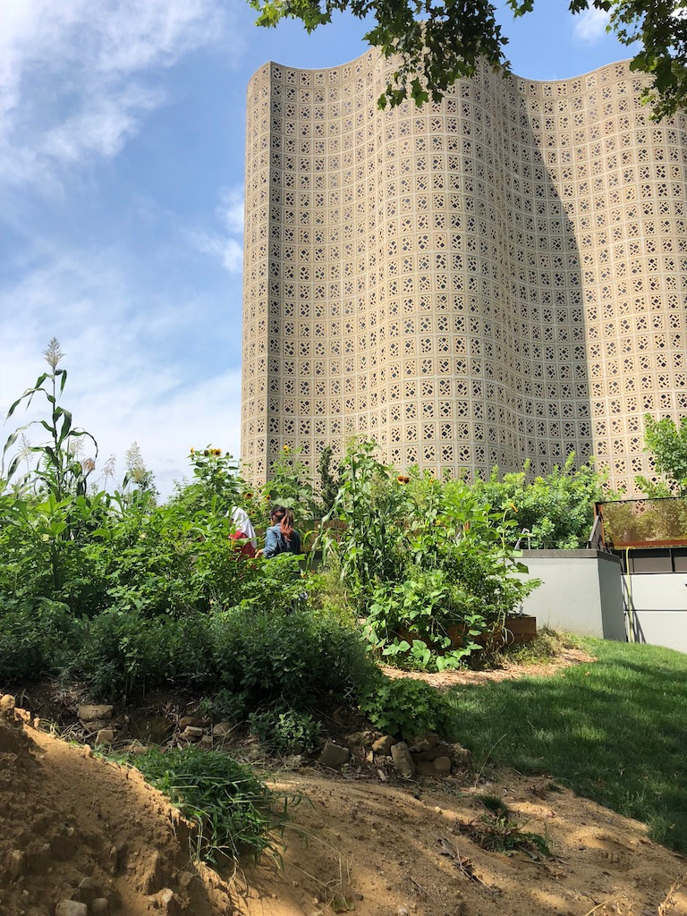
Climate Justice
S. Perl Egendorf, PhD
EESC 1201
May 1, 2023

Slide 2
- Bali Principles of Climate Justice, (2002)
- Shephard and Corbin-Mark (2009), Climate Justice
- Lennon (2021) Energy transitions in a time of intersecting precarities: from reductive environmentalism to antiracist praxis
- Hebdon et al (2016), Pedagogy and Climate Change
Class
Overview
Applying A Critical Systems Approach to Climate Change
Discussion

Slide 3
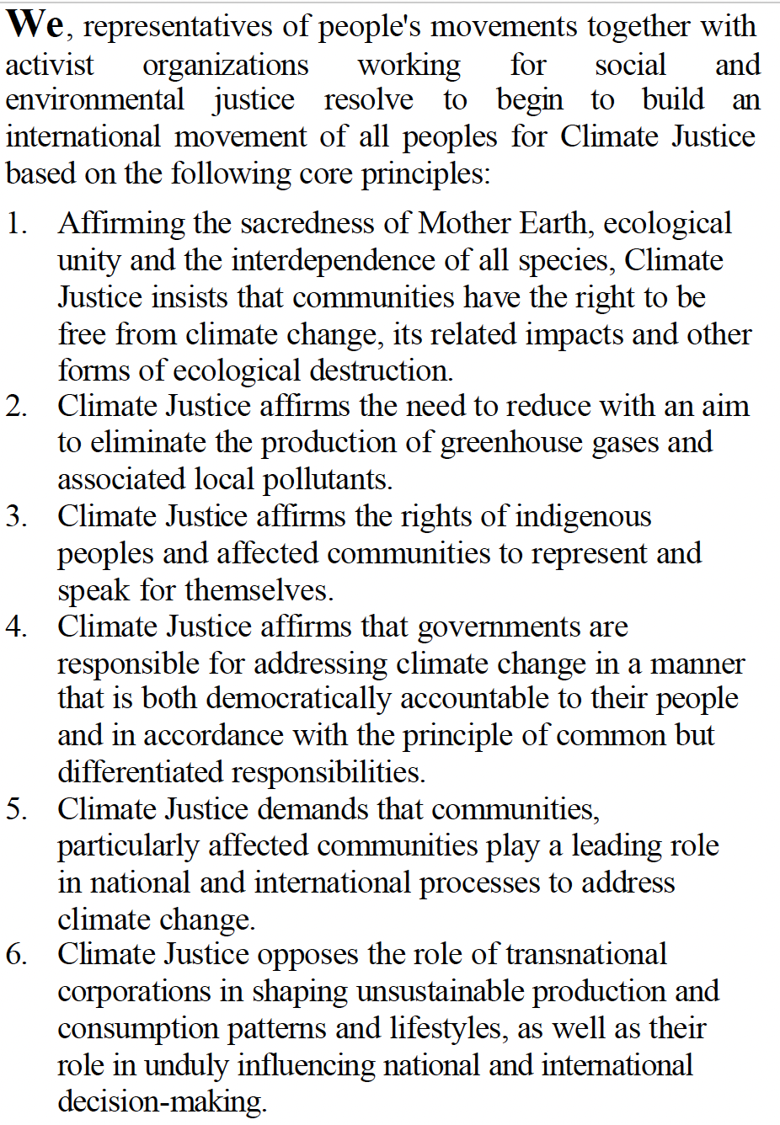
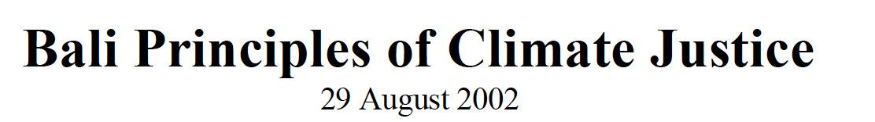
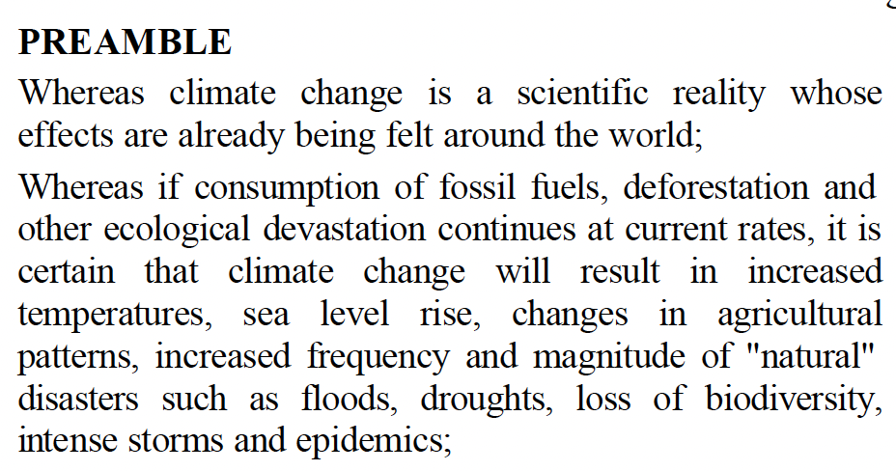
What is Climate Justice?
Notes:
The Bali Principles of Climate Justice were developed in Bali in the summer of 2002 by a broad coalition of movement organizations including CorpWatch, the Third World Network, and the Indigenous Environmental Network during the final preparatory negotiations for the 2002 Earth Summit, where they were formally codified on 29 August 2002. Encompassing 27 principles to guide international activist movements, they sought to redefine how we think about climate change as primarily a social and human rights issue, rather than a logistical problem to be solved with a few technical tweaks.

Slide 4
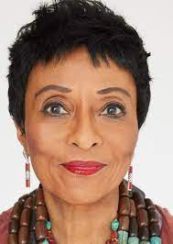
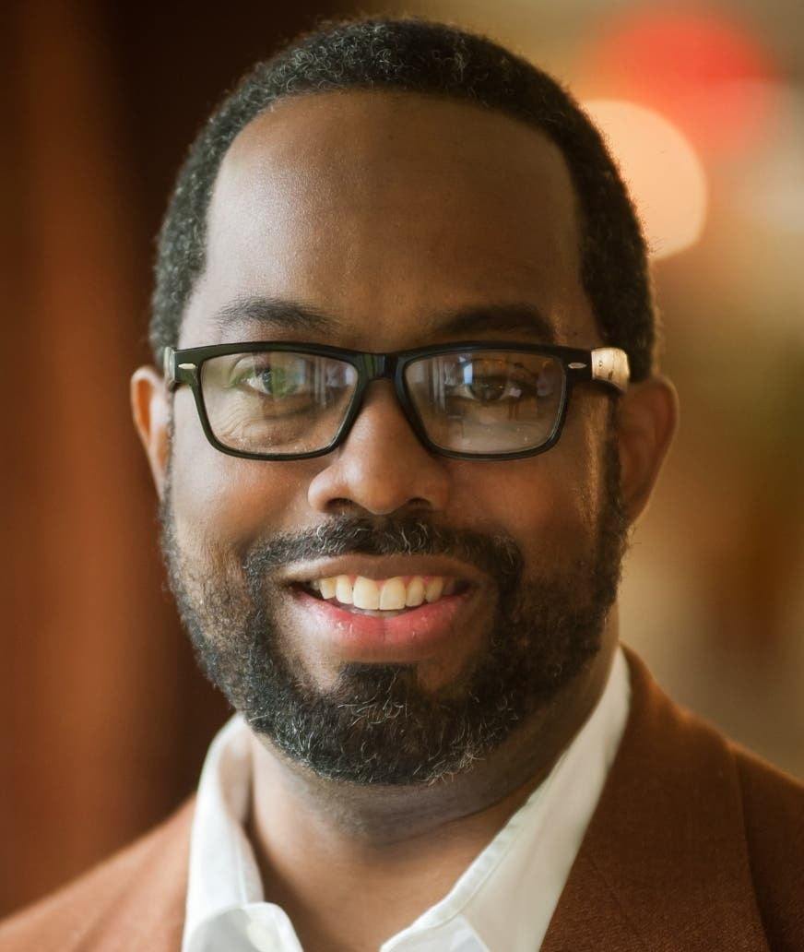
Shepard and Corbin-Mark (2009), Climate Justice
“This special issue edited by West Harlem Environmental
Action (WE ACT ) highlights climate justice:
The need to develop studies, policies, and interventions that address
the ethical and human rights dimensions of global warming,
the disproportionate burden of legacy pollution,
the unsustainable rise in energy costs for low-income families,
and the impacts of energy extraction, refining, and manufacturing on vulnerable communities.
Climate change is the most significant social and political challenge of the 21st century.”
Peggy Shepard is co-founder and executive director of WE ACT for Environmental Justice and has a long history of organizing and engaging Northern Manhattan residents in community-based planning and campaigns to address environmental protection and environmental health policy locally and nationally.
Cecil Corbin-Mark was a lifelong Harlem resident who rose to prominence as Deputy Director of the nonprofit WE ACT for Environmental Justice. (Courtesy of WE ACT for Environmental Justice)
“We want to highlight the need
for residents and advocates
to work with researchers and practitioners.
We know that it is critical to define a
community-based research agenda
and translate findings into strategies and interventions
that address the impacts
our most vulnerable communities will and are experiencing.
The time to act is now.”
https://www.ted.com/talks/peggy_shepard_how_to_build_an_equitable_and_just_climate_future

Slide 5
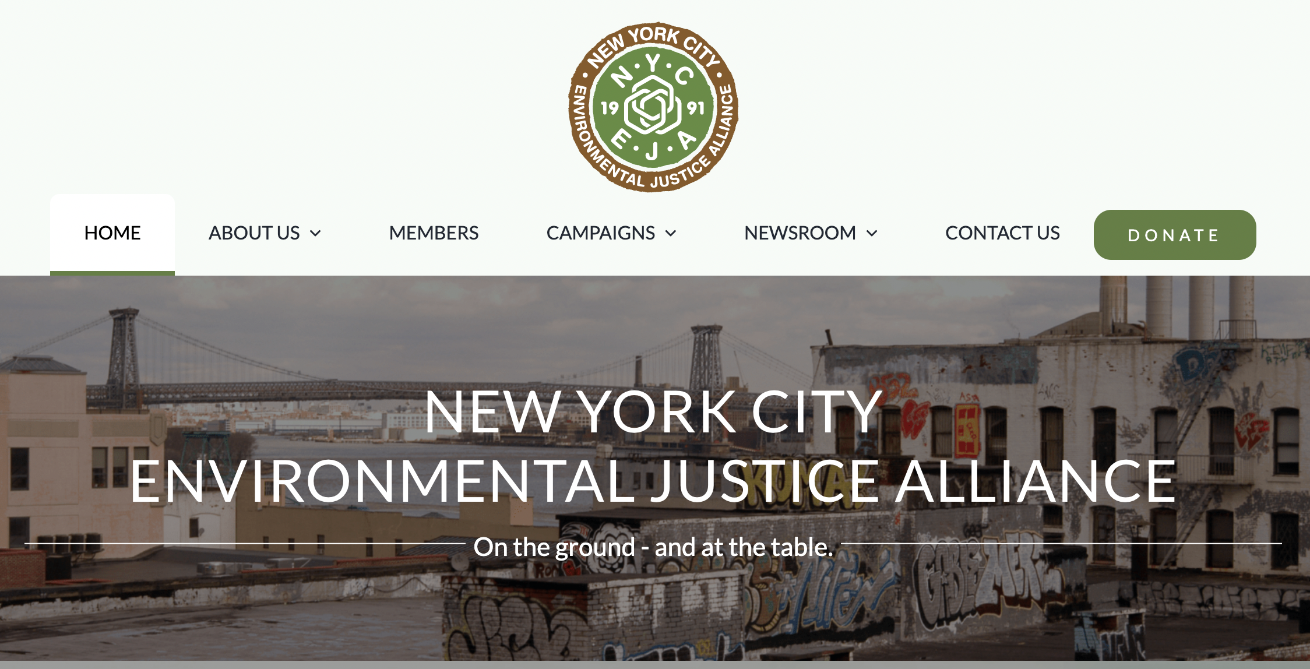
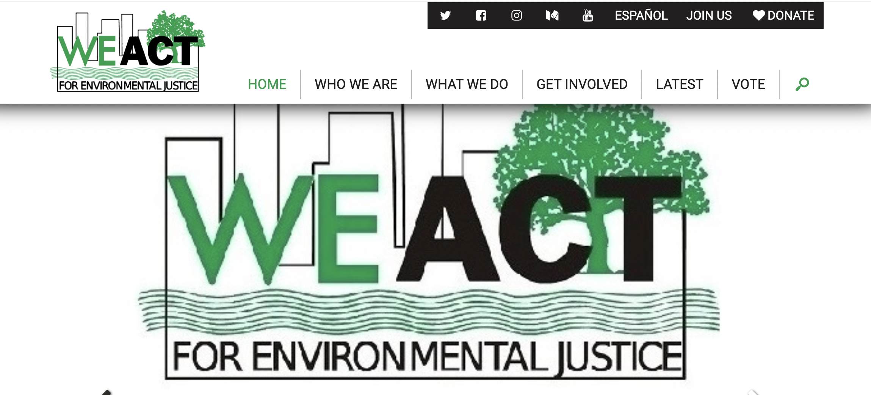
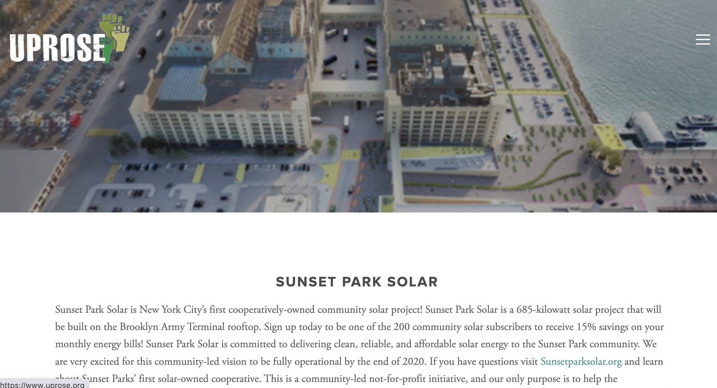
07
A Few Key EJ / CJ Orgs in NYC
WE ACT
NYC-EJA
UPROSE
https://www.weact.org/
https://nyc-eja.org/
https://www.uprose.org/sunset-park-solar

Slide 6
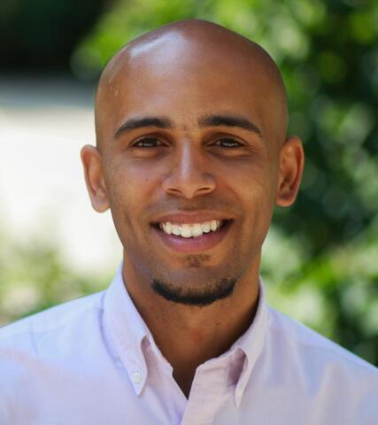
Lennon (2021)
Energy transitions in a time of intersecting precarities:
From reductive environmentalism to antiracist praxis
08
“Higher rates of Covid-19 infections and deaths in communities of color ... is directly attributable to respiratory and cardiovascular conditions caused by these communities’ proximity to fossil fuel infrastructures e.g. (refineries, power plants, highways).
Put differently, the pandemic’s racialized geography of precarity is imbricated in our broader energy and climate challenges.
Therefore, if we wish to act on [Michael Moore’s] Planet’s critiques and address climate change by confronting the technological limitations of renewable energy technologies in this moment of intersecting precarities, we must reject the film’s race-blind interrogation of humanity writ large, and instead train an antiracist lens on renewable energy production.
As the recent protests demonstrate, this antiracist work need not entail starting a “new” movement, and instead must build on and be integrated with the multi-dimensional, longstanding movements against white supremacy that have experienced unprecedented momentum as of late.”
Myles Lennon is an environmental anthropologist, Dean’s Assistant Professor of Environment & Society and Anthropology at Brown University, and a former sustainable energy policy practitioner.

Slide 7
Lennon (2021)
Energy transitions in a time of intersecting precarities:
From reductive environmentalism to antiracist praxis
08
“Planet’s preoccupation with
population,
alarmist rhetoric, and
inattention to race
are part and parcel of a broader reductive environmentalism that
fails to apprehend how our climate and energy challenges
are ultimately rooted in political structures, social inequalities, and institutional power.
In this way, Planet is less an exceptional piece of Luddism and more an incisive case study in how energy transition discourse is often de-situated from sociopolitical context.”
“Drawing from two years of ethnographic research on community-based solar campaigns in the northeast US, I contend that
when antiracist activists focus narrowly on the means of reduction, (such as the reduction of “energy burden” in poor communities of color through the deployment of solar),
they necessarily overlook the means of production that Planet rightly calls attention to, (such as the unregulated, toxic facilities in other marginalized communities where many solar panels are made).
In other words, when communities of color in the Global North prioritize reduction over production in their efforts to democratize energy,
they counterintuitively strive to achieve equity, sustainability, and collective ownership
through inequitable, unsustainable, and capitalized solar supply chains that oppress other communities.

Slide 8
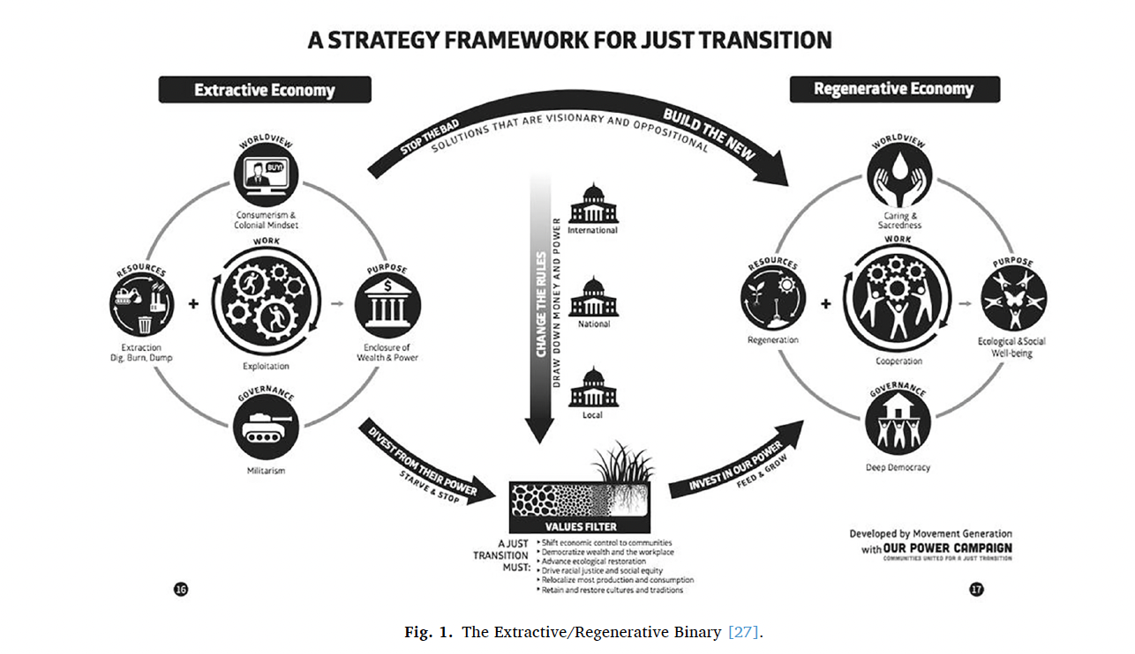

Slide 9
08
Hebdon et al (2016)
Pedagogy and Climate Change
After all, climate change is but one aspect of global change, which, although it
has accelerated over the past 300 years, has a longer history throughout
the Holocene (Kirch 2005).
Global change involves other alterations such as
land-use changes,
changes in the nitrogen and phosphorus cycles,
ocean acidification,
chemical pollution,
biodiversity loss,
stratospheric ozone depletion,
global freshwater depletion,
and atmospheric aerosol loading (Rockström et al. 2009).
All these anthropogenic global changes and the potential ways to affect their course
by definition lead back to human action.
Thus, pedagogy is not a secondary activity confined to the classroom
but an active verb that describes the way people can deal
with the multiple social roots of climate change in order to meet its epochal challenges.
Pedagogy capable of teaching climate change will need to
counter the issue’s dominant framings,
  which are shaped by the politics of science
  and educational expertise.
Climate change does not result from a single cause, nor is it amenable
to a one-dimensional fix, despite how common it
is to hear simple explanations or dismissals of it.
To be successful, pedagogies need to foster abilities
to think ecologically and
to discern how human agency is implicated in this “natural” disaster (Claus et al. 2015).

Slide 10
08
Hebdon et al (2016)
Pedagogy and Climate Change
Drawing on examples from international education,
Climate science, and renewable energy,
we argue that failures to mitigate climate change
actively have often co-developed with dominant educational approaches.
At the same time, in the wake of these failures
there is also an increasing awareness of the need
for alternative pedagogical priorities.
Critical pedagogy represents an oppositional strain
compared with mainstream pedagogies,
preferring being situated over imperial knowledge
and rejecting the idea
that while the expert speaks
the student should be mute.
While it may be tempting to shelter behind the idea
of politically detached science,
there are lessons that climate scientists can learn
from their experience with climate denialism—
for example, regarding the dis-utility
(and, at a time of possible environmental crisis, even the immorality)
of the pedagogic limitations that their own norms and paradigms impose.

Slide 11
04
Applying a Systems Approach
to
Climate
Change
A SYSTEMS APPROACH
Multiple scales of inputs, outputs, and feedback
A CRITICAL SYSTEMS APPROACH
Linking critical social theory with biophysical processes
APPLIED EXPERIMENTS
Environmental Justice and Participatory Action Research on storing carbon in urban soils in NYC

Slide 12
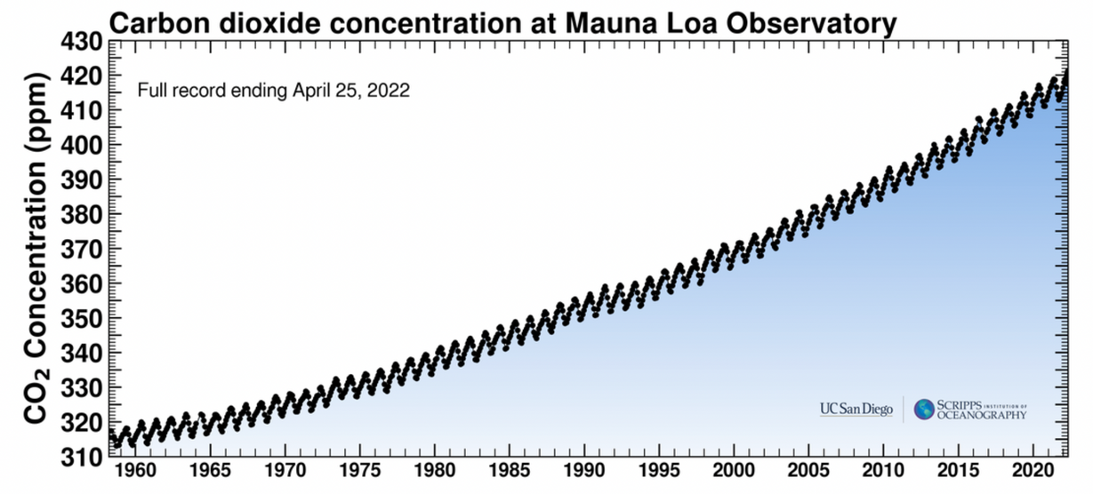
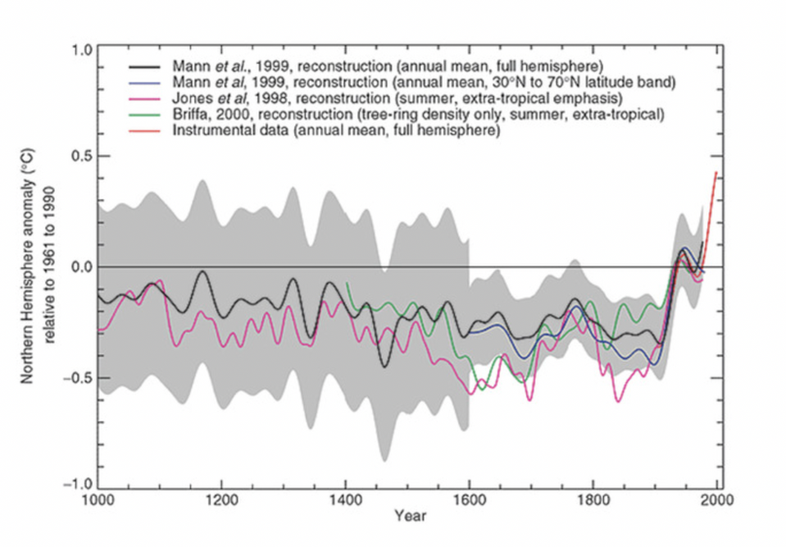
05
Success of Climate Science
https://keelingcurve.ucsd.edu/
https://www.theatlantic.com/technology/archive/2013/05/the-hockey-stick-the-most-controversial-chart-in-science-explained/275753/
IPCC Third Assessment

Slide 13
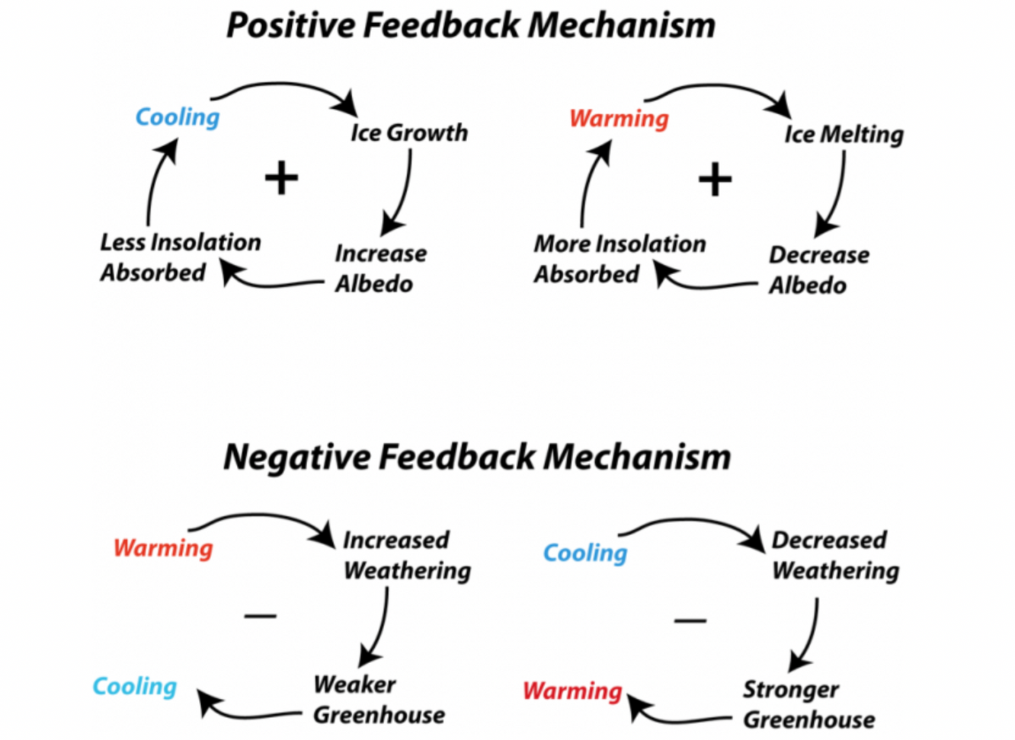
06
Feedbacks in Climate System
- water vapor feedback (positive)
- cloud feedback (positive)
- ice-albedo feedback (positive)
- lapse rate feedback (negative)
https://www.e-education.psu.edu/earth103/node/668

Slide 14
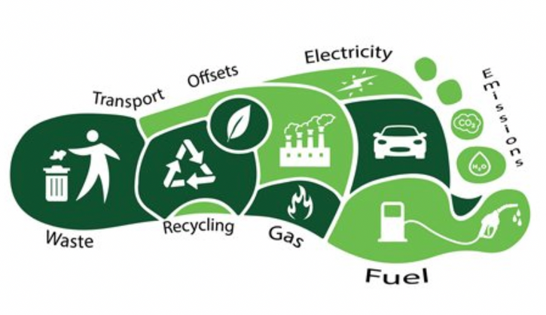

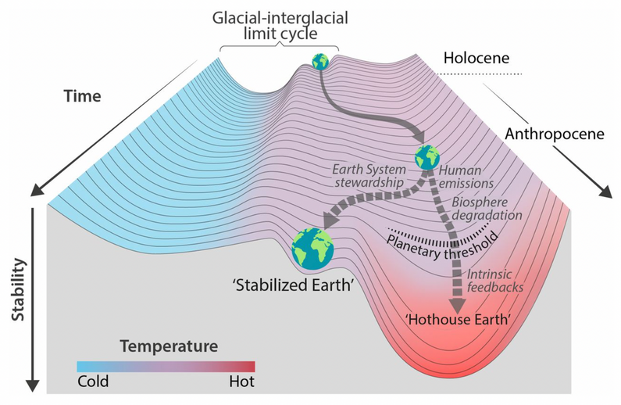
07
CAUSES OF CLIMATE CRISIS
INDIVIDUALS
CORPORATIONS
HUMAN SPECIES
Neoliberal Framework
"Carbon Footprints"
"Bad Actors"
Anthropogenic Impacts
"Anthropocene"
https://www.forbes.com/sites/arielcohen/2020/08/05/amidst-17-billion-in-q2-losses-bp-unveils-new-green-strategy/?sh=3b5d7c362aa4
https://www.ecomatcher.com/the-basics-of-a-carbon-footprint/
Steffen et al. (2018)

Slide 15
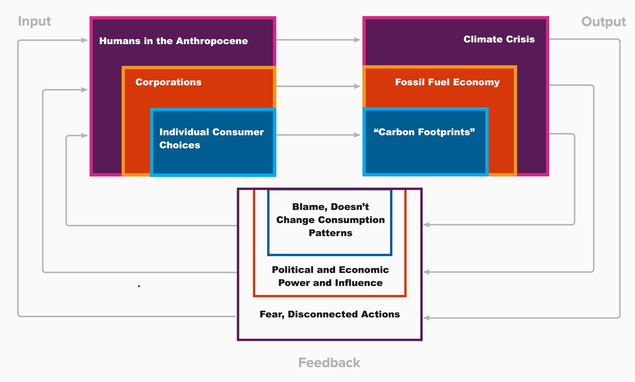
08
Mapping Social Feedbacks
in Climate System

Slide 16
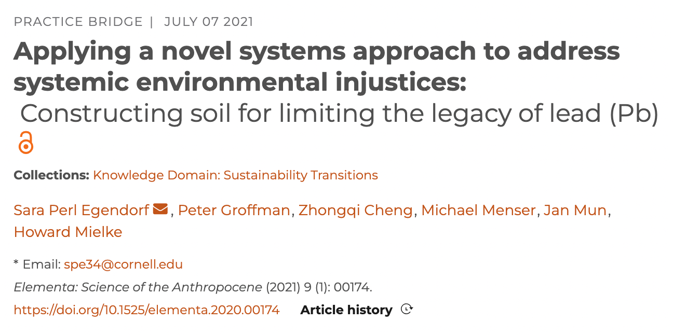
09
3 Steps for Critical Systems Approach
1. MAP THE SYSTEM
Critically -- attending to power
at all scales
2. IDENTIFY INTERVENTIONS
What has been attempted? What creates systemic changes? How?
3. APPLY EXPERIMENTS
Study degree to which systems move towards just and sustainable outputs and feedbacks

Slide 17
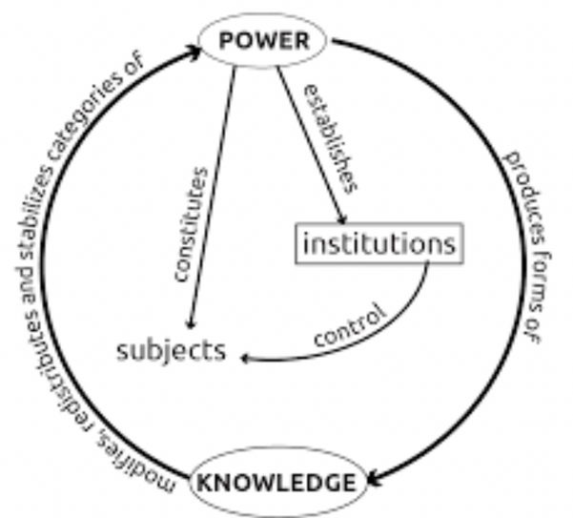
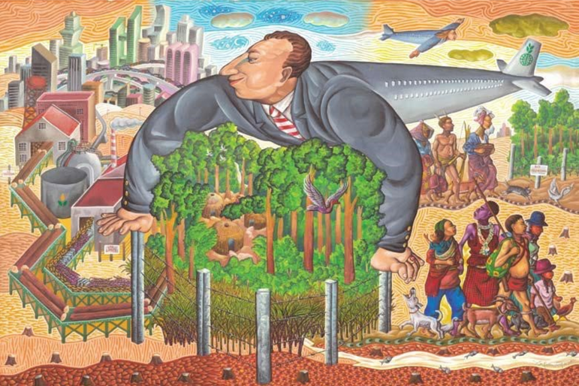
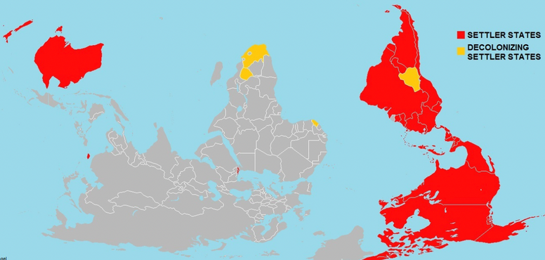
10
CRITICAL CAUSES OF CRISIS
POWER RELATIONS
RACISM AND CLASSISM
COLONIALISM AND CAPITALISM
Imbalances between humans, living organisms, nonliving entities, all constantly shifting
Ableism, Sexism, Transphobia, etc.
Macroscale systemic imbalances between living and beyond living
https://themediastudentsblog.wordpress.com/2017/02/11/foucault/
https://www.race.ed.ac.uk/understanding-racial-capitalism-in-africa-a-study-of-the-nigerian-oil-dependent-capitalist-economy/
https://decolonialatlas.wordpress.com/2014/11/03/settler-states-of-the-world/

Slide 18
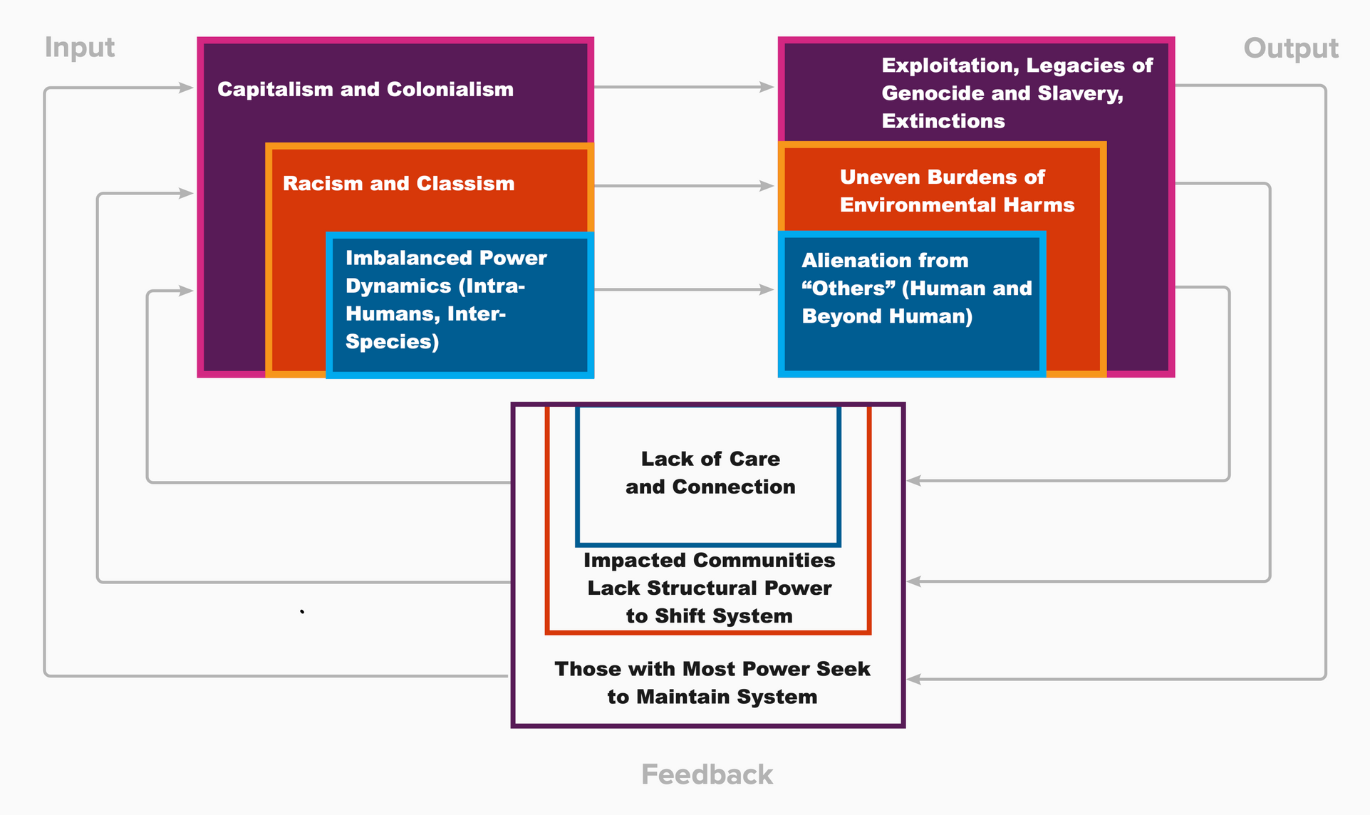
11
  1. Mapping Critical Social Feedbacks
in Climate System

Slide 19
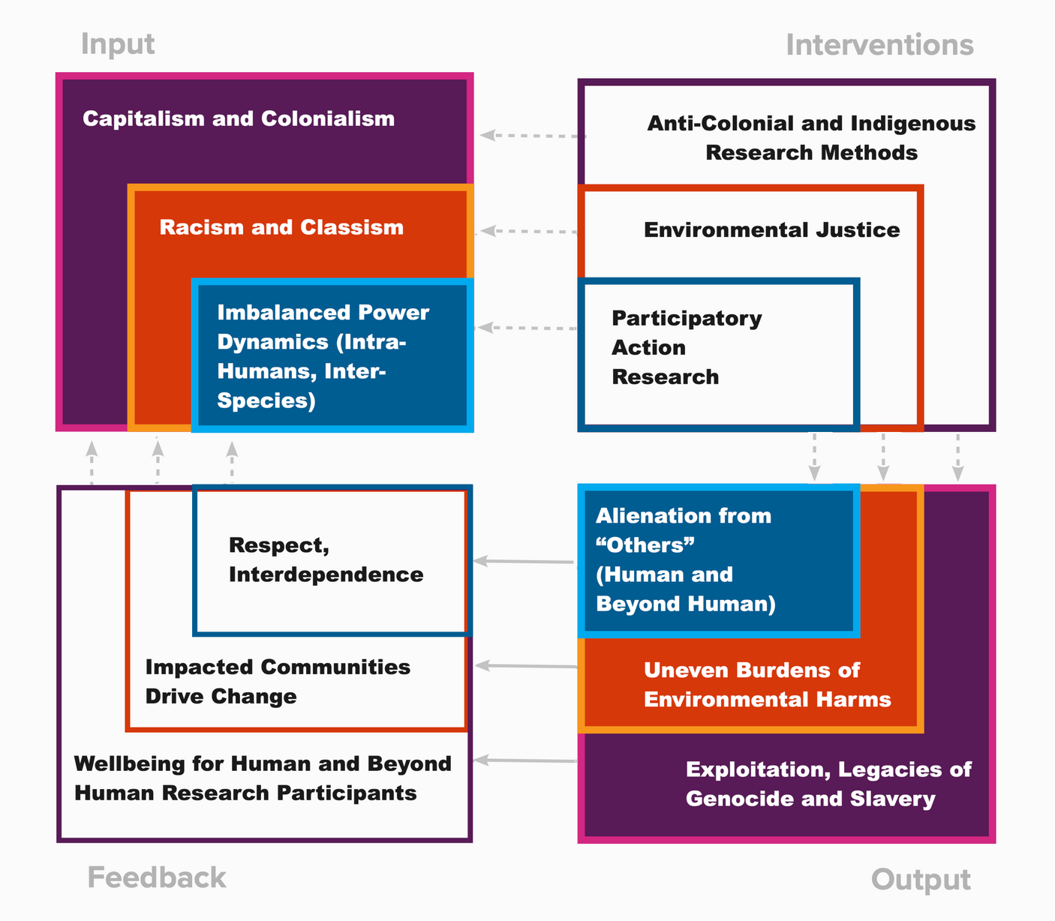
12
2. Identifying Interventions

Slide 20
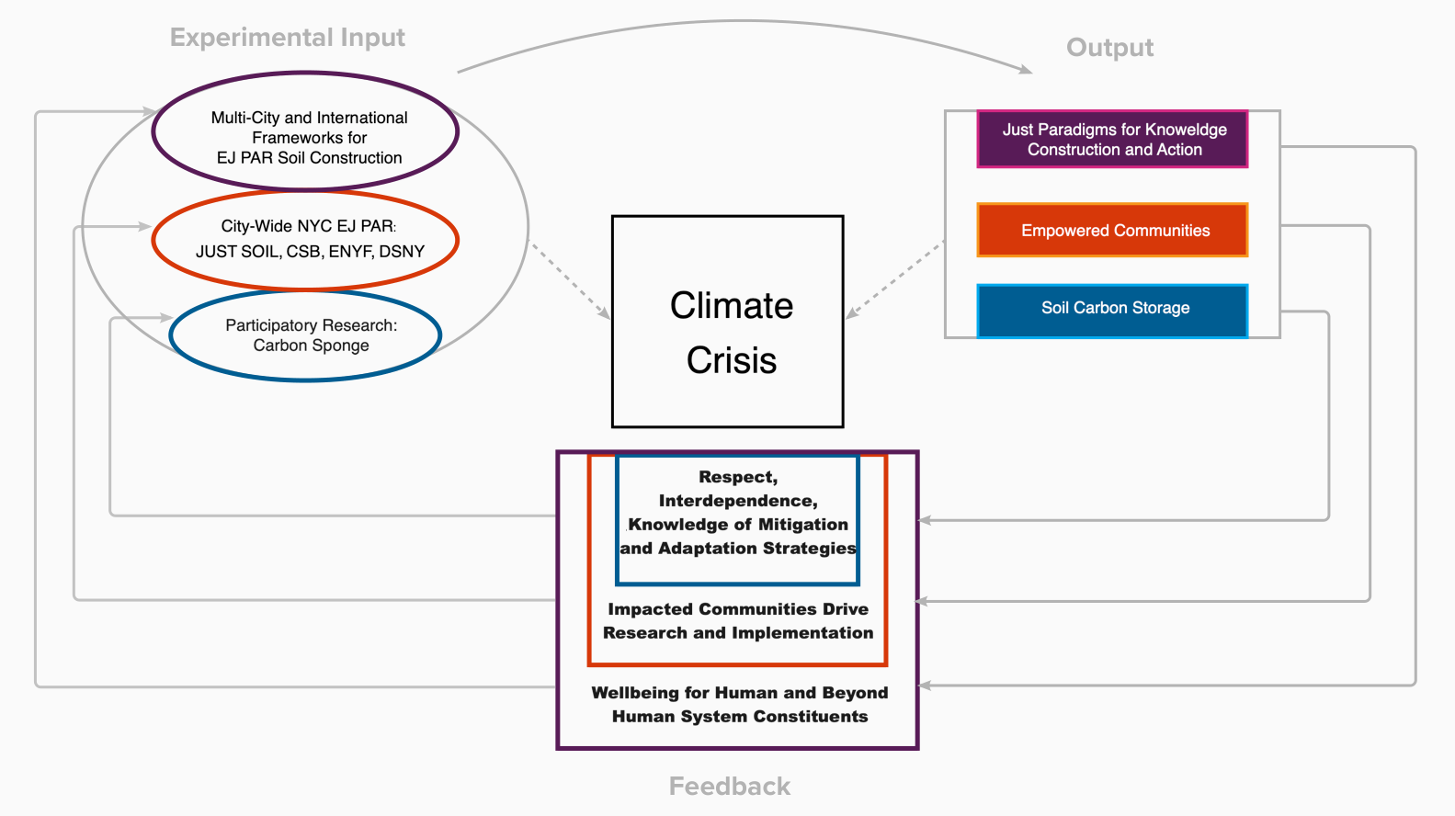
3. Applying Experiments
13

Slide 21
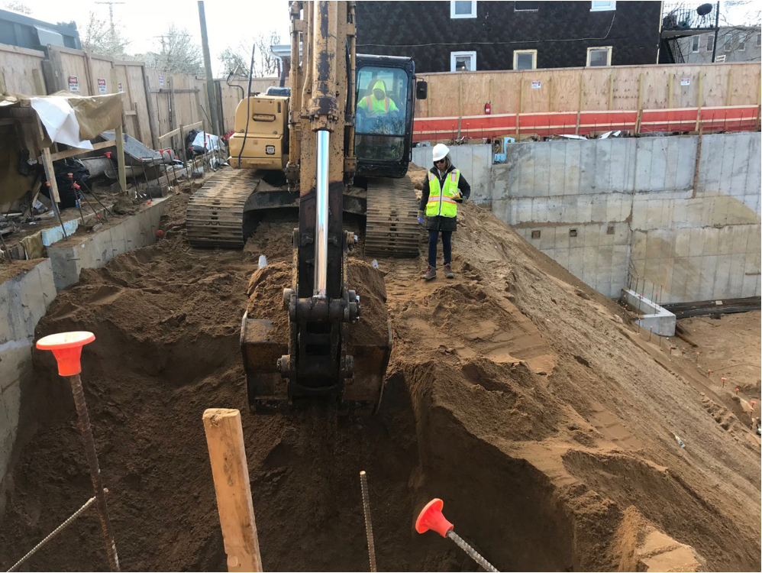
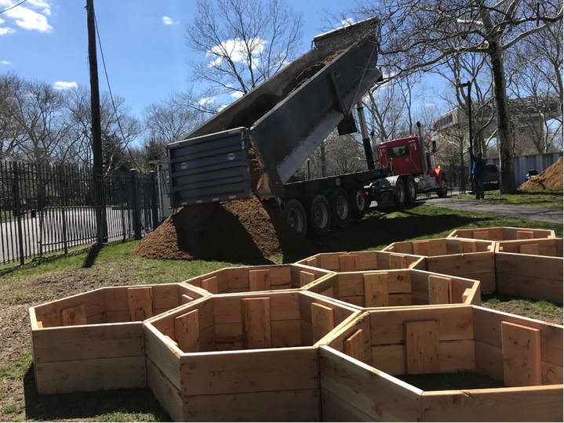
14
Clean
Soil
Bank Sediments
The NYC Mayor's Office of Environmental Remediation

Slide 22
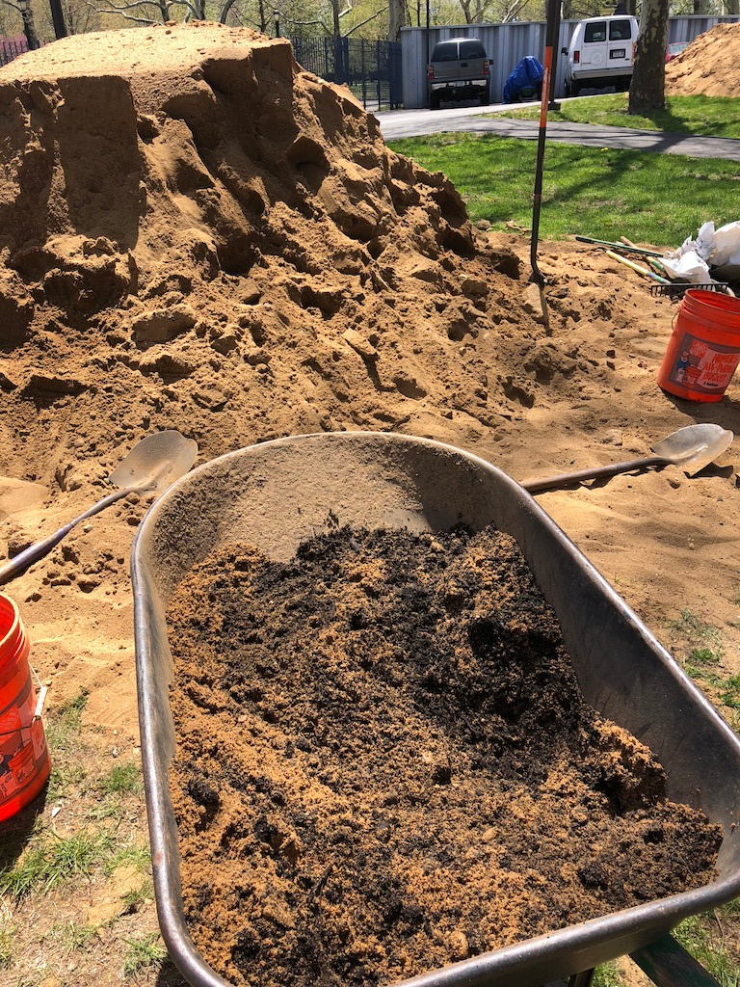
15
Urban Composts
The NYC Department of Sanitation
The NYC Compost Project
Many other sites

Slide 23
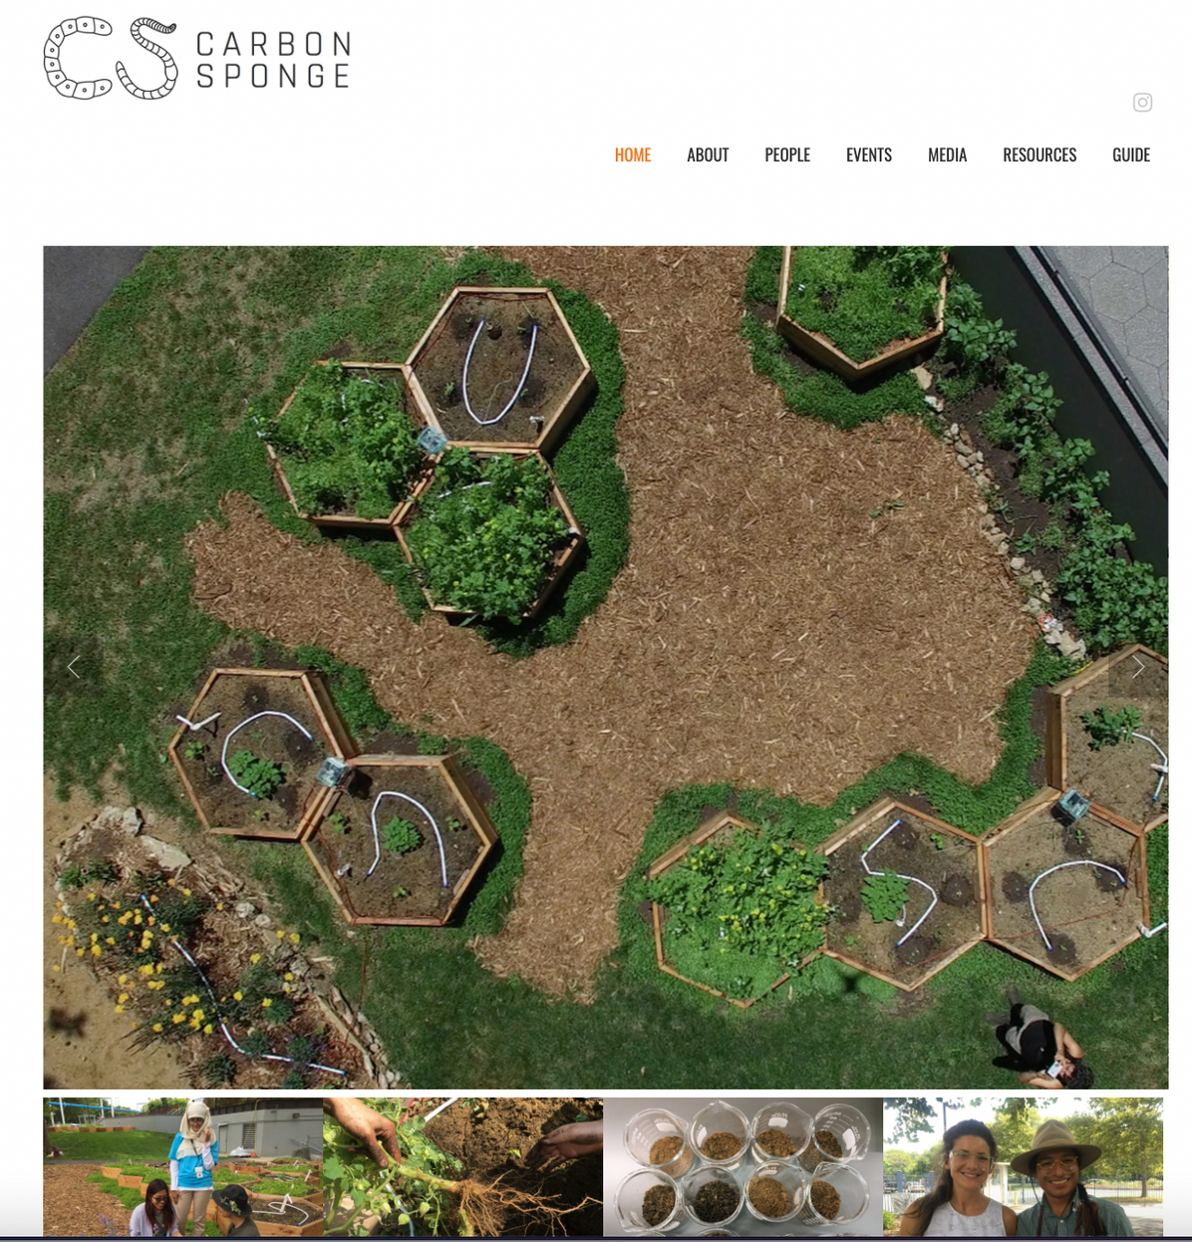
16
CARBON SPONGE
www.carbonsponge.nyc

Slide 24
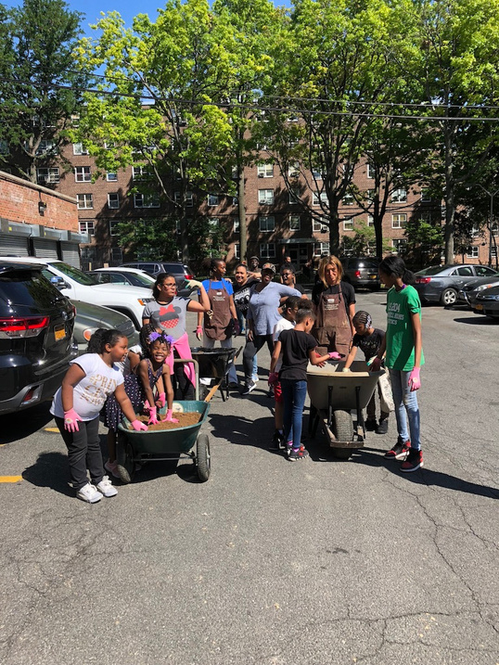
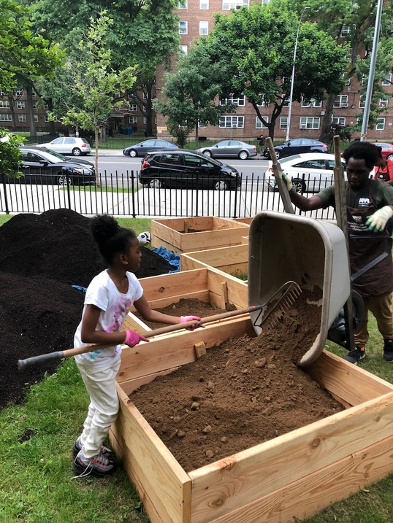
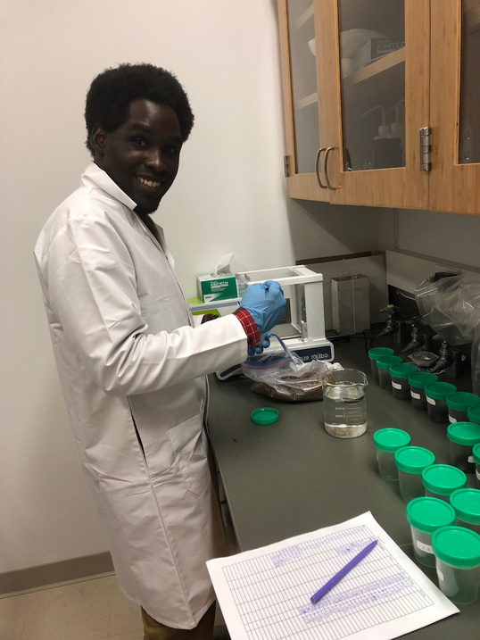
18
Soil EJ PAR in NYC
JUST SOIL
EAST NEW YORK FARMS
CITY-WIDE COMPOST STUDIES
PAR with NYCHA Ravenswood
Soil Distribution
NYC Compost Project and DSNY

Slide 25
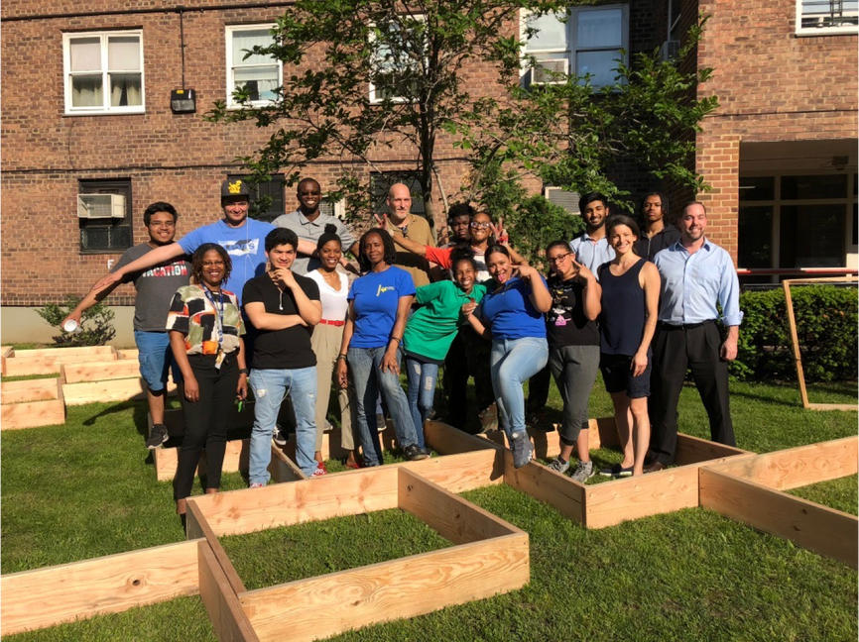
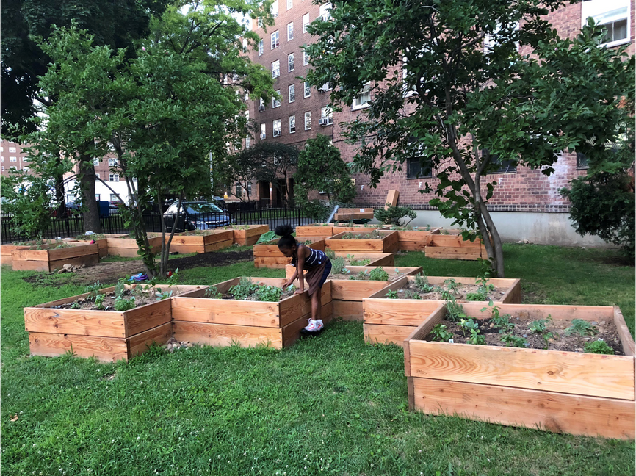
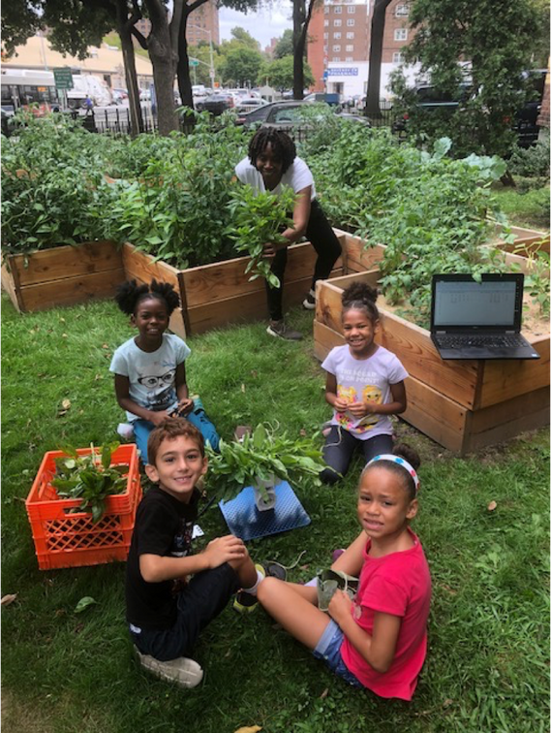
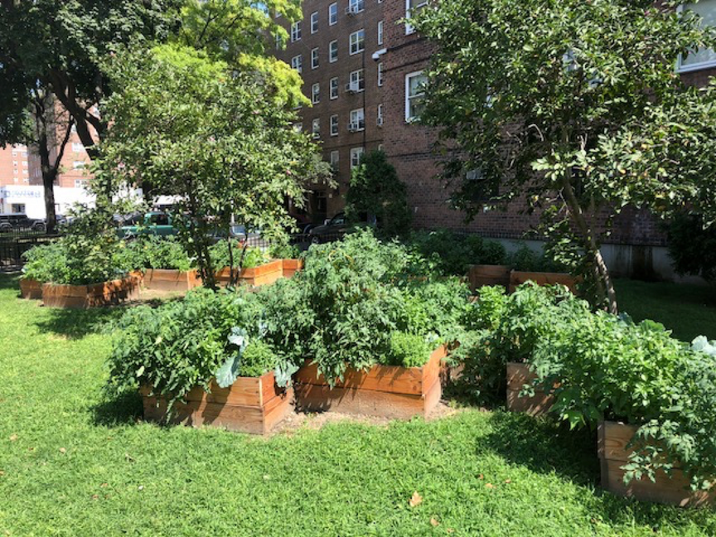
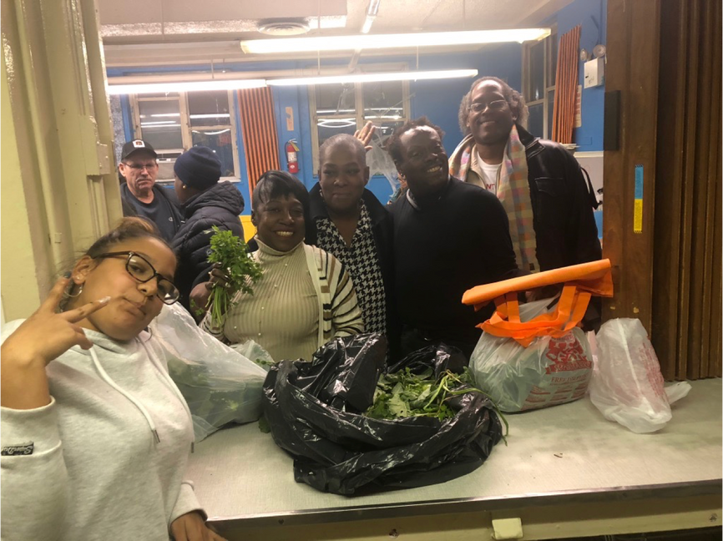
19
JUST SOIL

Slide 26
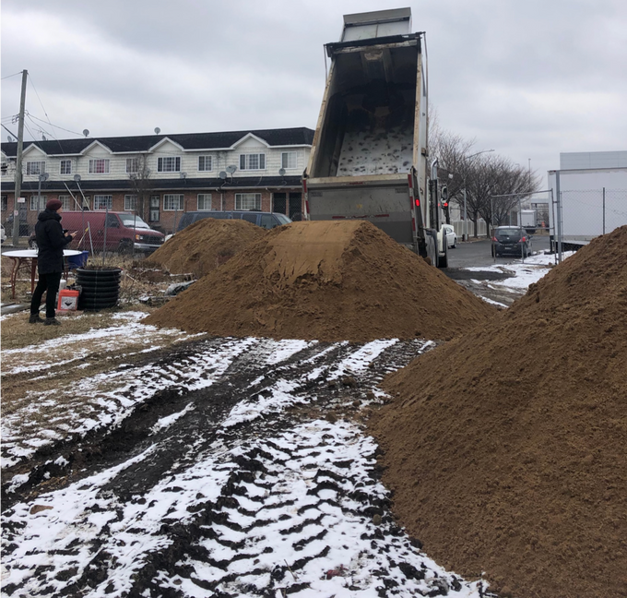
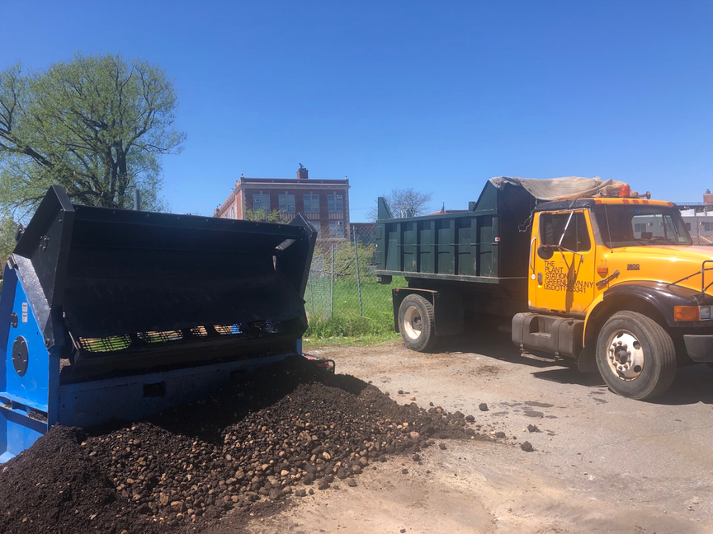
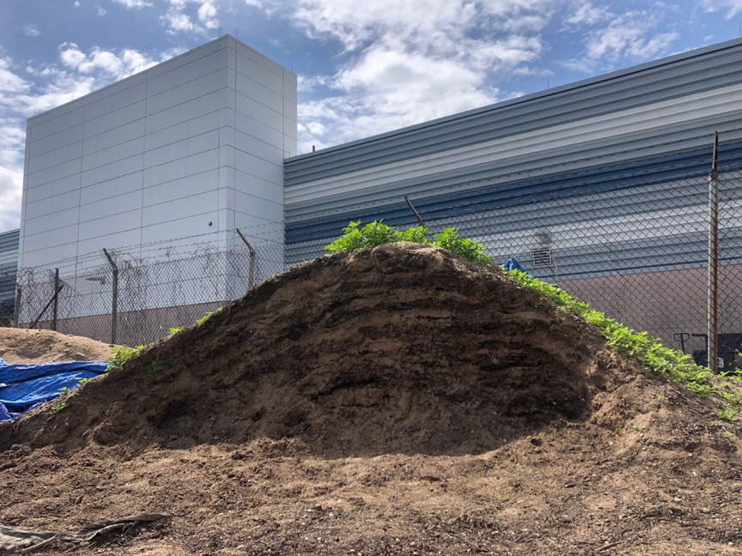
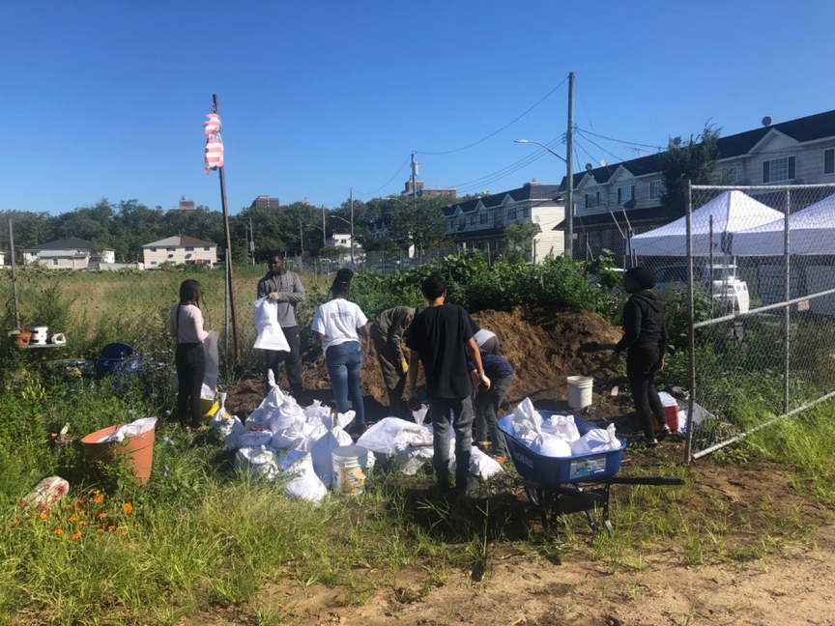
East New York Farms!
20

Slide 27
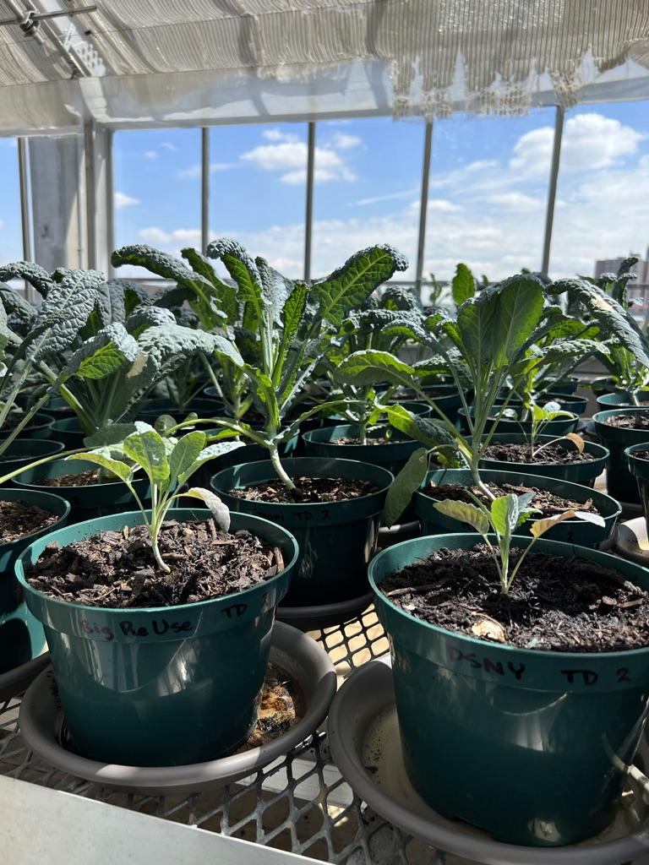

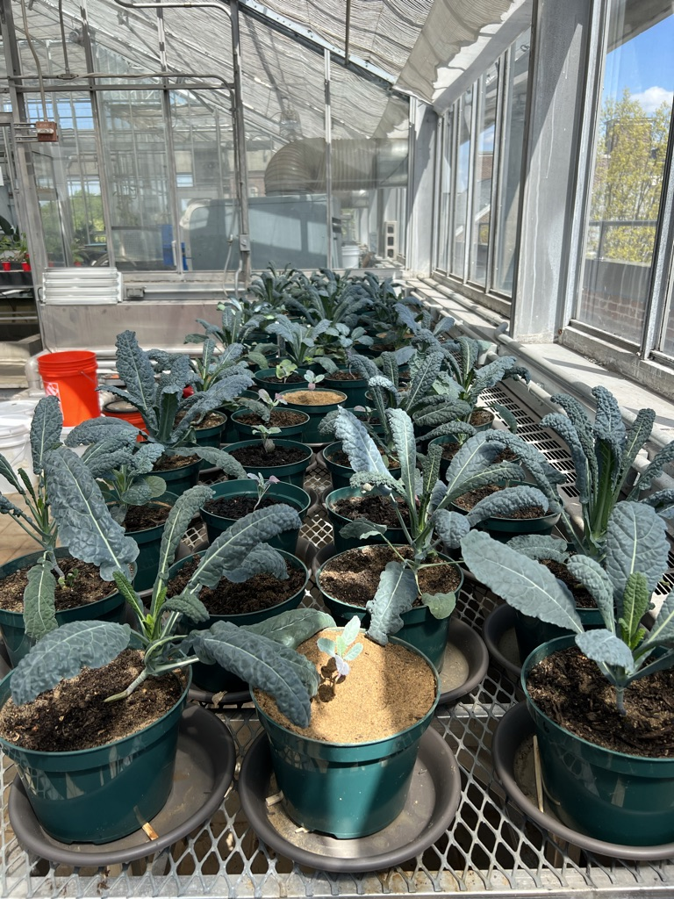
City-Wide Compost Studies
DSNY, NYC Compost Project,
Brooklyn College
Greenhouse Study of 9 local composts
THANK YOU STUDENTS!!!

Slide 28
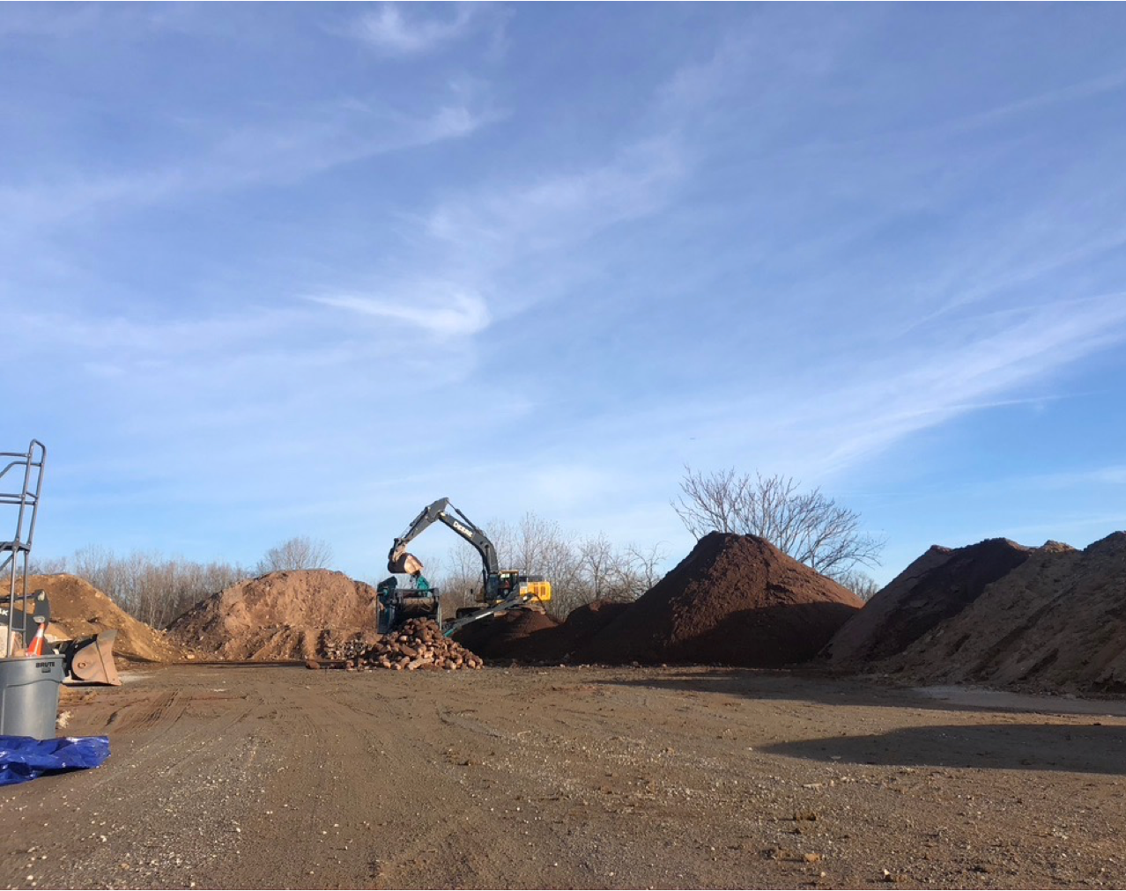
21
Scaling Up
NYC Clean Soil Bank Stockpile
Multi-City and International Frameworks for EJ PAR on Soil Construction

Slide 29
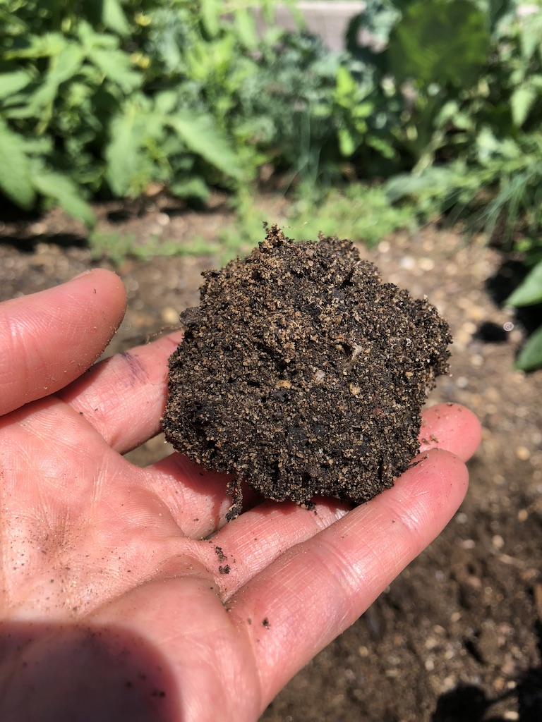
22
THANK YOU!
Climate Justice
segendorf@gradcenter.cuny.edu
S. Perl Egendorf, PhD
EESC 1201
May 1, 2023

