Slide 1
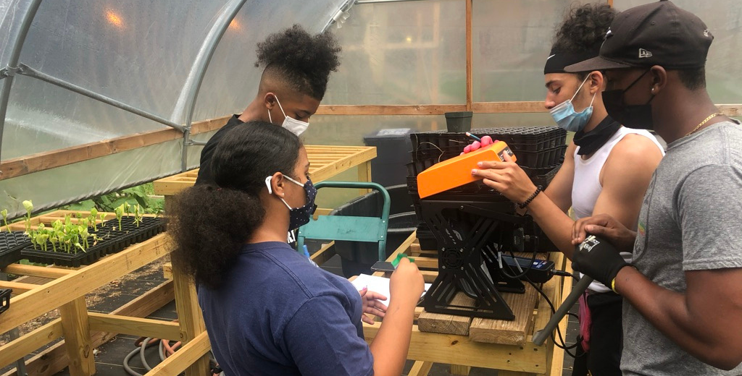
(URBAN) AGRICULTURE
&
FOOD JUSTICE
Dr. S. Perl Egendorf
EESC 1201 Class 9, 4/3/23

Slide 2
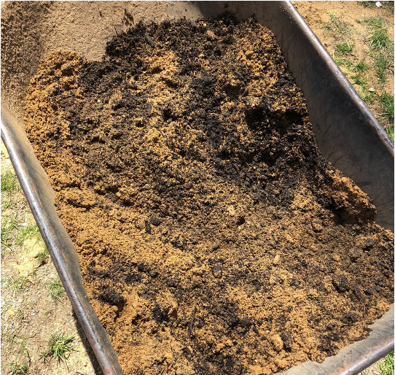
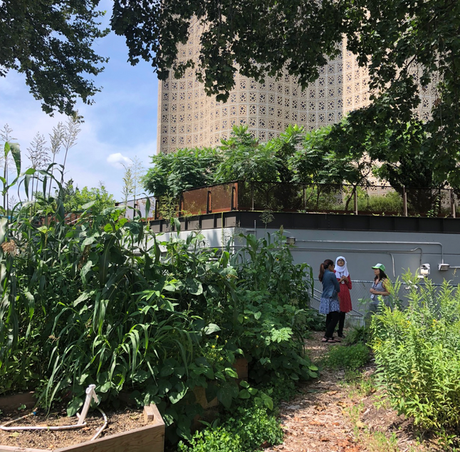
OVERVIEW
Course review
Chapter 10: “Feeding the World”
Penniman’s Farming While Black
Bradley and Herrera’s “Decolonizing Food Justice…”
Organizations you researched / discussion

Slide 3
COURSE REVIEW
How do we know and understand environments?
Earth’s birth / origin stories (the geosphere)
Ecology, ecosystems, nutrient cycling (the biosphere)
Environmental issues / justice (biosphere)
The hydrosphere
Plastic pollution and anti-colonial research
The pedosphere
The anthro-pedosphere
(Urban) agriculture and food justice
Energy (geo-bio-hydro-atmosphere)
Climate change (atmosphere)
Climate justice
Final Projects !
Reflect / Review
Final Exam

Slide 4
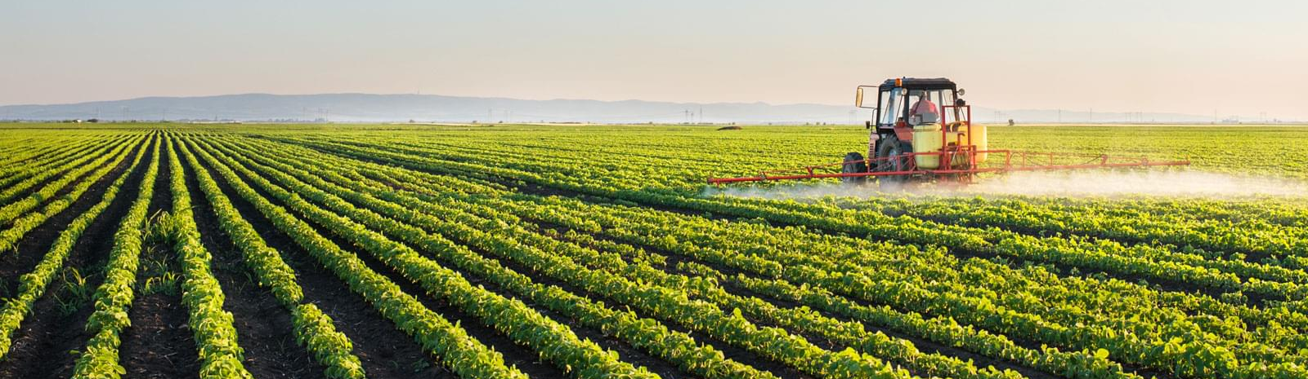
Conventional Farming
“has delivered tremendous gains in productivity and efficiency”
The World Bank estimates that between 70 percent and 90 percent of the recent increases in food production are the result of conventional agriculture rather than greater acreage under cultivation.
Shared characteristics:
rapid technological innovation,
large capital investments in equipment and technology,
large-scale farms, single crops (monocultures);
uniform high-yield hybrid crops, dependency on agribusiness,
mechanization of farm work,
and extensive use of pesticides, fertilizers, and herbicides.
Livestock - most production comes from systems where animals are highly concentrated and confined.

Slide 5
Conventional Farming
Ecological Concerns
Decline in soil productivity (wind and water erosion of exposed topsoil)
soil compaction
loss of soil organic matter, water holding capacity, and biological activity;
and salinization (increased salinity) of soils in highly-irrigated farming areas.
Converting land to desert (desertification) can be caused by overgrazing of livestock and is a growing problem, especially in parts of Africa.
non-point source water pollutants that include salts, fertilizers (nitrates and phosphorus, especially), pesticides, and herbicides.
over 400 insects and mite pests and more than 70 fungal pathogens that have become resistant to one or more pesticides. Pesticides have also placed stresses on pollinators and other beneficial insect species (e.g. honeybees).
This, along with habitat loss due to converting wildlands into agricultural fields, has affected entire ecosystems (such as the practice of converting tropical rainforests into grasslands for raising cattle).
Agriculture’s link to global climate change is just beginning to be appreciated. Destruction of tropical forests and other native vegetation for agricultural production has a role in elevated levels of carbon dioxide and other greenhouse gases. Recent studies have found that soils may be large reservoirs of carbon.
Additionally, the digestive processes of livestock such as cattle, are responsible for significant emissions of methane (a potent greenhouse gas), thereby contributing to global climate change.
Economic and Social Concerns
increasingly large federal expenditures
widening disparity among the income of farmers
escalating concentration of agribusiness—industries involved with manufacture, processing, and distribution of farm products—into fewer and fewer hands.
farmers have little control over prices of their goods, and they continue to receive a smaller and smaller portion of consumer dollars spent on agricultural products.
Loss of small farms – especially for farmers of color

Slide 6
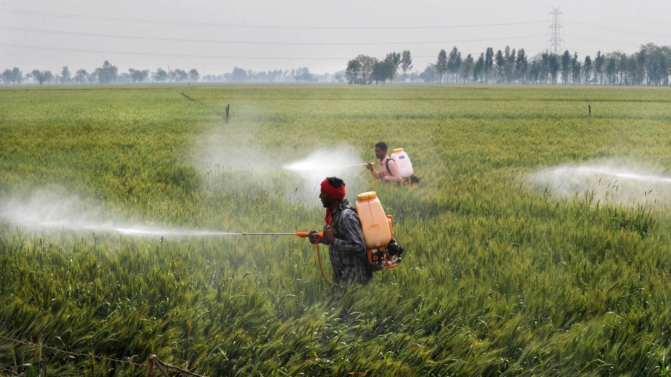
Pests and Pesticides
Pests = organisms that occur where they are not wanted or that cause damage to crops or humans or other animals.
A pesticide = any substance intended for preventing, destroying, repelling, or mitigating any pest.
Though often misunderstood to refer only to insecticides
the term pesticide also applies to herbicides, fungicides, and various other substances used to control pests.
By their very nature, most pesticides create some risk of harm—pesticides can cause harm to humans, animals, and/or the environment because they are designed to kill or otherwise adversely affect living things.
At the same time, pesticides are useful to human society because they can kill potential disease-causing organisms and control insects, weeds, worms, and fungi.
Despite the fact that the lion’s share of chemical pesticides are applied in developed countries, 99 percent of all pesticide poisoning cases occur in developing countries where regulatory, health and education systems are weakest.
Making matters worse, developing countries seldom have strong regulatory systems for dangerous chemicals; pesticides banned or restricted in industrialized countries are used widely in developing countries.
A new study shows that pesticides are a key contributor to climate change, from their manufacturing, transportation, and application, all the way to their degradation and disposal.
https://grist.org/agriculture/a-new-report-says-pesticides-intensify-climate-change/

Slide 7
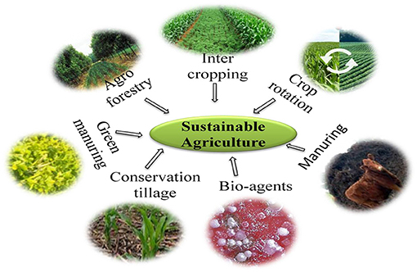
“Sustainable” Agriculture
In the US, the 1990 Congressional “Farm Bill” defined the term “sustainable agriculture” as “…an integrated system of plant and animal production practices having a site-specific application that will, over the long term:
satisfy human food and fiber needs;
enhance environmental quality and the natural resource base upon which the agricultural economy depends;
make the most efficient use of nonrenewable resources and on-farm resources and integrate, where appropriate, natural biological cycles and controls;
sustain the economic viability of farm operations; and
enhance the quality of life for farmers and society as a whole.”
Organic Farming is Good for Farmers, Consumers and the Environment
Organic agriculture is an ecological production management system that promotes and enhances biodiversity, biological cycles and soil biological activity.
Organic food is produced by farmers who emphasize the use of renewable resources and the conservation of soil and water to enhance environmental quality for future generations.
Organic meat, poultry, eggs, and dairy products come from animals that are given no antibiotics or growth hormones.
Organic food is produced without using most conventional pesticides, fertilizers made with synthetic ingredients or sewage sludge, or GMOs.
”We don’t say the ‘O’ word” … Organic agriculture is essentially indigenous agriculture
– Chief Mann, Turtle Clan Chief of the Ramapough Lenape Nation
https://www.frontiersin.org/articles/10.3389/fsoil.2022.821589/full
See: https://munseethreesisters.org/about-2/

Slide 8
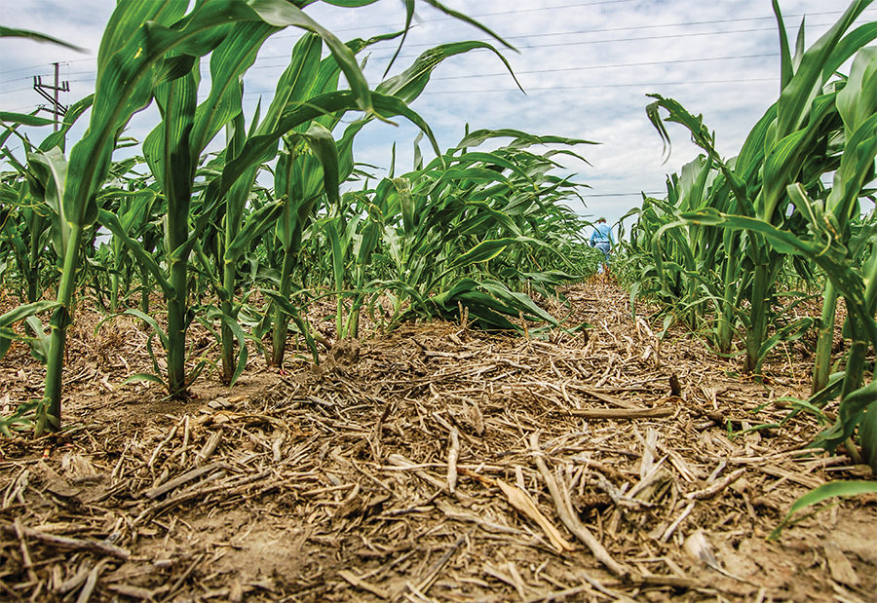
“Sustainable” Agriculture
Organic Farming Practices Reduce Unnecessary Input Use
In modern agricultural practices, heavy machinery is used to prepare the seedbed for planting, to control weeds, and to harvest the crop.
The use of heavy equipment has many advantages in saving time and labor, but can cause compaction of soil and disruption of the natural soil organisms.
The problem with soil compaction is that increased soil density limits root penetration depth and may inhibit proper plant growth.
Alternative practices generally encourage minimal tillage or no tillage methods.
With proper planning, this can simultaneously limit compaction, protect soil organisms, reduce costs (if performed correctly), promote water infiltration, and help to prevent topsoil erosion

Slide 9
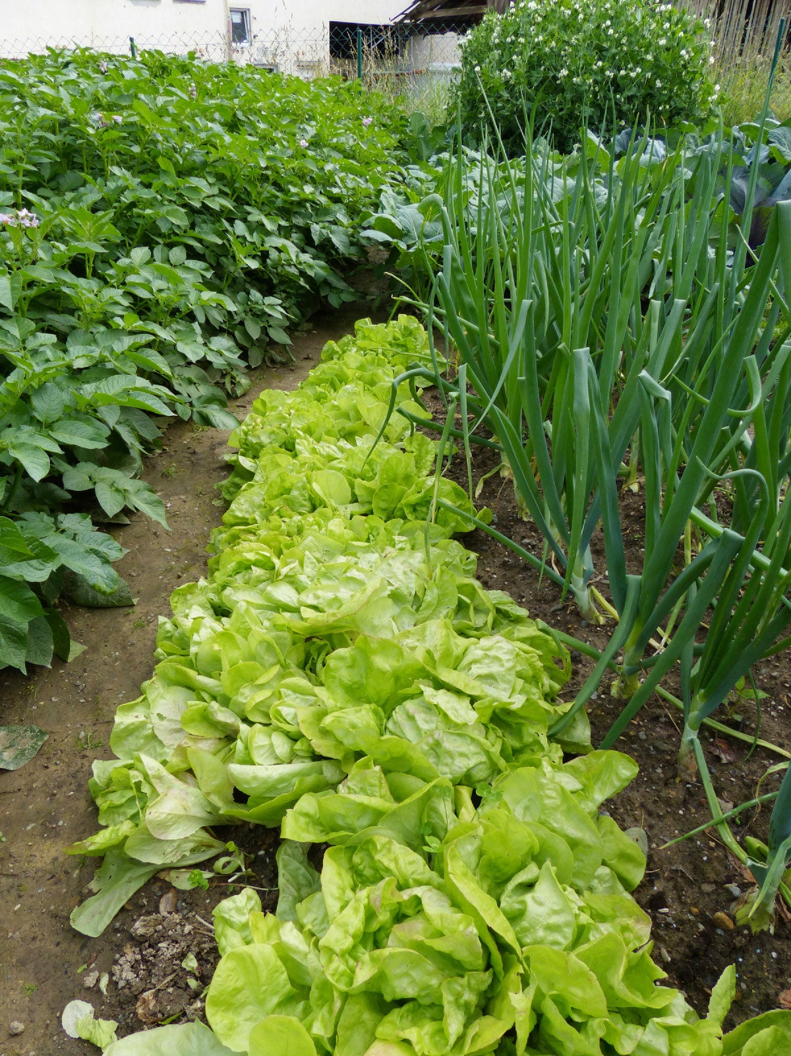
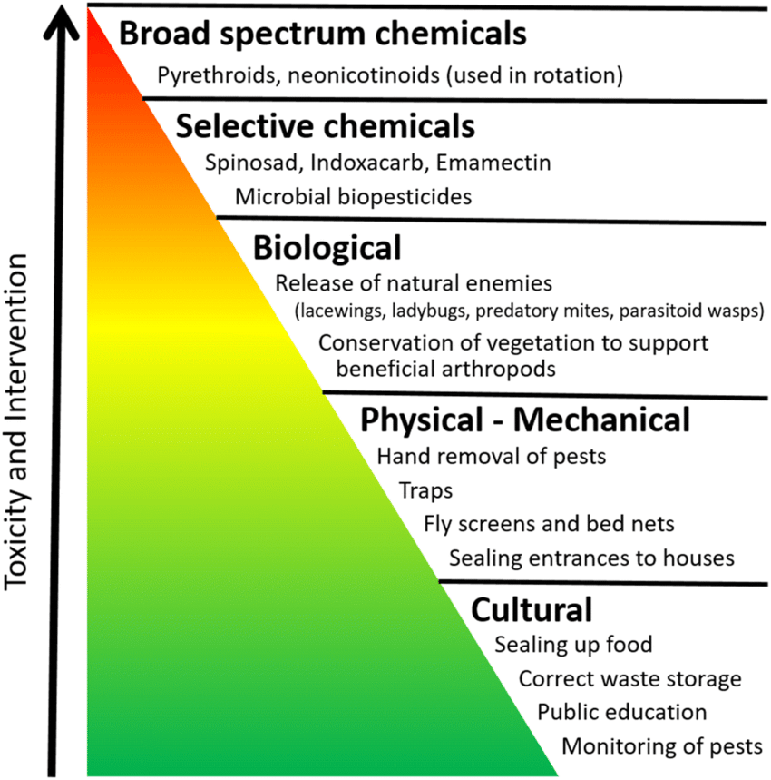
“Sustainable” Agriculture
IPM is a Combination of Common-Sense Practices
Integrated Pest Management (IPM) refers to a mix of farmer-driven, ecologically-based pest control practices that seeks to reduce reliance on synthetic chemical pesticides.
managing pests (keeping them below economically damaging levels) rather than seeking to eradicate them;
relying, to the extent possible, on non-chemical measures to keep pest populations low; and
selecting and applying pesticides, when they have to be used, in a way that minimizes adverse effects on beneficial organisms, humans, and the environment.
Intercropping Promotes Plant Interactions
growing two or more crops in close proximity to each other during part or all of their life cycles
promotes soil improvement, biodiversity, and pest management
increases diversity and interaction between plants, arthropods, mammals, birds and microorganisms resulting in a more stable crop-ecosystem and a more efficient use of space, water, sunlight, and nutrients
This collaborative type of crop management mimics nature and is subject to fewer pest outbreaks, improved nutrient cycling and crop nutrient uptake, and increased water infiltration and moisture retention.
Soil quality, water quality and wildlife habitat all benefit.
https://www.researchgate.net/figure/Pyramid-of-IPM-techniques-the-tool-kit-that-are-used-in-a-agricultural-systems-b_fig1_330756540

Slide 10
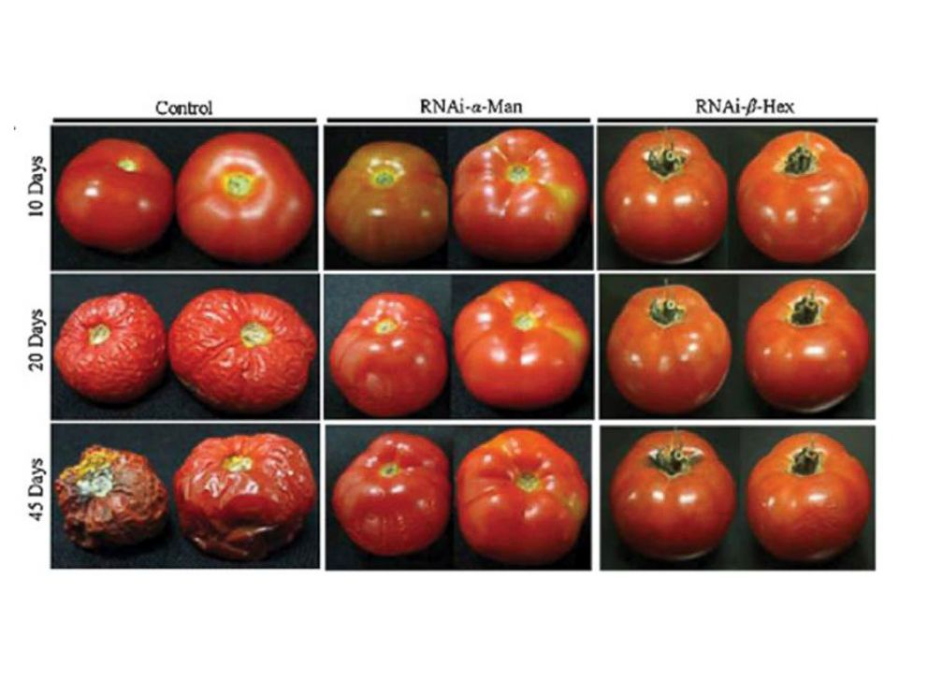
Agricultural biotechnology
…a range of tools that include both traditional breeding techniques and more modern lab-based methods. Genetic engineering is the name for the methods that scientists use to introduce new traits or characteristics to an organism. This process results in genetically modified organisms, or GMOs.
BENEFITS OF GENETIC ENGINEERING
Enhanced nutrition
biotechnology may provide consumers with foods that are nutritionally-enriched, longer-lasting, or that contain lower levels of certain naturally occurring toxins present in some food plants.
Cheaper and more manageable production
For example, some biotechnology crops can be engineered to tolerate specific herbicides, which makes weed control simpler and more efficient.
Other crops have been engineered to be resistant to specific plant diseases and insect pests
Improved pest control
For example, genetically engineered insect-resistant cotton has allowed for a significant reduction in the use of persistent, synthetic pesticides that may contaminate groundwater and the environment.
In terms of improved weed control, herbicide-tolerant soybeans, cotton, and corn enable the use of reduced-risk herbicides that break down more quickly in soil and are non-toxic to wildlife and humans.

Slide 11
Concerns about Genetically Modified Organisms
The complexity of ecological systems presents considerable challenges for experiments to assess the risks and benefits of GMOs.
Human health risk
At least some of the genes used in GMOs may not have been used in the food supply before, so GM foods may pose a potential risk for human health. Much of the GM production currently grown worldwide is destined for animal feed. The UN’s Food and Agriculture Organization has concluded that risks to human and animal health from the use of GMOs are negligible. But scientists acknowledge that little is known about the long-term safety of consuming food made from GMO products.
Intellectual property rights
Intellectual property rights are one of the important factors in the current debate on GMOs. The GM crops are patented by agribusiness companies leading to monopolization of the global agricultural food industry and controlling distribution of the world food supply. Social activists believe that the hidden reason why biotech companies are eager to produce GMO crops is because they can be privatized, unlike ordinary crops which are the natural property of all humanity. It is argued for example that to achieve this monopoly, the large agri-biotech company, Monsanto, has taken over small seed companies in the past 10 years and has become the biggest agri-biotech corporation in the world.
Interbreeding with native species
When the genetically modified organisms are allowed to breed with the organisms which are not genetically engineered, these organisms may then affect the genetics of non-genetically engineered organisms. Due to this reason the whole ecological system might get affected. The main concern is that genetically modified organisms might lead the non-GM organisms to extinction and reduce biodiversity.
Consumers right to choose
The International Federation of Organic Agriculture Movement has made stringent efforts to keep GMOs out of organic production, yet some US organic farmers have found their corn (maize) crops, including seeds, to contain detectable levels of genetically engineered DNA.
Ecological long-term effects
Early studies indicated the pollen from a particular type of genetically modified corn was harmful to the caterpillars of Monarch butterflies. This type of corn, known as Bt corn, is genetically modified to produce a bacterial protein that acts as a insecticide.
Another issue is that of superweeds. These are species of weeds that gain resistance to herbicides from GMO crops. GMOs that are modified to be resistant to herbicides can pass their genes to weeds, making them herbicide-resistant.

Slide 12
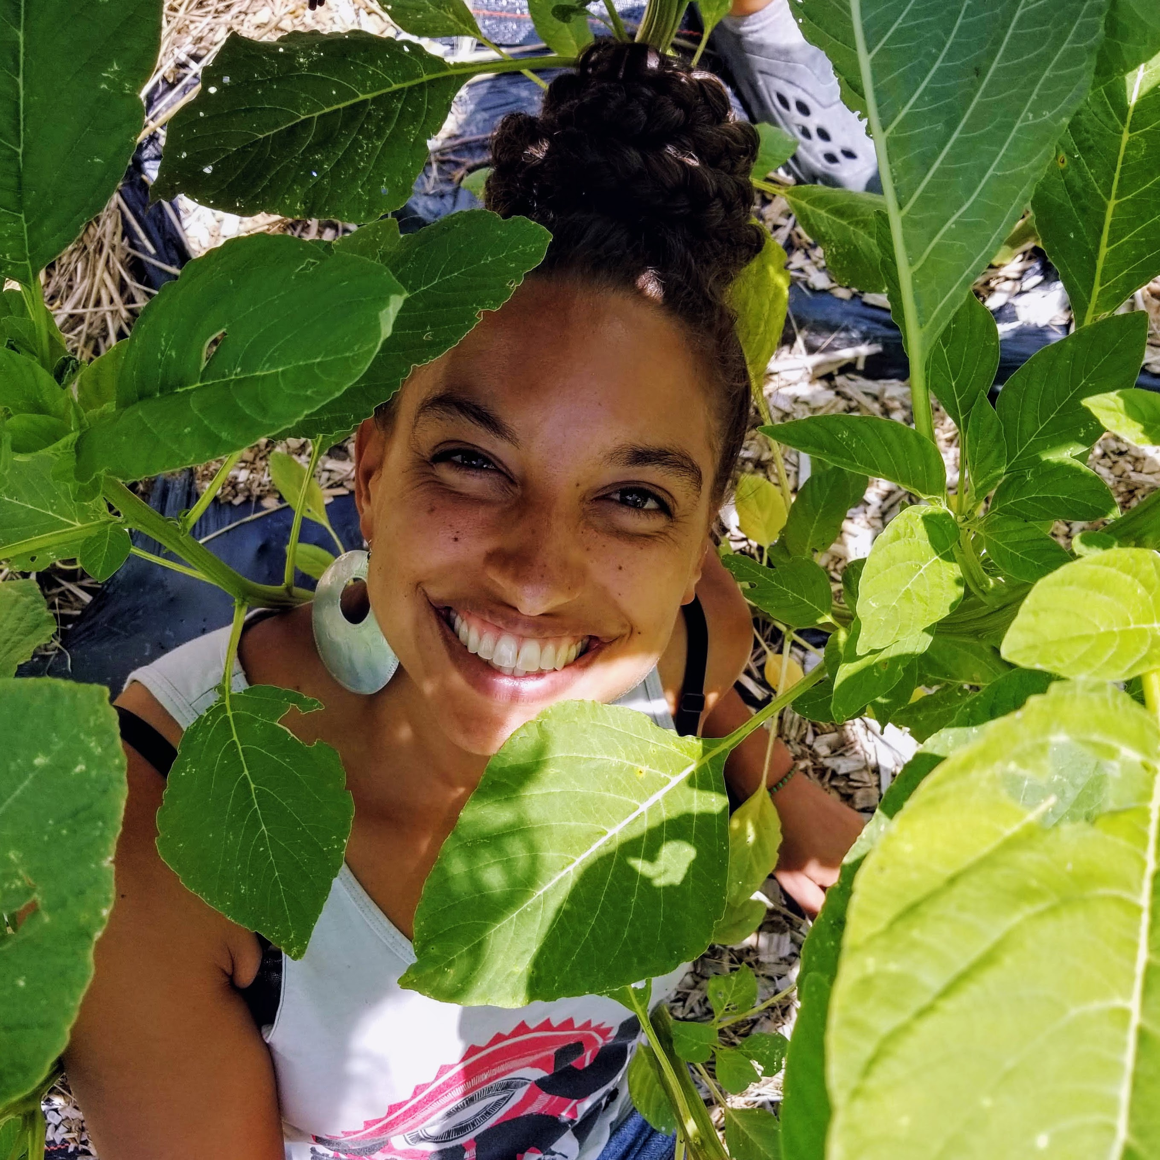
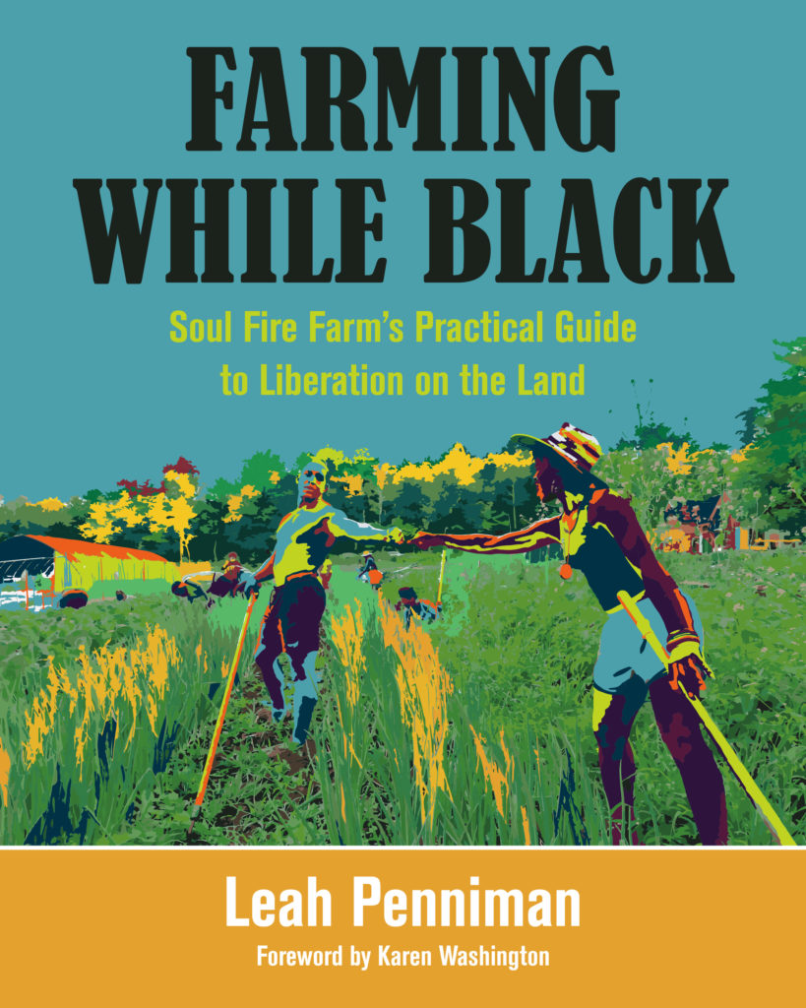
Leah Penniman
Farming While Black
Leah Penniman, Co-Director and Farm Manager, (Li*/Ya/She/He) has over 20 years of experience as a soil steward and food sovereignty activist, having worked at the Food Project, Farm School, Many Hands Organic Farm, Youth Grow and with farmers internationally in Ghana, Haiti, and Mexico. Li co-founded Soul Fire Farm in 2010 with the mission to reclaim our inherent right to belong to the earth and have agency in the food system as Black and Brown people.
Li’s book “Farming While Black” is a love song for the earth and her peoples.

Slide 13
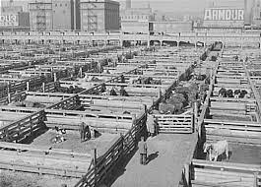
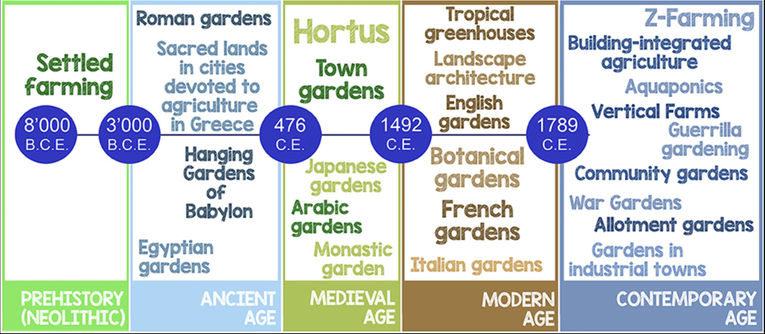
HISTORY
OF URBAN AGRICULTURE
“Urban agriculture seems new and exotic, but it's been the norm for cities since the dawn of farming 10,000 years ago.”
Tom Phillipot (Grist, 2010)
Orsini et al (2020) Features and Functions of Multifunctional Urban Agriculture in the Global North: A Review

Slide 14
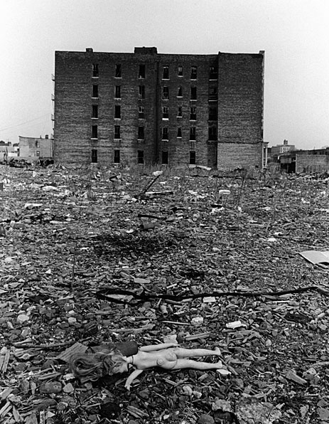
HISTORY OF URBAN AG
Penniman:
“The Great Migration that carried 6 million of our people out of the rural Southeast of the US and into the urban North, Midwest and West is often miscategorized as a voluntary exodus to exploit new economic opportunities. This truth is that our people were catalyzed to move because of segregation, land theft, racial terrorism, and lynching."
Migration
Discrimination in
housing
employment
schools
policing
National Housing Act of 1934 institutionalized pre-existing discrimination
Federal Housing Administration and HOLC: redlining maps
denied mortgages to Black people
Redlining lead to
lower property values
abandonment / arson
vacancy
population decline in Black neighborhoods
1960s and 1970's amid steep urban decline, arson, and divestment in urban neighborhoods, courageous Black and Latinx farmers revived their agricultural traditions by establishing community gardens
Photo: Mel Rosenthal (Phillipot, Grist, 2010), E 173rd and 14th Streets in the Bronx in the 1970’s

Slide 15
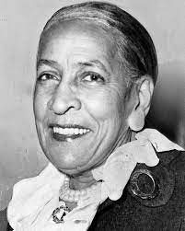
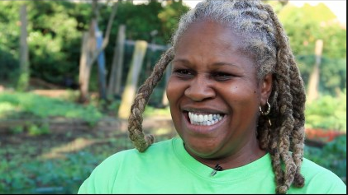
Urban Farmers of Color Created Urban Ag (UA)
in NYC and many other cities
“Neighbors transformed trash-strewn lots into urban oases with the support of their churches and neighborhood associations. Urban farmers of color removed rubble, planted trees, installed vegetable beds, and built structures for community gatherings.”
“White ‘pioneers’ have co-opted urban farming in many locations, attracting grants, media attention, and public influence denied to the Black founders of the movement.”
– Penniman
Hattie Carthan was among the nation’s first African-American community-based ecology activists
Karen Washington has lived in New York City all her life, and has spent decades promoting urban farming as a way for all New Yorkers to access to fresh, locally grown food.

Slide 16
Urban Farmers of Color Created Urban Ag (UA) in NYC and many other cities
"Individuals and corporations from outside the community are working to commercialize gardening and negate the original vision of home provisioning, safe spaces, and cultural maintenance for immigrants.
‘We have been here from the beginning. We tested the soil, put in raised beds, and have grown food sustainably and efficiently. Community gardeners are farmers. We are strong and we have done so much with nothing. We are the ones who can feed the world. We know how to work and what to do. If you give us the capital, land, and opportunities, we can move mountains.’”
- Washington, quoted in Penniman “Urban Farming”

Slide 17
FOOD JUSTICE
Decolonizing Food Justice:
Naming, Resisting, and Researching
Colonizing Forces in the Movement
Hank Herrera
Katharine Bradley
Hank dedicated his life to fighting for racial, economic and environmental justice, and for the right of indigenous people and communities to define their own food systems and tell their own stories.
Researcher and educator in political ecology, food systems, and climate justice

Slide 18
FOOD JUSTICE
Original vs. Moralist Notions
“The food justice movement is fundamentally a social justice movement. It takes issue with the inequalities in access to food, exploitative labor practices in the food system, and environmental degradation associated with conventional agriculture and environmental racism
(Alkon and Agyeman 2011; Gottlieb and Joshi 2010).”
The original notion of food justice:
“struggles against racism, exploitation, and oppression taking place within the food system (Hislop 2014) are integrated with practical efforts to establish fair, equitable access to fresh, healthy, affordable, culturally appropriate food in vulnerable neighborhoods, especially low-income neighborhoods and communities of color, with ownership and governance of the means of production and exchange accessible to people who eat this healthy food.”
”A moral imperative to establish ‘access’ to local food without regard for the ownership and governance of the means of production and exchange represents a moralist notion of food justice.”

Slide 19
FOOD JUSTICE
De/Anti-Colonizing Methods from Bradley and Herrera
“Based on an extensive review of leadership literature, Batliwala offers several elements of feminist leadership that, we contend, are highly relevant to the formation of a decolonized research agenda for food justice. They include
Making ‘the practice of power visible, democratic, legitimate and accountable, at all levels, in both public and private realms’ (2010:18);
‘an active participatory attitude, and inclusion, at all levels of the organization,’ particularly of people from marginalized groups (2010:26);
an intervention ‘in structures of power that keep the world unjust’ and
a challenge to multiple, intersecting oppressions (2010:26);
creating a ‘more gender and socially equitable architecture’ (2010:27); and,
ultimately, it must connect practices of power, politics and values.”
“The definitions, the practice, and the study of food justice must center and privilege indigenous knowledge, values, beliefs, interests, needs, hopes, and dreams.
The food justice movement and food justice research require leadership from indigenous communities.
When a formal research endeavor ignores the original notion of food justice, it is complicit in a colonizing process.”
“Collaboration requires that we accept each other’s faults, are willing to acknowledge when we are wrong, and trust each other’s commitment to justice.”

Slide 20
Let’s discuss
What stands out to you as most important?
Thinking about the organizations you researched – were they aligned with the original or moralist notions of food justice? How do you know?

