Slide 1
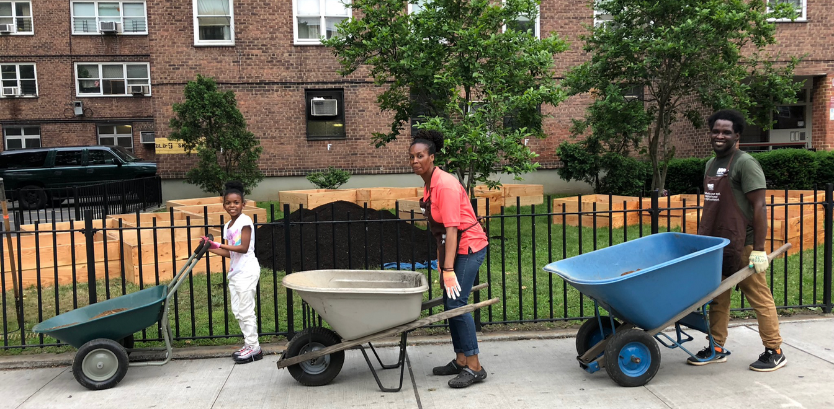
SOIL and HUMAN
SYSTEMIC INTERACTIONS
Dr. S. Perl Egendorf
EESC 1201 Class 8
March 27, 2023

Slide 2
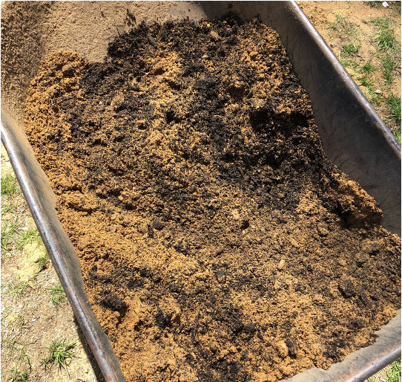
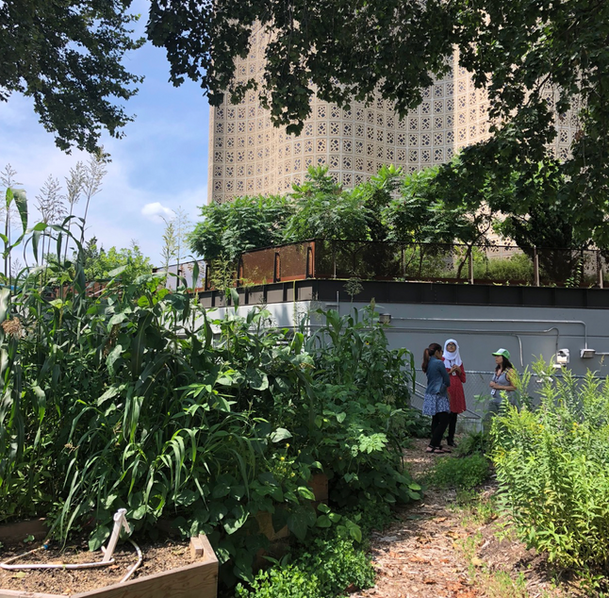
OVERVIEW
Acknowledgments
A multiscalar systems approach
Why soil? (Aumundson et al., 2015)
Defining environmental justice and environmental racism
Applying a systems approach to lead (Pb) in soil (Egendorf et al., 2021)
Ongoing projects – constructing just soils

Slide 3
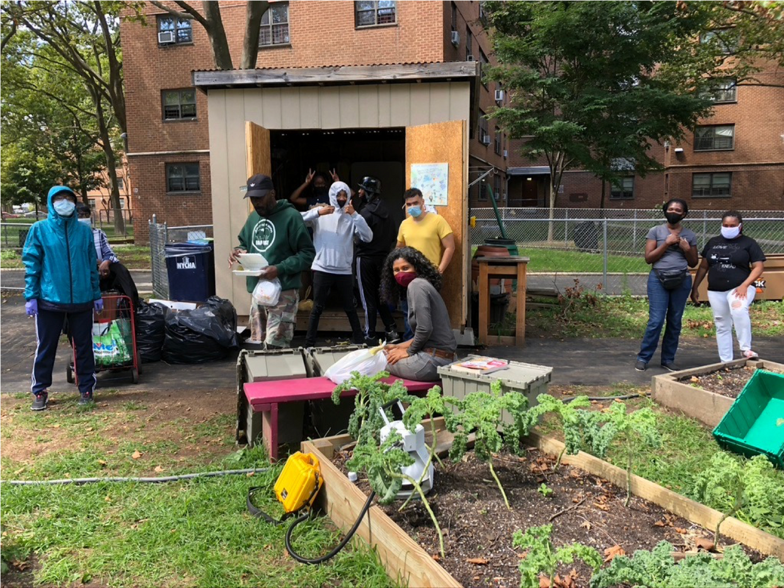
For Supporting:
Food justice
Food sovereignty
Personal health
Community wellbeing
Urban green space
Reduced waste
Mitigating climate change
Enhancing ecosystem health
Creating healthy soils, in concert with bacteria, archaea, protists, plants, fungi, and other animals
THANK YOU
URBAN GROWERS!

Slide 4
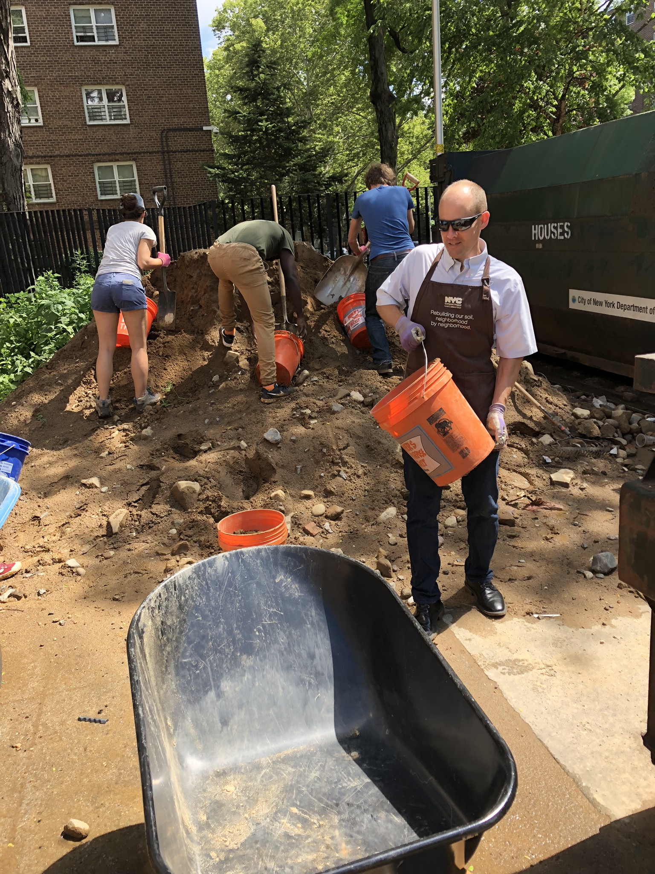
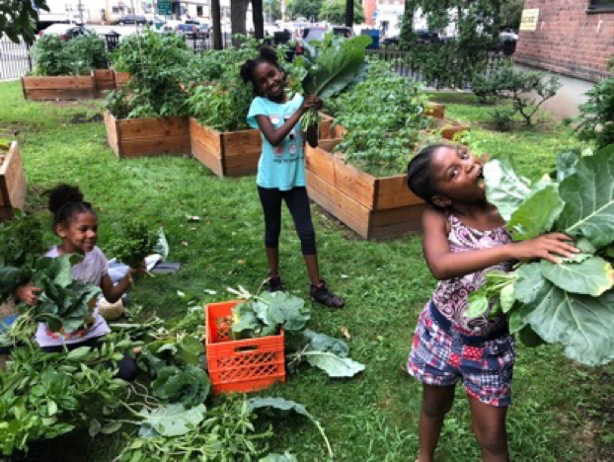
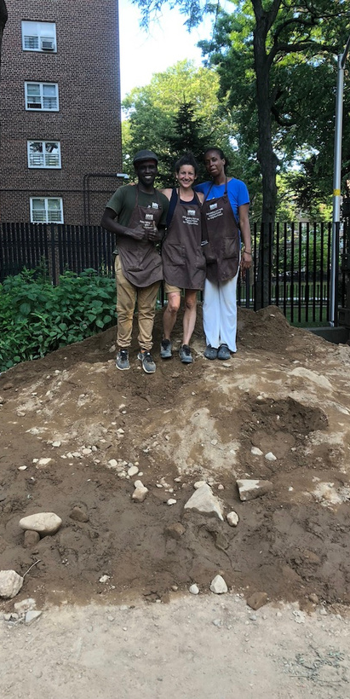
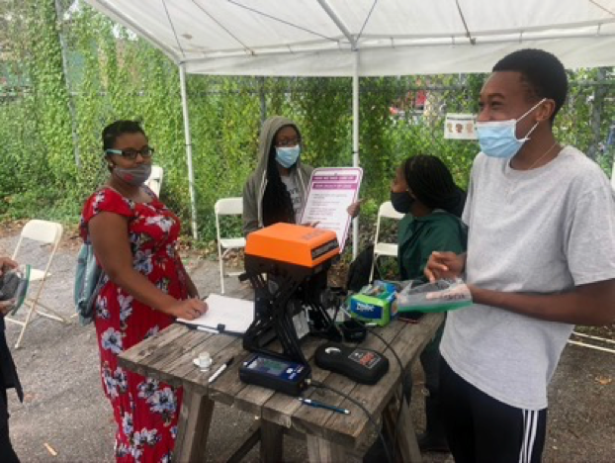
DSNY / NYC Compost Project Hosted by Earth Matter
NYC Mayor’s Office of Environmental Remediation (OER)
CUNY, Cornell, Columbia
NYC Parks / GreenThumb
NYS DOH
NYCHA
NYBG, BBG, QBG, Snug Harbor
>20 Greening Orgs
RESEARCH COLLABORATORS
32
Urban Farms
>500
Community Gardens
>200
School Gardens
>100
NYCHA Gardens

Slide 5
SYSTEMS THINKING / SYSTEMS MAPPING / SYSTEMS SCIENCE

Slide 6
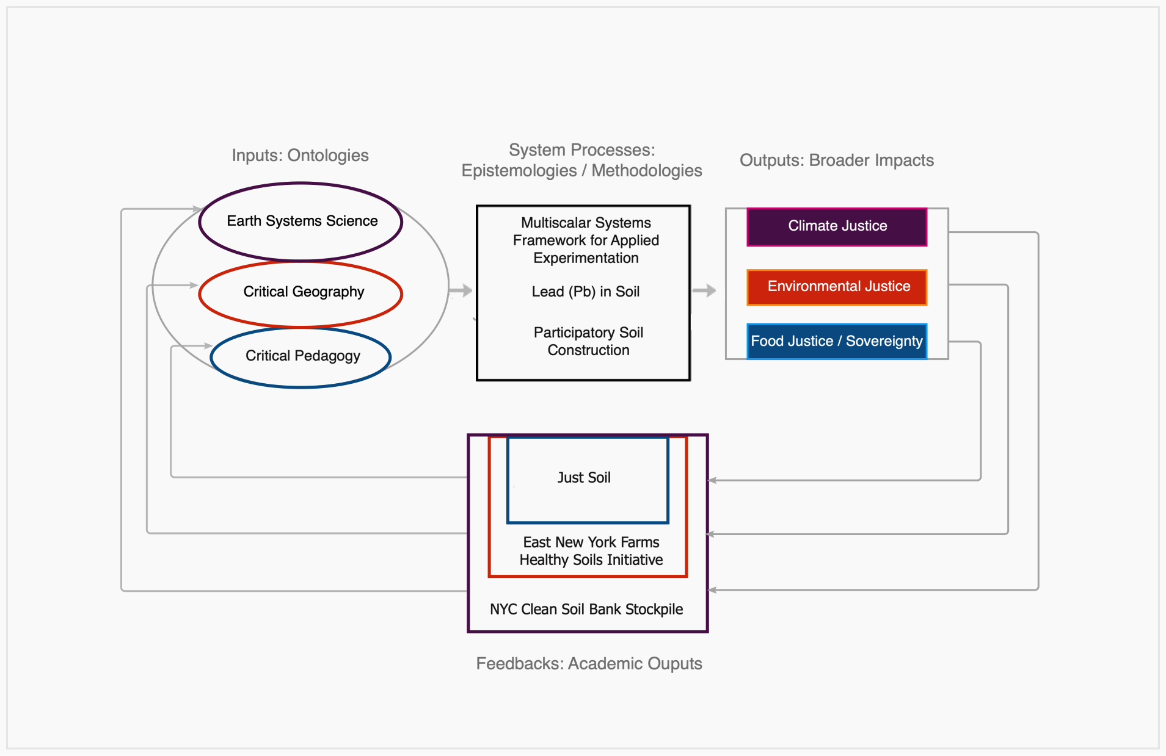
RESEARCH OVERVIEW

Slide 7
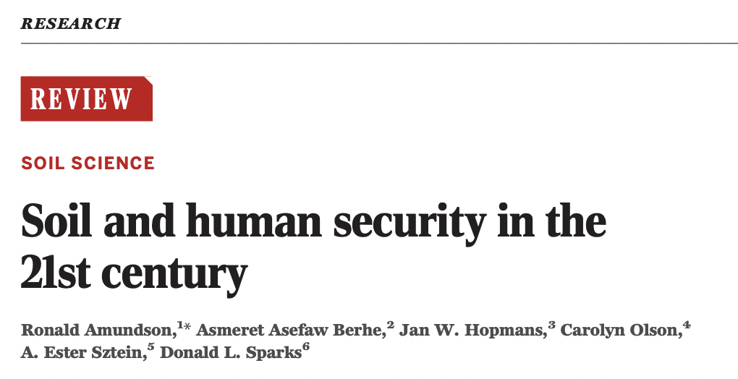
Human security has and will continue to rely on Earth’s diverse soil resources
Yet we have now exploited the planet’s most productive soils.
Soil erosion greatly exceeds rates of production in many agricultural regions.
Nitrogen produced by fossil fuel and geological reservoirs of other fertilizers are headed toward possible scarcity, increased cost, and/or geopolitical conflict.
Climate change is accelerating the microbial release of greenhouse gases from soil organic matter and will likely play a large role in our near-term climate future.
The direct and indirect response of soils to past and future human activities will play a major role in human prosperity and survival.
Stability of soil systems
Controlled by balance of inputs and losses of nutrients and carbon Farms
Erosion of soil
Orders of magnitude faster than it is replenished
Carbon emissions
Agriculture’s “slow ignition of Earth’s largest surficial reservoir of carbon” – capable of driving large positive feedbacks, accelerating climate change

Slide 8
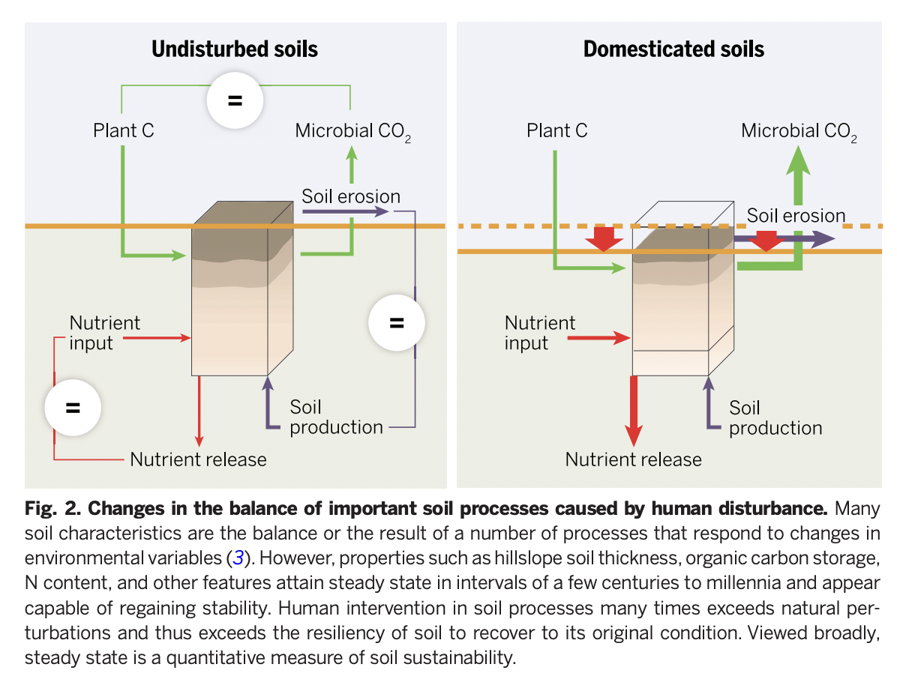

Slide 9
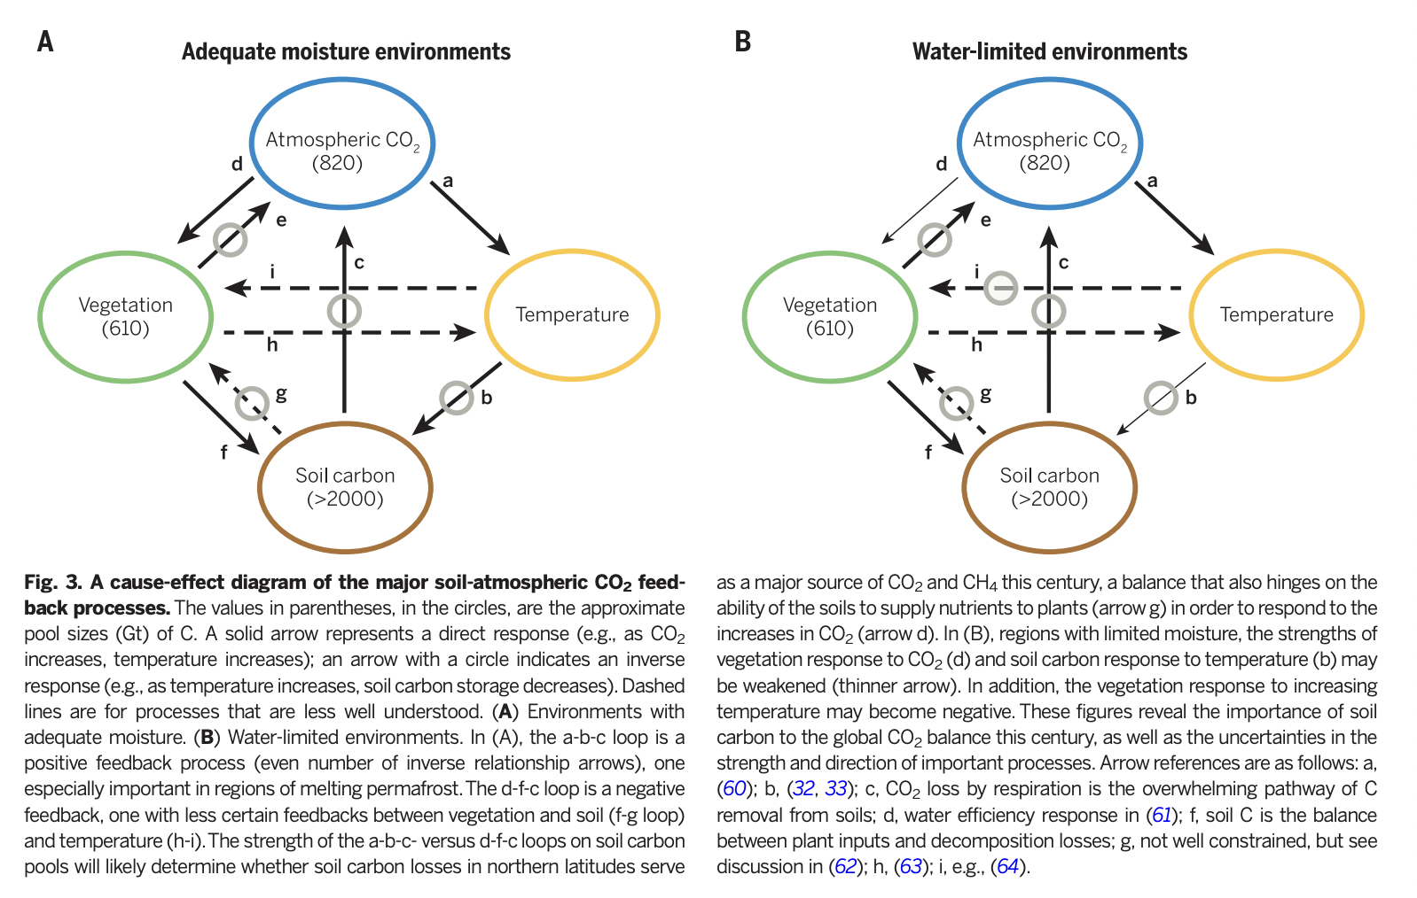

Slide 10
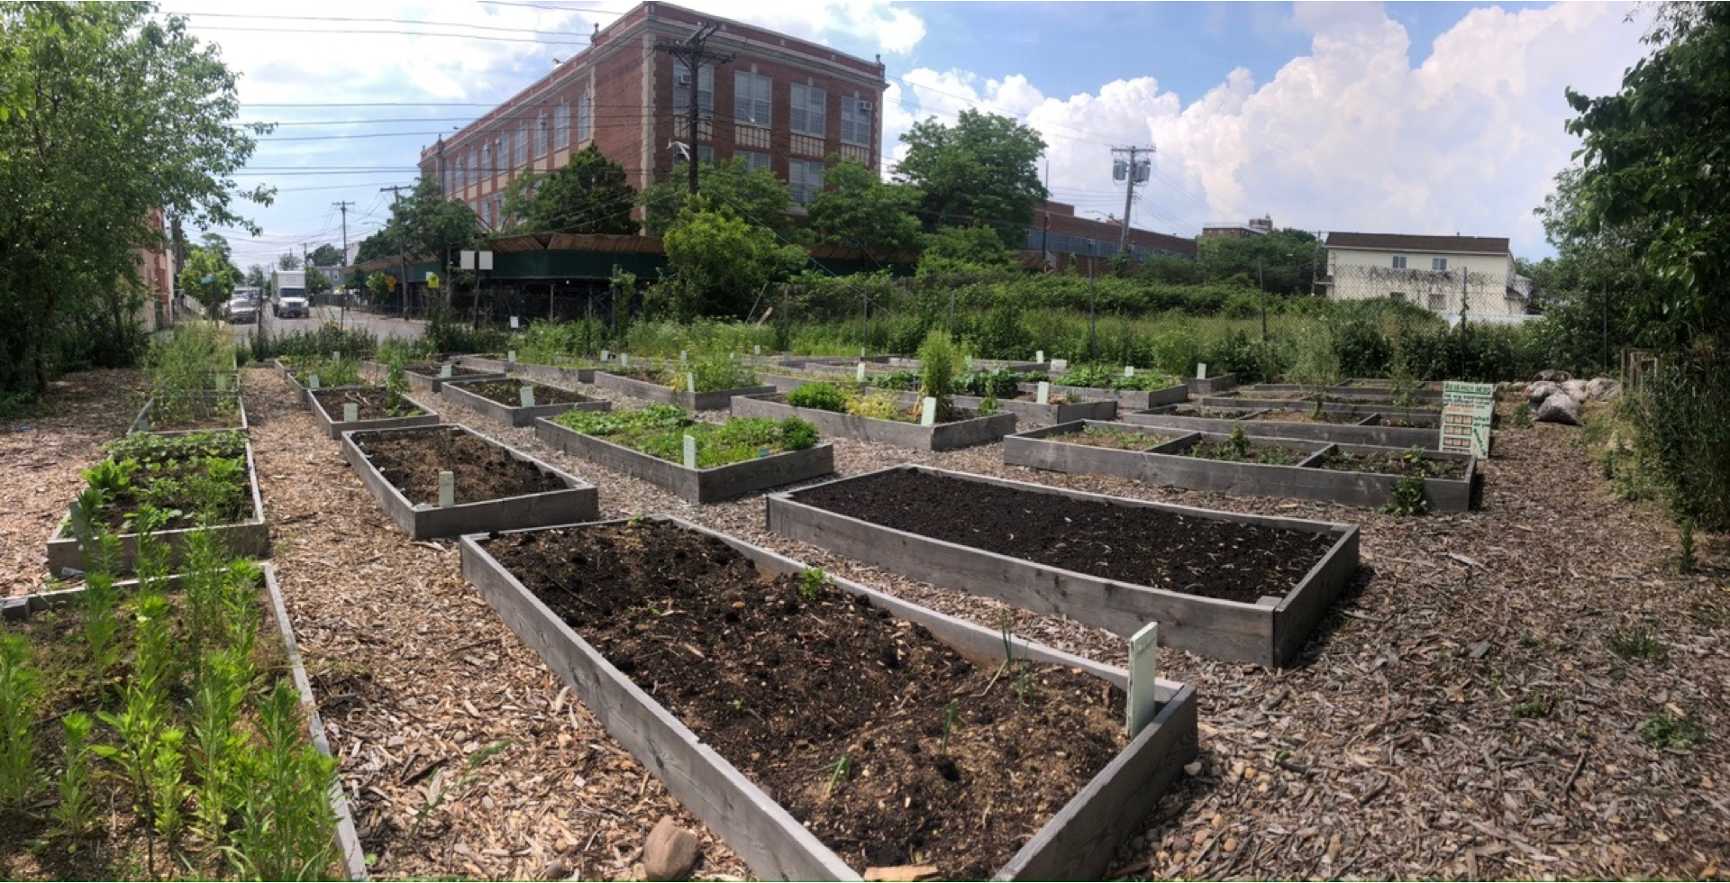
What is
Environmental Justice?
East New York Farms! Wortman Community Garden

Slide 11
EJ AND ENVIRONMENTAL RACISM
EJ scholar Dr. Robert Bullard:
“All people and communities are entitled to equal protection of environmental and public health laws and regulations.”
Benjamin Chavis, former head of United Church of Christ’s Commission on Racial Justice:
“Environmental racism is racial discrimination in environmental policymaking, the enforcement of regulations and laws, the deliberate targeting of communities of color for toxic waste facilities, the official sanctioning of the life-threatening presence of poisons and pollutants in our communities, and the history of excluding people of color from leadership of the ecology movements.”
Pellow (2017), Bullard (1996), Holifield (2001)

Slide 12
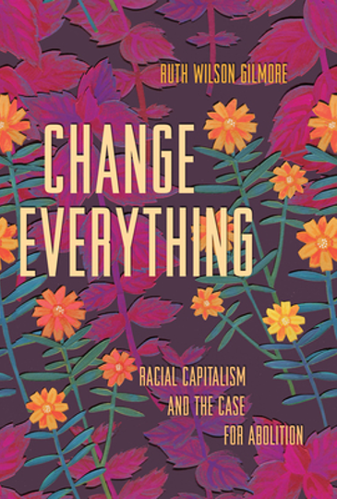
Racism is not just targeted bigotry or prejudice
It is a structure that makes certain groups of people more vulnerable to premature death (Gilmore, 2007).
Environmental racism is state-sanctioned violence and a constituent part of racial capitalism (Pulido, 2017).
A system based on exploitation of land and labor (workers), so that profits accumulate for a small fraction of the population (owners).
This exploitation has always been racialized, even before capitalism began in Europe (Robinson, 2000).
ENVIRONMENTAL RACISM AND STRUCTURAL VIOLENCE

Slide 13
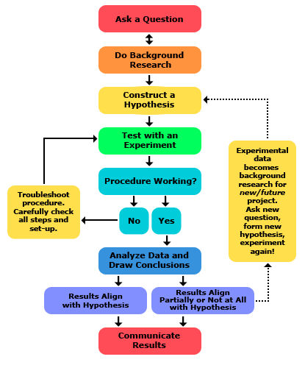
How can researchers engage with systemic issues pertaining to environmental injustices?
Hypothesis:
Use systems science
Develop applied and participatory experiments
Analyze outcomes / results
Revise experiments as necessary

Slide 14
SYSTEMS THINKING / SYSTEMS MAPPING / SYSTEMS SCIENCE

Slide 15
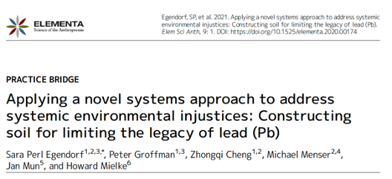
1. Conceptualize human and non-human systemic interactions at multiple scales
2. Identify interventions that have been attempted to change system (at various scales)
3. Conduct applied and participatory experiments to study effects of intervention with potential to create more just and sustainable systemic outputs

Slide 16
Egendorf et al. (2023)

Slide 18
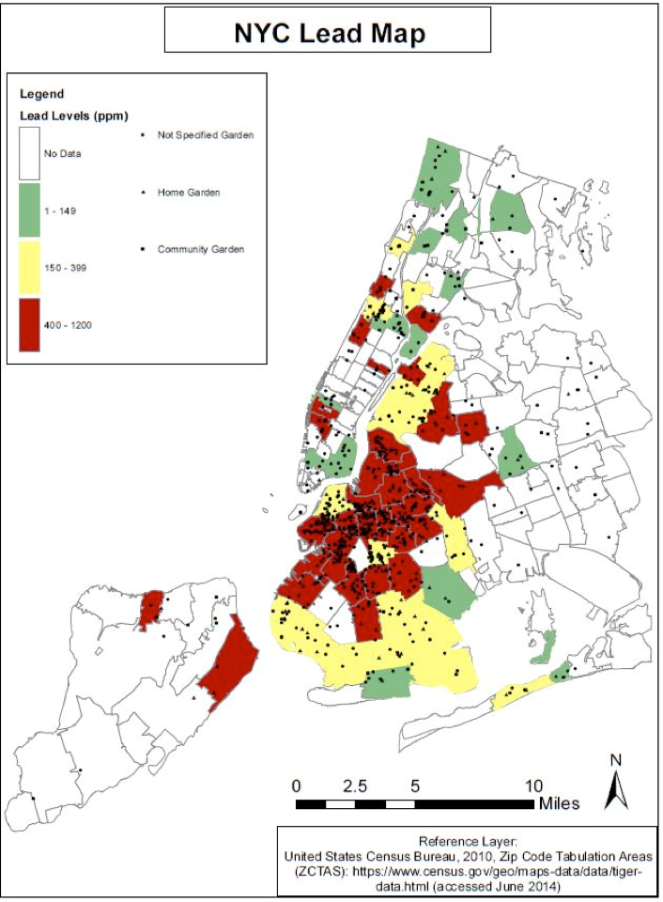
THE LEGACY OF LEAD IN SOIL
No systematic map of NYC soil Pb has been created, but Pb concentrations above EPA standards (400 ppm) are common in cities worldwide
Cheng et al., (2015)

Slide 19
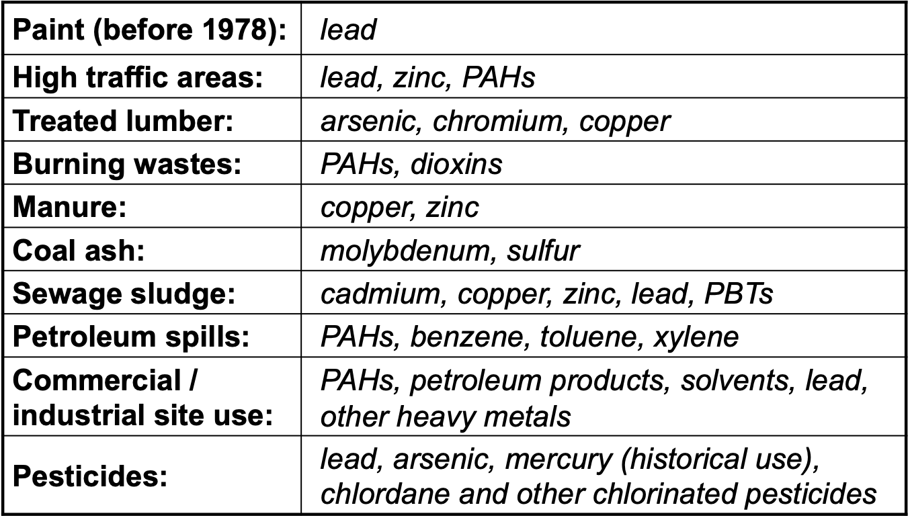
COMMON SOURCES OF SOIL CONTAMINANTS
Lead is common and “easy” to test for, but is NOT the only issue!
We refer to lead for simplicity, but other contaminants should be kept in mind
Hannah Shayler /
Healthy Soils Healthy Communities

Slide 23
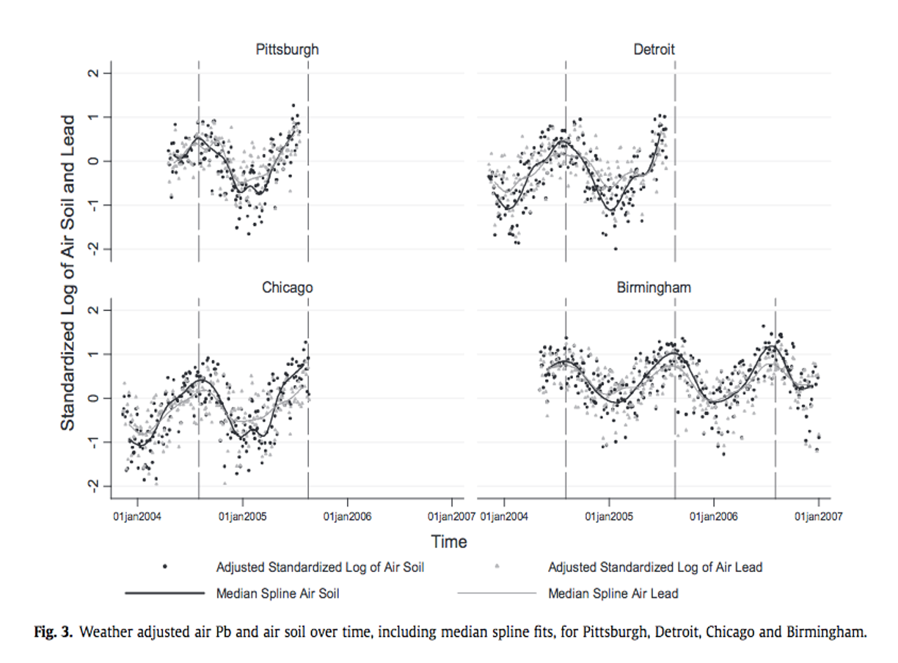
ONGOING SOURCES OF LEAD IN SOIL: DUSTS
DUSTS + LEAD GET BLOWN BY WIND
Laidlaw et al., (2012)
Mielke et al., (2011); Mielke and Reagan, (1998)

Slide 24
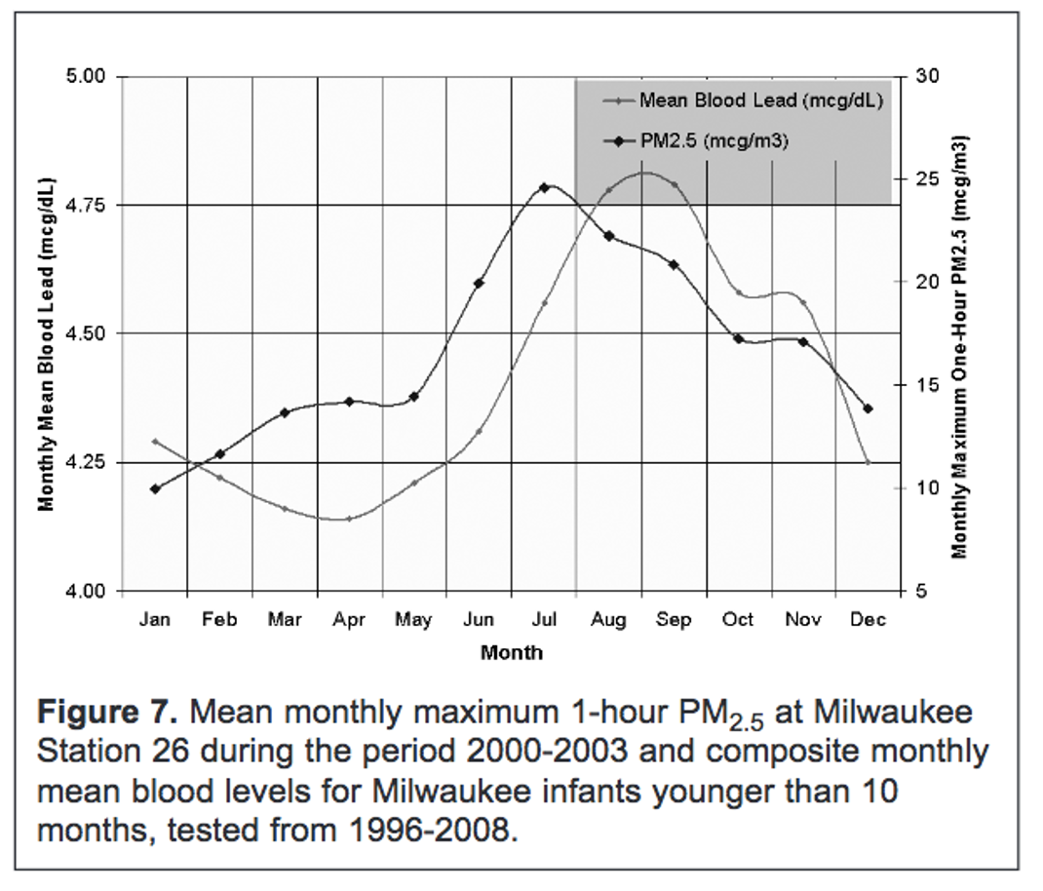
DUSTS ARE EASILY INHALED
Here we see dusts in the atmosphere in the summer correlated with elevated Blood Lead Levels (BLLs)
Dust --> Human Lead Exposure
Havlena et al (2009)

Slide 26
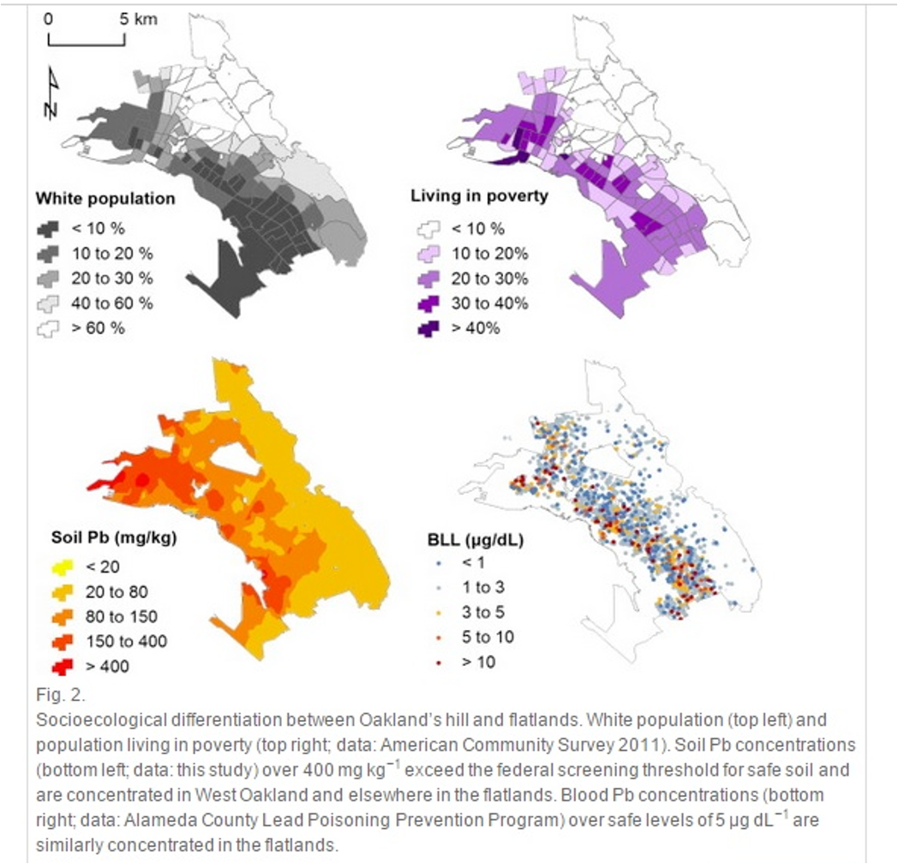
SOIL LEAD AND ENVIRONMENTAL INJUSTICE
As with many environmental issues, low income communities of color tend to be more at risk of soil Pb exposure
In these Oakland, CA maps, we see high soil Pb associated with
-Communities of color
-High rates of poverty
-Elevated Blood Lead Levels (BLLs)
McClintock (2015)

Slide 27
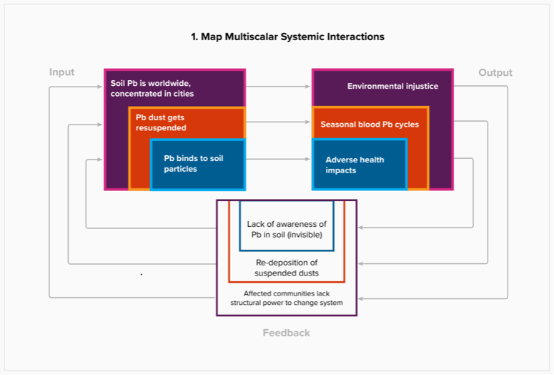
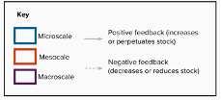

Slide 30
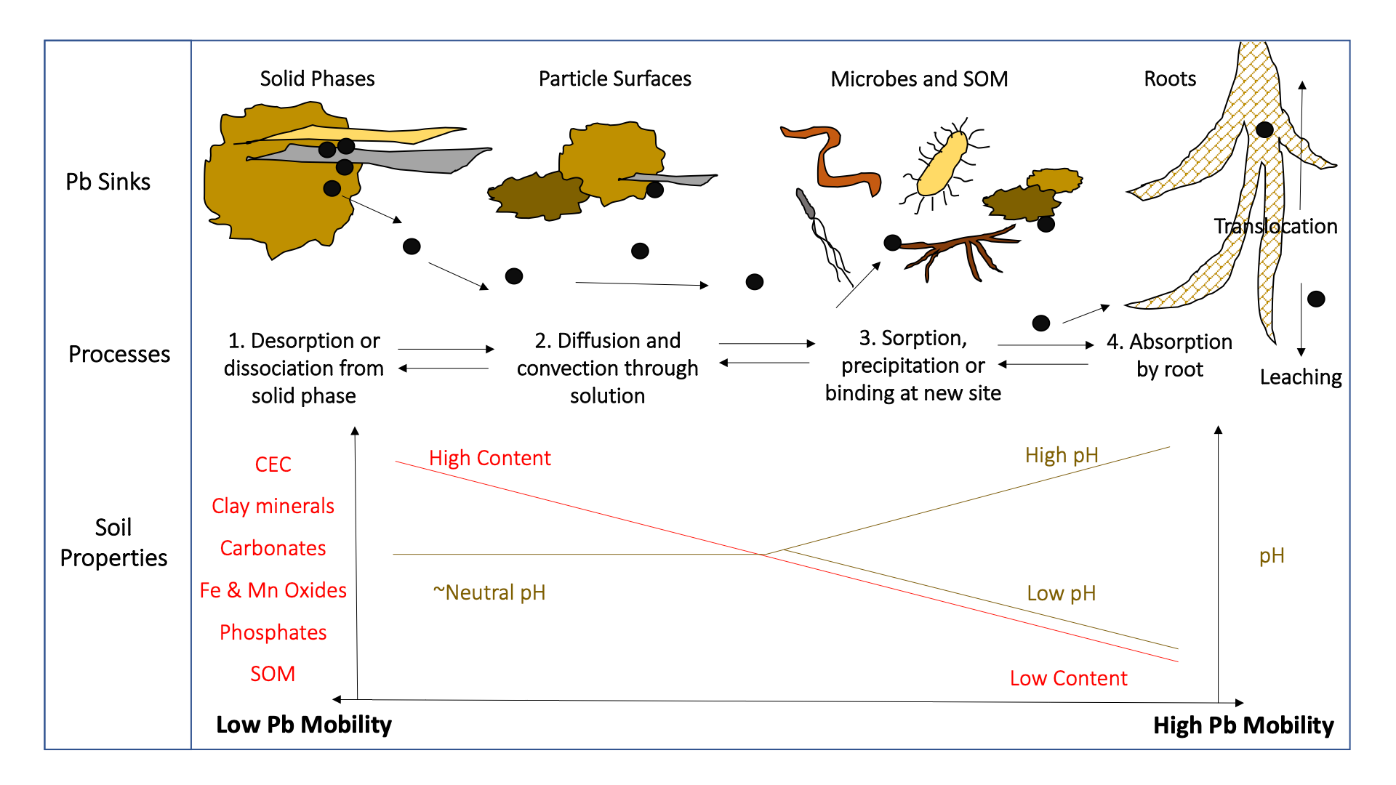
Why are there Misconceptions? Pb in Soil is Complicated
Egendorf et al (2020)

Slide 32
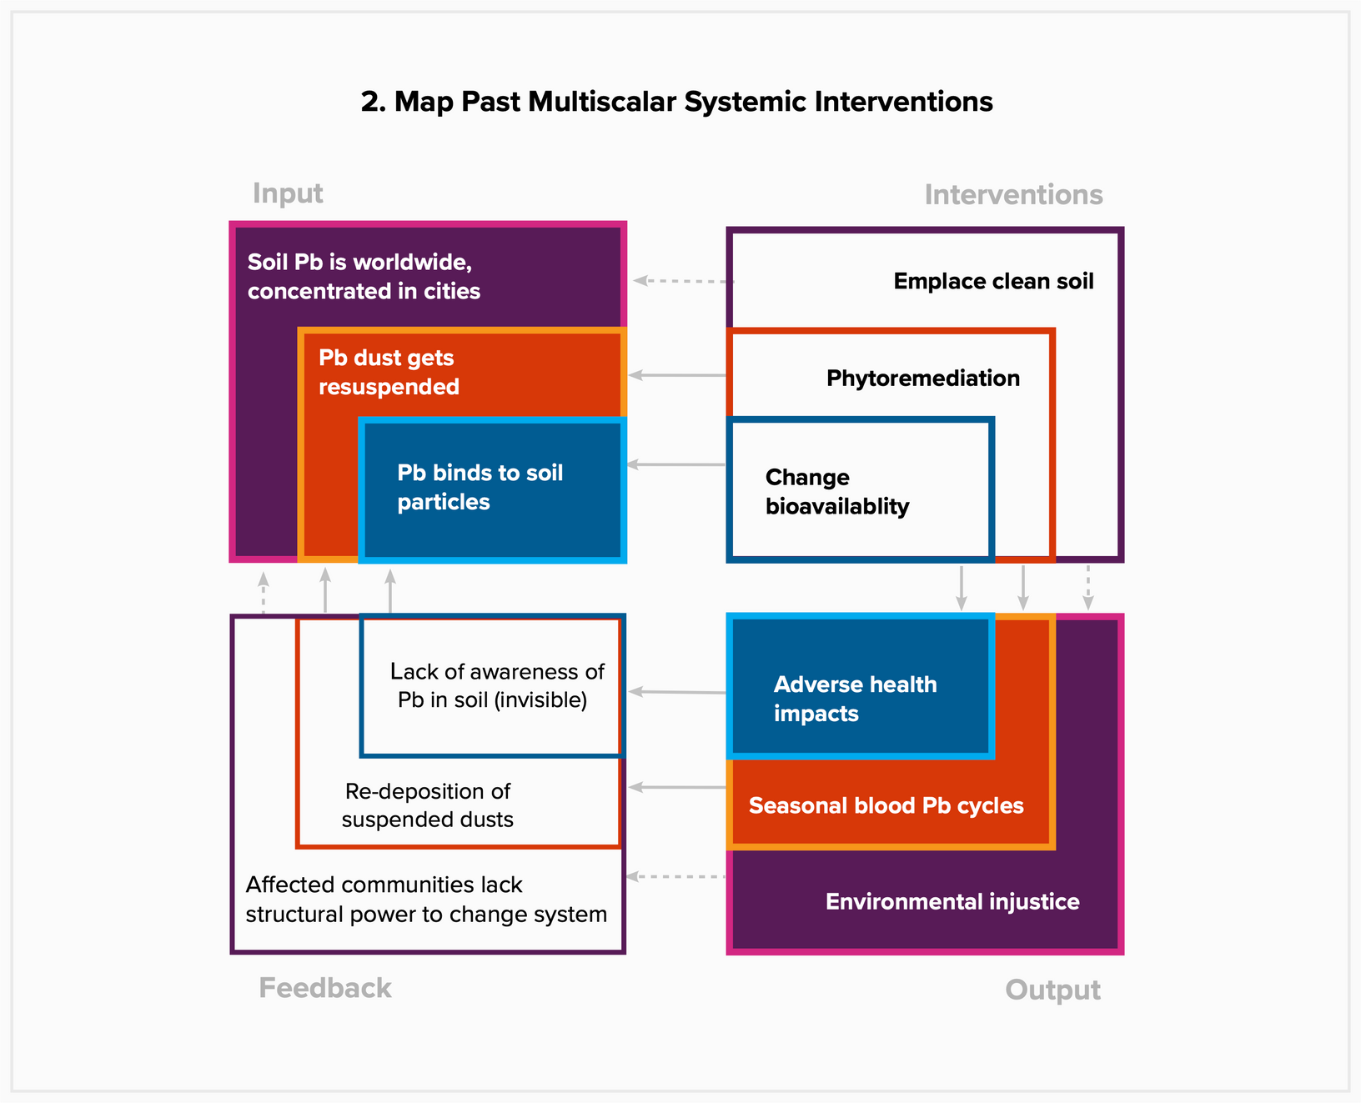
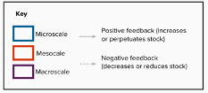

Slide 33
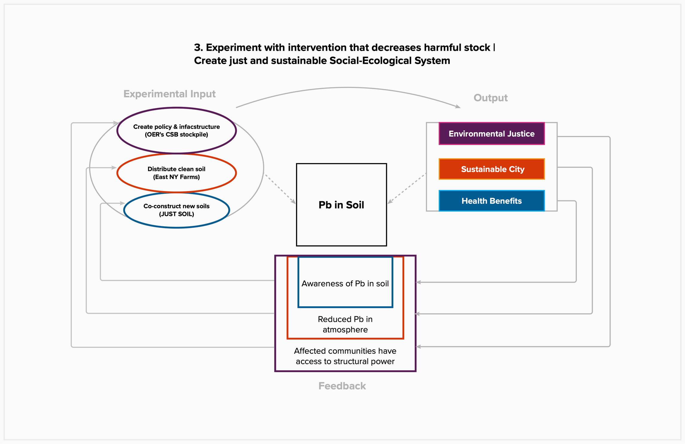
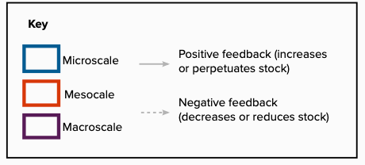

Slide 34
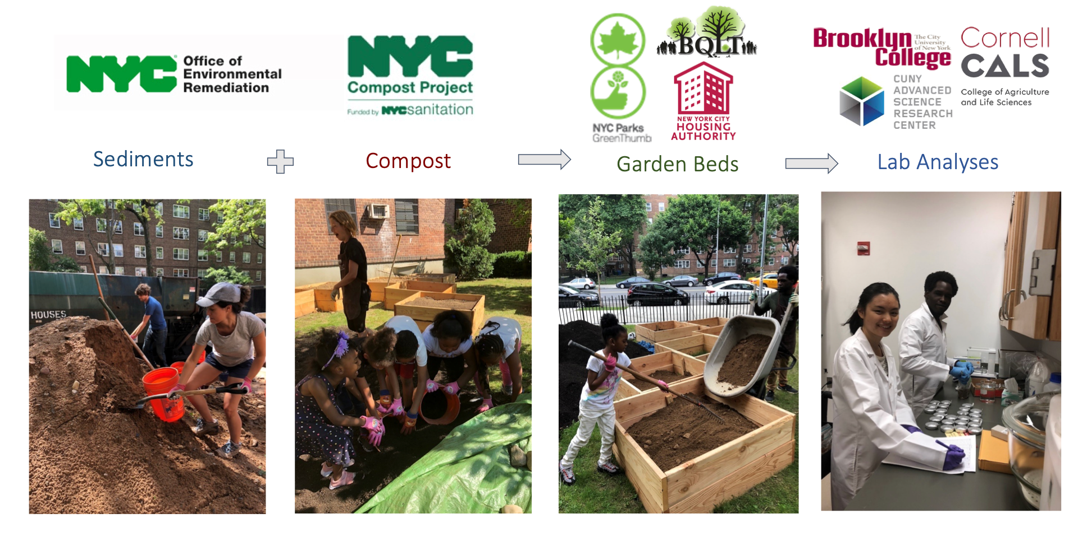
CONSTRUCTING NEW SOIL
NYC CLEAN SOIL BANK (CSB)

Slide 35
RESULTS: AGRONOMIC PROPERTIES OF SOILS
Table 2: Mean (n=6), soil parameters in Clean Soil Bank sediment (CSB S) and compost percentage admixtures (CSB 20%, CSB 33%, CSB 50%) used in study and control soil (CON). Mean values were taken from gardens 1, 2 and 3 directly after mixing in June, 2015.

Slide 36
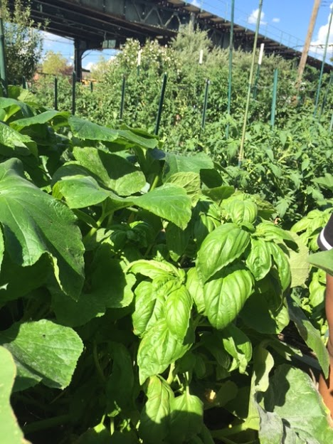
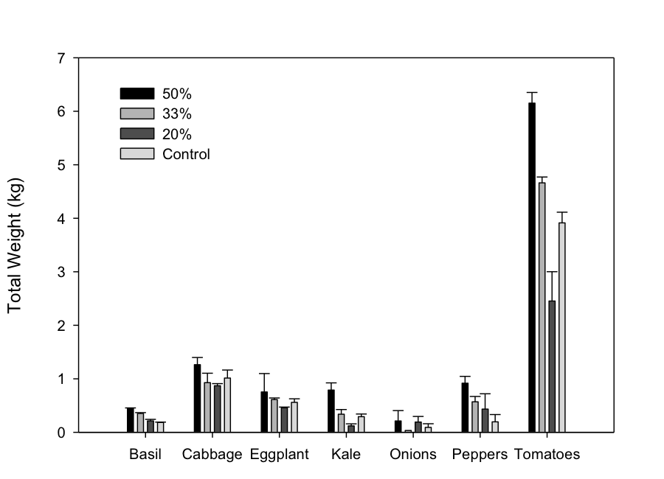
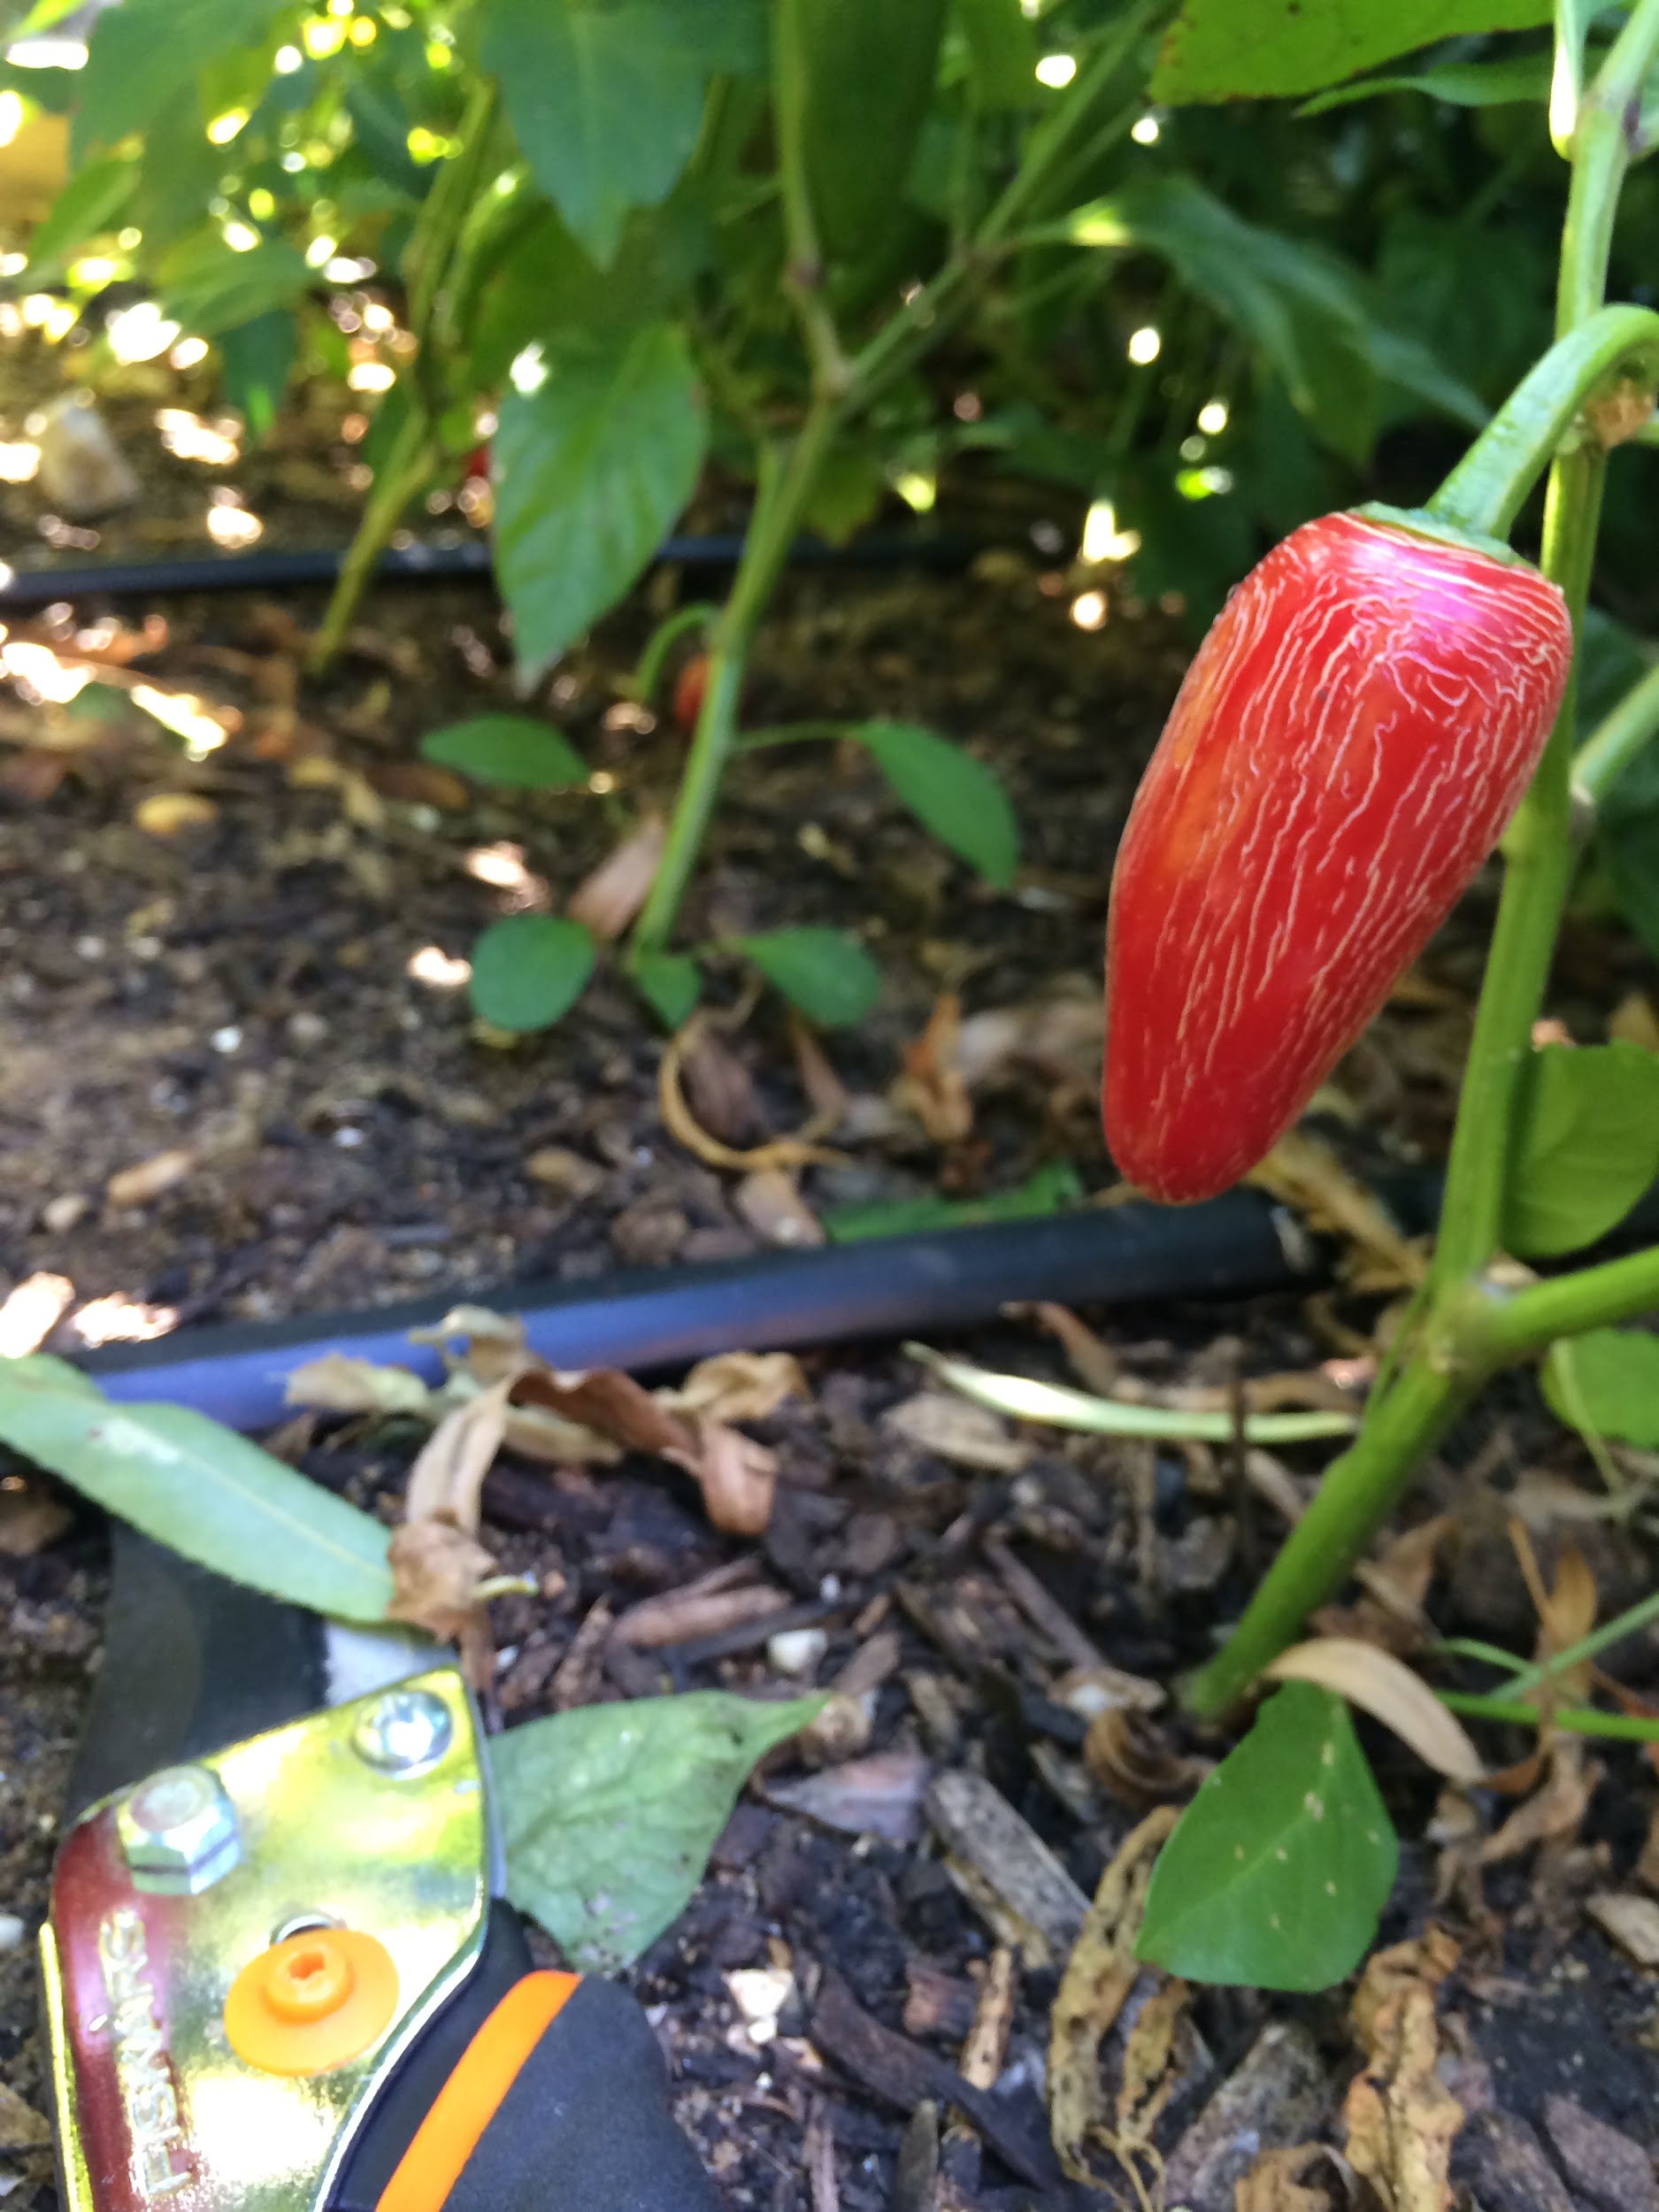
RESULTS: TOTAL AGRONOMIC YIELD
Figure 4: Mean ± SE of crop yield (kg) in fresh weight (f.w.). Values are mean of CSB compost admixture beds (20%, 33%, 50%) and control soils from gardens 1 and 2.

Slide 37
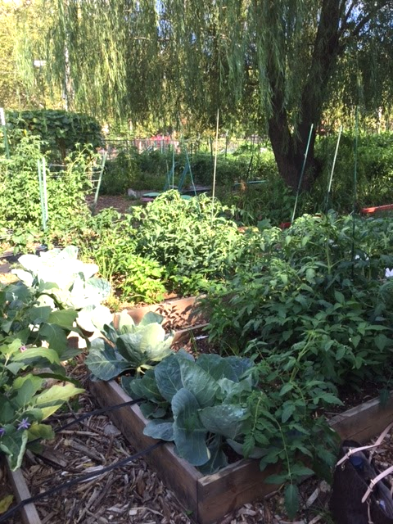
FINDINGS:NYC CLEAN SOIL BANK MIXTURES CREATE VIABLE GROWING MEDIA
Soil parameters indicate mixtures are suitable for edible crops
At least 33% compost by volume was adequate for yield
Crops show no evidence of contamination
Soil metal concentrations remained low over initial two years of study
Egendorf et al., (2018)

Slide 38
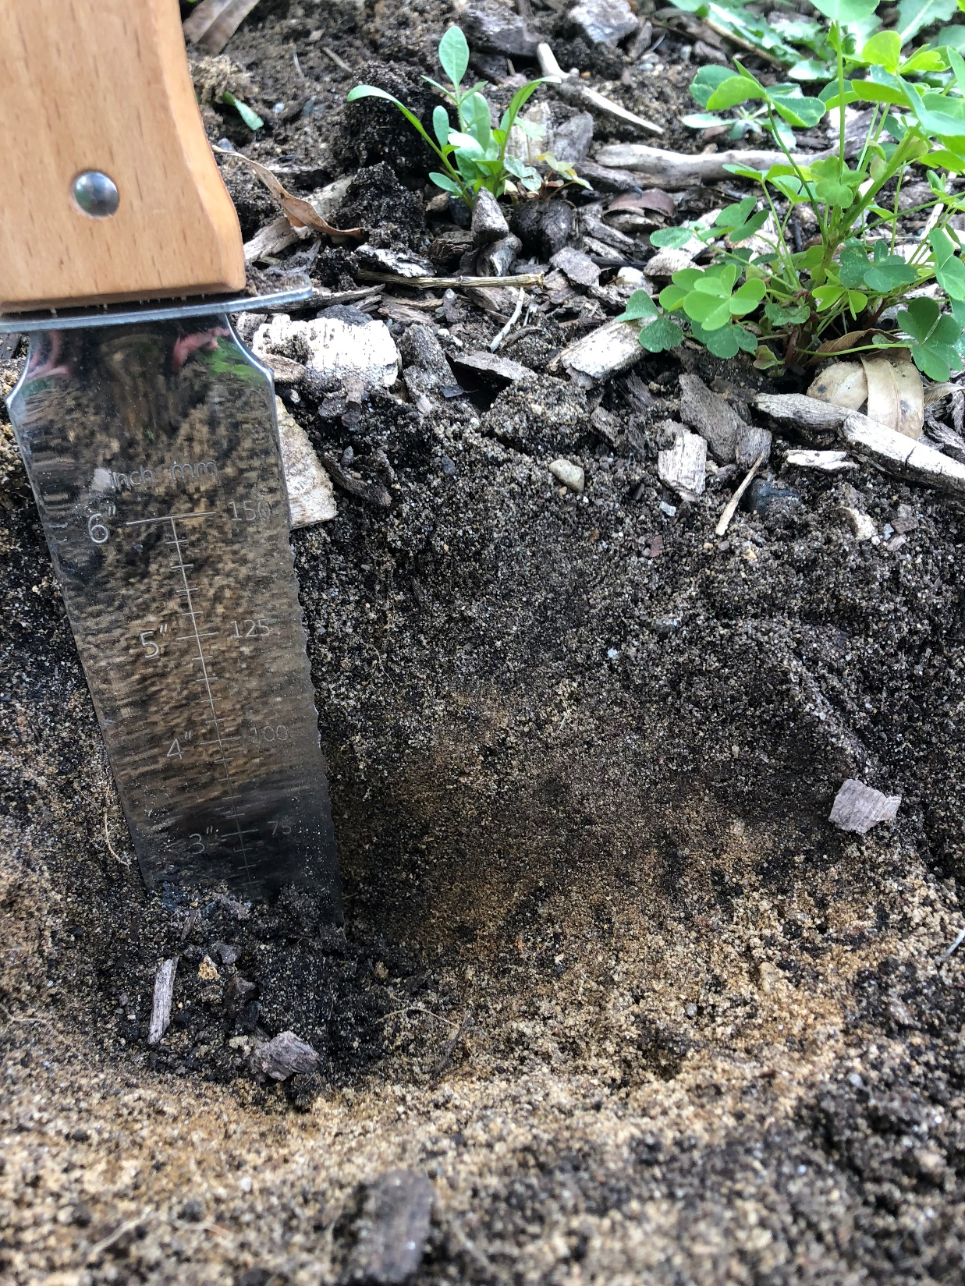
ENYF 33%
In 2018
What biological, chemical, and physical processes are going on in these newly constructed soils over time and in different spaces?
What ratios and types of compost enhance crop production?
How much carbon is being sequestered?
How might we optimize these conditions?
E 43rd St 33%
in 2018

Slide 39
CURRENT EXPERIMENTS CONSTRUCTING SOIL IN NYC
Biogeochemical
Social
Conduct participatory research
on soil mixtures
with NYCHA communities, and others
[Just Soil & Carbon Sponge]
Micro
Construct new
CSB soil mixtures
Study infrastructure development
with city agencies and organizations
(DSNY, Parks Department…)
[ENYF Healthy Soil Initiative, NYCCP PAR]
Evaluate soil development
over time
with multiple producers
Meso
Support policy, infrastructure,
and funding for self-sustaining
soil distribution and
education system
in NYC and other collaborating regions
[OER’s Stockpile, International Technosol Commission]
Continue to quantify volumetric
soil exchanges and
surface contaminant covers
over space and time
Macro

Slide 40
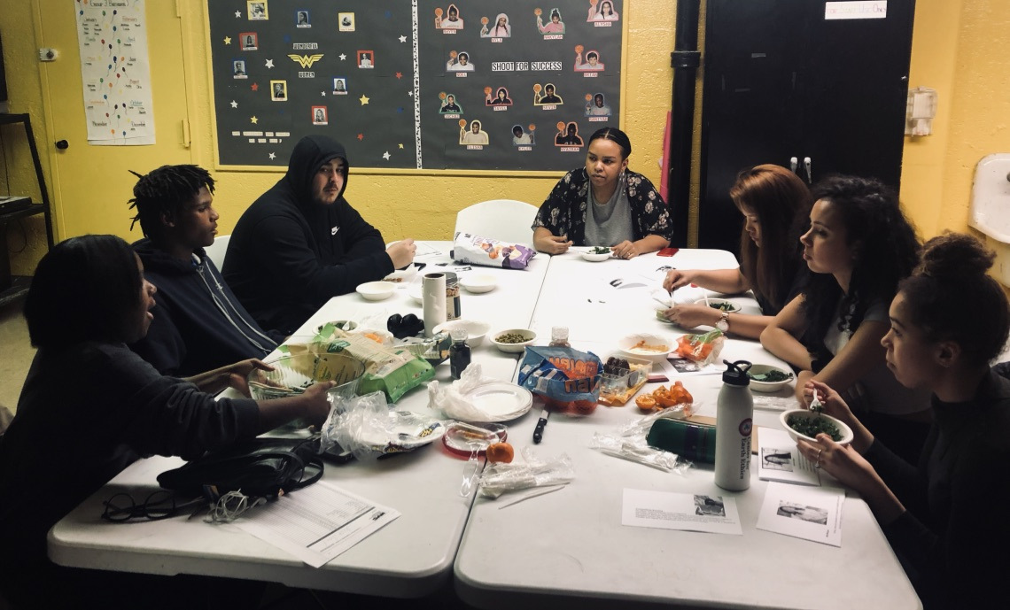
MICROSCALE EXPERIMENTS: JUST SOIL
NYCHA Ravenswood, NYCCP Hosted by Big Reuse, NYS Ag and Markets Grant, CUNY, Cornell

Slide 41
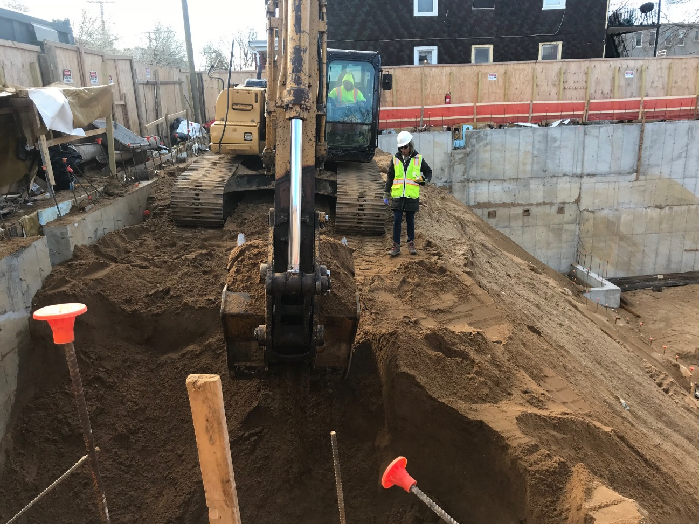
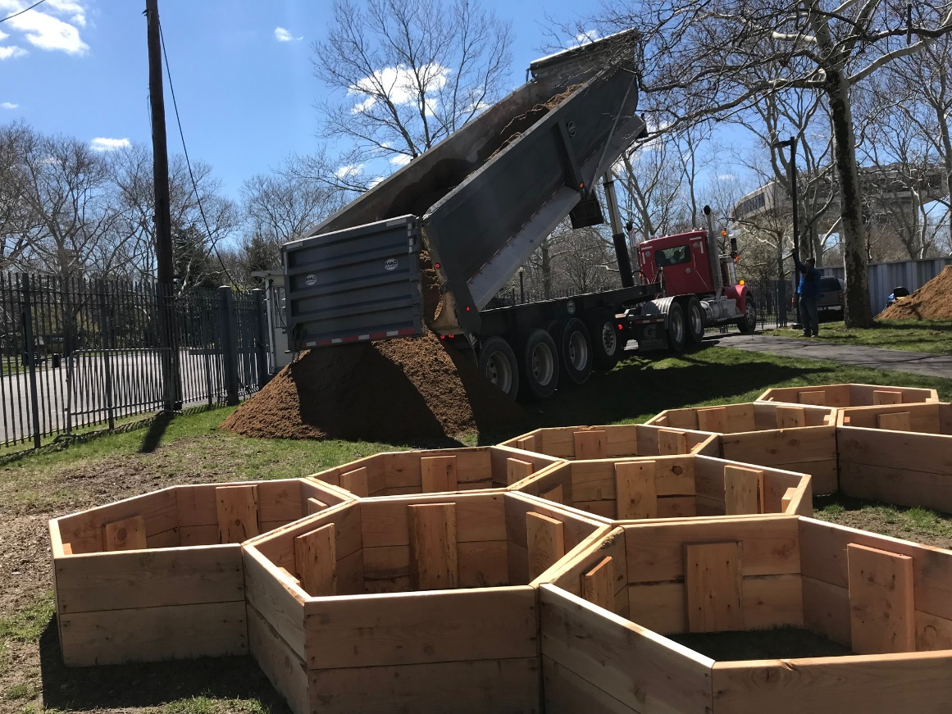

Slide 42
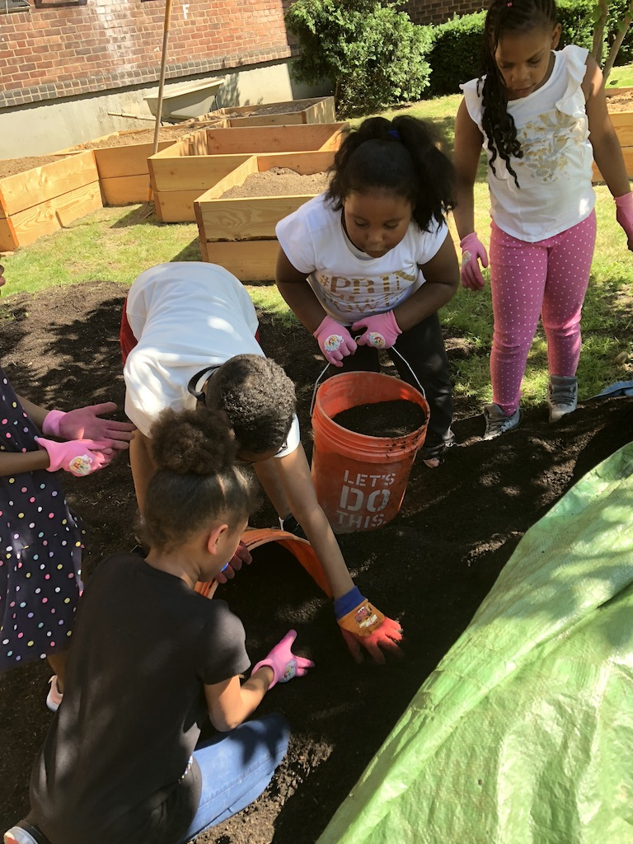

Slide 43
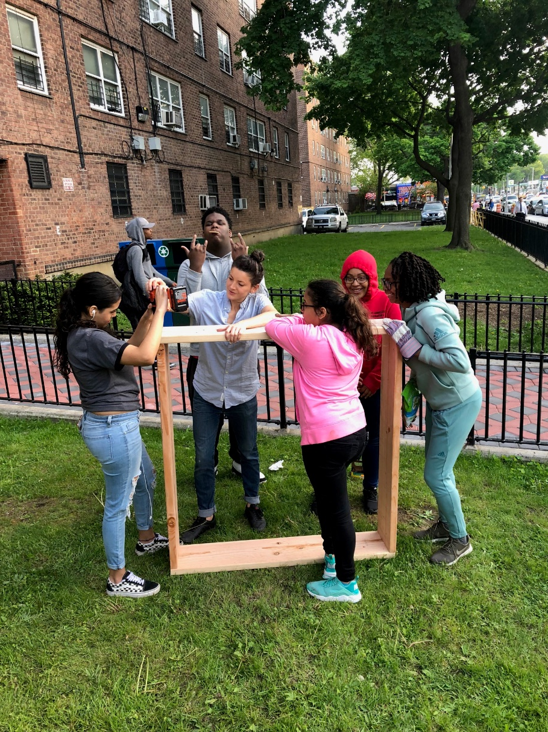
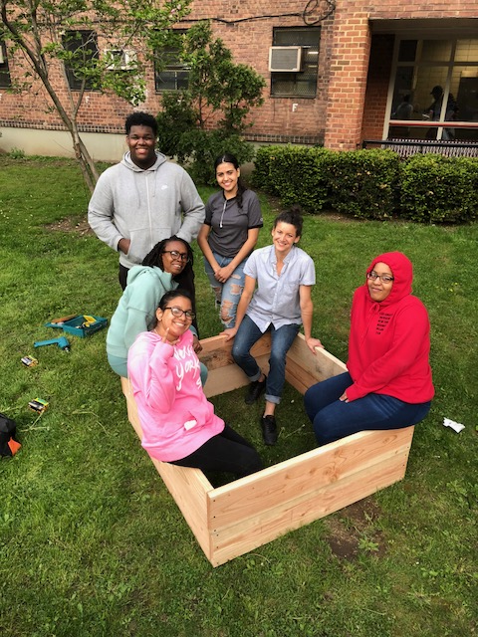

Slide 44
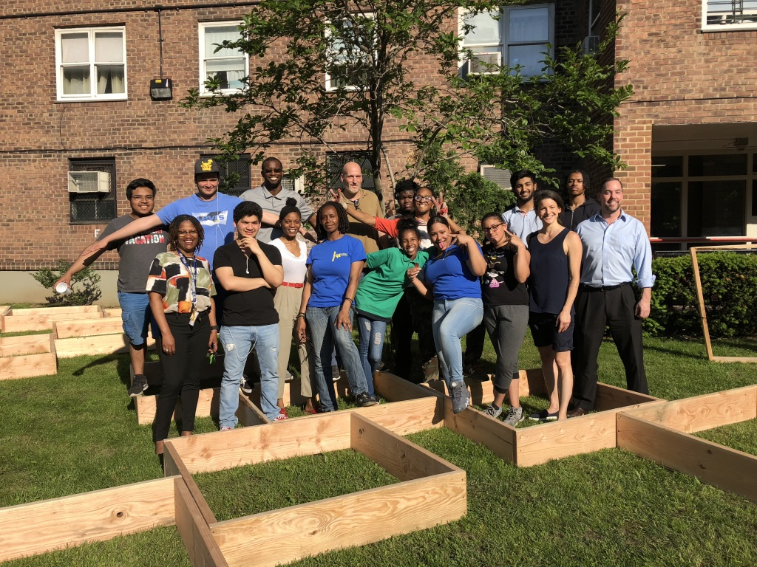

Slide 45
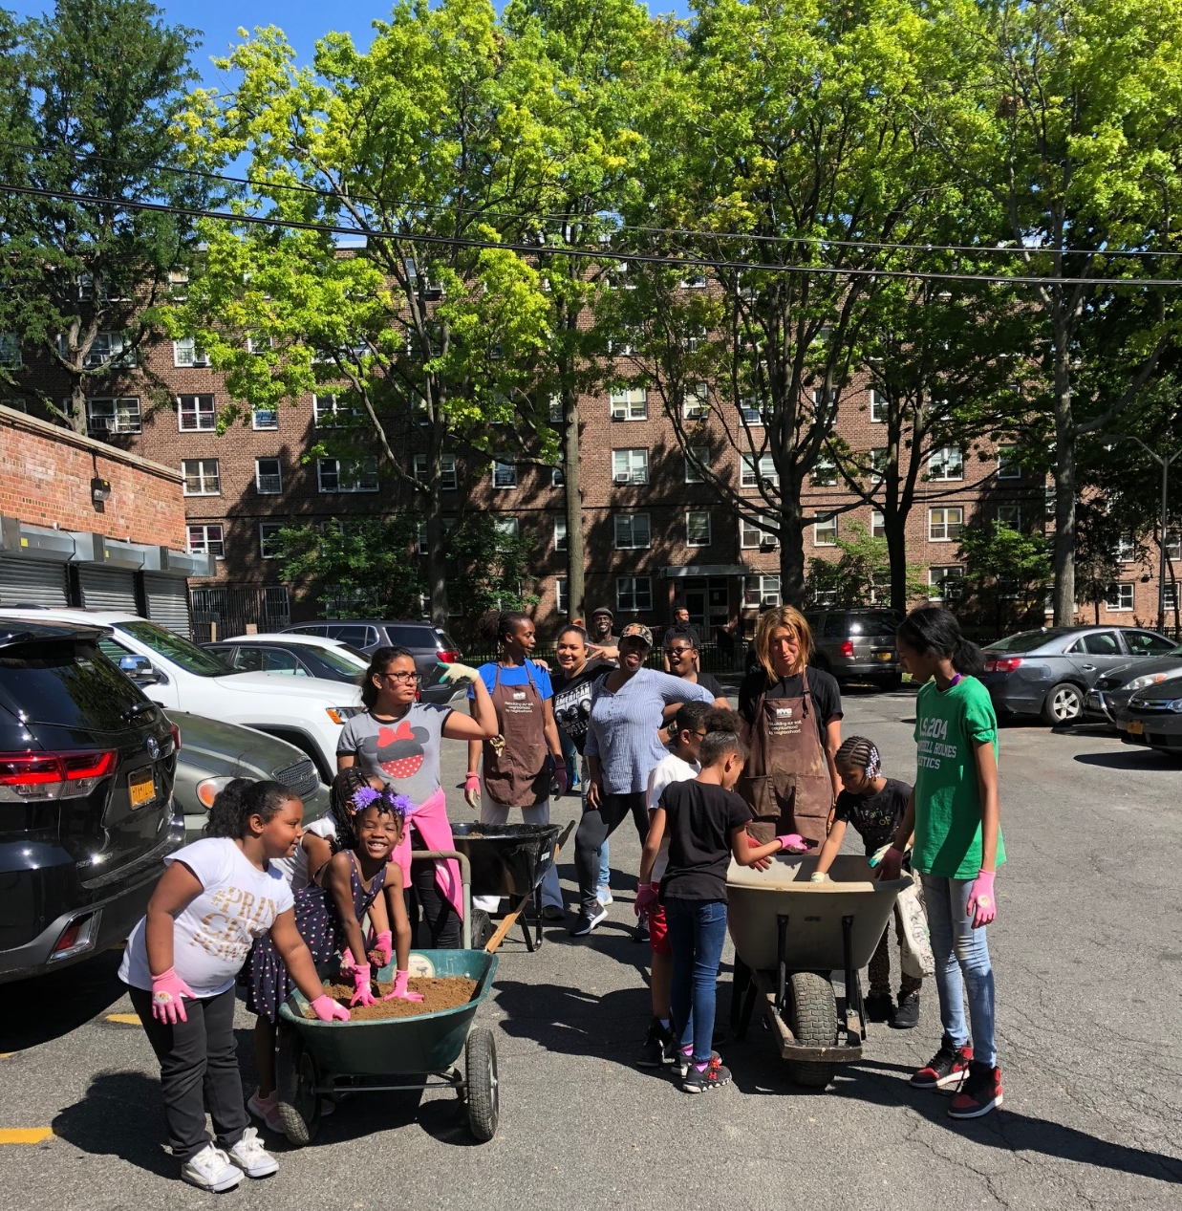

Slide 46
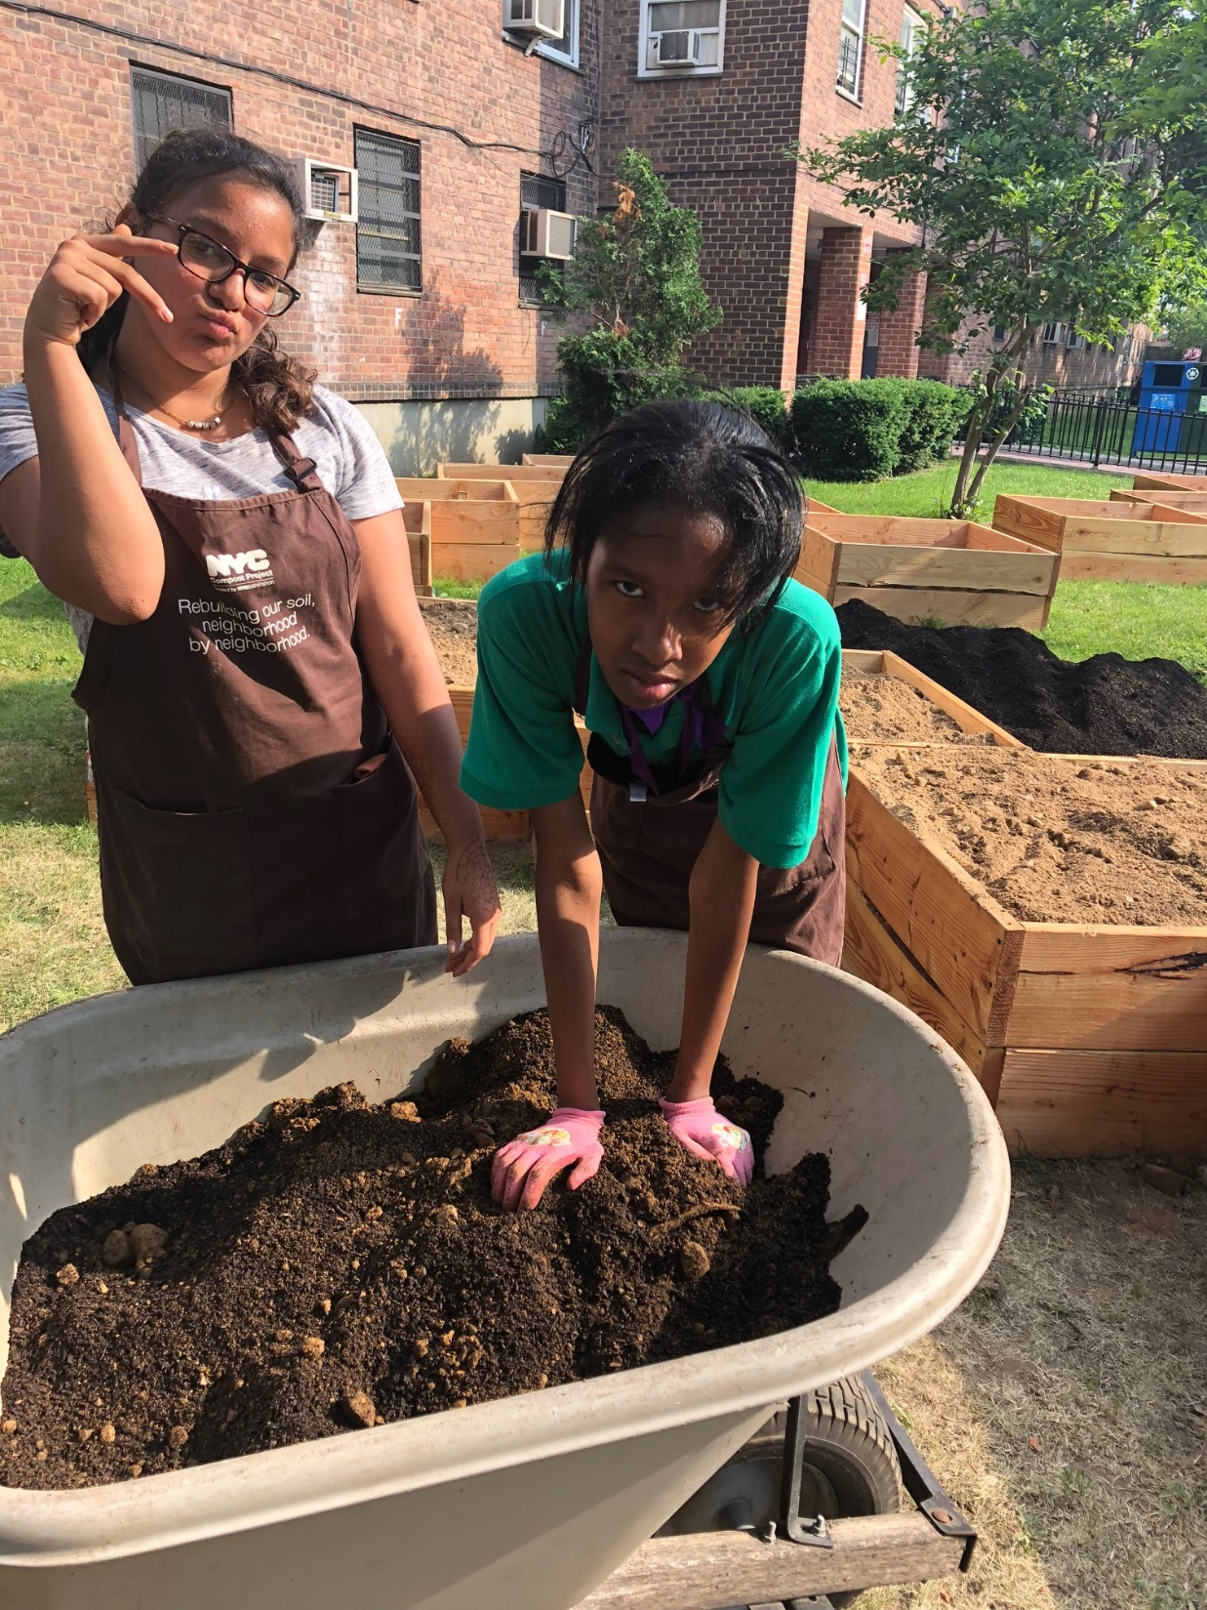

Slide 47
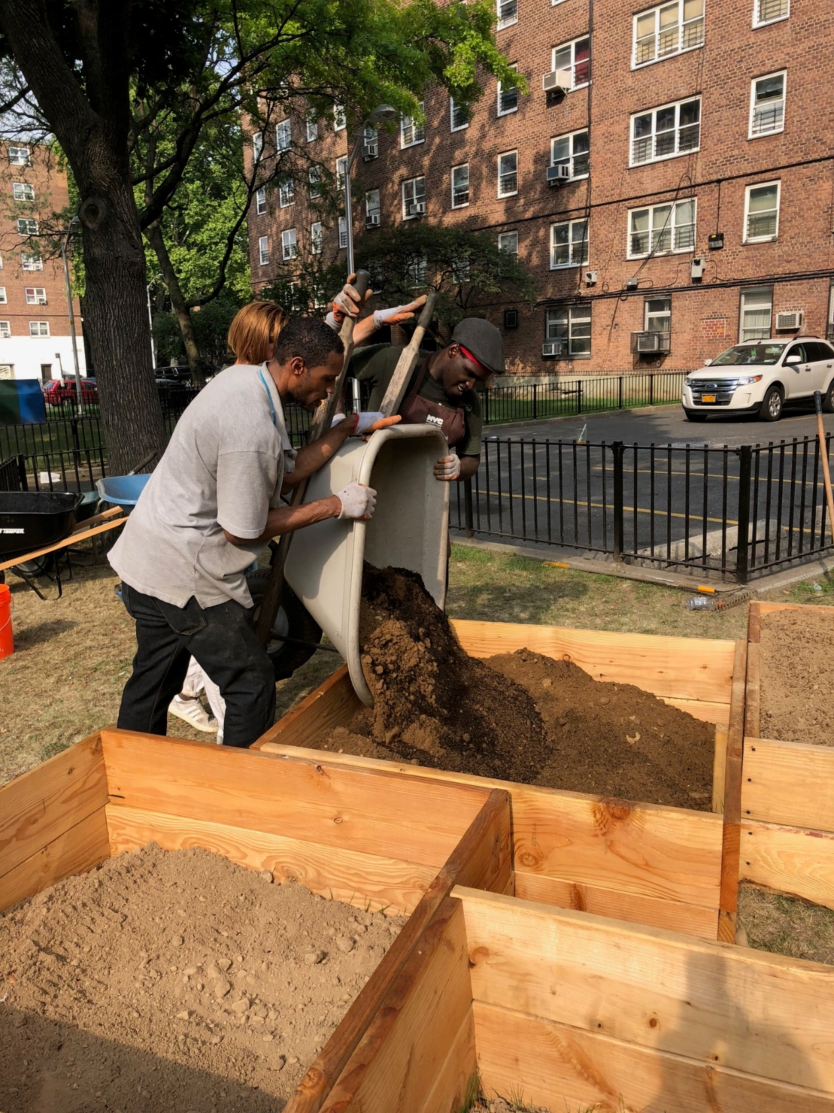

Slide 48
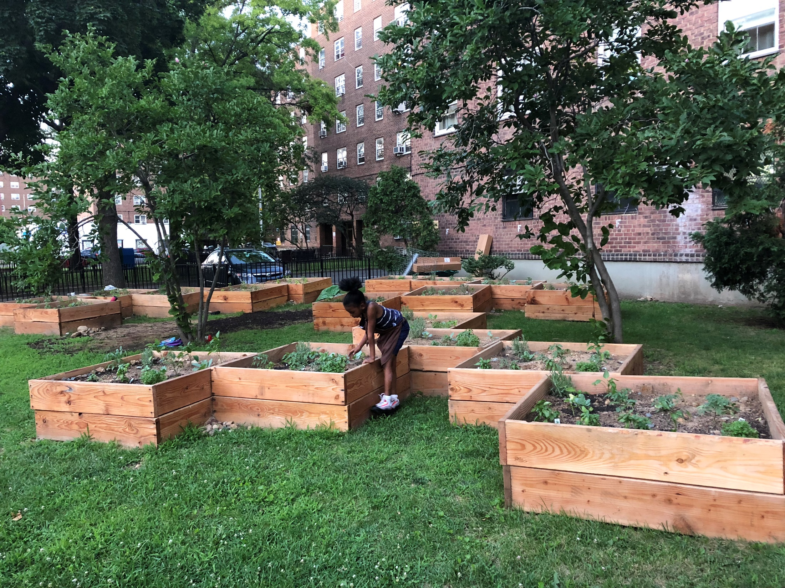

Slide 49
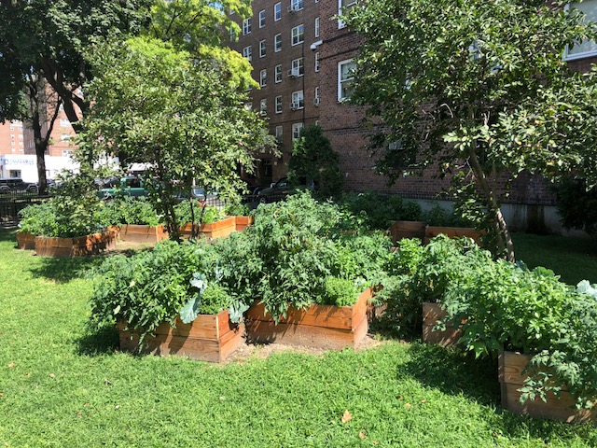

Slide 50
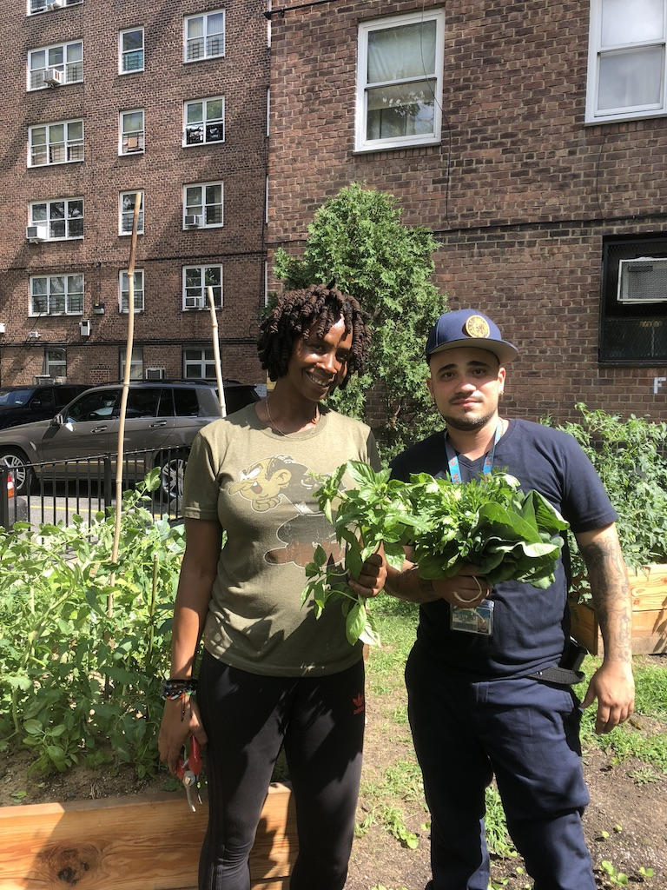
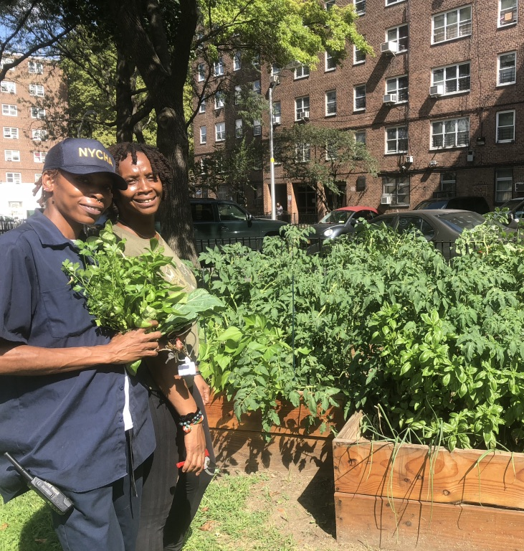

Slide 51
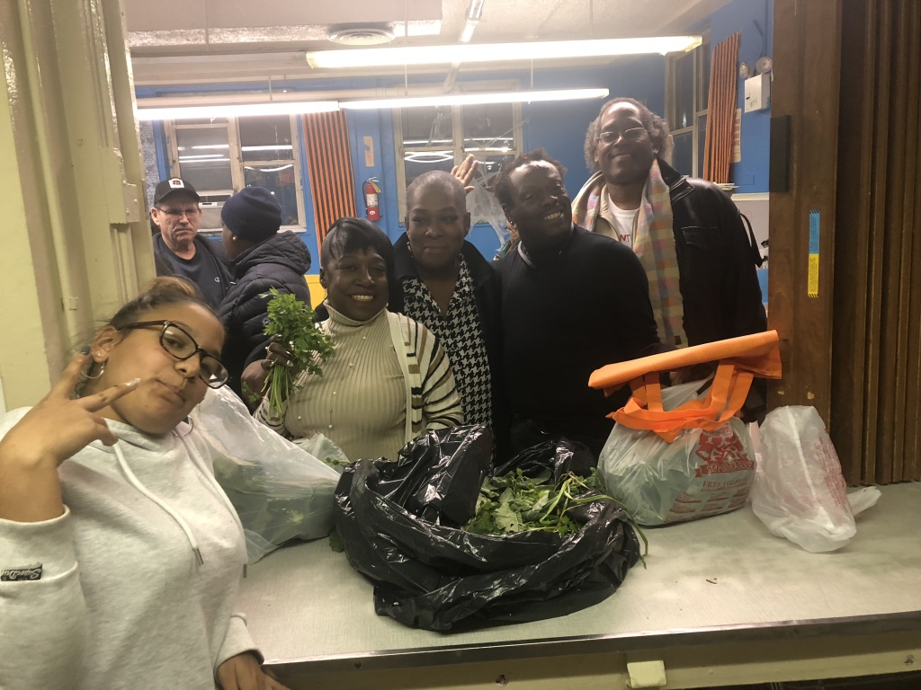

Slide 52
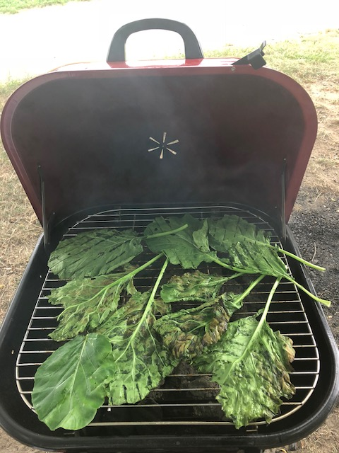

Slide 63
MESOSCALE EXPERIMENTS:
EAST NEW YORK FARMS HEALTHY SOILS INITIATIVE / SOIL DISTRIBUTION NETWORK
East New York Farms, NYS DEC EJ Grant, OER, DSNY, CUNY, Cornell

Slide 73
MACROSCALE EXPERIMENTS
NYC OER’S CLEAN SOIL BANK (CSB) STOCKPILE, EAST NY

Slide 74
THANK YOU!
QUESTIONS?
Dr. S. Perl Egendorf / perl@earthmatter.org / @dr_perl_

Slide 75
References
Bullard, R.D., 1996. Unequal protection: environmental justice and communities of color. Sierra Club Books, San Francisco.
Cheng, Z., Paltseva, A., Li, I., Morin, T., Huot, H., Egendorf, S., Su, Z., Yolanda, R., Singh, K., Lee, L., Grinshtein, M., Liu, Y., Green, K., Wai, W., Wazed, B., Shaw, R., 2015. Trace Metal Contamination in New York City Garden Soils. Soil Science 180, 167–174. https://doi.org/10.1097/ss.0000000000000126
Egendorf, S.P., Cheng, Z., Deeb, M., Flores, V., Paltseva, A., Walsh, D., Groffman, P., Mielke, H.W., 2018. Constructed soils for mitigating lead (Pb) exposure and promoting urban community gardening: The New York City Clean Soil Bank pilot study. Landscape and Urban Planning 175, 184–194. https://doi.org/10.1016/j.landurbplan.2018.03.012
Egendorf, S.P., Groffman, P., Cheng, Z., Menser, M., Mun, J., Mielke, H., 2021. Applying a novel systems approach to address systemic environmental injustices: Constructing soil for limiting the legacy of lead (Pb). Elementa: Science of the Anthropocene 9. https://doi.org/10.1525/elementa.2020.00174
Egendorf, S.P., Groffman, P., Moore, G., Cheng, Z., 2020. The limits of lead (Pb) phytoextraction and possibilities of phytostabilization in contaminated soil: a critical review. International Journal of Phytoremediation 1–15. https://doi.org/10.1080/15226514.2020.1774501
Egendorf, S.P., Segal, P.Z., (2023). The Legacy of Lead: a Bio-geo-socio-chemical Cycle. Available at saraperlegendorf.net
Gilmore, R.W., 2007. Golden Gulag: Prisons, Surplus, Crisis, and Opposition in Globalizing California. University of California Press.
Havlena, J., Kanarek, M.S., Coons, M., 2009. Factors associated with the seasonality of blood lead levels among preschool Wisconsin children. WMJ: Official Publication Of The State Medical Society Of Wisconsin 108, 151–155.
Holifield, R., 2001. Defining Environmental Justice and Environmental Racism. Urban Geography 22, 78–90. https://doi.org/10.2747/0272-3638.22.1.78
Laidlaw, M.A.S., Zahran, S., Mielke, H.W., Taylor, M.P., Filippelli, G.M., 2012. Re-suspension of lead contaminated urban soil as a dominant source of atmospheric lead in Birmingham, Chicago, Detroit and Pittsburgh, USA. Atmospheric Environment 49, 302–310. https://doi.org/10.1016/j.atmosenv.2011.11.030
McClintock, N., 2015. A Critical Physical Geography of Urban Soil Contamination. Urban Studies and Planning Faculty Publications and Presentations. https://doi.org/10.1016/j.geoforum.2015.07.010
Mielke, H.W., Laidlaw, M.A.S., Gonzales, C.R., 2011. Estimation of leaded (Pb) gasoline’s continuing material and health impacts on 90 US urbanized areas. Environ Int 37, 248–257. https://doi.org/10.1016/j.envint.2010.08.006
Mielke, H.W., Reagan, P.L., 1998. Soil Is an Important Pathway of Human Lead Exposure. Environmental Health Perspectives Supplements 106, 217. https://doi.org/10.2307/3433922
Pellow, D.N., 2017. What is Critical Environmental Justice? John Wiley & Sons.
Pulido, L., 2017. Geographies of race and ethnicity II: Environmental racism, racial capitalism and state-sanctioned violence. Progress in Human Geography 41, 524–533. https://doi.org/10.1177/0309132516646495
Robinson, C.J., 2000. Black Marxism: The Making of the Black Radical Tradition. Univ of North Carolina Press.

