Slide 1
Water Availability and Use
EESC 1201 Class 5
Professor Perl
3/6/23

Slide 2
Core Message
Freshwater: a limited, essential resource
Water is unevenly distributed on the planet.
Consumption is unequal.
Wise water use is key to sustainability.
Notes:
Freshwater is a precious but limited resource, and it is essential to life.
Some regions consume water faster than it is replenished. And, unfortunately, water is not evenly distributed across the globe; many people worldwide lack access to enough clean water.
Methods are available to recover and purify otherwise dirty water, but we also need to use water more wisely.

Slide 3
Case Study: Fighting over Water in the American Southwest
The Colorado River provides water to over 36 million people, along with other living organisms.
Water rights have been and remain contentious.
In most years, the river no longer reaches the Gulf of California where it historically ended.
Notes:
Chasing Water, a film by Pete McBride, follows the course of the Colorado River from Wyoming to the Gulf of California.
https://vimeo.com/216565463

Slide 4
I. How Is Water Distributed on Earth, and What Are the Sources of Freshwater?
Key Concept 1: Only 2.5% of water on Earth is freshwater, and very little of that is accessible to humans. Fortunately, even this small percentage represents a large amount of water.

Slide 5
Freshwater: Distribution and Sources
Key Terms
Groundwater: water found underground trapped in soil or porous rock
Surface water: any body of water found above the ground, such as oceans, rivers, and lakes
The Colorado River delta. So little water remains at this point that the river no longer reaches the sea.
Notes:
Freshwater: water that has few dissolved ions such as salt
Only 3% of the water on Earth is freshwater.
Water provides many important ecosystem services that animals and plants require to live.
Humans require freshwater.
Up to 75% of the human body, for instance, consists of water.

Slide 6
IG 1: Distribution of Water on Earth
Notes:
Ask your students to study the diagram to determine what percentage of the total water supply on Earth is found in groundwater. What percentage is found in rivers?

Slide 7
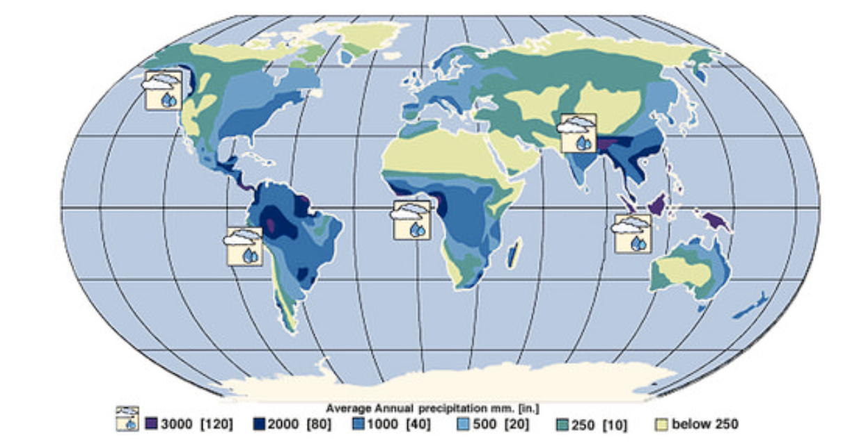
Global Precipitation Patterns

Slide 8
II. How Does Water Cycle Through the Environment?
Key Concept 2: Water moves through the environment via the water cycle, a process that constantly recycles water on Earth through ground and surface waters, plants, and the atmosphere.

Slide 9
The Water Cycle: Evapotranspiration
Key Terms
Water cycle: the movement of water through various water compartments such as surface waters, atmosphere, soil, and living organisms
Transpiration: the loss of water vapor from plants
The combination of evaporation and transpiration is called evapotranspiration.
Notes:
Plants with deep roots, like trees, may bring up thousands of gallons of water a year, releasing much of this to the atmosphere.
Evapotranspiration sends more than 66,000 cubic kilometers of water vapor into the atmosphere every year, equivalent to 17,000 trillion gallons.

Slide 10
IG 2: The Water Cycle
Notes:
The trees of tropical rain forests are said to contribute as much as half of the rain that falls back on the forest. Ask your students to explain how this occurs.

Slide 11
III. How Are Surface Water and Groundwater Supplies Accessed, and What Problems Do These Water Sources Face?
Key Concept 3: Surface waters provide freshwater to human communities, but if we remove water faster than it is replaced, the sources can run dry; water wars can even erupt. Groundwater supplies can shrink due to over-withdrawal and to decreased infiltration, causing wells to run dry or become contaminated with saltwater (in coastal regions).

Slide 12
Groundwater (1 of 2)
Key Terms
Aquifer: an underground, permeable region of soil or rock that is saturated with water
Infiltration: the process of water soaking into the ground
As water travels through the soils and rocks, it is filtered.
A core of limestone illustrates the porous nature of the rock
Notes:
In the United States, most freshwater comes from surface waters.

Slide 13
Groundwater (2 of 2)
Key Terms
Water table: the uppermost water level of the saturated zone of an aquifer
Saltwater intrusion: the inflow of ocean (salt) water into a freshwater aquifer that happens when an aquifer has lost some of its freshwater stores
Water wars: political conflicts over the allocation of water sources
Notes:
The quantity of water in an aquifer is often measured in terms of acre-feet, the amount needed to cover an acre in water to a depth of 1 foot (30.5 centimeters), which is equivalent to more than 1.1 million liters (300,000 gallons).
One acre-foot of water is enough for two American families for 1 year.
Access to freshwater, as an essential but limited resource, can lead to human conflict. There is a long history of conflict in the American Southwest over rights to the water in the Colorado River.

Slide 14
IG 3: Groundwater Is Found in Aquifers of Porous Rock or Permeable Soil
Notes:
Ask your students why deep cones of depression and dry wells (formed from overdrawing well water) might be more common in inland areas than in coastal ones.

Slide 15
An Aquifer Collapses
Large volumes of water are pumped from aquifers for agriculture, industry, and personal use.
Infiltration is blocked by hard surfaces, such as roads and buildings.
Overall, water in the aquifer is reduced, reducing structural integrity.

Slide 16
IV. How Does Water Use Differ Between Sectors and Income Levels, and What Problems Does Water Scarcity Cause?
Key Concept 4: Agriculture is the biggest user of water, followed by industrial and then domestic use. Not surprisingly, domestic use goes up as income goes up. Water shortages can be physical (lack of water) or economic (the inability to pay for water).

Slide 17
IG 4: Global Water Use by Sector
Crop irrigation in the United States consumes 80% of our water.
Surface and groundwater contribute about equally to irrigation.
The Ogallala aquifer is the largest groundwater system in North America, supplying 30% of all U.S. irrigation water.
Notes:
It lies beneath eight states in the Great Plains of the American Midwest.
It supplies about 30% of all U.S. irrigation water to these farm belt states.
Withdrawals exceed recharge rates; only about 15% of what is removed is replaced.
In the countries of South Asia, closer to 90% of their total usage goes to irrigation.
One study predicts that the aquifer will be 69% depleted by 2060.
Go to https://www.youtube.com/watch?v=XXFsS94HF08 for a National Science Foundation video on the Ogallala aquifer.
Steps must be taken to improve irrigation efficiencies or reduce the irrigation water needed for crops.

Slide 18
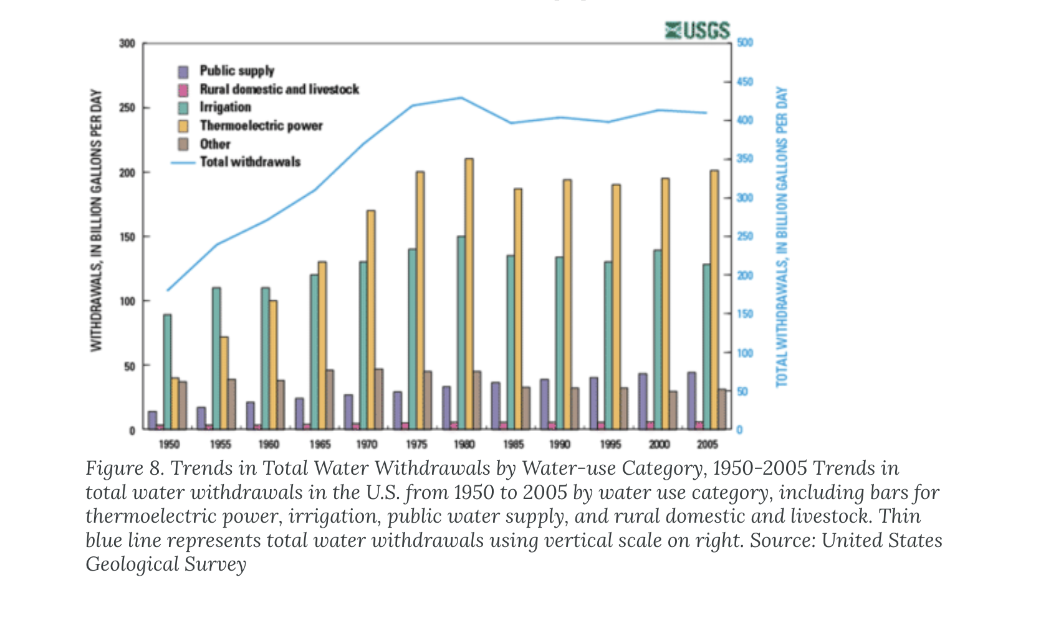
Thermoelectric power (fossil fuels) are estimated to use 40% of water withdrawls
https://www.watercalculator.org/footprint/the-water-footprint-of-energy/

Slide 19
IG 4: Global Water Use: Domestic Water Use
Key Terms
Domestic water includes indoor and outdoor use of water by households and small businesses.
Uses the least amount of water
Water use up as income levels increase
Notes:
Industrial use of water varies from country to country.
Water use is higher in more developed nations than less developed ones.
Thermoelectric power plants such as coal or nuclear facilities use large amounts of water for cooling, and in many developed nations, this represents the biggest portion of industrial water use; in the United States, it accounts for around 85% of the industrial sector’s use of water.
On average, a citizen in the United States uses more than twice what a citizen of France uses, and about three times as much as the world average.

Slide 20
Water Scarcity
Key Terms
Water Scarcity: not having access to enough clean water
Water often contaminated with fecal materials.
4.5 billion people lack access to sanitation facilities.

Slide 21
IG 4: Global Water Use and the UN’s Sustainable Development Goals
Notes:
Ask your students what might account for the large difference in domestic water use per person in France and the United States.

Slide 22
V. How Is Domestic Water Regulated in the United States, and What Problems Does Our Water Supply Face?
Key Concept 5: The United States has one of the world’s most dependable purification and delivery systems for tap water thanks to the Safe Drinking Water Act; however, thousands of violations occur each year, and infrastructure upgrades are needed to continue providing safe drinking water.

Slide 23
Safe Drinking Water Act (SDWA)
Key Terms
Potable: water that is clean enough for consumption
Safe Drinking Water Act (SDWA): federal law that protects public drinking water supplies in the United States
Notes:
Many U.S. water treatment facilities and water infrastructure are old or too small to handle growing local populations.
The EPA estimates upgrades will cost more than $650 million.
Their 2016 Action Plan lays out a framework for addressing these and other issues.

Slide 24
IG 5: Violations of the Safe Drinking Water Act

Slide 25
Flint, Michigan
Residents noticed their water was discolored.
In a money-saving bid, new county admins switched the water source without accounting for safety.
Water contained lead, a neurotoxin. More than 100,000 people were exposed to high lead for over 2 years.
Many of them were children.
Notes:
This is a classic example of an environmental justice disaster—the people effected were low-income minorities; the consequences of brain-damaged children will be felt for decades.

Slide 26
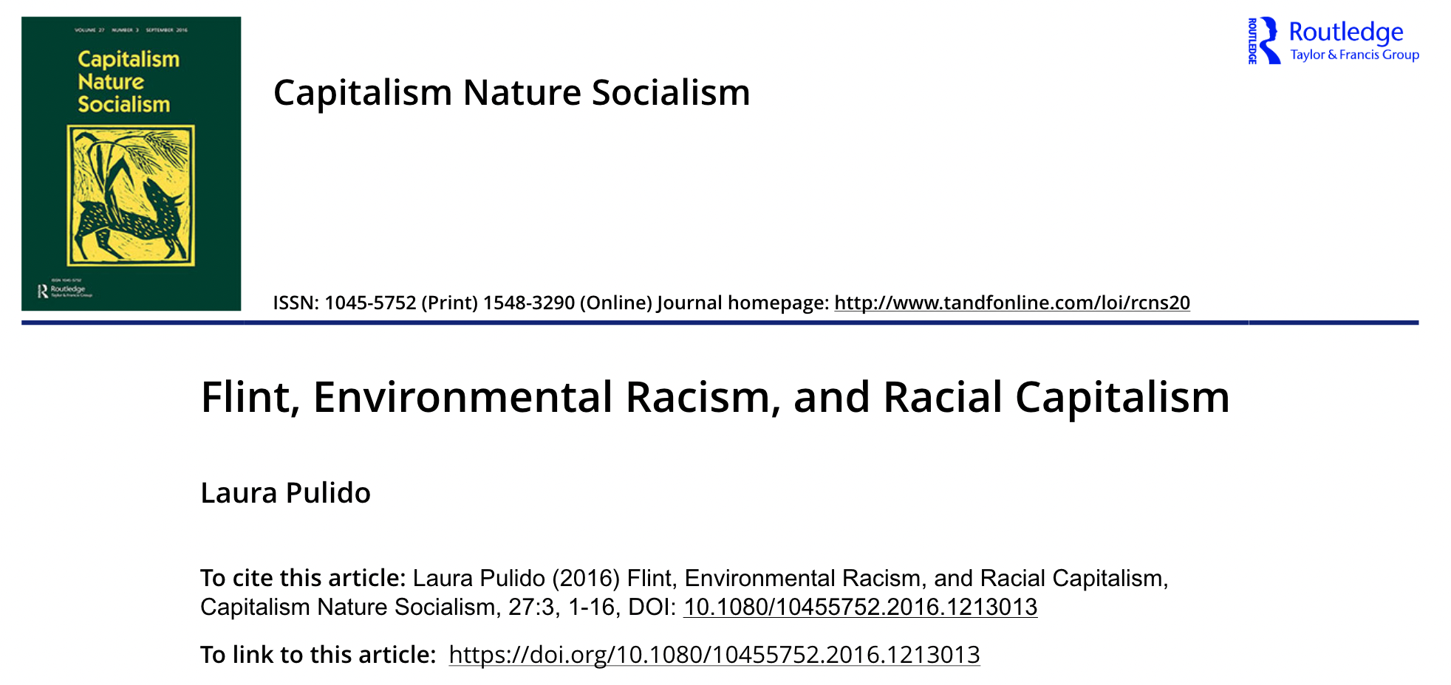
https://doi.org/10.1080/10455752.2016.1213013

Slide 27
VI. How Can Wastewater Be Treated to Make It Safe to Release into the Environment?
Key Concept 6: Wastewater can be decontaminated using high-tech methods that use advanced filtration and chemicals or low-tech methods that mimic the way wetlands purify water.

Slide 28
IG 6: How It Works: Wastewater Treatment High Tech
Key Terms
Wastewater treatment: the process of removing contaminants from wastewater to make it safe enough to release into the environment
Notes:
Urban areas have more technologically advanced systems:
Wastewater treatment begins with filtering the water.
Water is then sent to settling tanks, where remaining solids sink to the bottom.
The water continues on to other tanks, where bacteria digest much of the remaining organic matter.
In the final step, water is chemically treated before it is discharged.
Effluent: wastewater discharged into the environment

Slide 29
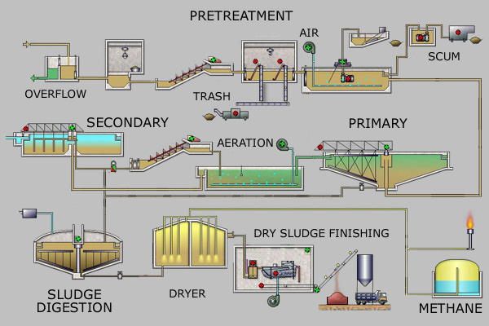
Wastewater Treatment
pretreatment
(screening and removal of sand and gravel),
primary treatment
settling or floatation to remove organic solids, fat, and grease)
secondary treatment
aerobic bacterial decomposition of organic solids
tertiary treatment
bacterial decomposition of nutrients and filtration
disinfection
treatment with chlorine, ozone, ultraviolet light, or bleach
and either discharge to surface waters
usually a local river
reuse for some other purpose
such as irrigation, habitat preservation, and artificial groundwater recharge.

Slide 30
IG 6: How It Works: Wastewater Treatment Rural Area
Key Terms
Wastewater: used and contaminated water that is released after use by households, businesses, industry, or agriculture
Notes:
Urban areas have more technologically advanced systems:
Wastewater treatment begins with filtering the water.
Water is then sent to settling tanks, where remaining solids sink to the bottom.
The water continues on to other tanks, where bacteria digest much of the remaining organic matter.
In the final step, water is chemically treated before it is discharged.
Effluent: wastewater discharged into the environment

Slide 31
Alternatives to Traditional Wastewater Treatment
In some areas, like Arcata, California, sewage treatment resembles a natural ecosystem.
Land is converted into a wetland, an ecosystem that is permanently or seasonally flooded.

Slide 32
VII. What Technologies Can Address Water Scarcity, and What Are the Trade-offs of Each?
Key Concept 7: Water scarcity can be addressed by storing water (using dams or underground storage) and desalinating seawater, and using new solutions like purified wastewater. All these solutions come with trade-offs.

Slide 33
IG 7: Technologies That Address Water Scarcity: Dams and Reservoirs
Key Terms
Dams: structures that block the flow of water in a river or stream
Common in areas where lakes and rivers are an important source of water.
Notes:
Freshwater source
Flood control
Electricity production
Recreation and fishing
Lose an enormous amount of water every day through evaporation
Construction of dams can also spark water wars
Worldwide, reservoirs lose more water to evaporation than is used for industry and domestic purposes combined.
The water level in just about every reservoir in northern California was well below average in 2016.
Turkey’s plans to build 22 dams that pull water from the Tigris and Euphrates Rivers for agriculture and electric power will impact its neighbors Syria and Jordan downstream. There is great potential for conflict.

Slide 34
Dams and Reservoirs
Key Terms
Reservoirs: artificial lakes formed when a river is impounded by a dam
Store freshwater for a variety of uses
Hoover Dam and Lake Mead on the Colorado River—electricity generation and freshwater, but source may be depleted soon
Notes:
Freshwater source
Flood control
Electricity production
Recreation and fishing
Lose an enormous amount of water every day through evaporation.
Construction of dams can also spark water wars.
Worldwide, reservoirs lose more water to evaporation than is used for industry and domestic purposes combined.
The water level in just about every reservoir in northern California was well below average in 2016.
Turkey’s plans to build 22 dams that pull water from the Tigris and Euphrates Rivers for agriculture and electric power will impact its neighbors Syria and Jordan downstream. There is great potential for conflict.

Slide 35
IG 7: Technologies that Address Water Scarcity: Desalination (1 of 2)
Key Terms
Desalination: the removal of salt and minerals from seawater to make it suitable for consumption
What do we do with leftover salt?
Very expensive (energetically and monetarily) process.
Notes:
Go to https://www.youtube.com/watch?v=3Skuk8DeXpE for a video on desalination in California.
The largest facilities in the world are in the Middle East.
Some process as much as 750 million liters (200 million gallons) of water per day.
The largest facility in the United States produces water for San Diego.
It is expected to meet about 7% of the city’s water needs, which equates to about 190 million liters or 50 million gallons a day.

Slide 36
IG 7: Technologies that Address Water Scarcity: Desalination (2 of 2)
Water has three extra cleansing steps:
Microfiltration
Reverse osmosis
Treated with UV light
Notes:
After undergoing normal wastewater treatment, the water is subjected to three extra cleansing steps, starting with microfiltration. In this step, the water passes through microscopic, straw-like fibers that filter out many suspended solids, bacteria, and viruses. Then a crucial step known as reverse osmosis is performed. During this process, high pressure forces water through a plastic membrane. After reverse osmosis, the water is exposed to ultraviolet (UV) light, which kills any remaining viruses and bacteria.
The project cost $481 million, and it takes about $40 million to operate it annually, and produces 100 million gallons of drinking water every day.

Slide 37
IG 7: Technologies that Address Water Scarcity: Recycling Wastewater
Las Vegas returns 90 million gallons of purified wastewater to Lake Mead every day.
Highly potable
Notes:
After undergoing normal wastewater treatment, the water is subjected to three extra cleansing steps, starting with microfiltration. In this step, the water passes through microscopic, straw-like fibers that filter out many suspended solids, bacteria, and viruses. Then a crucial step known as reverse osmosis is performed. During this process, high pressure forces water through a plastic membrane. After reverse osmosis, the water is exposed to ultraviolet (UV) light, which kills any remaining viruses and bacteria.
The project cost $481 million, and it takes about $40 million to operate it annually, and produces 100 million gallons of drinking water every day.

Slide 38
IG 7: Technologies to Address Water Scarcity: Underground Storage
Notes:
Ask your students which technology they would recommend for use in their area if there was a need to increase water supplies.

Slide 39
VIII. How Can Conservation Help Address Water Scarcity Issues?
Key Concept 8: Conservation can effectively address scarcity and includes the use of water-saving technologies, behavioral changes that decrease water use, and consumer choices that minimize our water footprint.

Slide 40
Water Footprint
Water footprint: the water appropriated by industry to produce products or energy; includes the water actually used and water that is polluted in the production process
Average U.S. citizen uses 140 gallons of water per day.
Notes:
Blue jeans and other cotton clothing items have a particularly large water footprint because cotton is typically grown in arid climates.

Slide 41
Addressing Water Shortages with Conservation
The easiest and least expensive way to maintain water supplies is to use less water.
The average U.S. citizen uses about 530 liters (140 gallons) of water per day in the home.
Water is also used on our behalf by industry to make the products and energy that we consume (indirect use).
This brings the average daily use of water up to 4,200 liters (1,100 gallons) per person in the United States.

Slide 42
IG 8: Reducing Our Water Footprint: U.S. Household Water Use
Notes:
Ask your students to estimate how long a typical shower lasts and then calculate how much water they would use over the course of a year if they used a traditional, 3.8-gallon/minute showerhead. Do the same calculation for the low-flow showerhead. How many gallons per year would they save by switching to a low-flow showerhead? Compared to the water used in a typical shower using a traditional showerhead, how much would they save in a year if they reduced the duration of their shower by half and used a low-flow showerhead?

Slide 43
IG 8: Reducing Our Water Footprint: Indirect U.S. Household Water Use
Notes:
In addition to direct water use, we use water indirectly as we use electricity.

Slide 44
IG 8: Reducing Our Water Footprint: Gallons of Water Needed per 1 lb of Food
Notes:
To save water, eat lower on the food chain.

Slide 45
IG 8: Reducing Our Water Footprint: Gallons of Water Needed per Product
Notes:
Blue jeans take a lot of water because a lot of cotton is grown in arid areas.

Slide 46
IG 8: Reducing Our Water Footprint: Water Saving Technologies and Actions
Water-Saving Technologies and Actions
Our water usage can be reduced by using new water-efficient technologies and by making behavioral changes that don’t waste water.
OLD TECHNOLOGY | NEW TECHNOLOGY | BEHAVIORAL CHANGE
Toilet 6 gallons/flush | Low-Flow Toilet 1.3 gallons/flush | Don’t flush tissues—use the trash. Flush liquid waste less frequently.
Shower 3.8 gallons/minute Bath 35 gallons | Low-Flow Shower Head 2.3 gallons/minute | Take a shorter shower or a “Navy” shower: Turn off the shower head except to rinse (some shower heads come with a convenient valve that allows you to switch off the water without turning it off at the source).
Faucet 5 gallons/minute | Low-Flow Faucet 1.5 gallons/minute | Don’t leave the faucet running while brushing your teeth, shaving, or washing your face.
Washing Machine 40 gallons/load | Washing Machine (Energy Star) 22 gallons/load | Don’t wash a clothing item unless it needs it (those jeans can probably be worn several times before washing) and run the washer only when it is full.
Dishwasher 9 gallons/load | Dishwasher (Energy Star) 4 gallons/load | Run the dishwasher only when it is full and limit the amount of rinsing you do before loading dishes into the dishwasher; if you have a new dishwasher, rinsing isn’t needed.
Infographic 6.1.8 part 4
Karr, Scientific American: Environmental Science for a Changing World, 4e
© 2021 W. H. Freeman and Company
Notes:
Blue jeans take a lot of water because a lot of cotton is grown in arid areas.

Slide 47
Summary
It is important to remember that freshwater is a precious but limited resource.
Access to freshwater is unevenly distributed across the globe, and limited access can lead to conflict.
Dams, reservoirs, and desalination are all methods used to increase the availability of freshwater. But newer promising methods, like those used in Orange County, are now available to recover and purify dirty water.
But the best way to preserve water is for everyone to use less.
Notes:
In 2014, the city of San Diego approved a $3.5 billion project that that will send highly purified wastewater to a local reservoir.

Slide 48
Part 2: Water Pollution

Slide 49
Core Message
Water pollution:
Decreases usable water supply
Harms wildlife, human life
Is caused by human actions
Solution:
Control what we discharge into water
Restore forested areas
Limit the use of pollutants
Collecting water samples in the Gulf of Mexico

Slide 50
Case Study: Where Did the Oxygen Go?
In 1974, Eugene Turner, a biologist, confirmed what other researchers were reporting: extremely low oxygen levels (hypoxia) in the Gulf Coast.
The cause of the hypoxia was unknown.
Turner hypothesized it might have something to do with nearby oil rigs.
Notes:
Go to https://www.youtube.com/watch?v=rK_mEHqx7rw to view “Happening Now: Dead Zone 2015,” by usoceangov.

Slide 51
I. What Is Water Pollution, and How Is It Classified by Source?
Key Concept 1: Water pollution may come from readily identifiable sources such as discharge pipes (point sources) or from more dispersed sources such as storm water runoff or atmospheric fallout (nonpoint sources).

Slide 52
Water Pollution: Types and Causes
Key Terms
Water pollution: the addition of any substance to a body of water that might degrade its quality
Many substances qualify as pollutants.
Sometimes pollutants, like raw sewage and industrial chemicals, are dumped directly into water.
Storm-water runoff: water from precipitation that flows over the surface of the land
Carries nutrients, pesticides, sediments, and trash into water
Notes:
Even groundwater sources can become polluted from underground chemical storage tanks or from the movement of surface pollutants down through the soil.
Thermal pollution: heated water released into surface waters near power plants raises the temperature of the water enough to impact many of the organisms that live there

Slide 53
Two Classes of Water Pollution: Point Source Pollution
Key Terms
Point source pollution: pollution from wastewater treatment plants or industrial sites, such as that from discharge pipes or smokestacks.
Easily identified and remedied
Effluent: wastewater discharged into the environment
Some effluent very dangerous
Can carry raw sewage and waterborne pathogens

Slide 54
Two Classes of Water Pollution: Nonpoint Source Pollution
Key Terms
Nonpoint source pollution: runoff that enters the water from overland flow
Source not easily identifiable
Includes sediment pollution: silt, sand, and clay
Excessive amounts can cloud the water, disrupting photosynthesis
Can harm organisms directly by clogging gills
Can smother the nooks and crannies of sea or river bottoms that serve as habitat or spawning areas
The main type of water pollution harming the Gulf Coast

Slide 55
Pollution Residence Times
Water pollutants can move through different water reservoirs, through stages of the water cycle.
Water residence time is the average time that a water molecule spends in a water reservoir and affects pollution potential.
Water in rivers has a relatively short residence time, so pollution usually is there only briefly. Of course, pollution in rivers may simply move to another reservoir, such as the ocean, where it can cause further problems.
Groundwater is typically characterized by slow flow and longer residence time, which can make groundwater pollution particularly problematic.
Finally, pollution residence time can be much greater than the water residence time because a pollutant may be taken up for a long time within the ecosystem or absorbed onto sediment.

Slide 56
IG 1a: Major Causes of Water Pollution
Notes:
Ask your students what type of pollution predominantly contributes to the hypoxic zone in the Gulf of Mexico: point source or nonpoint source?

Slide 57
IG 1b: Major Causes of Water Pollution
Notes:
Ask your students what type of pollution predominantly contributes to the hypoxic zone in the Gulf of Mexico: point source or nonpoint source?

Slide 58
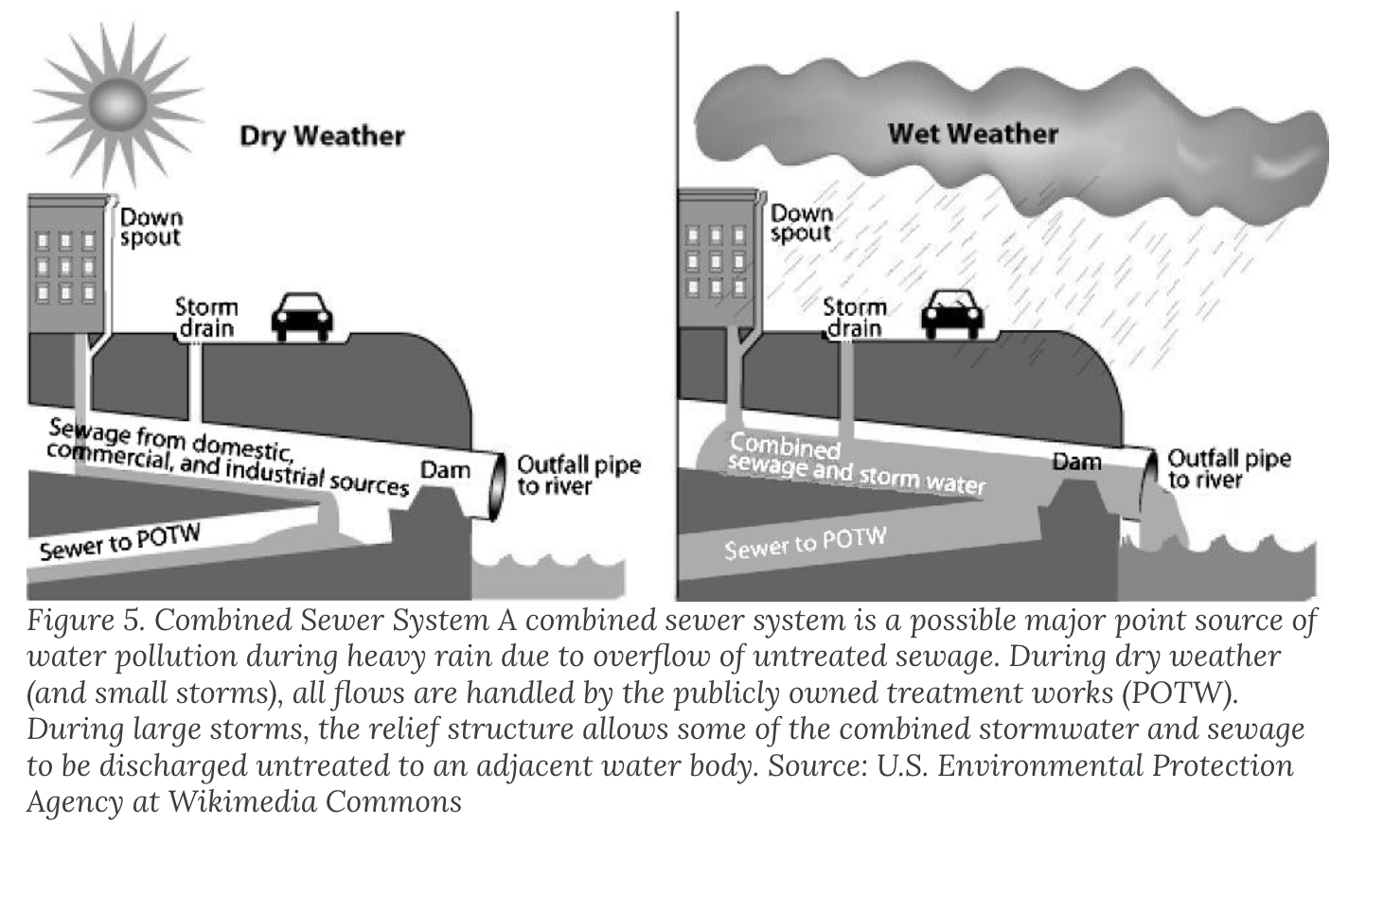
Combined Sewer Overflows (CSOs)

Slide 59
II. What Are the Causes and Consequences of Eutrophication?
Key Concept 2: The influx of excess nutrients into a body of water may spur algae growth and bacterial population explosions, which ultimately result in hypoxia severe enough to harm aquatic life.

Slide 60
Dissolved Oxygen (DO)
Key Terms
Dissolved oxygen (DO): the amount of oxygen in the water
Hypoxia: a situation in which a body of water contains inadequate levels of oxygen, compromising the health of many aquatic organisms
Water holds less oxygen than air.
Aquatic organisms need oxygen for cellular respiration.
Dead zones: areas depleted of oxygen
Notes:
Something in the Gulf waters was causing DO to plummet, resulting in hypoxia.

Slide 61
Oxygen-Demanding Waste
Oxygen-demanding waste is an extremely important pollutant to ecosystems.
Most surface water in contact with the atmosphere has a small amount of dissolved oxygen, which is needed by aquatic organisms for cellular respiration. Bacteria decompose dead organic matter and remove dissolved oxygen (O₂) according to the following reaction:
organic matter+O_{2→}CO₂+H₂O
Too much decaying organic matter in water is a pollutant because it removes oxygen from water, which can kill fish, shellfish, and aquatic insects.
The amount of oxygen used by aerobic (in the presence of oxygen) bacterial decomposition of organic matter is called biochemical oxygen demand (BOD).
The major source of dead organic matter in many natural waters is sewage; grass and leaves are smaller sources.
An unpolluted water body with respect to BOD is a turbulent river that flows through a natural forest. Turbulence continually brings water in contact with the atmosphere where the O₂ content is restored. The dissolved oxygen content in such a river ranges from 10 to 14 ppm O₂, BOD is low, and clean-water fish such as trout are able to survive.
A polluted water body with respect to oxygen is a stagnant deep lake in an urban setting with a combined sewer system. This system favors a high input of dead organic carbon from sewage overflows and limited chance for water circulation and contact with the atmosphere. In such a lake, the dissolved O₂ content is ≤5 ppm O₂, BOD is high, and low O₂-tolerant fish, such as carp and catfish dominate.

Slide 62
IG 2a: Eutrophication Can Create Dead Zones
Notes:
Ask your students why it is that in eutrophic waters, hypoxia can develop from both a decline in oxygen production and an increase in oxygen consumption.

Slide 63
Eutrophication
Key Terms
Eutrophication: a process by which excess nutrients in aquatic ecosystems feed biological productivity, ultimately lowering the oxygen content in the water
Nitrogen and phosphorus from runoff enter the water and trigger explosions of algae growth.
Algal growth blocks sunlight from reaching underwater plants, blocking photosynthesis.
Notes:
Oxygen levels fall as underwater photosynthesis declines.
Plants at the bottom of the water die.
Turbidity (cloudiness) of the water increases as roots can no longer secure the river or seabed in shallow areas.
Photosynthesis and oxygen levels are reduced even more.
Dead plants are consumed by bacterial decomposers, which use oxygen as they digest the dead plants.
Oxygen levels can drop low enough to kill invertebrate and vertebrate animals that cannot escape to oxygen-rich waters elsewhere.

Slide 64
Eutrophication, part 2
Oxygen levels fall as underwater photosynthesis declines.
Plants at the bottom of the water die.
Turbidity (cloudiness) of the water increases as roots can no longer secure the river or seabed in shallow areas.
Result: even lower oxygen, killing living organisms, including fish
Notes:
Photosynthesis and oxygen levels are reduced even more.
Dead plants are consumed by bacterial decomposers which use oxygen as they digest the dead plants.
Oxygen levels can drop low enough to kill invertebrate and vertebrate animals that cannot escape to oxygen-rich waters elsewhere.

Slide 65
IG 2b: Eutrophication Can Create Dead Zones
Notes:
Ask your students why it is that in eutrophic waters, hypoxia can develop from both a decline in oxygen production and an increase in oxygen consumption.

Slide 66
Hypoxic Waters Are an Environmental and Economic Concern
The National Oceanic and Atmospheric Administration (NOAA) estimates that the Gulf of Mexico dead zone costs millions of dollars in lost revenue to the seafood and tourism industries each year.
In addition to the Gulf of Mexico, NOAA has identified dead zones all along the Atlantic and Gulf coasts, in several Pacific coast regions, and in two of the five Great Lakes.

Slide 67
Other Water Pollutants
Pathogens are disease-causing microorganisms, e.g., viruses, bacteria, parasitic worms, and protozoa, which cause a variety of intestinal diseases such as dysentery, typhoid fever, and cholera. Pathogens enter water primarily from human and animal fecal waste due to inadequate sewage treatment.
Oil spills are another kind of organic pollution. Oil spills can result from supertanker accidents such as the Exxon Valdez in 1989, which spilled 10 million gallons of oil into the rich ecosystem of coastal Alaska and killed massive numbers of animals.
Toxic chemicals involve many different kinds and sources, primarily from industry and mining. General kinds of toxic chemicals include hazardous chemicals and persistent organic pollutants that include DDT (pesticide), dioxin (herbicide by-product), and PCBs (polychlorinated biphenyls, which were used as a liquid insulator in electric transformers).
Persistent organic pollutants (POPs) are long-lived in the environment, biomagnify through the food chain, and can be toxic.
Another category of toxic chemicals includes radioactive materials such as cesium, iodine, uranium, and radon gas, which can result in long-term exposure to radioactivity if it gets into the body.
A final group of toxic chemicals is heavy metals such as lead, mercury, arsenic, cadmium, and chromium, which can accumulate through the food chain. Heavy metals are commonly produced by industry and at metallic ore mines.

Slide 68
III. What Is a Watershed, and How Does It Affect the Quality of Surface Water and Groundwater?
Key Concept 3: All the land area over which water could potentially flow and empty into a body of water is that water body’s watershed. Runoff can pick up pollutants in the watershed and deliver them to the water body. Land uses that decrease runoff and increase infiltration protect surface waters and help to recharge aquifers.

Slide 69
Watersheds
Key Terms
Watershed: the land area surrounding a body of water over which water such as rain can flow and potentially enter that body of water
The entire Mississippi River watershed drains into the Gulf of Mexico.
The Mississippi River begins in Minnesota.
Notes:
Along the Mississippi and within its watershed, many streams have been channelized and their water diverted for other uses.
Wetlands have been completely drained to allow urban and suburban development and for agriculture.
These activities reduce the infiltration of rainwater into the ground by speeding the flow of water across and out of a watershed, sending with the water whatever industrial, agricultural, or municipal pollutants it encounters on its trip downhill.
In the Mississippi River watershed, this includes runoff pollution from roadways, urban areas, and industries throughout the region, as well as animal waste and excess fertilizer from hundreds of thousands of acres of farmland.
Approximately 1.5 million metric tons of nitrogen and phosphorus from agriculture flow through the Mississippi River watershed and into the Gulf of Mexico every year.

Slide 70
IG 3: Watersheds
Notes:
Suppose you discover that the stream by your house appears to be polluted (for example, an unusual smell, lots of dead fish, noticeable pollution). Ask your students why it might be helpful to have mapped this stream’s watershed.

Slide 71
Cities and Farmland within the Watershed of the Mississippi River
Farms, highways, cities—all contribute to pollution in the Mississippi River watershed.
Notes:
Approximately 1.5 million metric tons of nitrogen and phosphorus from agriculture flow through the Mississippi River watershed and into the Gulf of Mexico every year.

Slide 72
IV. How Is Water Quality Assessed?
Key Concept 4: The chemical, physical, and biological health of water is monitored to assess water quality.

Slide 73
Assessing Water Quality
Key Terms
Biological assessment: the process of sampling an area to see what lives there as a tool to determine how healthy the area is
Benthic macro­invertebrates: easy-to-see (not microscopic) arthropods such as insects that live on the stream bottom
Abundance and diversity of pollution-tolerant and pollution-sensitive species in the sample can be used to “rate” the stream quality.
Notes:
Monitoring pH, dissolved oxygen (DO), and other pollutants is included in chemical assessment.

Slide 74
IG 4: Biological Assessment
Notes:
Ask your students if they were conducting a biological assessment and were hoping for a healthy stream, which they would rather have in their net: pollution-tolerant organisms, pollution-intolerant organisms, or both? Encourage them to explain their responses.

Slide 75
V. What Public Policies Are in Place to Protect Water Quality?
Key Concept 5: The Clean Water Act sets pollution standards to limit the release of pollution from point sources and has been effective at reducing this form of pollution.

Slide 76
The Clean Water Act
Key Terms
Clean Water Act (CWA): U.S. federal legislation that regulates the release of point source pollution into surface waters and sets water quality standards for those waters; also supports best management practices to reduce nonpoint source pollution
Enacted in 1972
Administered by the EPA
Performance standards: allowable levels of a pollutant that can be present in environmental waters or released over a certain time period
Protects the public against pathogens in recreational waters
Notes:
Contains a Citizen Suit Provision, which allows citizens or groups to sue the state or federal government if they feel the statutes of the CWA are not being upheld
The United Nations cites the provision of clean water and sanitation as one of its 2030 Sustainable Development Goals.
In the United States, the EPA allows only very small amounts of fecal bacteria such as E. coli in recreational waters; the presence of fecal bacteria indicates sewage or animal waste contamination. Violations are investigated and addressed at either the federal or state level.
Today, about 65% of U.S. waters meet the fishable/swimmable goal, more than double the number that met that goal prior to the passage of the CWA.
A recent addition to the CWA is the Clean Water Rule, which clarifies which U.S. waters are subject to protection—specifically, it protects not just navigable waters or those of immediate municipal or recreational value but also any headwater or tributary that has been shown to impact the health of downstream waters. At the time of this writing, Donald Trump was attempting to do away with this rule.

Slide 77
The Cuyahoga River
The Clean Water Act was inspired by the Cuyahoga River which, due to so many pollutants, caught fire in 1969.
Did not cover many upstream areas. Efforts to include those areas have been blocked by the Trump administration.

Slide 78
IG 5: The Clean Water Act
Notes:
The idea of pollution standards implies that there is some level of a pollutant that is acceptable to have in our waters. Ask your students if they agree with this or whether we should strive for “zero pollution.” Have them explain their answer.

Slide 79
VI. What Role Does Watershed Protection Play in Preventing Water Pollution?
Key Concept 6: Good watershed management can reduce nonpoint source pollution. For example, well-vegetated riparian areas reduce runoff and act as nutrient sinks.

Slide 80
Addressing Nonpoint Source Pollution
Key Terms
Watershed management: management of what goes on in an area around streams and rivers
Necessary for addressing nonpoint source pollution
Key to reversing the dead zone in the Gulf
Total maximum daily loads (TMDLs): the maximum amount of a pollutant allowed to enter a water body so that the water body will meet water quality standards
Riparian areas: the land areas close enough to a body of water to be affected by the water’s presence (e.g., areas where water-tolerant plants grow) and that affect the water itself (e.g., provide shade)
Notes:
CWA creating best management practices, agreed-upon actions that minimize pollution problems caused by human actions
The CWA does not specify, for example, how much nitrogen fertilizer a farmer can apply. And this is not feasible because recommended amounts vary from farm to farm, and runoff potential varies according to rainfall, terrain, and even the crop that is planted. But scientists, farmers, and homeowners are working to fix it, just the same.
In the late 1990s, New York City invested billions of dollars to restore and protect areas in the Catskills and the Delaware watershed supplying its water; thanks to this investment, the city avoided the need to construct high-tech and costly filtration systems.

Slide 81
IG 6a: Healthy Riparian Areas Provide Many Benefits
Notes:
Ask your student why zone 1 in a managed riparian area should not have have managed forest like zone 2.

Slide 82
IG 6b: Healthy Riparian Areas Provide Many Benefits
Notes:
Ask your student why zone 1 in a managed riparian area should not have have managed forest like zone 2.

Slide 83
VII. How Can Nonpoint Source Water Pollution Be Reduced?
Key Concept 7: Decreasing nonpoint source pollution can be accomplished by minimizing the use of chemical on lawns and farms and by redirecting or capturing storm water to prevent runoff from reaching bodies of water.

Slide 84
Reducing Runoff Pollution
Agricultural best management practices reduce runoff pollution.
Controlled drainage systems
Planting winter crops
Planting trees as windbreaks
Urban areas
Use permeable pavers to allow water to soak into the ground
Permeable pavement in Chicago
Notes:
Using controlled drainage systems, which alter the depth of the water (via a small wooden box that serves as a dam) to meet the needs of the crop
Frequently testing the soil to ensure that only the correct type and amount of fertilizer is added as needed
Tilling fertilizer directly into the soil rather than spreading it on the surface
Planting winter crops in the off season to hold soil in place
Planting trees as windbreaks to reduce soil erosion from wind
Using GPS technology as part of precision agriculture to guide farm equipment and reduce overlap when working a field
Reduces disturbance of soil that might lead to erosion
Guides site-specific applications of chemicals within a single field to minimize the amount used.

Slide 85
IG 7: Increasing Infiltration of Stormwater

Slide 86
VIII. What Strategies Can Be Used to Restore Damaged Aquatic Ecosystems?
Key Concept 8: Addressing water pollution includes identifying where problems exist, reducing pollution at the source, employing watershed management to reduce runoff potential, and restoring wetlands.

Slide 87
Holistic Strategies to Protect and Restore Aquatic Habitats
Addressing hypoxia in the Gulf of Mexico requires a holistic approach that considers all the causes and consequences of the problem in a plan that addresses the triple bottom line.
Environmental needs
Social impacts
Economic realities
Notes:
The environmental needs of the coastal and offshore ecosystems must be addressed by pursuing best management practices that reduce the occurrence or impact of water pollution.
The social impacts on human communities must be addressed so that important fisheries are replenished and protected, and coastal communities are better protected against storm surges or coastal erosion.
The economic realities that require us to prioritize our actions must be addressed. We can first pursue either actions that are less expensive and easy to implement or more costly with high payoffs to the environment or community.

Slide 88
IG 8: Gulf of Mexico Regional Ecosystem Restoration
Notes:
Ask your students how the task force is considering the triple bottom line with their recommendations to reduce the size of the Gulf hypoxic zone.

Slide 89
Summary
In 2017, the Gulf hypoxic zone was 8,776 mi².
Water pollution is a wicked problem with many causes and consequences, as well as multiple stakeholders who often have different opinions about what actions to take.
Steps to address watershed health and reduce the potential for runoff are reducing nonpoint source pollution.
But there is still much to do, and meeting needs and protecting our water at the same time may get even more difficult due to climate change that is reducing agricultural productivity in many areas worldwide, a trend that is expected to get worse in the future.

