Slide 1
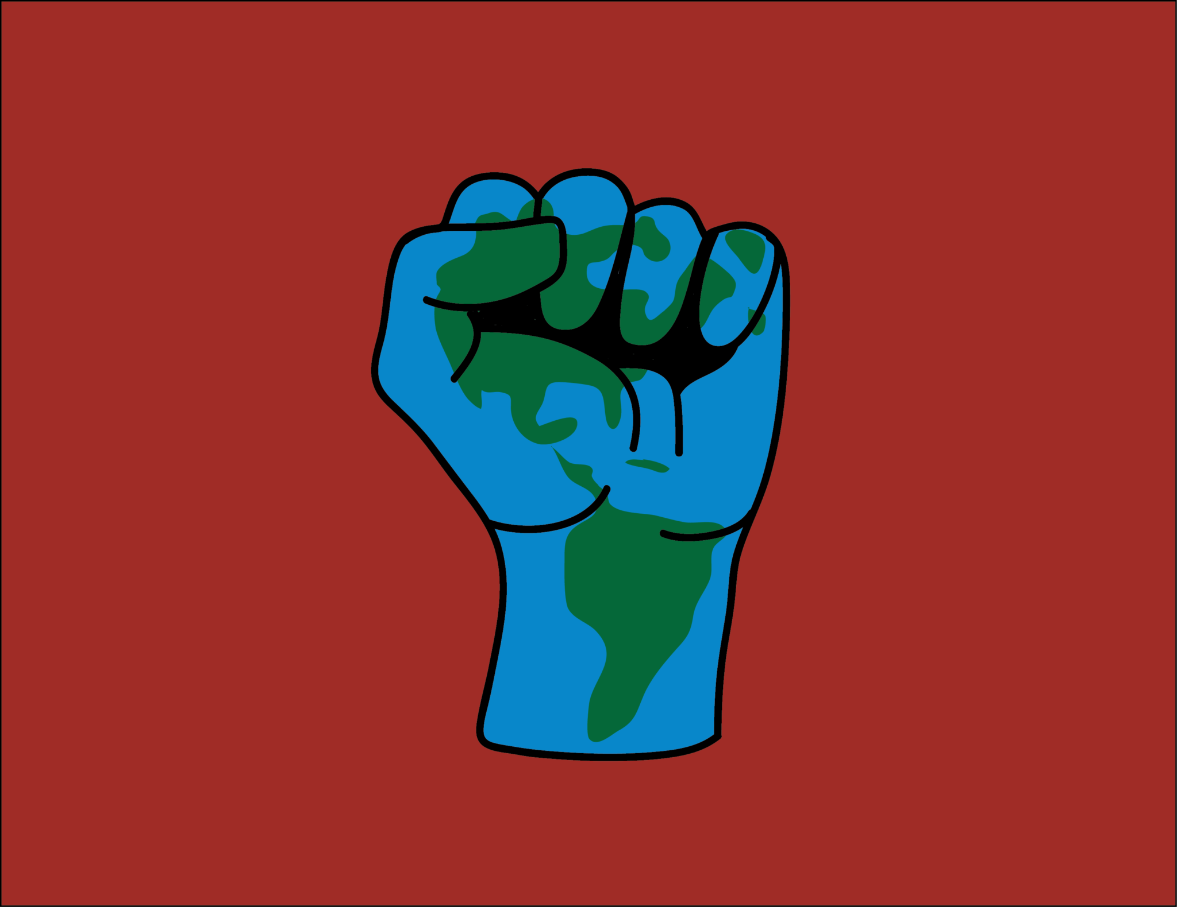
Dr. S. Perl Egendorf
Environmental
Justice
EESC 1201
March 2, 2023

Slide 2
Quick Free Write
Love Canal
Environmental Health
Environmental Justice
Racial Capitalism
Residential Segregation
Class
Overview

Slide 3
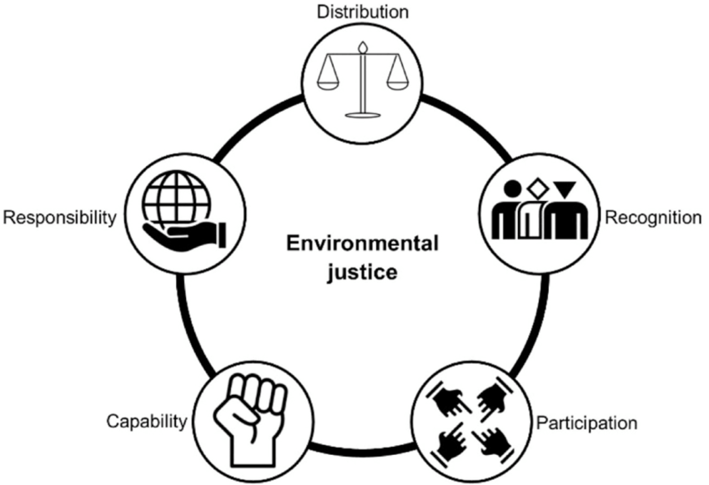
Quick Free Write
“Why do some communities get “dumped on” while others escape?” – Dr. Bob Bullard
Write for 3 minutes, share in groups for 3 minutes

Slide 4
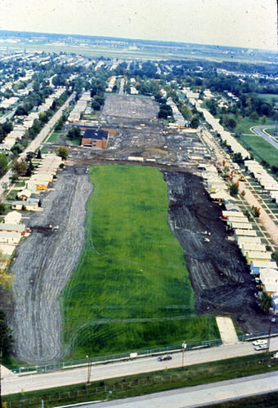
Love Canal
Love Canal is a neighborhood in Niagara Falls named after a large ditch (approximately 15 m wide, 3–12 m deep, and 1600 m long) that was dug in the 1890s for hydroelectric power.
In the 1920s the town began dumping urban waste into Love Canal, and in the 1940s the U.S. Army dumped waste from World War II there, including waste from the frantic effort to build a nuclear bomb.
Hooker Chemical purchased the land in 1942 and lined it with clay. Then, the company put into Love Canal an estimated 21,000 tons of hazardous chemical waste, including the carcinogens benzene, dioxin, and PCBs in large metal barrels and covered them with more clay.
In 1953, Hooker sold the land to the Niagara Falls school board for $1, and included a clause in the sales contract that both described the land use (filled with chemical waste) and absolved them from any future damage claims from the buried waste.
The school board promptly built a public school on the site and sold the surrounding land for a housing project that built 200 or so homes along the canal banks and another 1,000 in the neighborhood (See image).
Love Canal. Source: US Environmental Protection Agency

Slide 5
Love Canal
From the 1950s to the late 1970s, residents repeatedly complained of strange odors and substances that surfaced in their yards. City officials investigated the area, but did not act to solve the problem.
Local residents allegedly experienced major health problems including high rates of miscarriages, birth defects, and chromosome damage, but studies by the New York State Health Department disputed that.
Finally, in 1978 President Carter declared a state of emergency at Love Canal, making it the first human-caused environmental problem to be designated that way.
The Love Canal tragedy helped to create Superfund, which has analyzed tens of thousands of hazardous waste sites in the U.S. and cleaned up hundreds of the worst ones.
Nevertheless, over 1,000 major hazardous waste sites with a significant risk to human health or the environment are still in the process of being cleaned.
Who lived there? (Think race and class…)
How did they organize?
Love Canal. Source: US Environmental Protection Agency

Slide 6
For most of human history, biological agents were the most significant factor in health.
These included pathogenic (disease causing) organisms such as bacteria, viruses, protozoa, and internal parasites.
In modern times, cardiovascular diseases, cancer, and accidents are the leading killers in most parts of the world.
However, infectious diseases still cause about 22 million deaths a year, mostly in developing countries.
Geosphere –> Biosphere –>
Anthroposphere
Environmental conditions determine the health of ecosystems and human populations
Chemical agents also have significant effects on human health.
Toxic heavy metals, dioxins, pesticides, and endocrine disrupters are examples of these chemical agents.
Heavy metals (e.g., mercury, lead, & cadmium) are typically produced as by-products of mining and manufacturing processes.
All of them biomagnify (become more concentrated in species with increasing food chain level).

Slide 7
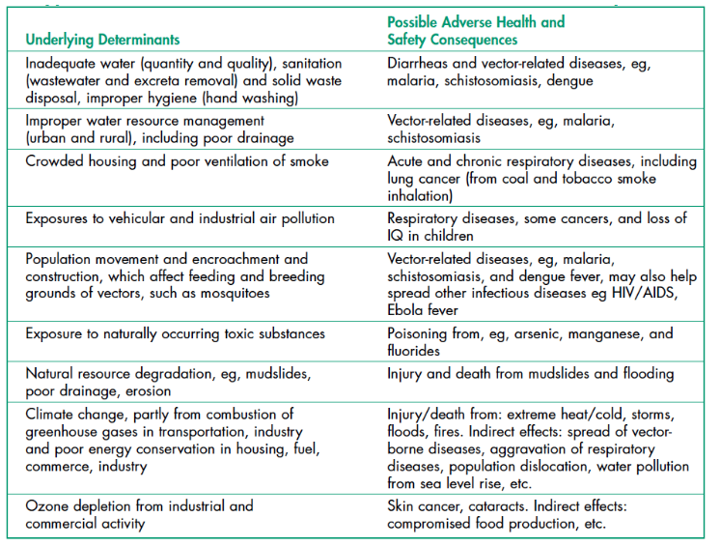
Environmental Health
Concerned with preventing disease, death and disability by reducing exposure to adverse environmental conditions.

Slide 8
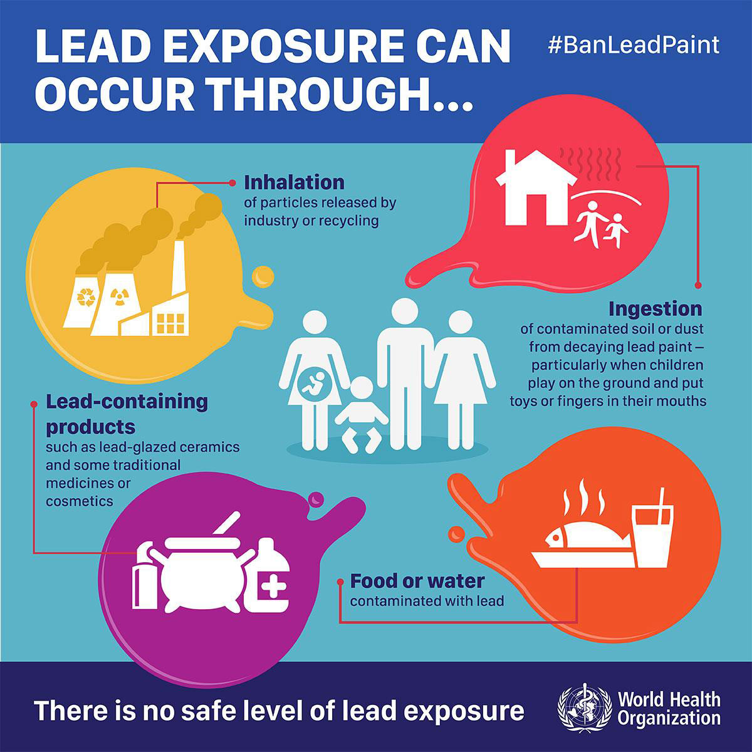
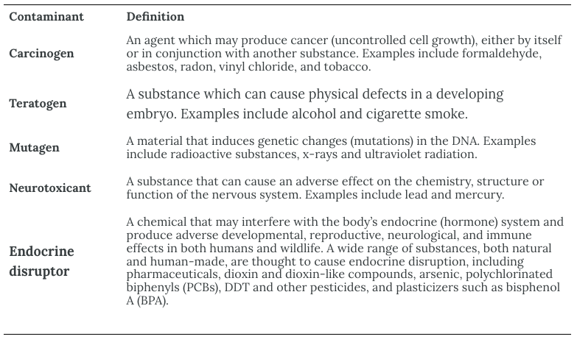
Contaminants
Exposure Routes
Classification of Contaminants

Slide 9
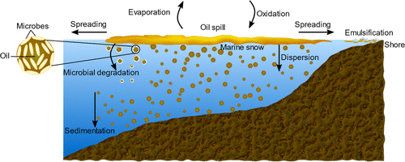
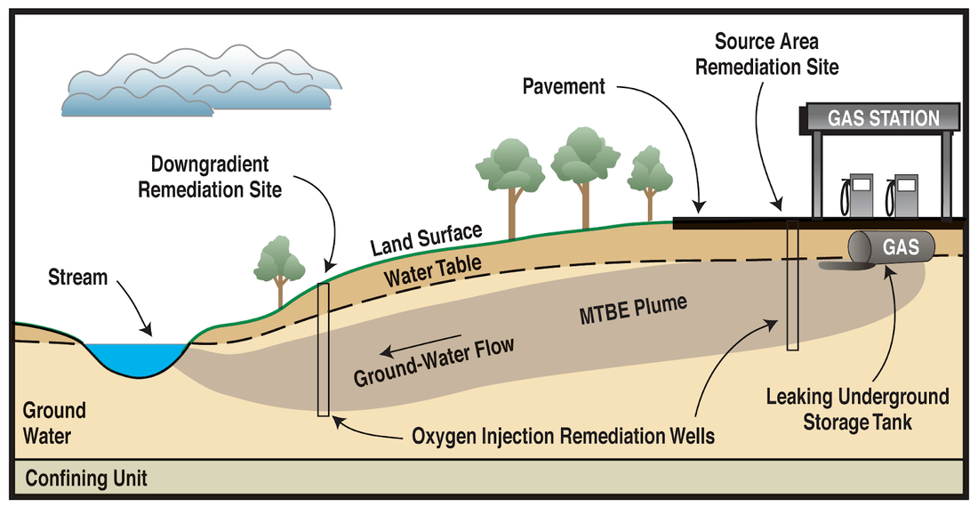
Bioremediation
A “treatment that uses naturally occurring organisms to break down hazardous substances into less toxic or non toxic substances.”
Note: not every substance can be effectively transformed or removed from a given environment …
https://pubs.acs.org/doi/10.1021/acsestengg.0c00217
“Why do some communities get ‘dumped on’ and others escape?”
https://energytoday.energysociety.org/bioremediation.html

Slide 10
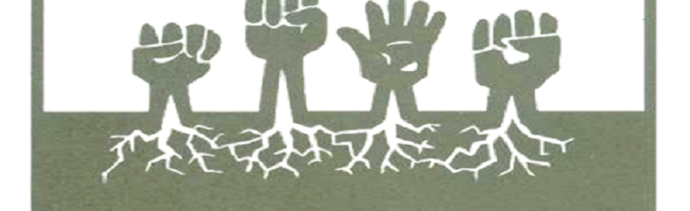
Movement and Scholarship
1970s and 1980s – gained visibility and strength as activists confronted toxic hazards disproportionately located in communities of color
Brought together discourses of public health, civil and human rights, anti-racism, social justice and ecological sustainability with tactics like civil disobedience, public protests, and legal action
Prevented construction or expansion of unwanted / controversial facilities like landfills, incinerators, mines, and chemical plants
Historic 1991 EJ Summit conference
Participants drafted the Principles of Environmental Justice – a synthesis of anti-racism and ecological sustainability in support of anti-militarist, anti-imperialist, gender-justice politics, and inherent worth of nonhuman natures
Largely comprised of people from communities of color, indigenous communities and working-class communities
Focused on combating environmental injustice, racism, and gender and class inequalities that manifest in disproportionate burdens of environmental harms facing these populations
EJ Background
Pellow (2017), What is Critical Environmental Justice?

Slide 11
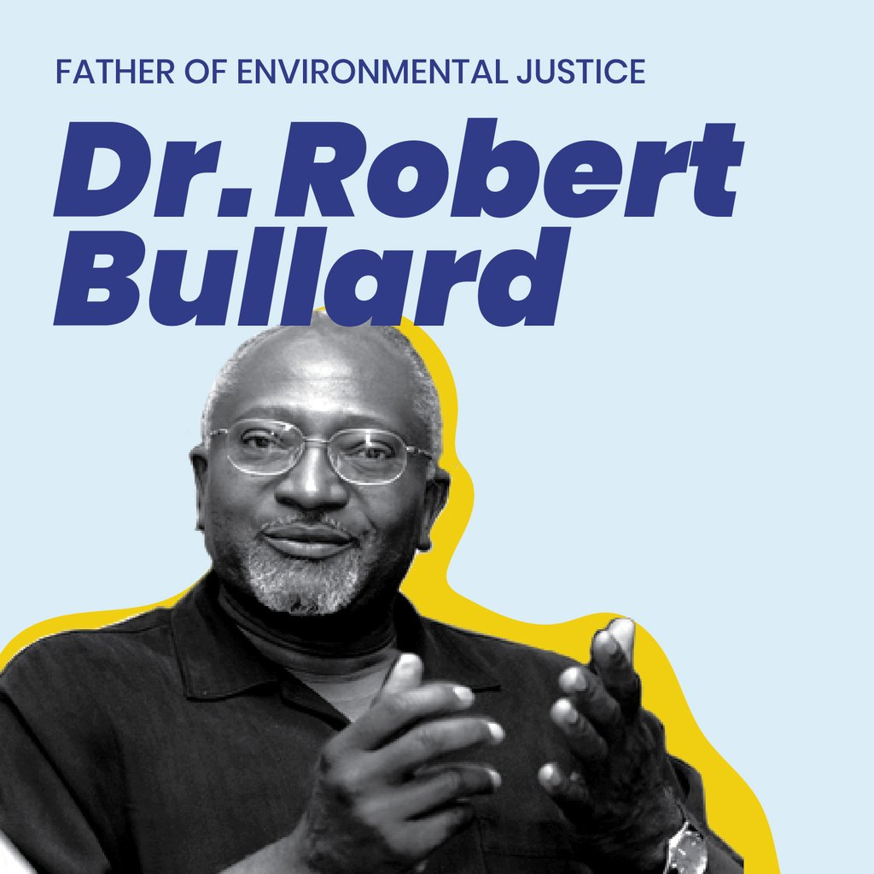
EJ and Environmental Racism: Definitions
EJ Studies scholar Robert Bullard:
“All people and communities are entitled to equal protection of environmental and public health laws and regulations.”
EPA expanded upon this, state agencies too
Benjamin Chavis, former head of United Church of Christ’s Commission on Racial Justice:
“Environmental racism is racial discrimination in environmental policymaking, the enforcement of regulations and laws, the deliberate targeting of communities of color for toxic waste facilities, the official sanctioning of the life-threatening presence of poisons and pollutants in our communities, and the history of excluding people of color from leadership of the ecology movements.”
Chavis, in Bullard (1996) “Unequal protection: environmental justice and communities of color”
Holifield (2001), “Defining Environmental Justice and Environmental Racism”

Slide 12
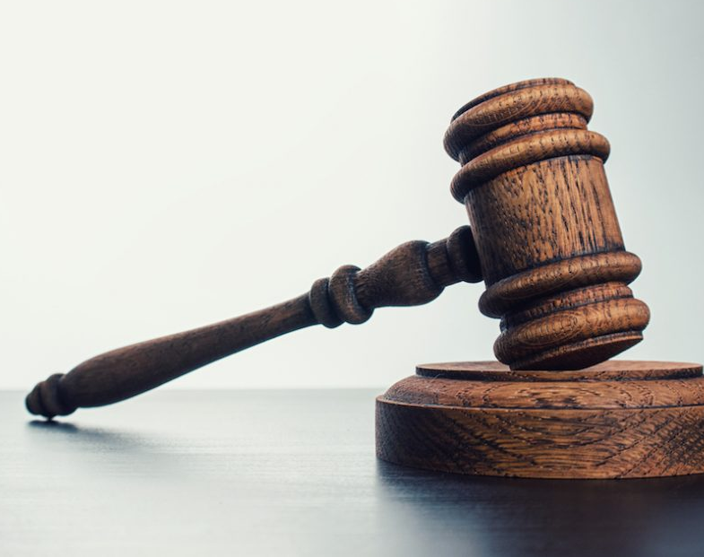
Legal Issues “Proving” Environmental Racism
Problem of intent:
Since 1976, the US Supreme Court has construed “race discrimination” to mean intentional or purposeful conduct on the basis of race – requiring that intent is attached to an individual actor
Courts respond by rejecting claims of environmental racism for failure to prove discriminatory intent
Problem of causation:
The disproportionate locations of toxic sites in communities of color has been argued to be correlation, not causation
Causes could be attributed to affected community “choices” and “market dynamics”
Problem of remuneration:
When in intent to cause harm is found, the offender may be financially liable
This can assist with short-term issues, but does not address underlying structures that continually drive environmental injustices
Cole and Foster (2000), From the Ground Up: Environmental Racism and the Rise of the Environmental Justice Movement

Slide 13
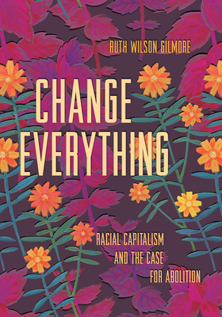
Environmental Racism and Structural Violence
Racism is not just targeted bigotry or prejudice
It is a structure that makes certain groups of people more vulnerable to premature death (Gilmore, 2007).
Environmental racism is state-sanctioned violence and a constituent part of racial capitalism (Pulido, 2017)
A system based on exploitation of land and labor (workers), so that profits accumulate for a small fraction of the population (owners).
This exploitation has always been racialized, even before capitalism began in Europe (Robinson, 2000)
In the US settler colonial context, understanding how racial capitalism continually devalues life and land is fundamental for changing structures towards more just outcomes
Gilmore (2007) Golden Gulag
Pulido (2017) “Geographies of race and ethnicity II: Environmental racism, racial capitalism and state-sanctioned violence”
Robinson (2000) Black Marxism
← New book coming soon!

Slide 14
Racial Capitalism
Capitalism operates through the production and exploitation of racial difference.
During U.S. slavery, enslaved Africans and their descendants were defined as racially different (“Black”) and inferior to justify their property status and perpetual servitude.
Poor European descended people were defined as racially different (“White”) and superior to Black people to prevent them from fully recognizing their own economic exploitation and common interests with Black people.
This “divide and conquer” strategy allows elites to deflect blame for their exploitation and immiseration of the poor.
It allows corporations to extract wealth from vulnerable racialized populations.
Source: Dr. Alan Takeall, Queens College Urban Studies 101

Slide 15
A History of Racial Segregation
Over the course of the 20th Century, U.S. cities actually became much more segregated than they were before the Civil War.
This segregation was enforced by different modes:
Overt prejudice: Individual refusal to rent or sell to people of particular races, ethnicities, or nationalities.
De jure: Official segregation (e.g. Jim Crow laws, “separate but equal”)
Institutional Discrimination: policies and practices that directly or indirectly allow discrimination
Denying home loans/mortgages to particular neighborhoods or favoring particular groups over others
Source: Dr. Alan Takeall

Slide 16
Federal Policies Facilitating Racial Segregation
1934: Federal
Housing Administration
1896: Plessy v.
Ferguson
1956: Federal
Highway Act
1964: Civil
Rights Act
1944: G.I. Bill
White Flight
Source: Dr. Alan Takeall

Slide 17
20th Century: Restrictive Covenants & Contract Buying
As large numbers of African Americans moved to northern and western cities after Reconstruction, white people sought to maintain exclusive white areas through mob violence and through deed clauses that restricted to whom other white people could sell property.
Relegated to overcrowded Black areas of the city, Black aspiring homeowners were vulnerable to predatory “rent to own” schemes. The white owner would “sell” a house to a Black family but retain the deed until the home was fully paid off. But if the buyer missed even a single payment, they could be evicted and forfeit all the money they put into purchasing the home.
Source: Dr. Alan Takeall

Slide 18
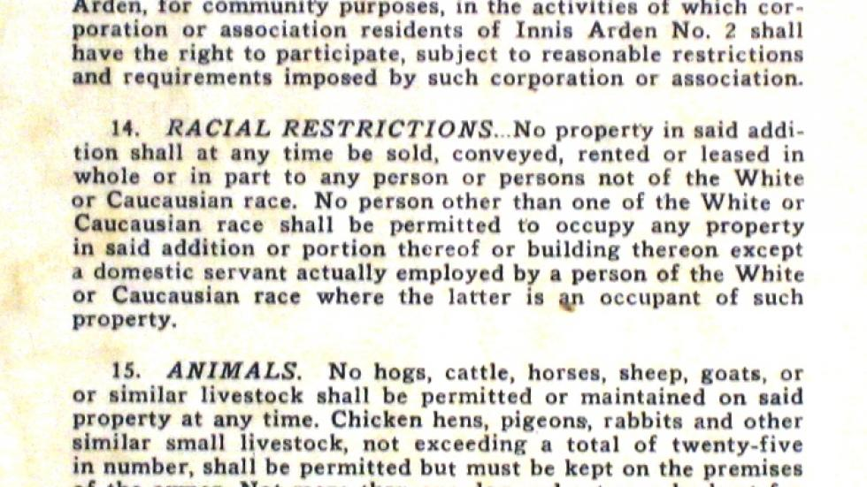
Restrictive Covenant: Seattle, WA
Source: Dr. Alan Takeall
Notes:
A racially restrictive clause in a deed for a property in Innis Arden, a community in Shoreline, Wash., north of Seattle. (University of Washington)

Slide 19
Redlining
The Home Owners Loan Corporation (HOLC) created “security maps” for 239 cities from 1935-1940 using ‘local experts’ from the private sector.
They surveyed and assessed real estate conditions for parent organization-- the Federal Home Loan Bank Board.
These maps reflected concern by government, real estate industry and the academy about the importance of racial composition and housing conditions to long term real estate investments.
Source: Dr. Alan Takeall
Notes:
In order to boost mortgage lending, the federal govt moved to assign differential values to racially segregated space. White areas were backed by the FHA while Black and mixed areas were largely not backed.
Thus, real estate speculators and lenders could make lots of money by encouraging and exploiting racial segregation and “creating” white spaces in suburban areas. Since racial discrimination was legal, suburban housing markets saw increasing home values because of the great demand for exclusively white space.
Meanwhile, Black areas were disinvested and saw declining property values. This made inner city land and buildings extremely cheap for speculators by the 1970s.

Slide 20
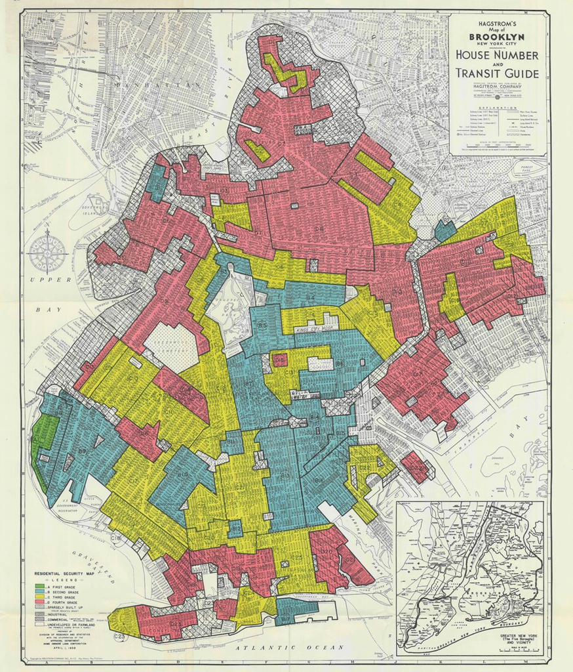
Source: Dr. Alan Takeall

Slide 21
Urban Renewal
The New Deal also provided money to cities for “slum clearance” programs.
These urban renewal programs exacerbated racial segregation by bulldozing poor but stable racially mixed neighborhoods to make way for highways, train stations, other city projects.
Urban Renewal also reflected a “dual housing policy”:
Concentrating Black people into inner city ghettos and building public housing in segregated neighborhoods
Encouraging white people to move to suburban communities-- subsidized by FHA loans
Source: Dr. Alan Takeall

Slide 22
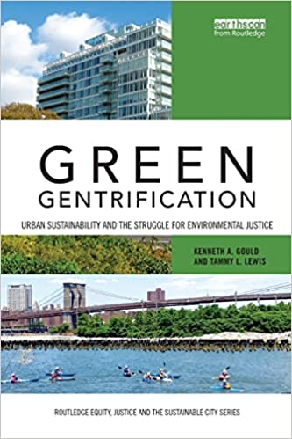
Environmental, ecological or green gentrification is a process in which cleaning up pollution or providing green amenities increases local property values and attracts wealthier residents to a previously polluted or disenfranchised neighborhood.
[BC Urban Sustainability Professors!]

Slide 23
The Crux of the Problem?
“The crux of the problem is that the mainstream environmental movement has not sufficiently addressed the fact that social inequality and imbalances of social power are at the heart of environmental degradation, resource depletion, pollution, and even overpopulation.
The environmental crisis can simply not be solved effectively without social justice.” – Dr. Bob Bullard
Your thoughts?

Slide 24
Summary
Environmental “disasters” affect quality of life and life outcomes (Love Canal), and biological and chemical agents impact human health.
Environmental health is concerned with preventing disease, death and disability to contaminants (organic and inorganic).
Bioremediation is a strategy where organisms are used to clean up polluted sites (generally polluted with organic contaminants).
From Paris, “The environmental justice movement was founded as a response to environmental injustices and disadvantages experienced by marginalized communities, notably communities of color and low-income [communities]. According Robert D. Bullard, the movement began with the realization that not all environmental issues are equally significant and that some communities are disproportionately impacted. Bullard underlines the importance of tying the campaign for environmental justice to the fight for social and economic justice since environmental justice not only addresses pollution but also social, economic, and political inequality.
Defining EJ in response to environmental racism is crucial. However, defining environmental racism as "deliberate targeting," has led to issues. Specifically, it is difficult to prove "deliberate intent to discriminate" with environmental issues in a court of law (issues of intent, correlation not causation, and payment not addressing underlying causes).
Therefore, it is important to recognize the structural causes of racism: racial capitalism.
"Racial difference" fuels capitalism, creating a social order where exploitation is justified. Exploited white workers feel superior to exploited Black workers, enabling exploitation to persist.
These structural issues produced racial segregation from a range of laws and tactics: Jim Crow laws, Federal Housing Administration (FHA) mortgage lending policies, restrictive covenants, contract buying, HOLC Redlining maps, urban renewal, and currently, green gentrification.
So why are certain communities dumped on?

Slide 25
References:
Bullard, R.D., 1996. Unequal protection: environmental justice and communities of color. Sierra Club Books, San Francisco.
Cole, L., Foster, S., 2000. From the Ground Up: Environmental Racism & the Rise of the Environmental Justice Movement. New York University (NYU Press), New York, NY.
Gilmore, R.W., 2007. Golden Gulag: Prisons, Surplus, Crisis, and Opposition in Globalizing California. University of California Press.
Holifield, R., 2001. Defining Environmental Justice and Environmental Racism. Urban Geography 22, 78–90. https://doi.org/10.2747/0272-3638.22.1.78
Pellow, D.N., 2017. What is Critical Environmental Justice? John Wiley & Sons.
Pulido, L., 2017. Geographies of race and ethnicity II: Environmental racism, racial capitalism and state-sanctioned violence. Progress in Human Geography 41, 524–533. https://doi.org/10.1177/0309132516646495
Robinson, C.J., 2000. Black Marxism: The Making of the Black Radical Tradition. Univ of North Carolina Press.

