Slide 1
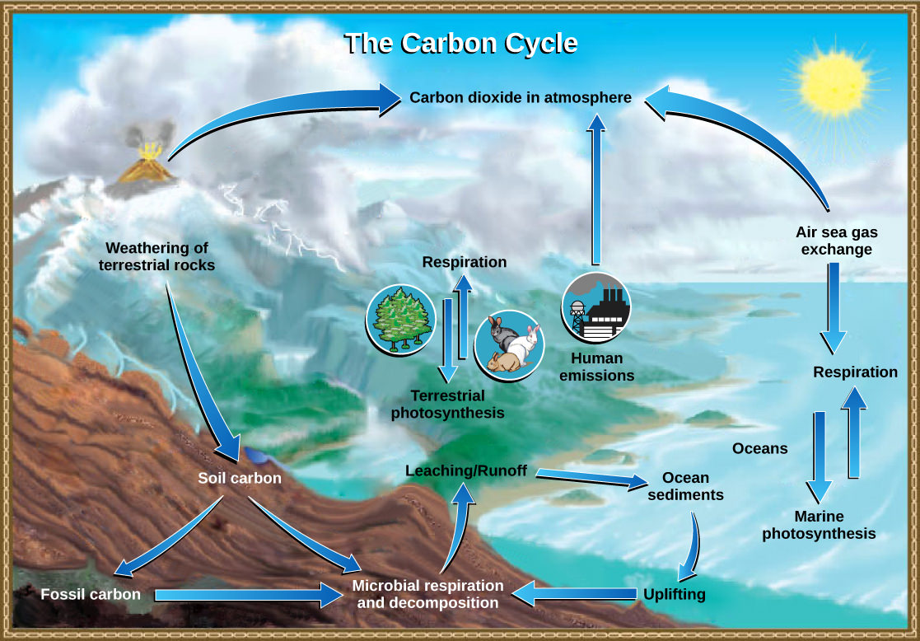
CHAPTER 2: MATTER, ENERGY, & LIFE CHAPTER 3: ECOSYSTEMS AND THE BIOSPHERE
EESC 1201
Professor Perl
Class 3: 2/21/23

Slide 2
Blackboard Response Highlights…
Taalib, “As I learn more about how we treat the environment unknowingly and knowingly, just makes me more aware of how even the smallest changes can have the biggest impact on the environment.”
Emma, “When I was 10, I watched "An Inconvenient Truth" by Al Gore, where I felt fear and a sense of lingering doom (I consider it my first panic attack). I didn't understand what it meant and interpreted it as the world going up in sudden flames.”
Allen, “I grew up in two worlds…There is a side to me that very much enjoys dressing up and being and indulging in consumerism but because of my experiences growing up with my Mexican family, I have gained ancestral knowledge in how to grow things and becoming aware of the nature around us.”

Slide 3
Logistics
Thank you for all filling out the pre-course survey!
New BC compost survey: https://bit.ly/BCComposting
All amazing BB posts! (No late penalties)
Next BB post due Sunday, 2/26/23 by 8pm (please respond to another post for full credit)
Optional class field trip to NYC Compost Project Hosted by Earth Matter!
Friday 3/17/23, 8:45 am at Governor’s Island Ferry Terminal, Manhattan
If interested, fill out consent form here (also available on BB in course documents): https://docs.google.com/forms/d/e/1FAIpQLSe3eF4EFi4-7a9ui3t0iKvRvk5H1zM5hc36lda0YLDwqXv0oA/viewform

Slide 4
Overview of Class
https://www.youtube.com/watch?v=_lNF3_30lUE
2.1 Matter
2.2 Energy
2.3 A Cell is the Smallest Unit of Life
2.4 Energy Enters Ecosystems Through Photosynthesis
3.1 Energy Flow through Ecosystems
3.2 Biogeochemical Cycles

Slide 5
2.1 What is Matter?
Matter is something that occupies space and has mass.
All matter is composed of elements,
cannot be broken down or transformed chemically into other substances.
Each element is made of atoms
each with a constant number of protons and unique properties.
A total of 118 elements have been defined; however, only 92 occur naturally and fewer than 30 are found in living cells.
The remaining 26 elements are unstable and therefore do not exist for very long or are theoretical and have yet to be detected.
Each element is designated by its chemical symbol (such as H, N, O, C, and Na), and possesses unique properties.
These unique properties allow elements to combine and to bond with each other in specific ways.

Slide 6
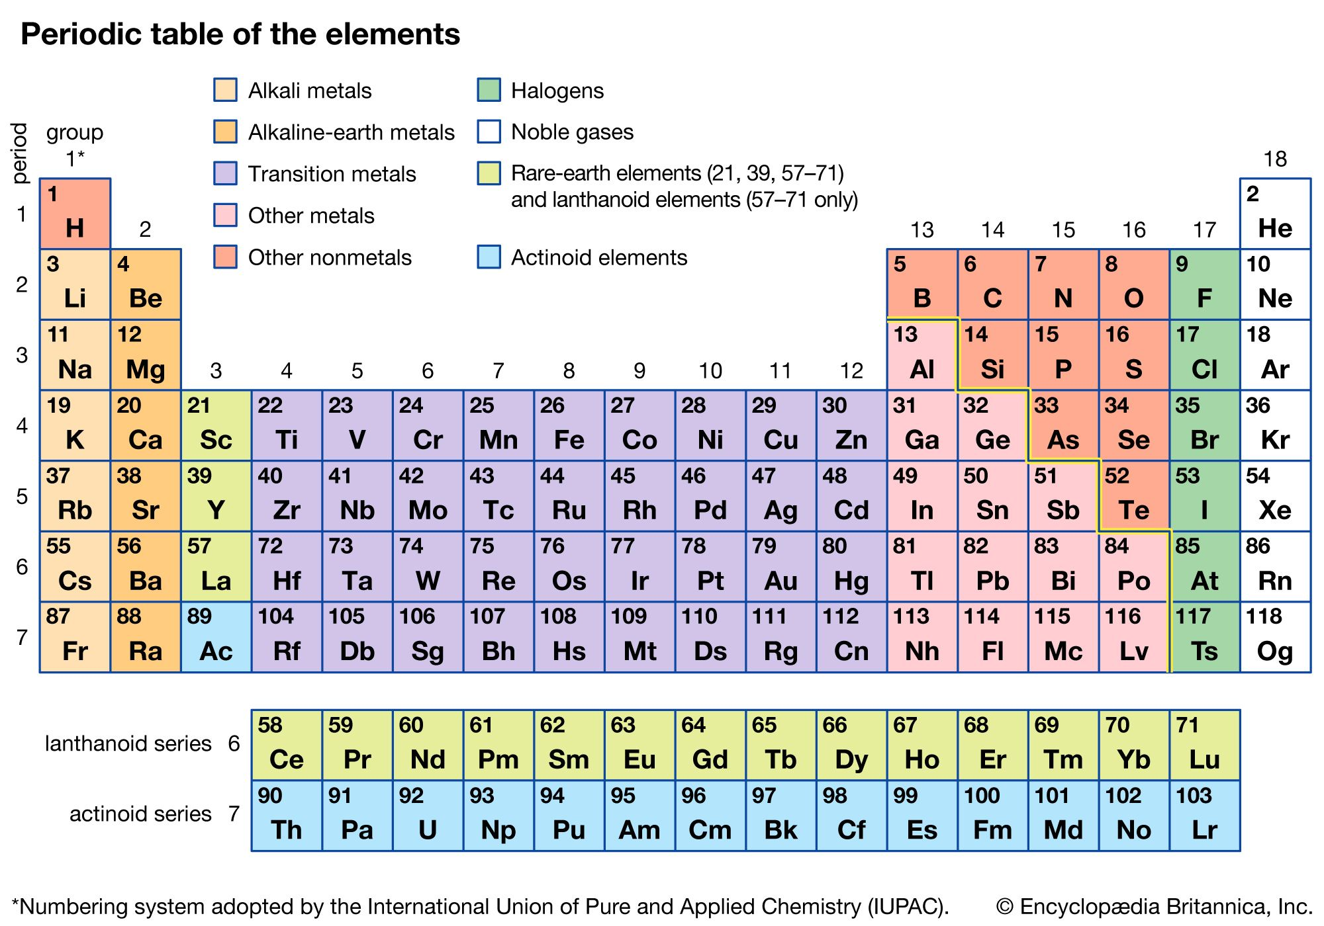
Matter -> Life
An atom is the smallest component of an element that retains all of the chemical properties of that element.
All matter, whether it be a rock or an organism, is made of atoms.
Often, these atoms combine to form molecules.
In multicellular organisms, molecules can interact to form cells that combine to form tissues, which make up organs.

Slide 7
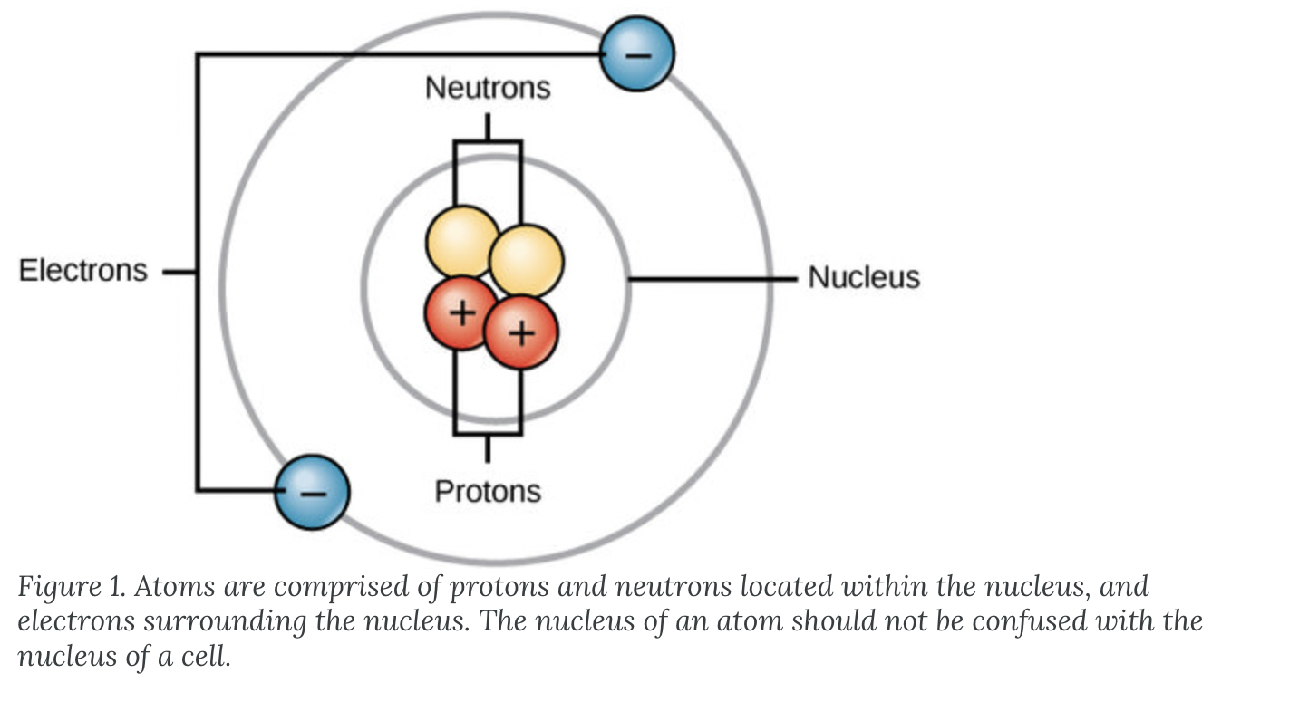
The Basics of an Atom, Key Terms
Protons = positive charge, in nucleus
Electrons = negative charge, outside nucleus
Neutrons = neutral charge, in nucleus
Atomic number = number of protons
Mass number = number of protons + number of neutrons
Isotopes = different forms of the same element (same number of protons, but different number of neutrons)
Radioactive isotopes = unstable, will lose protons, other subatomic particles, or energy to form more stable elements
Ion = atom does not contain equal protons and electrons (has a charge)
Cation = positive ions (losing electrons)
Anions = negative ions (gaining electrons)

Slide 8
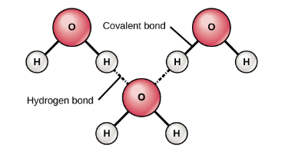
Chemical Bonds
Ionic bonds = bond between oppositely charged ions (an anion and a cation).
Covalent bonds = electrons are shared between two atoms.
Strongest and most common form of chemical bond in organisms. Unlike most ionic bonds, covalent bonds do not dissociate in water.
Covalent bonds come in two varieties: polar and non-polar.
A non-polar covalent bond = electrons are shared equally between the two atoms.
Polar covalent bonds = electrons are shared unequally.
Why does this occur? Each element has a known electronegativity: a measure of their affinity for electrons.
Oxygen = high electronegativity
Hydrogen = low electronegativity
Polar covalent bonds = two atoms involved have significantly different electronegativities.
A hydrogen bond is an interaction between two polar molecules. This type of bond is very common in organisms.
Notably, hydrogen bonds give water the unique properties that sustain life.

Slide 9
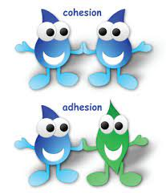
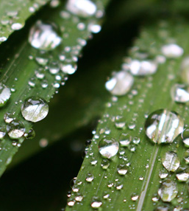
WATER IS CRUCIAL TO MAINTAINING LIFE
WATER IS POLAR.
The shared electrons spend more time associated with the oxygen atom than they do with hydrogen atoms.
No overall charge to a water molecule, but a slight positive charge on each hydrogen atom and a slight negative charge on the oxygen atom.
The slightly positive hydrogen atoms repel each other and form the unique shape.
Each water molecule attracts other water molecules because of the positive and negative charges in the different parts of the molecule. Water also attracts other polar molecules (such as sugars) that can dissolve in water and are referred to as hydrophilic (“water-loving”).
WATER STABILIZES TEMPERATURE.
The hydrogen bonds in water allow it to absorb and release heat energy more slowly than many other substances.
Temperature is a measure of the motion (kinetic energy) of molecules. As the motion increases, energy is higher and thus temperature is higher. Water absorbs a great deal of energy before its temperature rises.
WATER IS AN EXCELLENT SOLVENT.
Because water is polar, with slight positive and negative charges, ionic compounds and polar molecules can readily dissolve in it.
WATER IS COHESIVE.
In cohesion, water molecules are attracted to each other (because of hydrogen bonding), keeping the molecules together at the liquid-air (gas) interface.
Cohesion gives rise to surface tension, the capacity of a substance to withstand rupture when placed under tension or stress.
Cohesive forces are also related to the water’s property of adhesion, or the attraction between water molecules and other molecules.
This is observed when water “climbs” up a straw placed in a glass of water. You will notice that the water appears to be higher on the sides of the straw than in the middle. This is because the water molecules are attracted to the straw and therefore adhere to it.
Cohesive and adhesive forces are important for sustaining life. For example, because of these forces, water can flow up from the roots to the tops of plants to feed the plant.

Slide 10
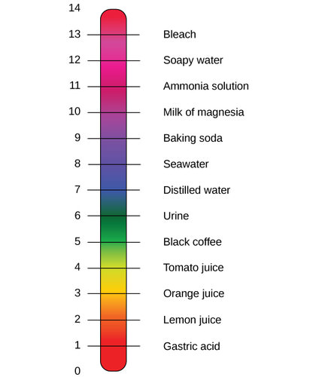
Buffers, pH, Acids, and Bases
The pH of a solution is a measure of its acidity or alkalinity.
The pH scale ranges from 0 to 14.
A change of one unit = a change in the concentration of hydrogen ions by a factor of 10
A change in two units = change in the concentration of hydrogen ions by a factor of 100.
Pure water is neutral with a pH of 7.0.
Anything below 7.0 (ranging from 0.0 to 6.9) is acidic, and anything above 7.0 (from 7.1 to 14.0) is alkaline.
The blood in your veins is slightly alkaline (pH = 7.4). The environment in your stomach is highly acidic (pH = 1 to 2).

Slide 11
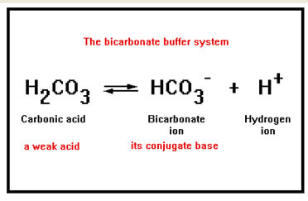
Acids, Bases and Buffers
Acids = substances that provide hydrogen ions (H+) and lower pH
Bases = provide hydroxide ions (OH–) and raise pH
The stronger the acid, the more readily it donates H+.
Conversely, bases are those substances that readily donate OH–. The OH– ions combine with H+ to produce water, which raises a substance’s pH.
How is it that we can ingest or inhale acidic or basic substances and not die? Buffers are the key.
Buffers readily absorb excess H+ or OH–, keeping the pH of the body carefully maintained.
Without this buffer system, the pH in our bodies would fluctuate too much and we would fail to survive.

Slide 12
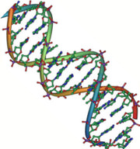
Biological Molecules
Besides water, the molecules necessary for life are organic.
Organic molecules = contain carbon covalently bonded to hydrogen.
In addition, they may contain oxygen, nitrogen, phosphorus, sulfur, and additional elements.
There are four major classes of organic molecules:
Carbohydrates
Lipids
Proteins
Nucleic acids

Slide 13
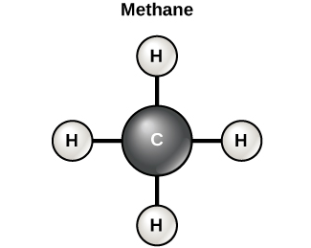
Carbon
It is often said that life is “carbon-based.”
Carbon atoms, bonded to other carbon atoms or other elements, form the fundamental components of many of the molecules found uniquely in living things.
Other elements play important roles in biological molecules, but carbon qualifies as the “foundation” element for molecules in living things.
It is the bonding properties of carbon atoms that are responsible for its important role.
Carbon can form four covalent bonds with other atoms or molecules. The simplest organic carbon molecule is methane (CH4), in which four hydrogen atoms bind to a carbon atom.

Slide 14
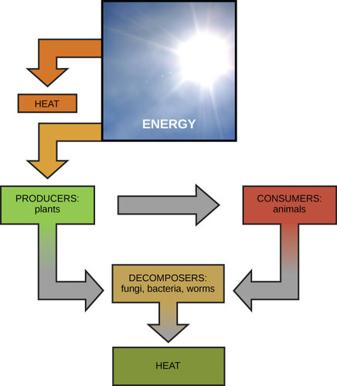
2.2 Energy
Virtually every task performed by living organisms requires energy.
Nutrients and other molecules are imported into the cell to meet these energy demands.
Together, all of the chemical reactions that take place inside cells, including those that consume or generate energy, are referred to as the cell’s metabolism.
From where, and in what form, does this energy come? How do living cells obtain energy, and how do they use it?

Slide 15
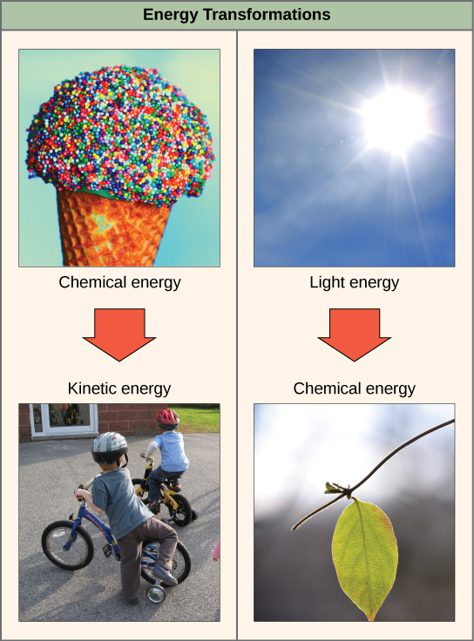
The Study of Energy: Thermodynamics
In general, energy is defined as the ability to do work, or to create some kind of change.
The 1st law of thermodynamics = the total amount of energy in the universe is constant and conserved.
Energy may be transferred from place to place or transformed into different forms, but it cannot be created or destroyed.
Plants perform one of the most biologically useful energy transformations on earth: that of converting the energy of sunlight to chemical energy stored within organic molecules.
The 2nd Law of Thermodynamics: All energy transfers and transformations are never completely efficient. In every energy transfer, some amount of energy is lost in a form that is unusable. In most cases, this form is heat energy.
Heat always moves from hotter objects to colder objects (or "downhill"), unless energy in some form is supplied to reverse the direction of heat flow.
The more energy that is lost by a system to its surroundings, the less ordered and more random the system is. Scientists refer to the measure of randomness or disorder within a system as entropy.

Slide 16
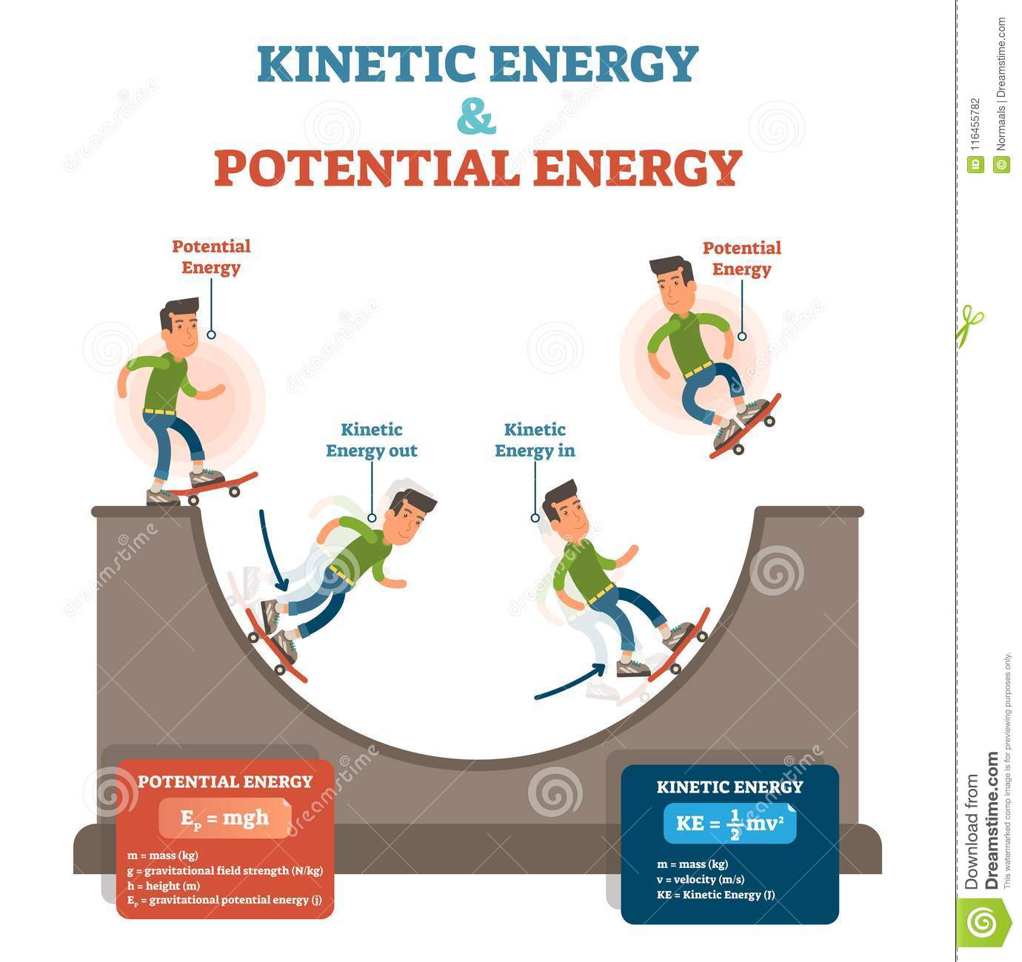
Potential and Kinetic Energy
Kinetic energy = energy of motion
A speeding bullet, a walking person, and the rapid movement of molecules (thermal energy) in the air all have kinetic energy.
Potential energy = stored energy
Potential energy is not only associated with the location of matter, but also with the structure of matter.
The fact that energy can be released by the breakdown of certain chemical bonds implies that those bonds have potential energy.
There is potential energy stored within the bonds of all the food molecules we eat, which is harnessed for use.
The type of potential energy that exists within chemical bonds, and is released when those bonds are broken, is called chemical energy.
Chemical energy is responsible for providing living cells with energy from food. The release of energy occurs when the molecular bonds within food molecules are broken.

Slide 17
2.3 A Cell is the Smallest Unit of Life
Cell theory:
All living things are composed of one or more cells, that the cell is the basic unit of life, and that all new cells arise from existing cells.
Animal, plant, fungal, and protist cells are classified as eukaryotic, whereas bacteria and archaea cells are classified as prokaryotic.
All cells share four common components:
1) a plasma membrane, an outer covering that separates the cell’s interior from its surrounding environment;
2) cytoplasm, consisting of a jelly-like region within the cell in which other cellular components are found;
3) DNA, the genetic material of the cell; and
4) ribosomes, particles that synthesize proteins.

Slide 18
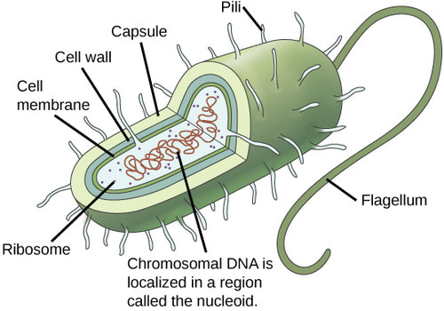
Prokaryotic Cells
A prokaryotic cell:
Simple, single-celled (unicellular) organism that lacks a nucleus, or any other membrane-bound organelle.
Prokaryotic DNA is found in the central part of the cell: a darkened region called the nucleoid.

Slide 19
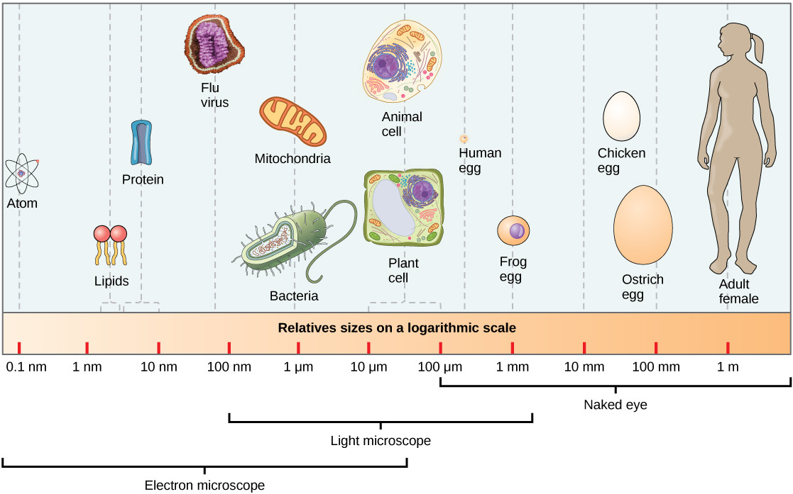
Eurkaryotic Cells
A eukaryotic cell is a cell that has a membrane-bound nucleus and other membrane-bound compartments or sacs, called organelles, which have specialized functions.
The word eukaryotic means “true kernel” or “true nucleus,” alluding to the presence of the membrane-bound nucleus in these cells.
The word “organelle” means “little organ,” and, as already mentioned, organelles have specialized cellular functions, just as the organs of your body have specialized functions.
At 0.1–5.0 µm (micrometer) in diameter, most prokaryotic cells are significantly smaller than eukaryotic cells, which have diameters ranging from 10–100 µm.
The small size of prokaryotes allows ions and organic molecules that enter them to quickly spread to other parts of the cell.
Similarly, any wastes produced within a prokaryotic cell can quickly move out.
However, larger eukaryotic cells have evolved different structural adaptations to enhance cellular transport.

Slide 20
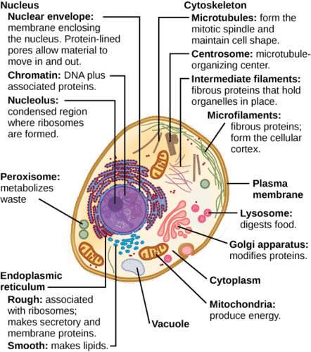
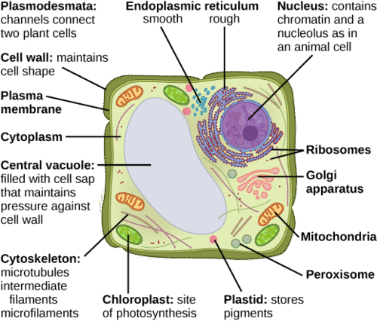
Animal vs. Plant Cells

Slide 21
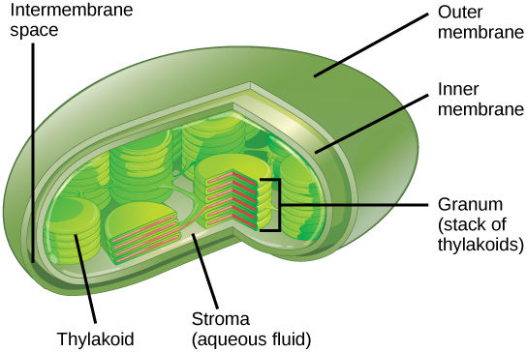
Chloroplasts
Chloroplasts function in photosynthesis and can be found in eukaryotic cells such as plants and algae.
In photosynthesis, carbon dioxide, water, and light energy are used to make glucose and oxygen.
This is the major difference between plants and animals: plants are able to make their own food, like glucose, whereas animals must rely on other organisms for their organic compounds or food source.

Slide 22
2.4 Energy Enters Ecosystems Through Photosynthesis – Bringing it all Together
All living organisms on Earth consist of one or more cells.
Each cell runs on the chemical energy found mainly in carbohydrate molecules, and the majority of these molecules are produced by one process: photosynthesis.
Through photosynthesis, certain organisms convert solar energy (sunlight) into chemical energy, which is then used to build carbohydrate molecules.
The energy stored in the bonds to hold these molecules together is released when an organism breaks down food.
Cells then use this energy to perform work, such as movement.
The energy that is harnessed from photosynthesis enters the ecosystems of our planet continuously and is transferred from one organism to another.
Therefore, directly or indirectly, the process of photosynthesis provides most of the energy required by living things on Earth.
Photosynthesis also results in the release of oxygen into the atmosphere.
In short, to eat and breathe humans depend almost entirely on the organisms that carry out photosynthesis.

Slide 23
Solar Dependence and Food Production
An autotroph is an organism that can produce its own food.
The Greek roots of the word autotroph mean “self” (auto) “feeder” (troph).
Plants are the best-known autotrophs, but others exist, including certain types of bacteria and algae.
Oceanic algae contribute enormous quantities of food and oxygen to global food chains.
Plants are photoautotrophs: a type of autotroph that uses sunlight and carbon from carbon dioxide to synthesize chemical energy in the form of carbohydrates.
Heterotrophs are organisms incapable of photosynthesis that must therefore obtain energy and carbon from food by consuming other organisms.
The Greek roots of the word heterotroph mean “other” (hetero) “feeder” (troph), meaning that their food comes from other organisms. Even if the organism being consumed is another animal, it traces its stored energy back to autotrophs and the process of photosynthesis.
Figure 1. (a) Plants, (b) algae, and (c) certain bacteria, called cyanobacteria, are photoautotrophs that can carry out photosynthesis (TECHNICALLY ALGAE). Algae can grow over enormous areas in water, at times completely covering the surface.

Slide 24
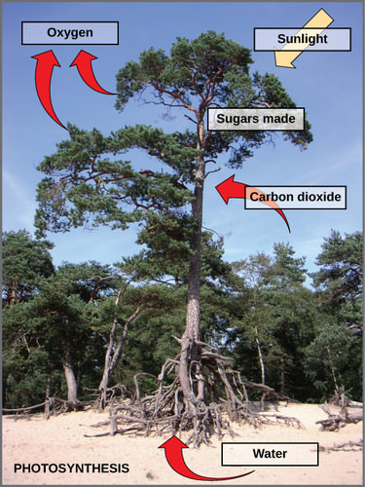
Main Structures and Summary of Photosynthesis
Photosynthesis requires sunlight, carbon dioxide, and water as starting reactants.
After the process is complete, photosynthesis releases oxygen and produces carbohydrate molecules, most commonly glucose.
These sugar molecules contain the energy that living things need to survive.
The complex reactions of photosynthesis can be summarized by the chemical equation shown here.

Slide 25
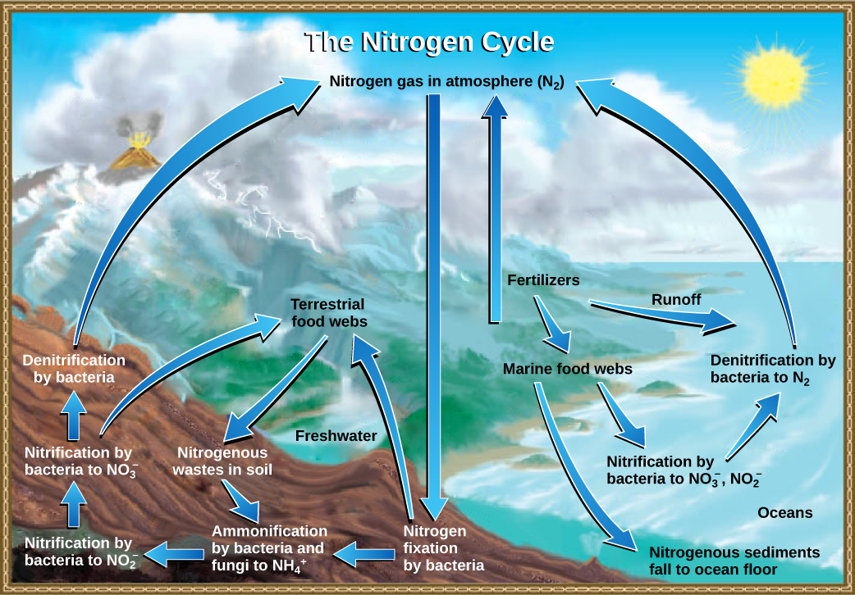
Chapter 3: ECOSYSTEMS AND THE BIOSPHERE
3.1 Energy Flow through Ecosystems
3.2 Biogeochemical Cycles
Skipping in lecture (but please do read!):
3.3 Terrestrial Biomes
3.4 Aquatic Biomes

Slide 26
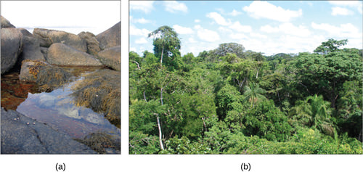
3.1 Energy Flow through Ecosystems
An ecosystem is a community of organisms and their abiotic (non-living) environment.
Ecosystems can be small, such as the tide pools found near the rocky shores of many oceans (image a), or large, such as those found in the tropical rainforest of the Amazon in Brazil (image b).
There are three broad categories of ecosystems based on their general environment:
freshwater,
marine, and
terrestrial.
Within these three categories are individual ecosystem types based on the environmental habitat and organisms present.

Slide 27
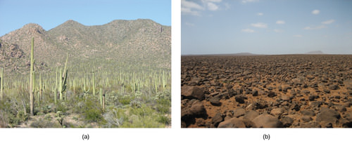
Broad Categories of Ecosystems
Freshwater ecosystems
the least common, occurring on only 1.8% of Earth’s surface.
ex: lakes, rivers, streams, and springs; quite diverse and support a variety of animals, plants, fungi, protists and prokaryotes.
Marine ecosystems
the most common, comprising 75% of Earth’s surface; three basic types: shallow ocean, deep ocean water, and deep ocean bottom.
Shallow ocean ecosystems include extremely biodiverse coral reef ecosystems.
Small photosynthetic organisms, collectively known as phytoplankton, perform 40% of all photosynthesis on Earth.
Deep ocean bottom ecosystems contain a wide variety of marine organisms. Light is unable to reach them.
Terrestrial ecosystems, also known for their diversity, are grouped into large categories called biomes.
A biome is a large-scale community of organisms, defined by the dominant plant types that exist in geographic regions of the planet with similar climatic conditions.
Examples of biomes include tropical rainforests, savannas, deserts, grasslands, temperate forests, and tundras.
Grouping these ecosystems into just a few biome categories obscures the great diversity of the individual ecosystems within them.
For example, the saguaro cacti (Carnegiea gigantean) and other plant life in the Sonoran Desert, in the United States (image a), are relatively diverse compared with the desolate rocky desert of Boa Vista, an island off the coast of Western Africa (image b).

Slide 28
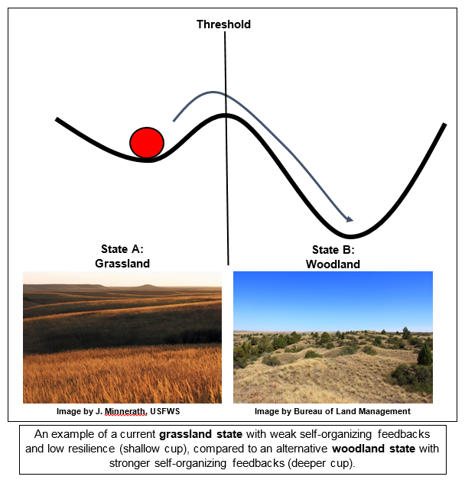
Ecosystems and Disturbance
Ecosystems are complex with many interacting parts.
They are routinely exposed to various disturbances: changes in the environment that affect their compositions, such as yearly variations in rainfall and temperature.
Example: lightning → forest fire → destroys part of forest ecosystem → the ground is eventually populated with grasses → followed by bushes and shrubs → and later mature trees.
Thus, the forest is restored to its former state. This process is so universal that ecologists have given it a name—succession.
The impact of environmental disturbances caused by human activities is now as significant as the changes wrought by natural processes.
Human agricultural practices, air pollution, acid rain, global deforestation, overfishing, oil spills, and illegal dumping on land and into the ocean all have impacts on ecosystems.
In ecology, two parameters are used to measure changes in ecosystems: resistance and resilience.
The ability of an ecosystem to remain at equilibrium in spite of disturbances is called resistance.
The speed at which an ecosystem recovers equilibrium after being disturbed is called resilience.
Ecosystem resistance and resilience are especially important when considering human impact.
The nature of an ecosystem may change to such a degree that it can lose its resilience entirely. This process can lead to the complete destruction or irreversible altering of the ecosystem.

Slide 29
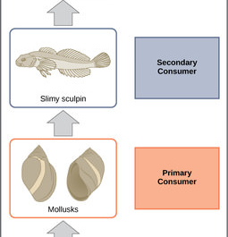
Food Chains and Food Webs
A food chain is a linear sequence of organisms through which nutrients and energy pass as one organism eats another.
These levels are used to describe ecosystem structure and dynamics.
There is a single path through a food chain. Each organism in a food chain occupies a specific trophic level (energy level), its position in the food chain or food web.
In many ecosystems, the base, or foundation, of the food chain consists of photosynthetic organisms (plants or phytoplankton), which are called producers.
The organisms that consume the producers are herbivores called primary consumers.
Secondary consumers are usually carnivores that eat the primary consumers.
Tertiary consumers are carnivores that eat other carnivores.
Higher-level consumers feed on the next lower trophic levels, and so on, up to the organisms at the top of the food chain.
In the Lake Ontario food chain, shown in the image, the Chinook salmon is the apex consumer at the top of this food chain.

Slide 30
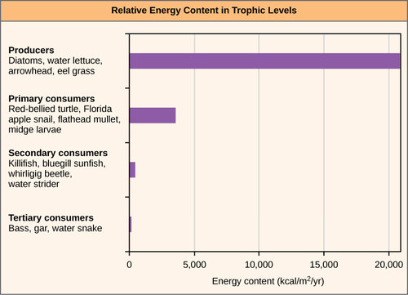
Energy in Trophic Levels
One major factor that limits the number of steps in a food chain is energy.
Energy is lost at each trophic level and between trophic levels as heat and in the transfer to decomposers.
Thus, after a limited number of trophic energy transfers, the amount of energy remaining in the food chain may not be great enough to support viable populations at higher trophic levels.

Slide 31
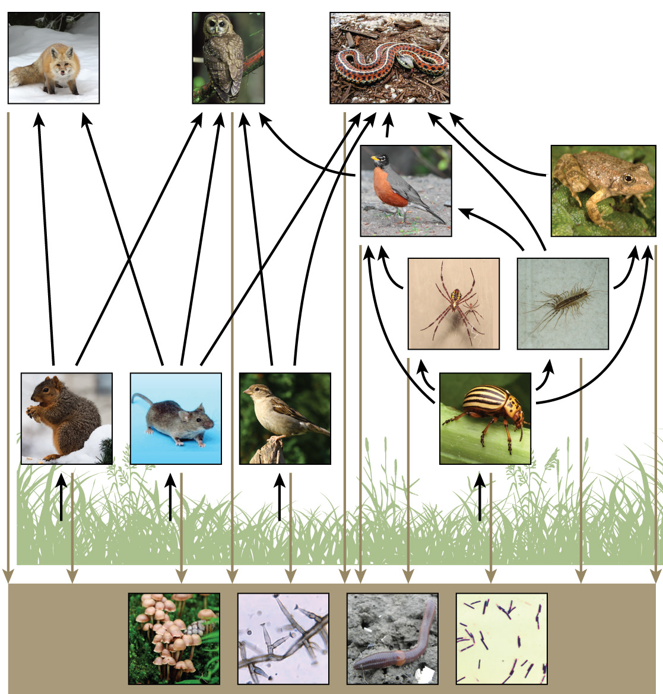
Food Web: A Holistic Model
Even when all organisms are grouped into trophic levels, some feed at more than one trophic level.
Species eat and are eaten by more than one species.
The linear model of ecosystems, the food chain, is a hypothetical and overly simplistic representation of ecosystem structure.
A food web is a concept that accounts for the multiple trophic (feeding) interactions between each species.
Two general types of food webs are often shown interacting within a single ecosystem.
A grazing food web has plants or other photosynthetic organisms at its base, followed by herbivores and various carnivores.
A detrital food web consists of a base of organisms that feed on decaying organic matter (dead organisms), including decomposers (which break down dead and decaying organisms) and detritivores (which consume organic detritus).
These organisms are usually bacteria, fungi, and invertebrate animals that recycle organic material back into the biotic part of the ecosystem as they themselves are consumed by other organisms.

Slide 32
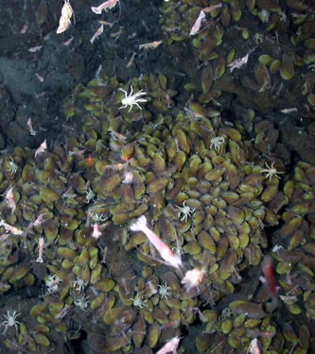
How Organisms Acquire Energy in a Food Web
Food-web diagrams illustrate how energy flows through ecosystems. They can also indicate how efficiently organisms acquire energy, use it, and how much remains for use by other organisms of the food web.
Energy is acquired by living things in two ways: autotrophs harness light or chemical energy and heterotrophs acquire energy through the consumption and digestion of other living or previously living organisms.
The rate at which photosynthetic producers incorporate energy from the Sun is called gross primary productivity. However, not all of the energy incorporated by producers is available to the other organisms in the food web because producers must also grow and reproduce, which consumes energy.
Net primary productivity is the energy that remains in the producers after accounting for these organisms’ metabolism and heat loss. The net productivity is then available to the primary consumers at the next trophic level.
Chemoautotrophs are primarily bacteria and archaea that are found in rare ecosystems where sunlight is not available, such as those associated with dark caves or hydrothermal vents at the bottom of the ocean (see image).
Many chemoautotrophs in hydrothermal vents use hydrogen sulfide (H₂S), which is released from the vents, as a source of chemical energy. This allows them to synthesize complex organic molecules, such as glucose, for their own energy and, in turn, supplies energy to the rest of the ecosystem.

Slide 33
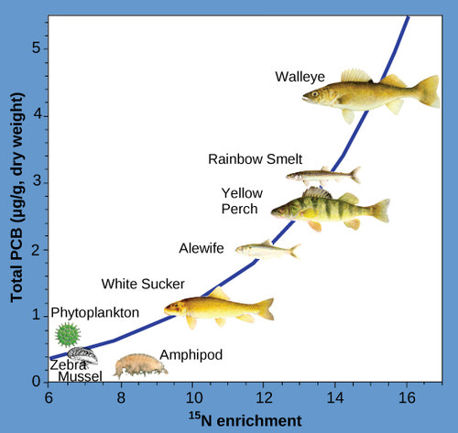
Consequences of Food Webs: Biological Magnification
One of the most important consequences of ecosystem dynamics in terms of human impact is biomagnification.
Biomagnification is the increasing concentration of persistent, toxic substances in organisms at each successive trophic level.
These are substances that are lipid soluble and are stored in the fat reserves of each organism.
Many substances have been shown to biomagnify, including classical studies with the pesticide dichlorodiphenyltrichloroethane (DDT), which were described in the 1960s bestseller Silent Spring by Rachel Carson.
DDT was a commonly used pesticide before its dangers to apex consumers, such as the bald eagle, became known.
DDT and other toxins are taken in by producers and passed on to successive levels of consumers at increasingly higher rates.
As bald eagles feed on contaminated fish, their DDT levels rise. It was discovered that DDT caused the eggshells of birds to become fragile, which contributed to the bald eagle being listed as an endangered species under U.S. law.
The use of DDT was banned in the United States in the 1970s. .

Slide 34
3.2 Biogeochemical Cycles – Bringing it All Together
Energy flows directionally through ecosystems, entering as sunlight (or inorganic molecules for chemoautotrophs) and leaving as heat during energy transformation between trophic levels.
Rather than flowing through an ecosystem, the matter that makes up organisms is conserved and recycled.
The six most common elements associated with organic molecules—carbon, nitrogen, hydrogen, oxygen, phosphorus, and sulfur—take a variety of chemical forms and may exist for long periods in the atmosphere, on land, in water, or beneath Earth’s surface.
Geologic processes, such as weathering, erosion, water drainage, and the subduction of the continental plates, all play a role in the cycling of elements on Earth.
Because geology and chemistry have major roles in the study of these processes, the recycling of inorganic matter between living organisms and their nonliving environment are called biogeochemical cycles.

Slide 35
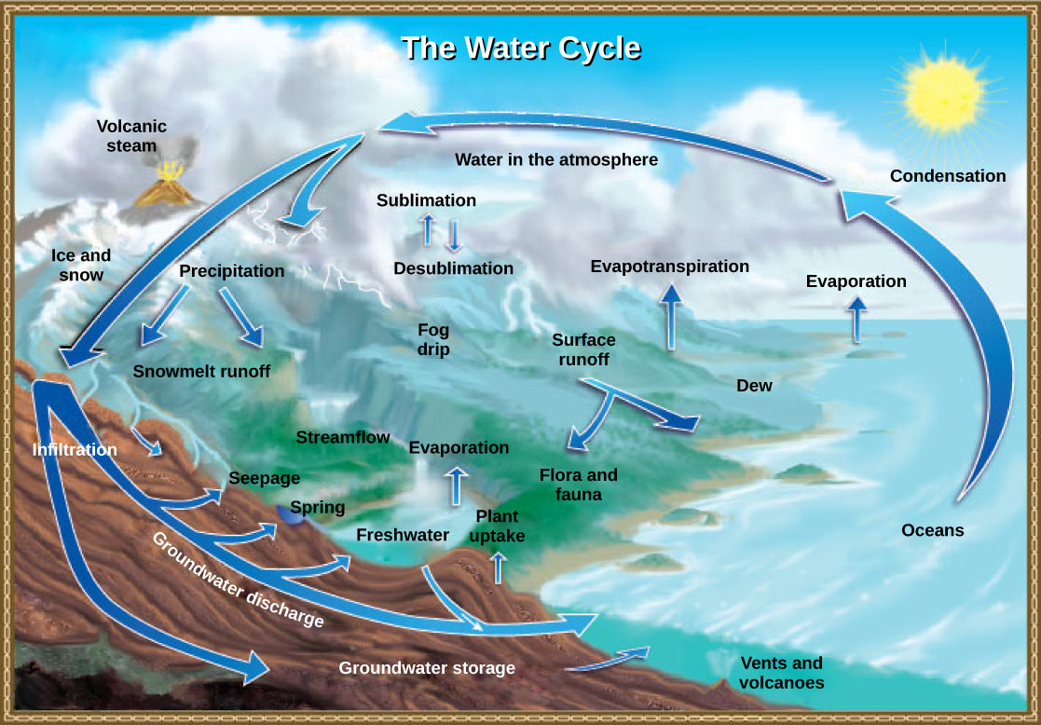
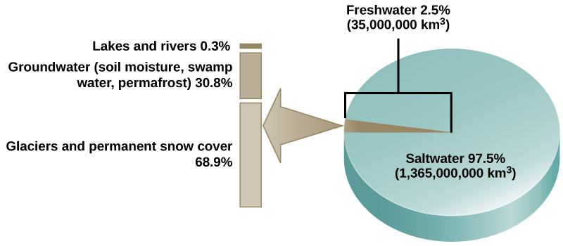
The Hydrologic Cycle

Slide 36
The Carbon Cycle

Slide 37
The Nitrogen Cycle
Are rocks a missing piece of the nitrogen cycle?
https://cen.acs.org/environment/climate-change/Rocks-missing-piece-nitrogen-cycle/96/i15#:~:text=Scientists%20have%20always%20assumed%20nitrogen,forms%20that%20organisms%20can%20use.

Slide 38
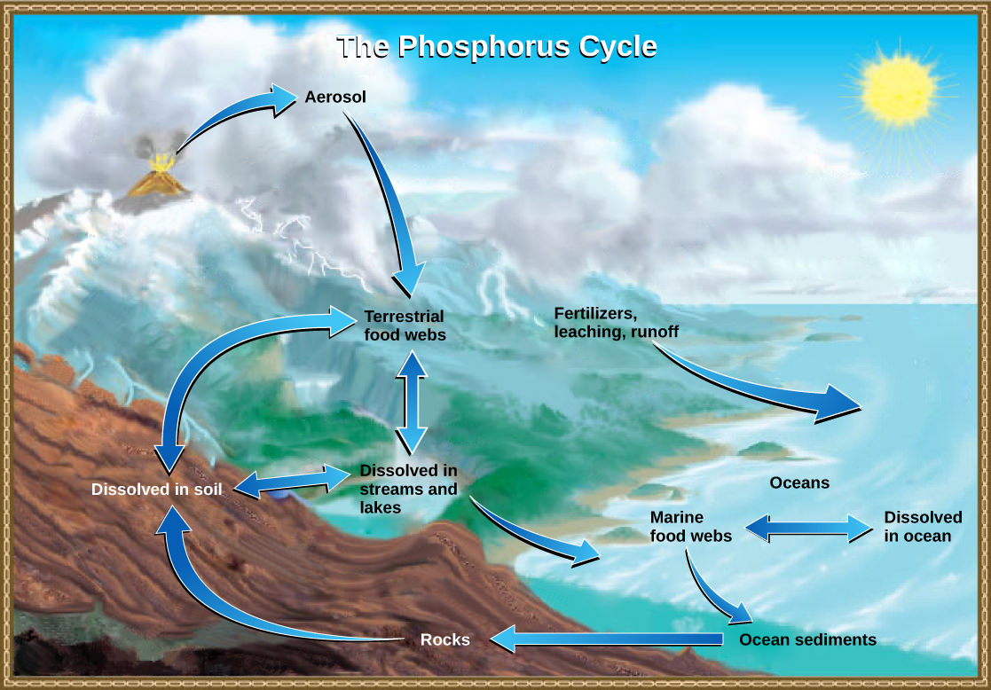
The Phosphorus Cycle

Slide 39
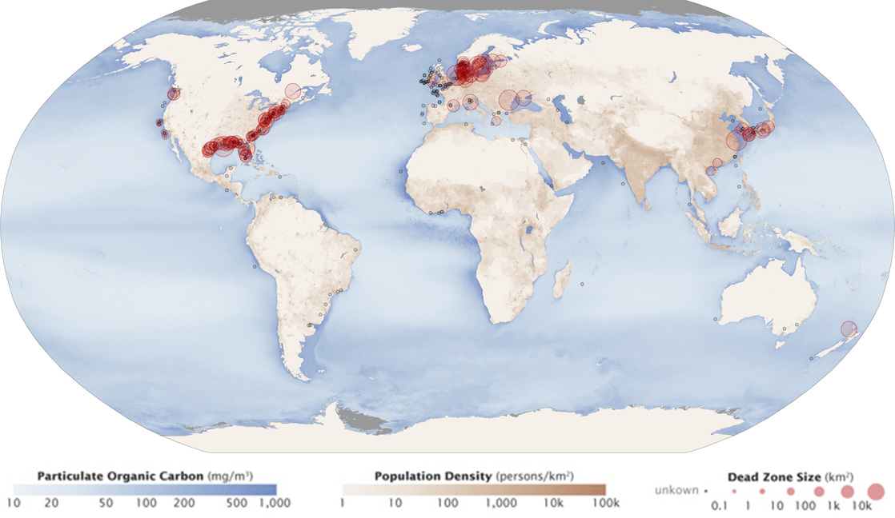
Eutrophication and Dead Zones

Slide 40
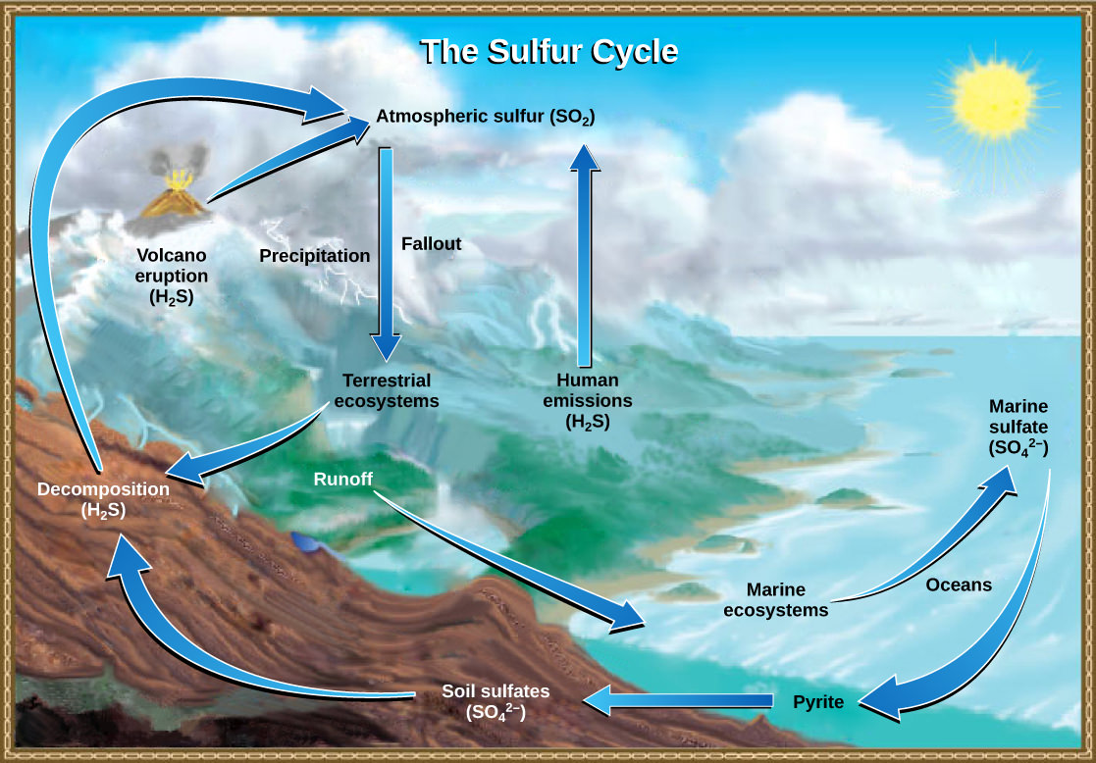
The Sulfur Cycle

