Slide 1
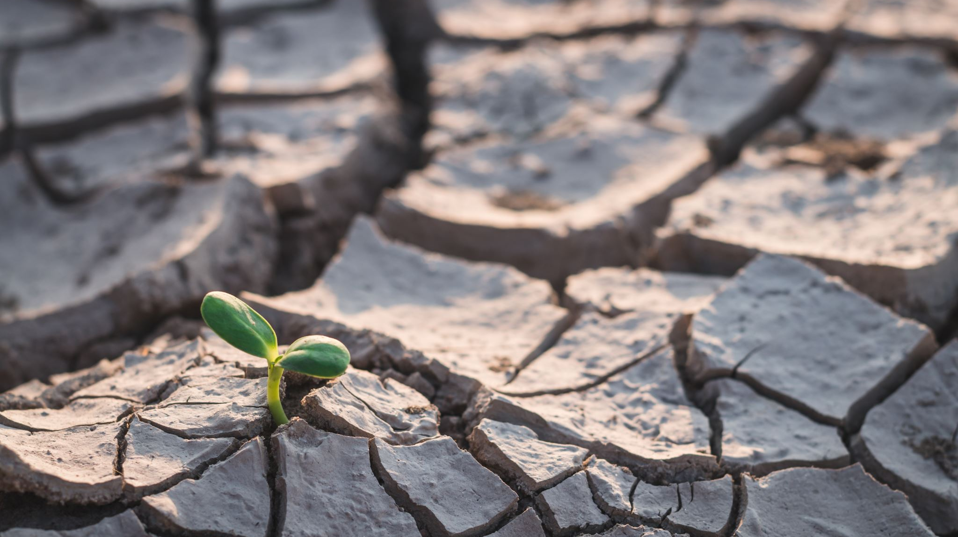
EESC 1201: Intro to Environmental Science
Dr. Sara ‘Perl’ Egendorf
Class 2: February 6, 2023

Slide 2
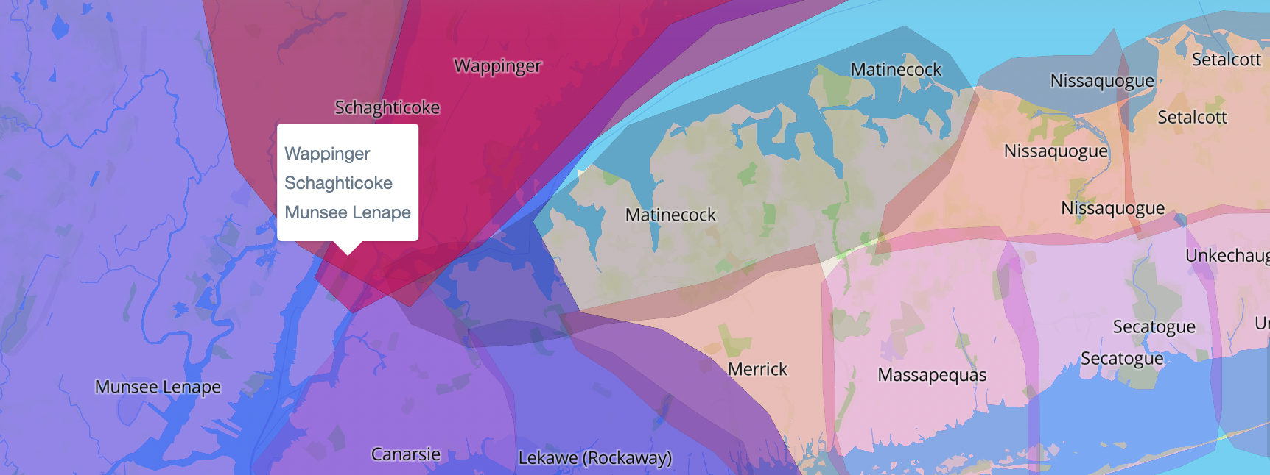
02
We in NYC are in Lenapehoking, the Lenape homeland, as well as lands stewarded by the Wappinger and Schagticoke Nations. I want to acknowledge these Indigenous communities, elders of the past and present, and their future generations to come.
As a settler, I recognize that I participate in active displacement, even if this is unintentional.
I invite us all to work toward dismantling the ongoing legacies of settler colonialism by supporting Indigenous rematriation of these lands.
Indigenous Land Acknowledgement
See http://landacknowledgements.org/ and https://native-land.ca/
for more information.

Slide 3
First Class Overview
Who am I?
Who are you?
Name, pronouns, year in college, racial/ethnic/cultural backgrounds, things you care about
Why are you taking this course?
What is the environment? (draw/map)
Syllabus
Course website: https://eesc1201.commons.gc.cuny.edu/

Slide 4
our Class Agreements
Let’s show consent with raising fingers:
1 = Agree to follow through; 2 = Ok, not blocking this; 3 = Can’t do this
be respectful / empathetic
be prepared / engage
encourage others to share insights
don’t be afraid to ask questions or be wrong / "no fear communication"
be patient
pay attention to others and build off of their ideas
enforce safe space -- for any gender/sexual orientation, for any racial background, particularly POC. Connect with others judgement-free.
work well in groups
don't talk over each other / 1 person speaks

Slide 5
2nd Class Overview
Writing and discussion (excellent posts and responses!)
Kimmerer: Stories and Listening
Skinner et al: Stories and Listening
- What is geology
- “Founding Fathers”
- Deep Time
Birth of the Universe
Earth’s Birth
Earth’s Layers
Earth’s Systems
Earth’s Cycles

Slide 6
ideas from first assignment
Derek: Coming from Chinese culture, there are many beliefs which affect how we view the world such as buddhism... These beliefs in buddhism causes less people to do bad deeds as they don't want to receive bad karma so people would help each other in need.
Alvaro: I hadn't even thought about religion and how that may affect our understanding of environments. It is true though that religion can be the cause of many people being kinder to one another.
Sydney: Coming from a Caribbean Island specifically Trinidad and Tobago,it's a simple but imperfect life compared to idealistic America. From race, religion and lifestyle. For example, there is a saying, "eat little and live long", that means take little so there is enough for tomorrow
Anais: Growing up here in the city, there was more learning about natural environments in science classes or the odd field trip to a community garden than hands-on experience with nature. It is hard to fully forget that we are surrounded by a manmade environments almost 24/7…I appreciate both sides of the environment, but I do feel slightly disconnected from nature.
Anthony: In my case, I was brought up in a “Caribbean culture” in New York…because corals have been getting affected by climate change since temperatures started to raise, making me realize since I was a kid that animals and plants are in extreme danger because of human activity in the area, and how human activity (and the government) haven’t cared about the natural habitats, making some species of plants and animals disappear over time. This, in fact, made me care more about where I live (and the planet in general) and how we can all contribute to a better environment and society, if we just think more about who and what is getting affected by our actions.
Cheyenne: I am a descendent of Taíno (Puerto Rican) heritage. Born in Brooklyn, NY, I grew up within the fast pace, technologically innovated, aggressive culture that is NYC. Our community is used to tall skylines, noise pollution, and wind gusts carrying dirt particles every where. … I am hoping enrolling in this course can help me better understand the world around me, so that my perception can be backed my scientific data and knowledge. I would consider myself still in the "learning" phase in regards to the natural world around me.
Carina: Furthermore, as someone from 21st century New York, awareness of indigenous people and their connection with the environment was similarly told, as a compulsion of guilt, but not as something to be truly recognized or restored. For these reasons, the way I perceive the world around me is in knowing the potential for change, for sustainability, and so on, but nonetheless with an internal default denial of its possibility.

Slide 7
Kimmerer, Skywoman Falling
"Same species, same earth, different stories. Like Creation stories everywhere, cosmologies are a source of identity and orientation to the world. They tell us who we are. We are inevitably shaped by them no matter how distant they may be from our consciousness. One story leads to the generous embrace of the living world, the other to banishment. One woman is our ancestral gardener, a cocreator of the good green world that would be the home of her descendants. The other was an exile, just passing through an alien world on a rough road to her real home in heaven.”
- What stories inform who you are, and how you understand the environments around you?

Slide 8
Kimmerer, Skywoman Falling
"the plants can tell us her story; we need to learn to listen"
Kimmerer asks readers to listen to plants!
What comes to mind when you hear this? Do you think this is possible? If so, how? If not, why not?
Write for 3 minutes …
Talk to someone you haven’t met before! (Moving seats is encouraged)
How can we listen to the Earth?
Everything we know about the world that occurred before oral and written stories …
We read in rocks!

Slide 9
Skinner et al, Dynamic Earth
”Like a doctor listens with a stethoscope to your body's sounds, we employ sensitive measuring devices to 'listen' to the rumble of distant earthquakes and sense the pulse of activities deep inside earth. We also use satellite imagery to spot surface patterns, ground-penetrating radar to see beneath desert sands, and sensors to find variations in earth's gravity”
Geologists read the rock record to understand
Past environmental changes
Chronologies of events
Predict future changes and hazards
Species distributions / extinctions
Where deposits of ore, gas, oil, and water wells are below ground

Slide 10
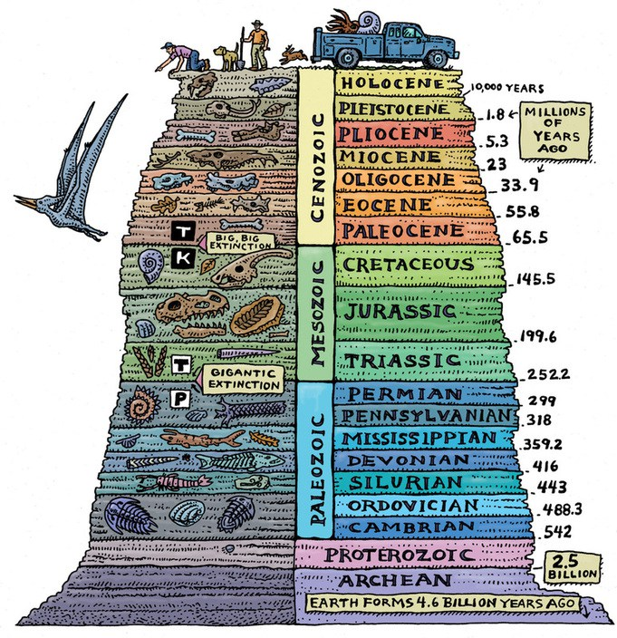
Historical Geology
Studies the past, as a clue to the present
Questions:
When did the oceans form?
When did dinosaurs first appear and last tread on Earth?
Why are the Sierra Nevada Mountains so much younger than the Appalachian Mountains?
When did the first photosynthetic plants appear, and how did the oxygen they produced affect rocks worldwide?

Slide 11
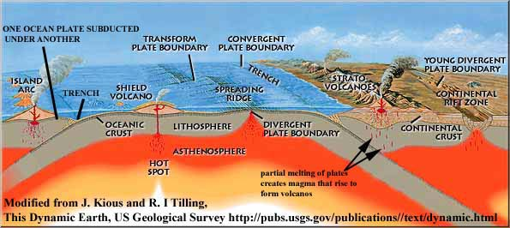
Physical Geology
Understanding the processes that operate on and inside Earth, and the materials on which these processes operate
Processes include:
Plate tectonics
Volcanism
Earthquakes
Landslides
Floods
Formation of mineral deposits
Mountain-building
Shore erosion
Landscape formation, etc.
Materials include:
Soil, sand, rocks, minerals, air, water

Slide 12
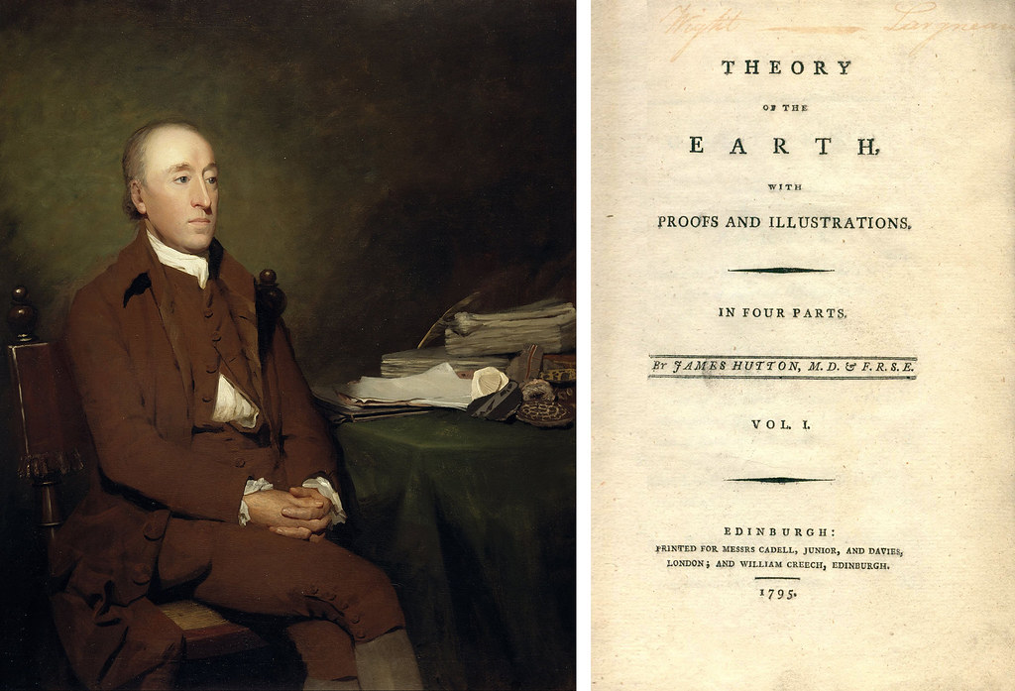
James Hutton, “Founding Father of Geology” (1726-1797)
In the 17th and 18th centuries, settlers of Europe and the Americas believed that Earth’s features were permanent and had been produced by a few great catastrophes (supernatural)
This led to the hypothesis of catastrophism (all within Judeo-Christian Bible timeline)
- Meteor impacts, mass extinctions, earthquakes, floods …
James Hutton, “Founding Father of Geology” (1726-1797)
- Used the scientific method to articulate:
- Principle of Uniformitarianism: the same processes we observe today have been operating throughout Earth’s history (present is the key to the past)
- “No vestige of a beginning, no prospect of an end” to Earth’s geologic cycles
Gradualism: majority of processes are gradual, with a spectrum to catastrophic

Slide 13
Siccar Point
Layers at the bottom are oldest
Younger at the top
Which are younger in the vertical layers?

Slide 14
Block Diagrams

Slide 15
Ginn et al, Unexpected Encounters with Deep Time Environmental Humanities (2018) 10 (1): 213–225. https://doi.org/10.1215/22011919-4385534
Deep time was of course first described in 1788 by the Scottish geologist James Hutton.
Most histories have Hutton vanquishing superstitious creationism with meticulous empirical observation of geologic features shaped by cycles of uplift, sedimentation, and erosion. His famous phrase, “no vestige of a beginning, no prospect of an end,” invoked a cyclical temporality: deep time was the endless cycling of geology, with no need for meaning, history, or linear progression.⁹ Hutton, Stephen Jay Gould argues, discovered “deep time by imposing his rigid view of time’s cycle upon a complex earth.”¹⁰
Hutton’s discovery gave us deep time but lost history in the process. It took Charles Lyell and, two hundred years later, the American author John McPhee to devise a sense of deep geologic time that was linear and historical, disclosed and verified by empirical observation and logical inference.¹¹
Today we have a rich understanding of the role of geology not only as a planetary process but in shaping life itself. Early forms of life may well have emerged around oceanic hydrocarbon vents, while current forms of life incorporate mineralogical substrates.
Some five hundred million years ago, “some of the conglomerations of fleshy matter-energy that made up life underwent a sudden mineralization,” writes Manuel DeLanda, and a new material for constructing living creatures—bone—emerged: “It is almost as if the mineral world that had served as a substratum for the emergence of biological creatures was reasserting itself, confirming that geology, far from having been left behind as a primitive stage of the earth’s evolution, fully coexisted with the soft, gelatinous newcomers.”¹²
The mineral and the biological have become necessary companions in earthly life.
Their interaction has also subtended capitalism’s spectacular double internality of nature moving through capital, capital moving through nature, over the last five hundred years.¹³
Fossil fuels, laid down in deep time, have made possible democracy, economy, anthropogenic climate change, and, paradoxically, technoscientific disclosure of the Anthropocene.
They also subtend modern human subjectivity and conditions of freedom: we are formed through, as Kathryn Yusoff puts it, a “subterranean geologic debt.”¹⁴ Geologic deep time is not therefore antecedent to the present but continues to organize and differentiate arrangements of energy and matter.

Slide 16
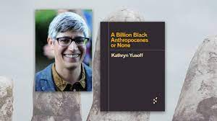
Yusoff, A Billion Black Anthropocenes
Sir Charles Lyell, president of the Geological Society of London and author of The Principles of Geology (a text that directly informed Darwin’s ideas of evolution), makes clear the ways in which geology and racial propositions are intertwined in his published accounts of his geologic surveying of North America (Lyell 1845, 1849)
“I am by no means disposed to assume that the natural capacities of the negroes, who always appeared to me to be an amiable, gentle, and inoffensive race, may not be equal in a moral and intellectual point of view to those of the Europeans, provided the coloured population were placed in circumstances equally favourable for their development. But it would be visionary to expect that, under any imaginable system, this race could at once acquire as much energy, and become as rapidly progressive, as the Anglo-Saxons.”

Slide 17
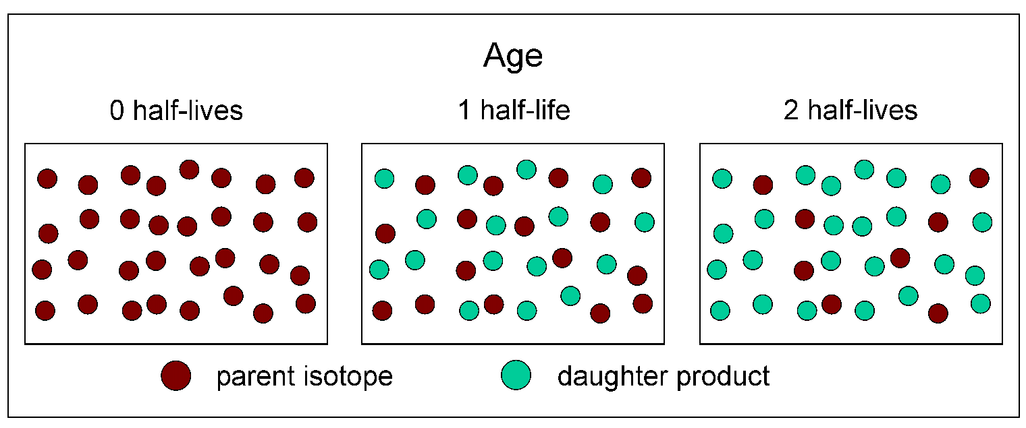
Geologic Time / Deep Time And the Earth’s AgE
4.54 billion years … how to comprehend this?
Thank you radioactive dating!

Slide 18
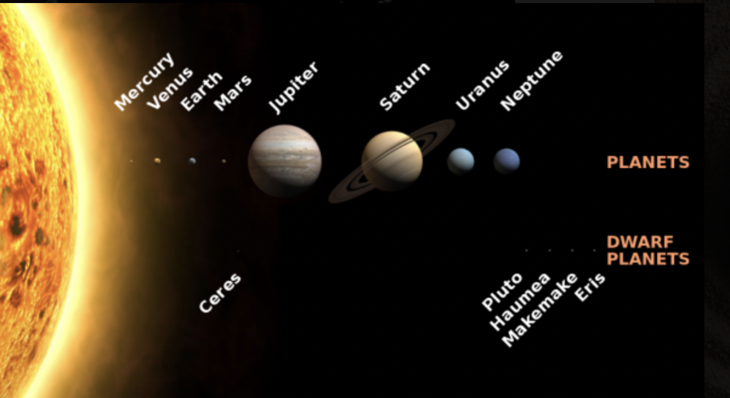
Earth’s neighborhood: the Solar System
Planets, asteroids, and meteoroids circle the sun, moons circle planets
If the sun were the size of a basketball,
- Mercury, the nearest planet, would be a grain of sand 12 meters away
- Earth would be a 2.5 mm granule 30 m away
- Saturn would look like a 2.5 cm grape 300 m away
The solar system’s 8 planets can be divided by density:
Terrestrial planets
– 4 closest to sun, small, rocky, dense (3 g/cm3 or greater)
Jovian planets
-4 farther to the sun than Mars
-Larger and less dense (Jupiter has 317 times Earth’s mass but is only 1.3 g/cm3)
-Have solid cores, but mass is in thick shells of light elements hydrogen and helium (low density). CO2, ammonia and sulfuric acid condense to form clouds in their atmosphere

Slide 19
Origin of the solar system – And Earth
Our sun and its planets were born in a way similar to that of other suns and planetary systems in the universe.
Birth began in a huge volume of space that was not entirely empty because earlier stars had exploded in supernovas, scattering atoms of various elements.
Most of these atoms were hydrogen and helium, but all the other chemical elements were present in small percentages too. Although thinly spread, these atoms formed a tenuous, turbulent, swirling cloud of cosmic gas.
Over millions of years, gravity slowly gathered the diffuse atoms into a denser gas.
As the atoms moved closer together, the gas was squeezed and grew hotter and denser as a result.
Near the center of the cloud, the temperature and density became so great that hydrogen atoms began to fuse to form helium atoms.
When hydrogen fusion occurred, the Sun was born as a nuclear reactor – 4.6 billion years ago!

Slide 20
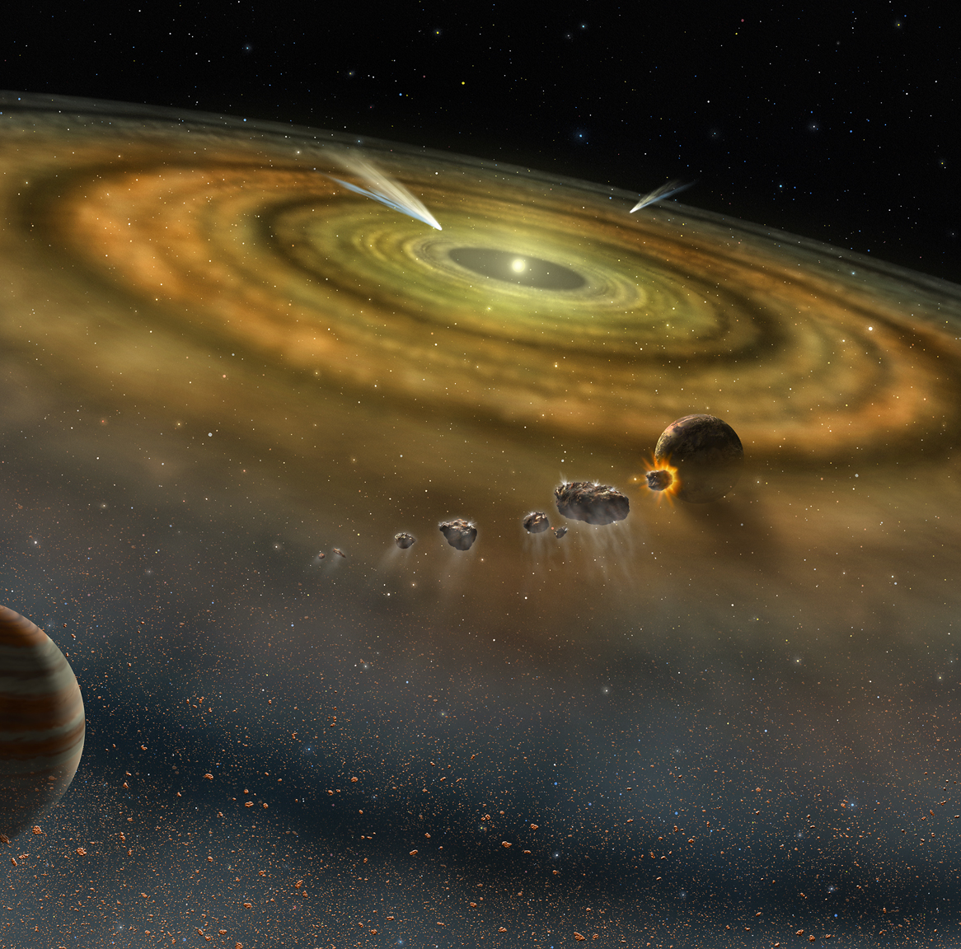
Origin Story Cont’d
At some stage, the outer portions of the cosmic gas cloud cooled and became dense enough to allow solid objects to condense, just like water vapor condenses directly from the gaseous state to the solid state to form snow.
These solid condensates eventually became the planets, moons, and the other solid objects of the solar system.
Planets and moons nearest the Sun, where temperatures were highest, are built largely of compounds that condense at high temps, containing iron, silicon, magnesium, and aluminum, mostly bound with oxygen.
Planets and moons distant from the Sun, where temps were lower, contain some of these compounds and volatile substances that are only solid at low temps (hydrogen, sulfur and oxygen combined in a solid state).
How do they know? Each element absorbs light at specific wavelengths unique to that atom. When astronomers look at an object's spectrum, they can determine its composition based on these wavelengths.

Slide 21
Planetary Accretion— Earth’s Birth
Condensation of the gas cloud formed innumerable small rocky fragments
How did they form planets?
Fragments were drawn together by gravitational attraction
The largest masses slowly swept up more and more of the condensed rocky fragments and grew larger
Meteorites are still gravitationally attracted to Earth – planetary accretion is still happening today (but less frequently)

Slide 22
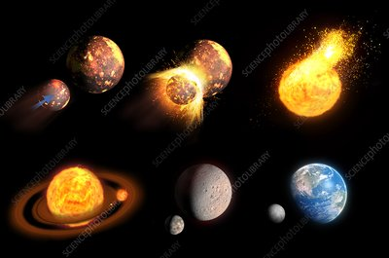
Earth’s Internal structure, energy, heat, gravity and buoyancy
Earth formed by accretion – but is it a mass of rocks glued together?
No!
What happened?
Earth melted!
Why and how?
Energy transformation, radioactive decay, heat flow, gravity, buoyancy, convection, solid and liquid state flow, and differentiation.
Why did Earth get so hot?
Energy can never be destroyed, but it can be transformed. When meteorites impact a planet or moon, its energy of motion (kinetic energy) is transformed to heat energy. As Earth grew larger, kinetic energy from impacts were transformed to heat energy, raising its temp.
Another source is responsible: naturally occurring radioactive elements. Some atoms spontaneously transform into another element, releasing energy (ex: uranium and thorium transform to lead, and potassium transforms to calcium).

Slide 23
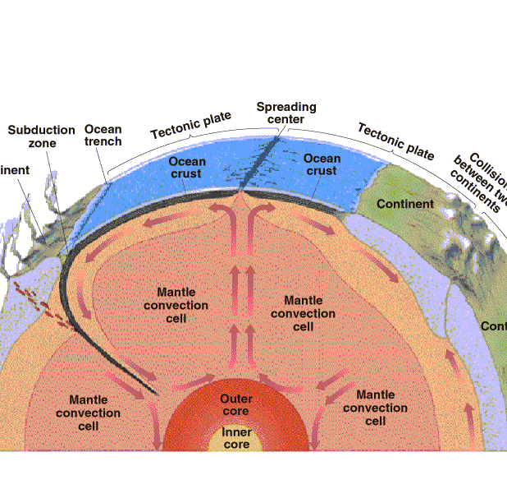
Layers of the Earth
Because Earth had become party fluid, less dense (more buoyant) molten material migrated towards the surface (materials rich in lighter elements silicon, aluminum, sodium, potassium).
Denser melted materials, such as molten iron, sank towards the center of the planet.
Gases also were released and created the early atmosphere – water vapor, carbon dioxide and nitrogen. This also formed the water of Earth’s oceans.

Slide 24
Layers of the Earth (by composition and Strength)
Core: most dense, composed of metallic iron, and lesser amounts of nickel and other elements.
- Inner core: solid
- Outer core: liquid
Mantle: thick shell of dense, rocky matter
- Mesosphere: high temp and high strength, hot enough to deform under stress (CMB at 2900km – 350km)
- Aesthenosphere: weak rocks, very plastic, easily deformed (like butter!) (350-100 or 200km)
Crust: thinnest and least-dense rocky matter
- Lithosphere: more rigid, includes the uppermost mantle and all of the crust
- The crust is far from uniform – oceanic crust is ~8km thick, whereas continental crust is ~45 km thick, ranging from 25-70 km.

Slide 26
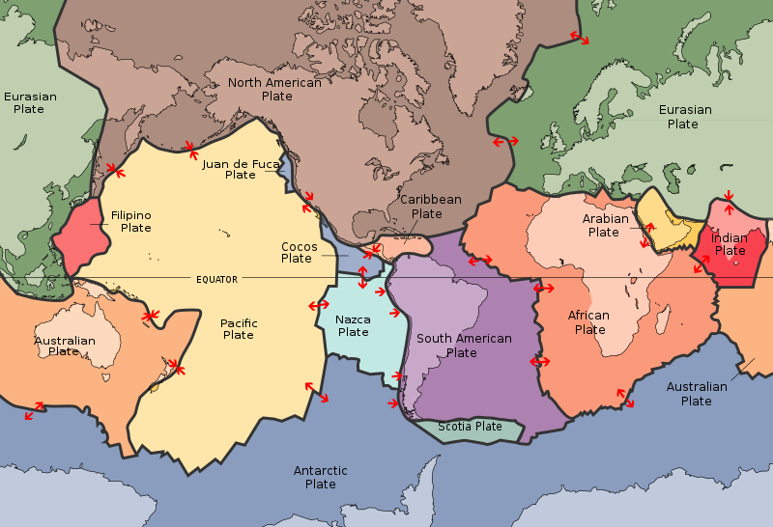
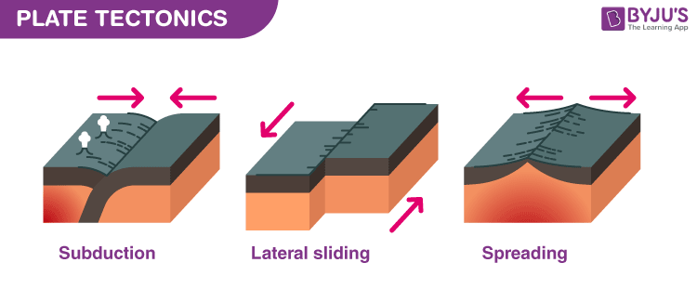
Plate Tectonics
Earth’s interior is intensely hot – temp at the core-mantle-boundary (CMB!) is ~6000 degrees C (Correction from textbook at 5000), the same temp as the surface of the Sun! (We know the sun’s temp from how hot it has to be for hydrogen to fuse to helium; we know the core’s temp from how hot it has to be for iron to melt iron under pressure.)
Heat is still being added from present-day radioactivity.
Earth gets rid of heat by convection in mesosphere and asthenosphere → creating plate tectonics!
The grand unifying theory in geology:
- Earth’s outermost 100 km “eggshell” (the lithosphere) is cracked and composed of about a dozen pieces (“plates”).
- The plates float on the hot, deformable asthenosphere, moving a few mm to a few cm a year in various directions, spreading apart, slowly colliding, and grinding past one another.
In the mid 1900’s, geologists assumed that Earth’s oceans and continents had existed in their location for much of earth’s 4.54 billion year history!

Slide 27
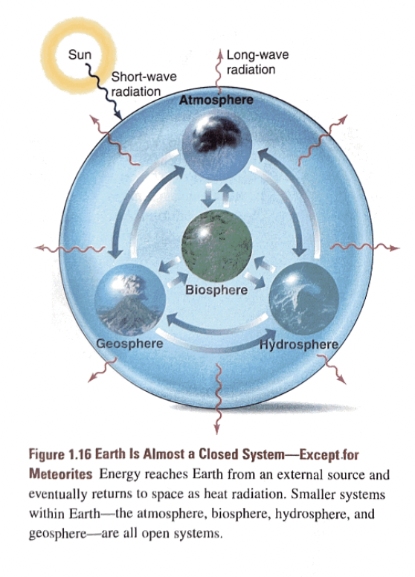
The system Concept
A system is any portion of the universe that can be isolated form the rest of the universe for observing and measuring change.
A powerful analytical tool for breaking up large, complex problems into smaller, more easily studied pieces, a system can include whatever you select to observe.
Closed systems are idealized (with a boundary that permits exchange of energy but not matter) ex: a space shuttle.
Open systems can exchange both energy and matter across its boundary. Ex: an island on which rain is falling.
The Earth system:
- Closed (except for meteorites coming in and some gases leaving)
- Open: with everything on Earth – matter and energy flow freely

Slide 28
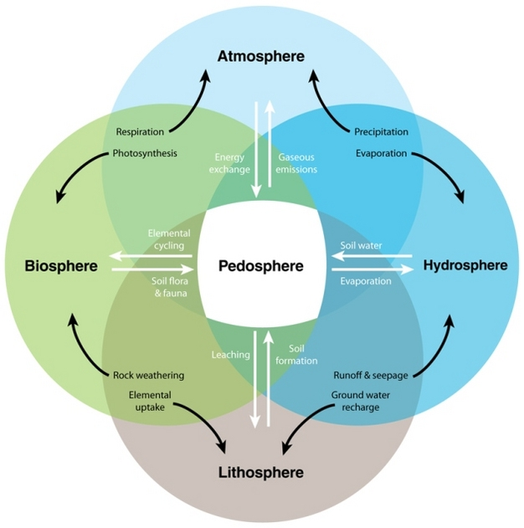
Our Planet’s “Four Spheres”
Atmosphere
Mixture of gases that surround Earth, predominantly nitrogen, oxygen, argon, carbon dioxide, and water vapor
Hydrosphere
All of Earth’s water, oceans, lakes, streams, underground water, snow, ice
Biosphere
All of Earth’s organisms, as well as organic matter not yet decomposed
Geosphere
Solid Earth from core to surface, composed of rock and regolith (loose, uncemented rock particles that cover Earth)
PEDOSPHERE
SOIL

Slide 29
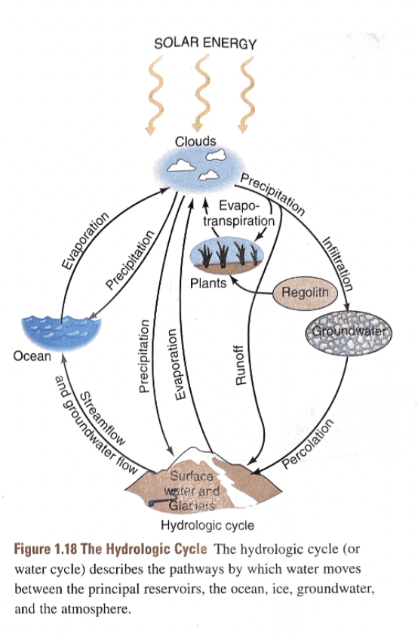
Cyclical Movements
2 key aspects to cycles
- The reservoirs in which the materials reside
- The flows or fluxes of materials from reservoir to reservoir
How long do they reside in reservoirs? Called residence time
Ex: a molecule of water may spend 200,000 in an ice sheet, 40,000 years in the ocean, 1000 years in a deep underground reservoir, 10 years in a lake, 10 days in the atmosphere, and 10 hours in an animal’s body

Slide 30
Rock Cycle

Slide 31
Tectonic Cycle

Slide 32
Interconnected Cycles

