Slide 1
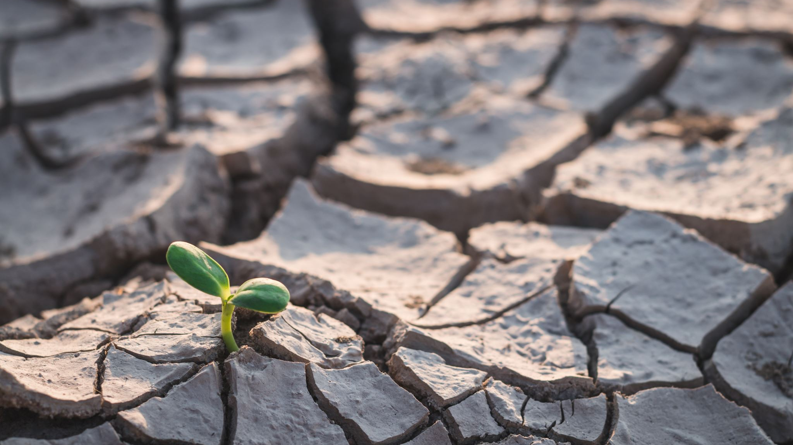
EESC 1201: Intro to Environmental Science
Dr. Sara ‘Perl’ Egendorf
Class 1: August 29, 2022

Slide 2
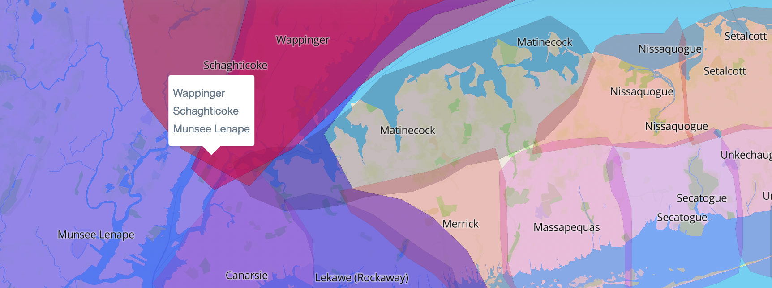
02
We in NYC are in Lenapehoking, the Lenape homeland, as well as lands stewarded by the Wappinger and Schagticoke Nations. I want to acknowledge these Indigenous communities, elders of the past and present, and their future generations to come.
As a settler, I recognize that I participate in active displacement, even if this is unintentional.
I invite us all to work toward dismantling the ongoing legacies of settler colonialism by supporting Indigenous rematriation of these lands.
Indigenous Land Acknowledgement
See http://landacknowledgements.org/ and https://native-land.ca/
for more information.

Slide 3
First Class Overview
Who am I?
How and why do I teach environmental science?
- Earth as a system, different forms of data, various ways of knowing
Who are you?
Class website (Open Educational Resource (OER))
Syllabus
Next week’s assignments – read, discussion board
Pre-class survey
What is the environment? (draw/map)

Slide 4
Who are you?
Write:
Name, pronouns, year in college, racial/ethnic/cultural backgrounds, things you care about
Why are you taking this course?
Introduce yourself to a person next to you
You will introduce each other to the class

Slide 5
Class Overview
Class website (OER
- https://eesc1201.commons.gc.cuny.edu/
Syllabus
- My expectations and plan for this course
Survey:
https://forms.gle/DqgHtXgeaGtUPZcS6

Slide 6
What is the environment?
Draw / map it!
Draw / map “the environment as a system” (if possible)
How do you understand the environment?
Share in small groups
Introduce yourselves!
Share with class

